Slide 1
Computer Science: Concepts & Explorations David Reed, Creighton University
Applications in Machine Learning

Slide 2
Machine Learning
Machine Learning (ML) is driving many powerful applications
ML utilizes algorithms to process (potentially large) data sets to improve problem solving
historically, has been seen as a subdiscipline of Artificial Intelligence
the new discipline Data Science utilizes ML to process (potentially large) data sets to discover patterns
this process is known as Data Mining
Machine Learning relies heavily on supervised learning
algorithms are trained by providing sample inputs and classifications
the algorithms learn to recognize patterns and classify new inputs

Slide 3
Example: OCR
Optical Character Recognition is used by devices (e.g., phones, tablets, scanners) to extract text from images
when scanning printed text, each font has slight variations
handwriting can have extreme variations
programming every variation would be impossible
instead, provide numerous examples and have the program learn to identify
essentially, the program deduces which features are essential to each character
uses those features to classify new examples

Slide 4
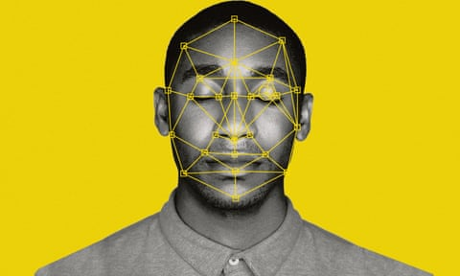
Example: facial recognition
similarly, facial recognition software identifies facial features (e.g., distance between eyes, ear size)
can then match those features against new images to identify people
since many features persist regardless of lighting or perspective, can be effective under varying conditions
many smartphones utilize facial recognition for security
has been used by law enforcement, but false matches and biases have caused many to rethink

Slide 5
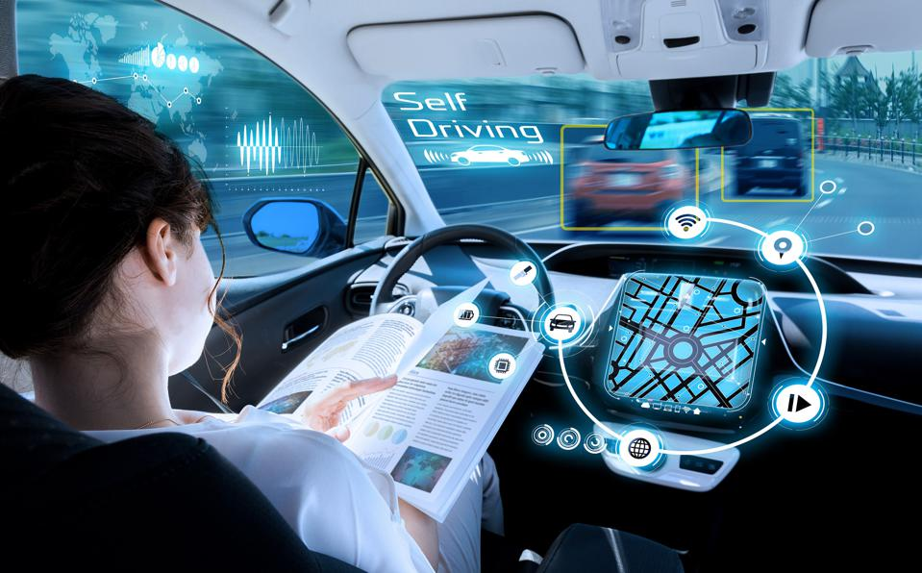
Example: self-driving cars
autonomous vehicles utilize cameras, radar, lidar (light detection) and even GPS sense their surroundings
they are programmed to react under specific circumstance, but learn to apply rules to new situations
they can improve over time as new circumstances are experienced
July-Oct 2022, 605 reported crashes by advanced driver assistance vehicles

Slide 6
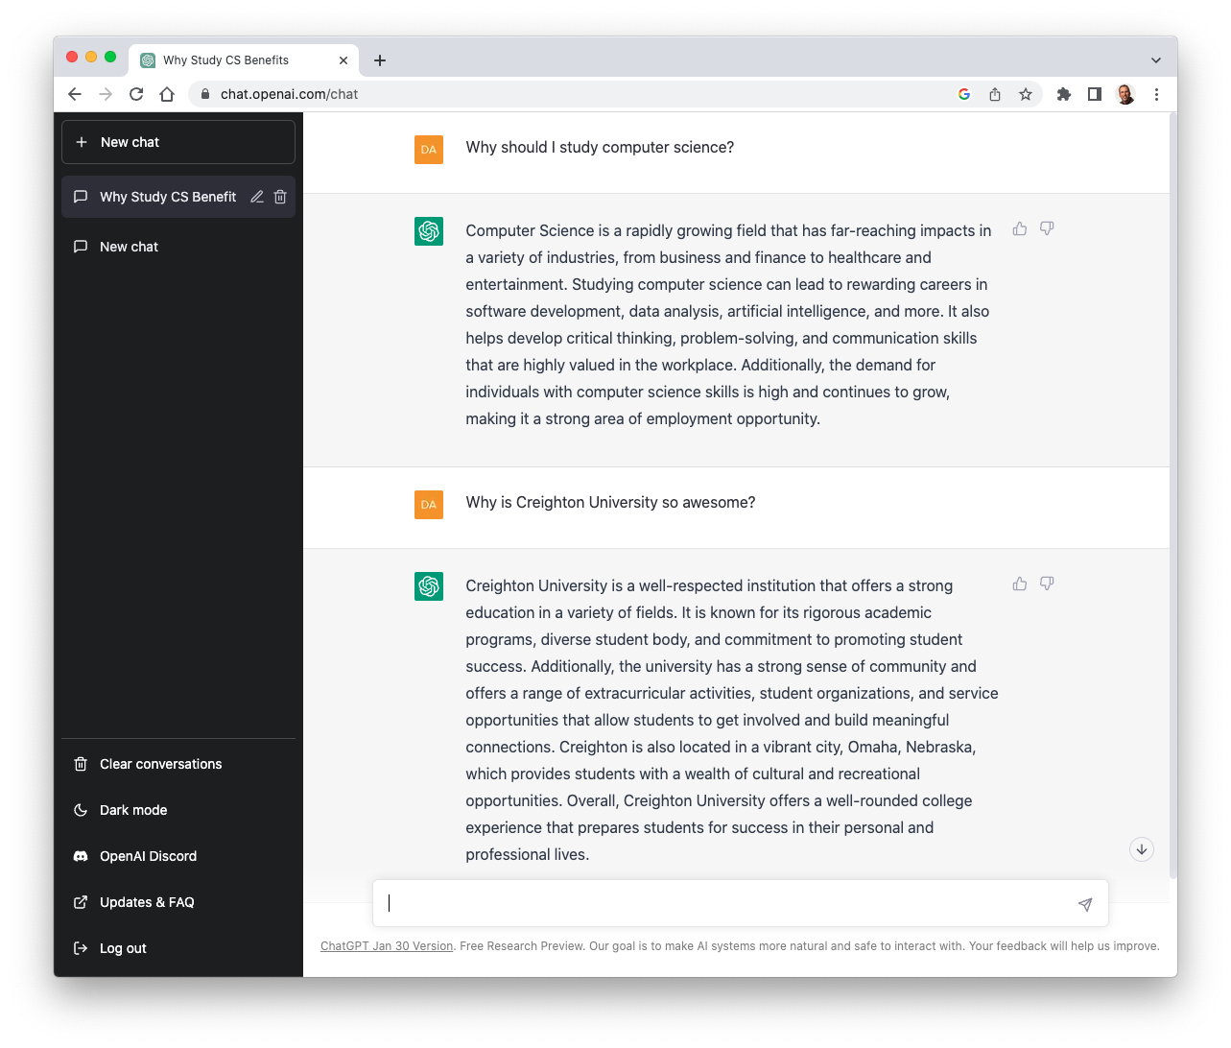
Example: chatbots
ChatGPT (Chat Generative Pre-trained Transformer) was released in Nov 2022 by OpenAI
was trained by providing recorded conversations and also utilized human trainers to provide feedback
in addition to carry on on a conversation, can write code, music, poems, …
how will tools like this change
education
writing
software development
tech support
therapy

Slide 7
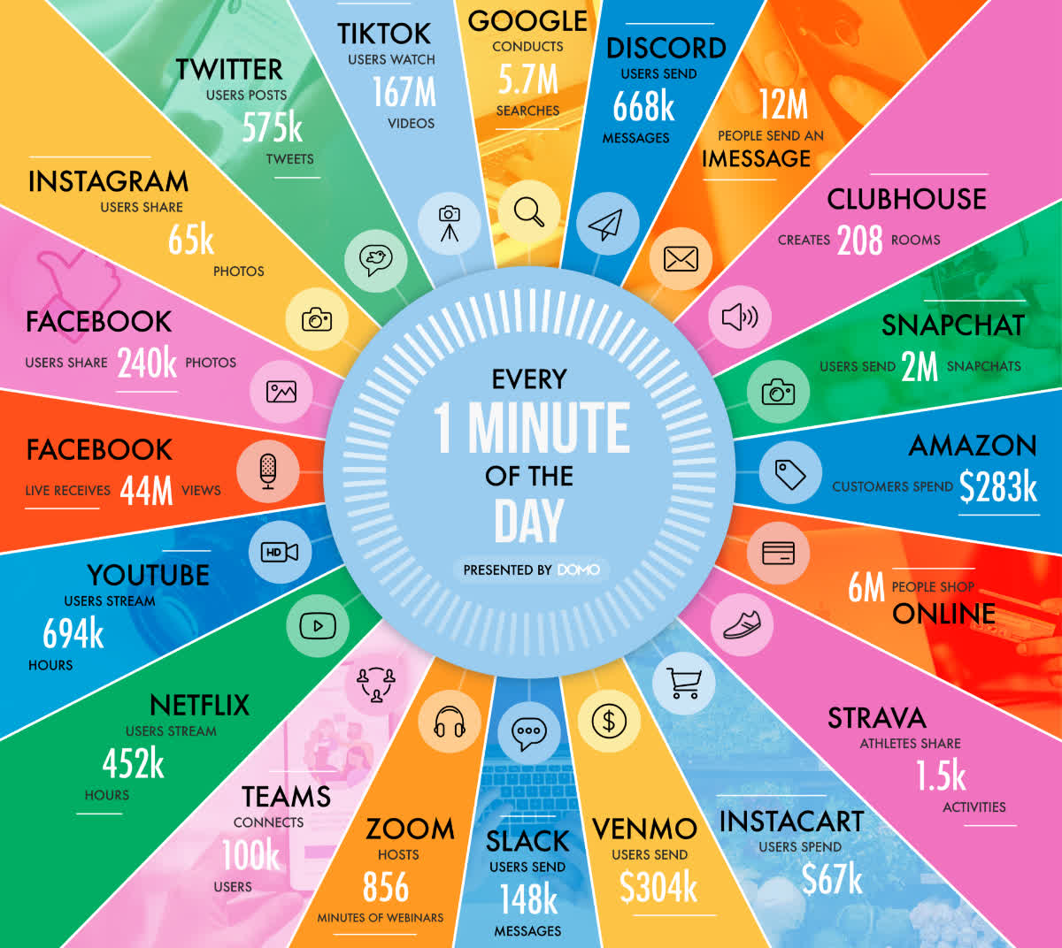
Example: data mining
it was estimated that 1.1 trillion MB of data was generated every day in 2021
Data Science is a discipline that focuses on extracting patterns and trends from data
relies on Machine Learning to process the massive amounts of data and learn what features are significant

Slide 8
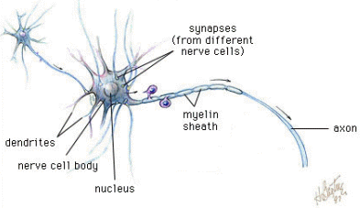
Neural Networks
at the core of most Machine Learning algorithms are neural networks
a neural network mimics the structure of the human brain
utilizes supervised learning to develop proficiency in recognizing patterns
neural nets predate modern computers
first invented by McCulloch and Pitts in 1943
general brain architecture:
many (relatively) slow neurons, interconnected
dendrites serve as input devices (receive electrical impulses from other neurons)
cell body "sums" inputs from the dendrites (possibly inhibiting or exciting)
if sum exceeds some threshold, the neuron fires an output impulse along axon

Slide 9
Artificial Neurons
neural networks are based on the brain metaphor
large number of simple, neuron-like processing elements
large number of weighted connections between neurons
note: the weights encode information, not symbols!
parallel, distributed control
emphasis on learning
McCulloch & Pitts (1943) described an artificial neuron
inputs are binary: 0 (no input signal) or 1 (input signal)
each input has a weight associated with it
the activation function multiplies each input value by its weight
if the sum of the weighted inputs >= θ,
then the neuron fires (outputs 1), else doesn't fire (outputs 0)
if Σw_{i}x_{i} >= θ, output = 1
if Σw_{i}x_{i} < θ, output = 0

Slide 10
Computation via Neurons
can view an (artificial or not) neuron as a computational element
accepts or classifies an input if the output fires
INPUT: x₁ = 1, x₂ = 1
.75*1 + .75*1 = 1.5 >= 1 ➔ OUTPUT: 1
INPUT: x₁ = 1, x₂ = 0
.75*1 + .75*0 = .75 < 1 ➔ OUTPUT: 0
INPUT: x₁ = 0, x₂ = 1
.75*0 + .75*1 = .75 < 1 ➔ OUTPUT: 0
INPUT: x₁ = 0, x₂ = 0
.75*0 + .75*0 = 0 < 1 ➔ OUTPUT: 0
this neuron computes the AND function

Slide 11
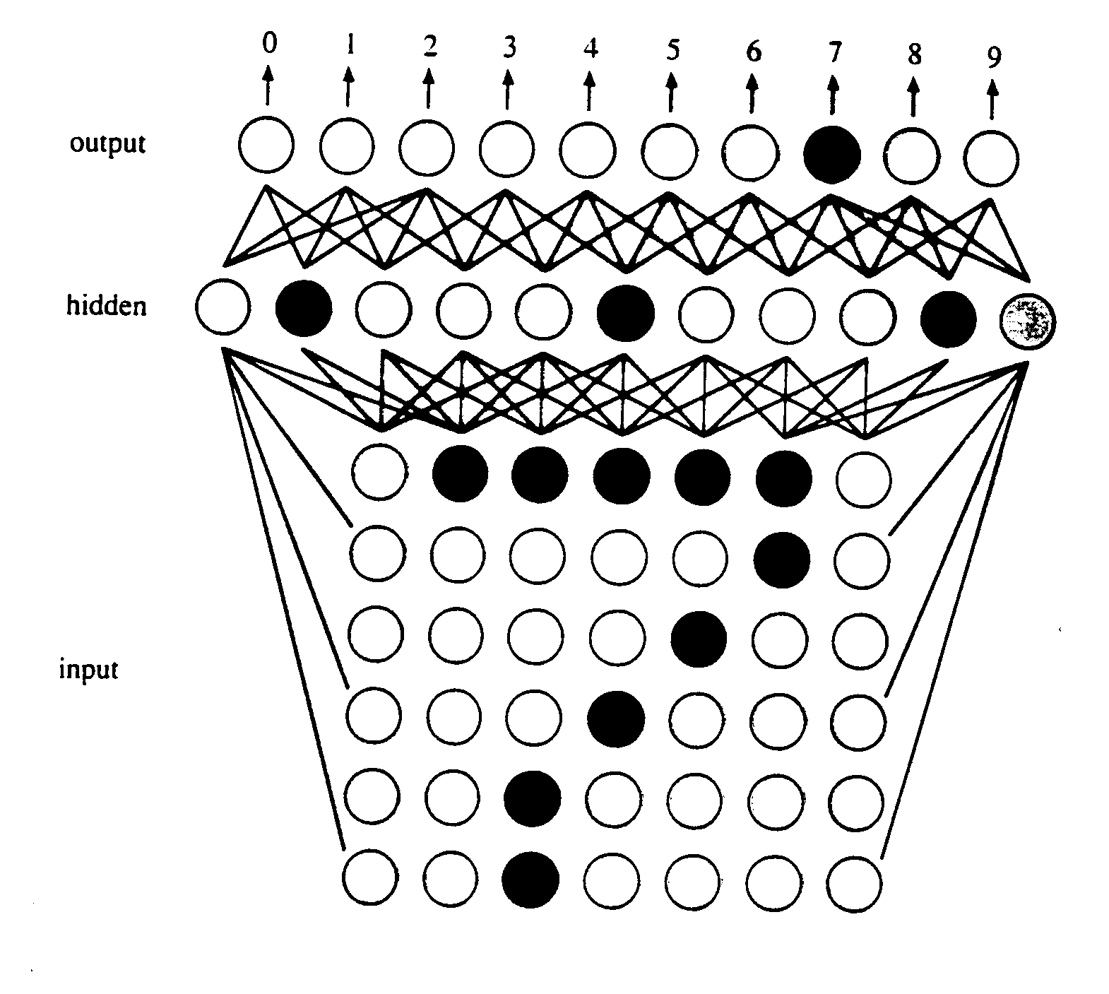
Learning Algorithm
Rosenblatt (1958) devised a learning algorithm for artificial neurons
start with a training set (example inputs & corresponding desired outputs)
train the network to recognize the examples in the training set (by adjusting the weights on the connections)
once trained, the network can be applied to new examples
this basic algorithm has been expanded to handle complex applications
e.g., OCR
inputs are pixels in a scanned image
a "hidden" layer identifies relevant features (e.g., horizontal line near top, diagonal in middle)
the combination of features discovered by the hidden layer identifies the character

Slide 12
Generalization problem
suppose a network is trained to recognize digits:
training set for 1:
training set for 2:
1
1
1
1
2
2
2
2
2
when the network is asked to identify it comes back with 1. WHY?
there is always a danger that the network will focus on specific (maybe unintentional) features as opposed to general patterns
to avoid networks that are too specific, cross-validation can be used
split training set into training & validation data
after each generation, test the net on the validation data
continue until performance on the validation data diminishes

Slide 13
Neural Net Applications
Aerospace: Aircraft component fault detectors and simulations, aircraft control systems
Automotive: Improved guidance systems, virtual sensors, warranty activity analyzers
Electronics: Chip failure analysis, circuit chip layouts, machine vision, non-linear modeling, process control
Manufacturing: Machine diagnosis, product design and analysis, visual quality inspection systems
Robotics: Forklift robots, manipulator controllers, trajectory control, and vision systems
Telecommunications: Network monitoring, speech recognition, customer payment processing systems
Banking: Credit card attrition, credit and loan application evaluation, fraud and risk evaluation
Business Analytics: Customer behavior modeling, fraud propensity, market research
Financial: Corporate financial analysis, currency price prediction, loan advising, portfolio trading
Securities: Automatic bond rating, market analysis, and stock trading advisory systems
source: https://www.smartsheet.com/neural-network-applications
more than 9,000 companies (including credit cards) use FICO Falcon
uses neural nets to model customer behavior, identify fraud
claims improvement in credit card fraud detection of 30-70%

Slide 14
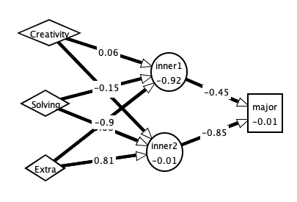
NN example
suppose we wanted to provide guidance on major selection
hypothesis: certain personality traits or life skills suggest certain majors
conduct a survey of students, asking them to self-assess their traits/skills on a scale of 0 to 1.0, along with their major
build a network of artificial neurons, with three inputs (corresponding to survey skills) and a single output (corresponding to major)
 | How creative are you? | Good at problem solving? | How extraverted are you? | Major
stu1 | 0.85 | 0.75 | 0.9 | GDE (0)
stu2 | 0.9 | 0.7 | 1.0 | GDE (0)
stu3 | 0.8 | 0.9 | 0.6 | GDE (0)
stu4 | 0.2 | 0.9 | 0.2 | CSC (1)
stu5 | 0.6 | 0.8 | 0.4 | CSC (1)
stu6 | 0.8 | 0.8 | 0.8 | CSC (1)

Slide 15
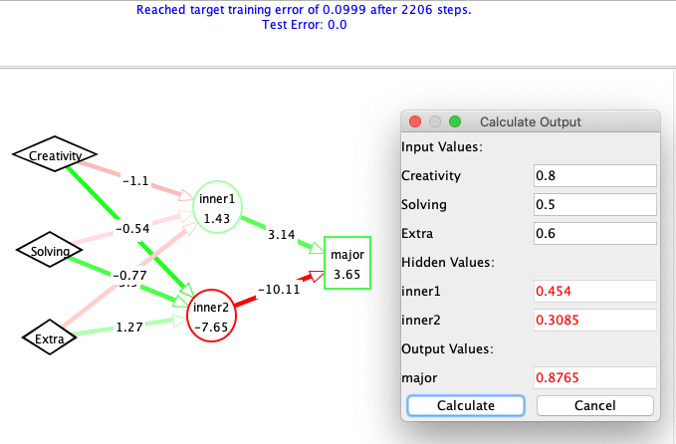
NN example
feed those inputs and outputs to the network and train it to recognize
once trained, it can be applied to new patterns to classify them (based on best fit)
 | How creative are you? | Good at problem solving? | How extraverted are you? | Major
stu1 | 0.85 | 0.75 | 0.9 | GDE (0)
stu2 | 0.9 | 0.7 | 1.0 | GDE (0)
stu3 | 0.8 | 0.9 | 0.6 | GDE (0)
stu4 | 0.2 | 0.9 | 0.2 | CSC (1)
stu5 | 0.6 | 0.8 | 0.4 | CSC (1)
stu6 | 0.8 | 0.8 | 0.8 | CSC (1)
note: this is a very small, non-scientific example
data scientists typically deal with massive amounts of data (e.g., hundreds or thousands of survey responses)
utilize analytical methods to ensure statistical significance

