Slide 1
Computer Science: Concepts & Explorations 2nd edition David Reed, Creighton University
Uploading a Web Page to Infinityfree

Slide 2
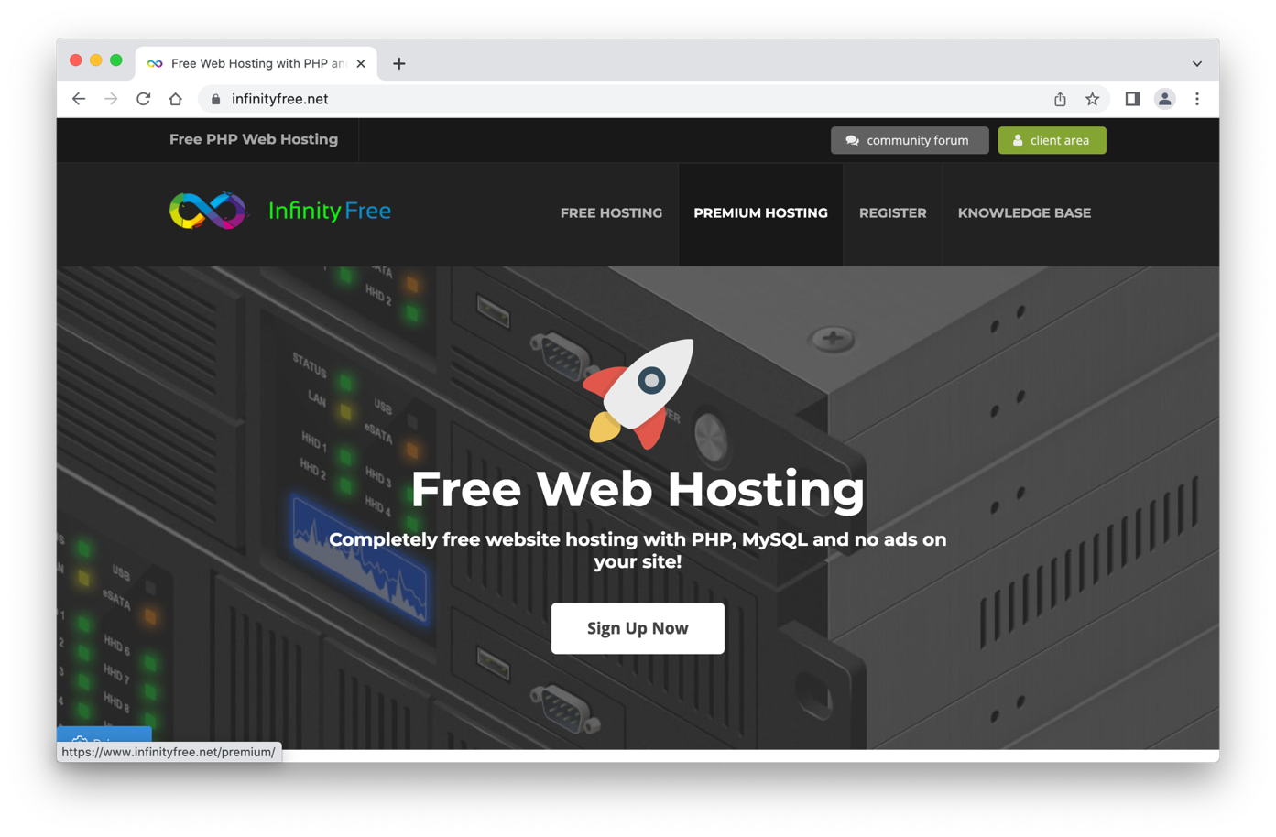
Infinityfree Web hosting
in order to make your Web pages accessible, you need a Web host
there are many free or inexpensive Web hosting services available
infinityfree.net provides free Web space where you can post your pages
click on the Sign Up Now button to sign up
you will have to enter your email & a password (remember it!)
it will confirm your identity through email

Slide 3
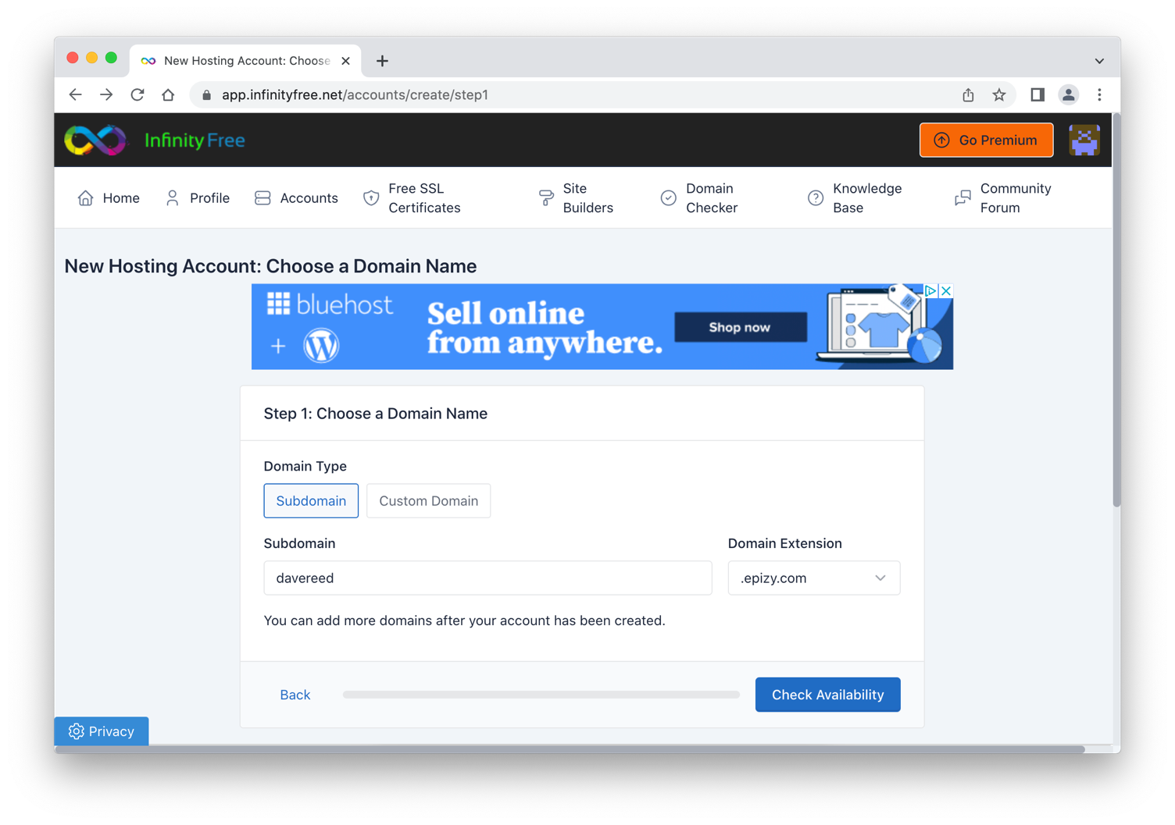
Creating an account
once you are confirmed, click on the +Create Account button
you will be prompted for a subdomain name & domain extension
I strongly recommend yourname.epizy.com
on next page, leave the user name and password blank (don't need)

Slide 4
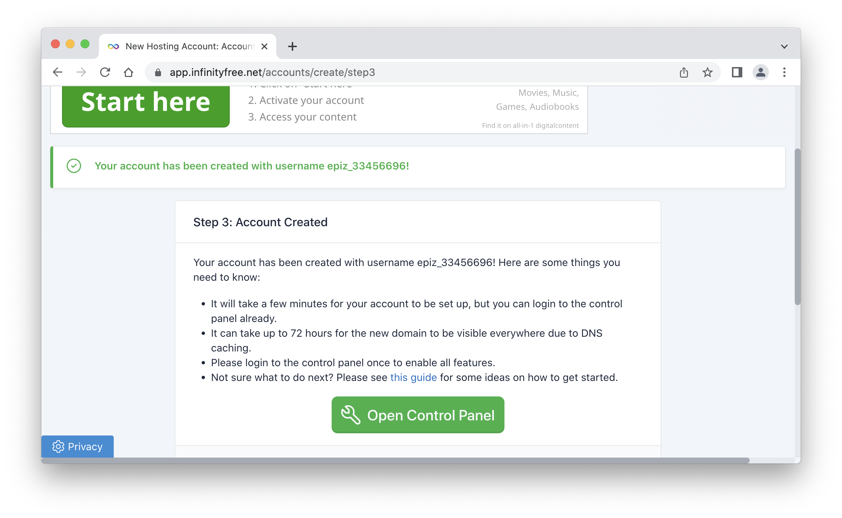
Account created
once your account is created, click the Open Control Panel button
the first time, you will have to agree to terms

Slide 5
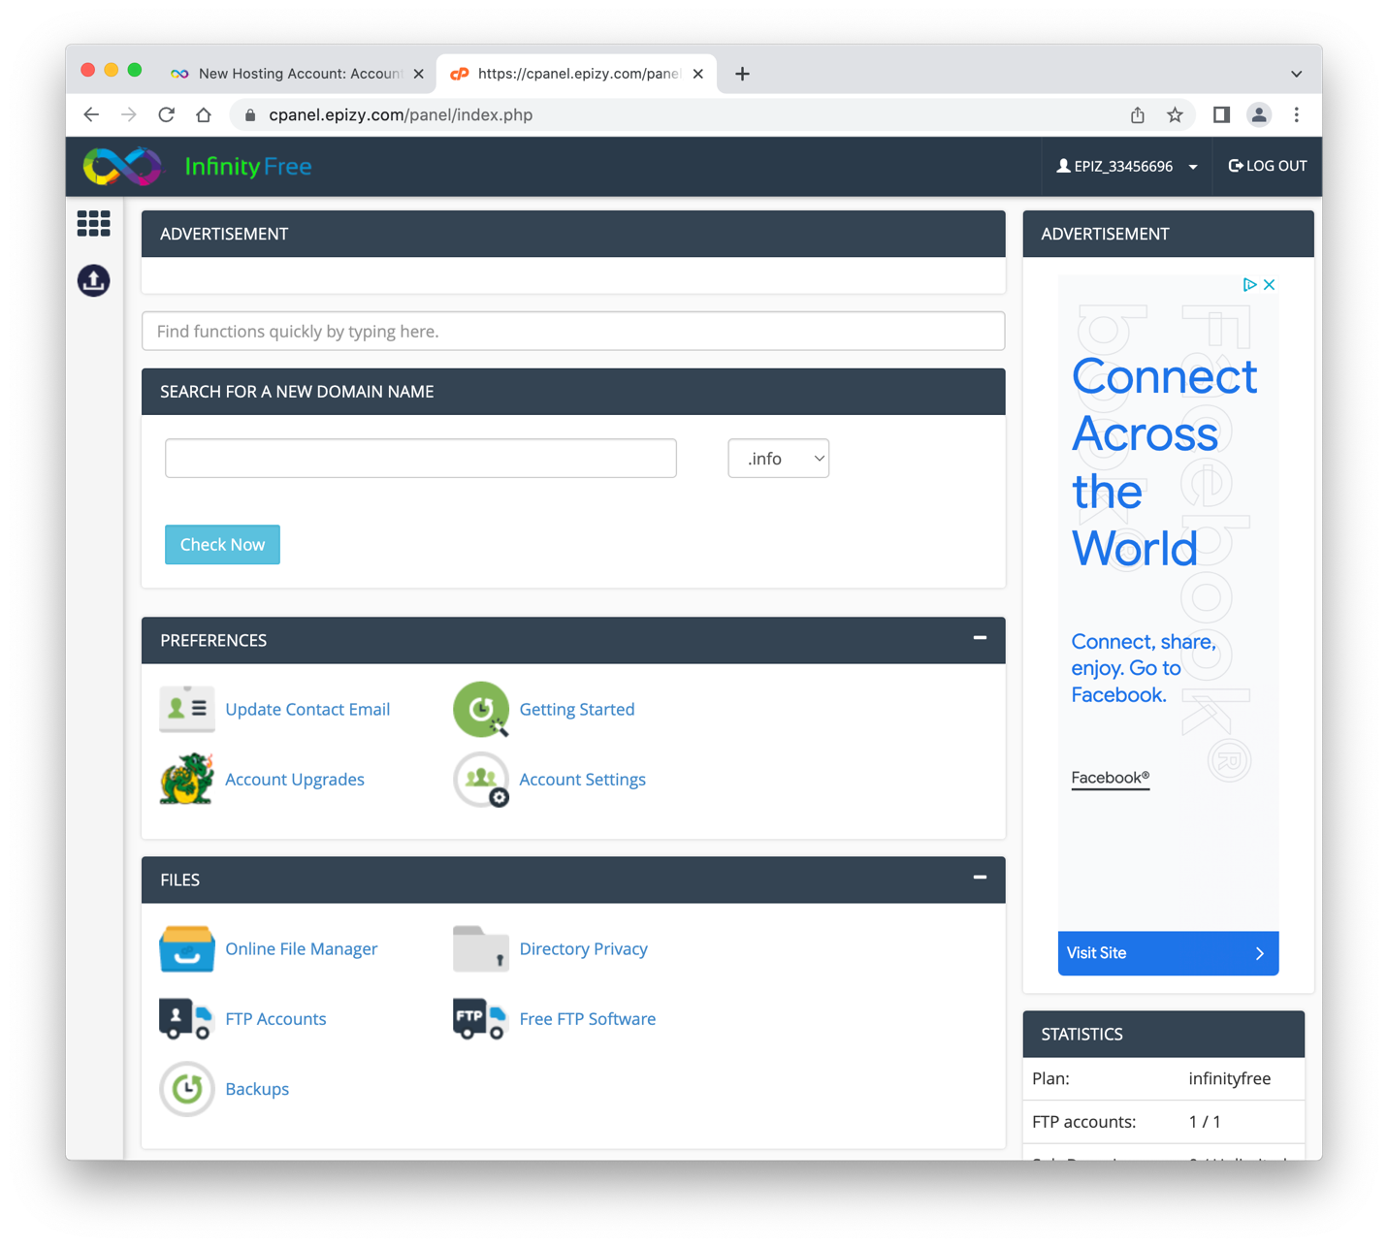
Control panel
once you are at the Control Panel, click on the Online File Manager link

Slide 6
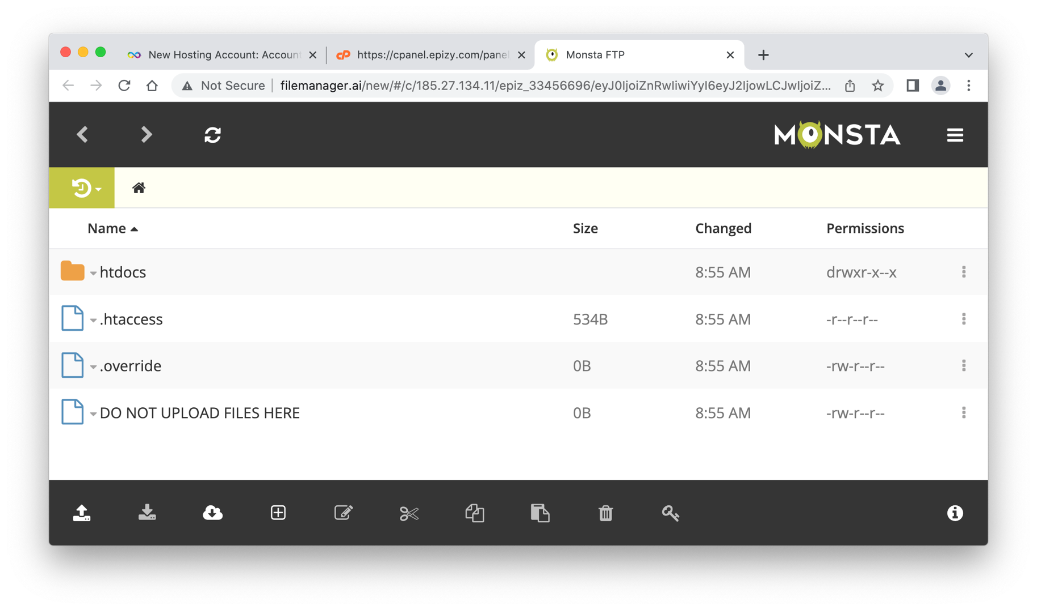
Online File Manager
one of the folders in your Online File Manager is .htdocs
this is where all of your Web content must be uploaded
click on the .htdocs folder to open it

Slide 7
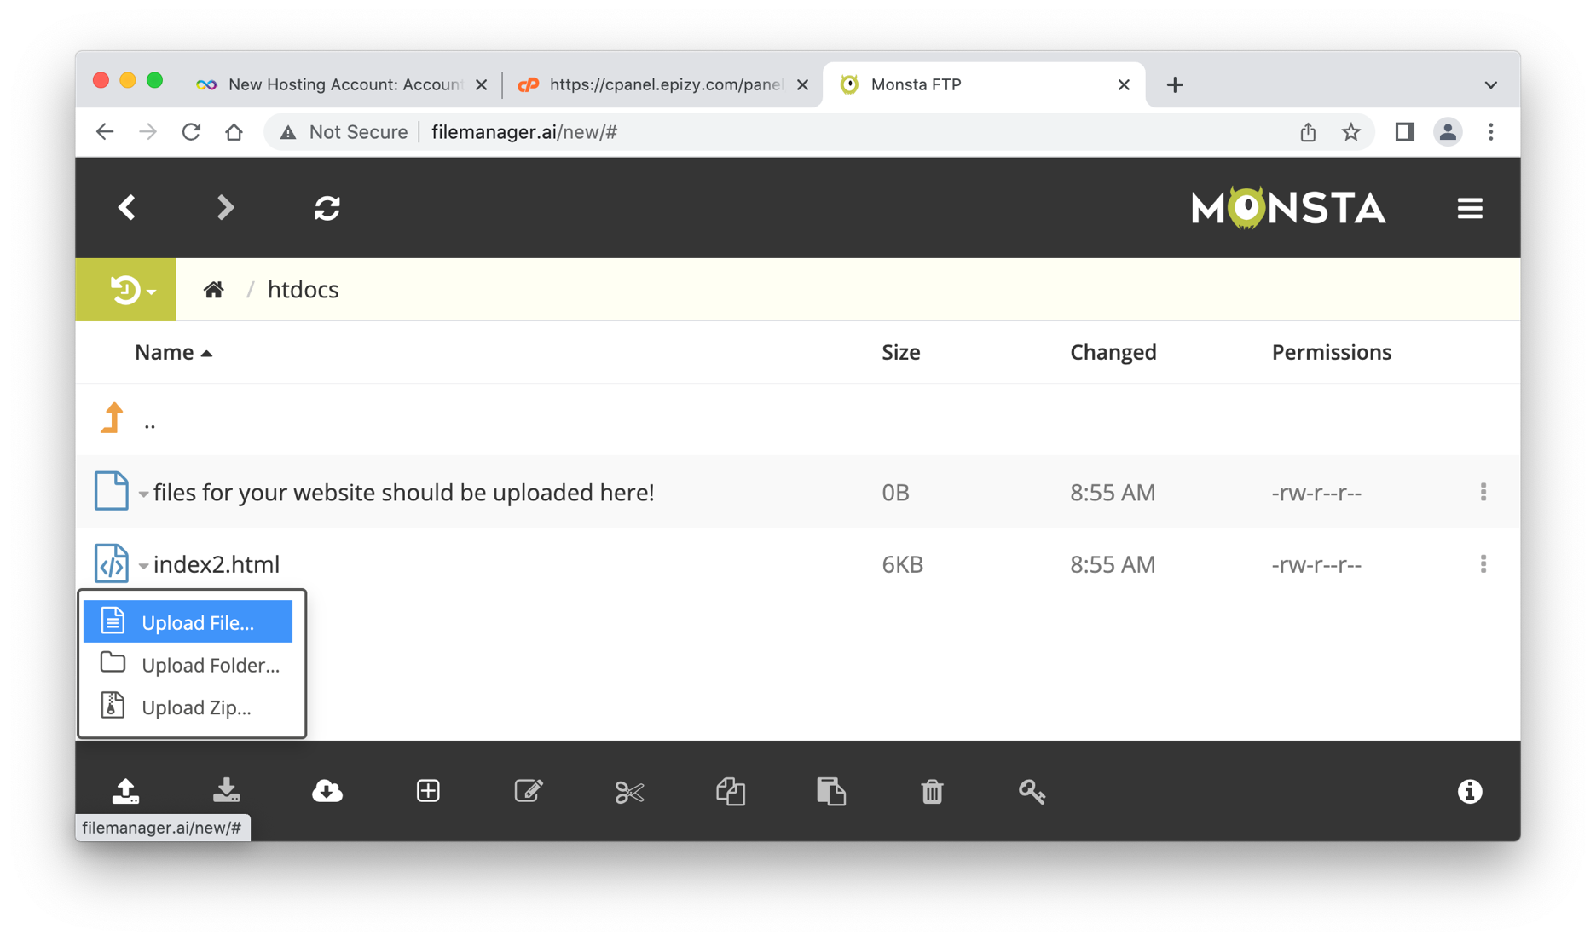
Uploading pages
to upload a page,
click on the upload icon at the bottom left and select Upload File
you can then browse to select the file to upload

Slide 8
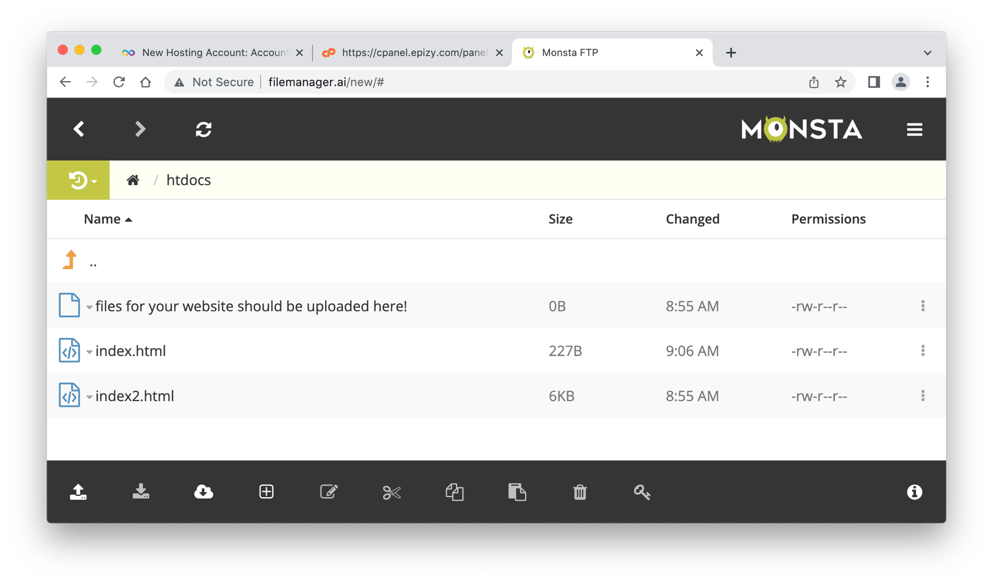
Uploading pages
once the page uploads, it should appear in the folder contents
note: for Projects 1.A and 2.A, your file must be named index.html
if it isn't, you can right-click and rename it

Slide 9
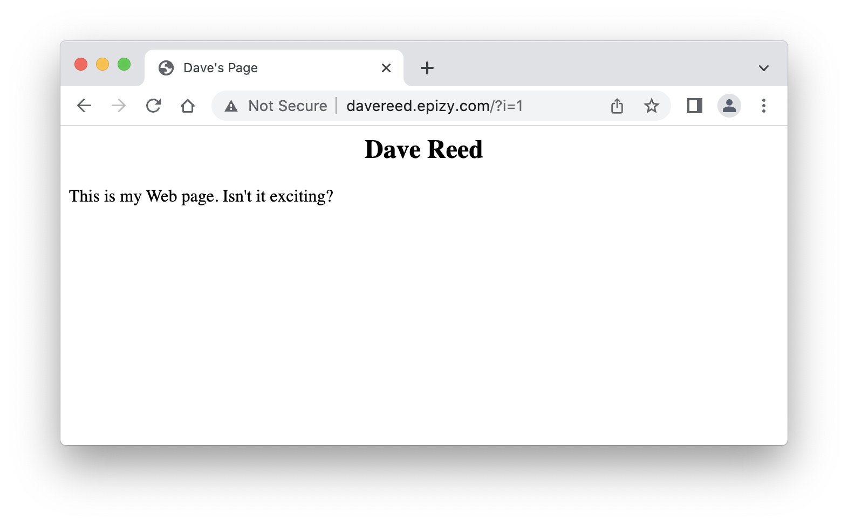
Viewing pages
once the page is uploaded, you can view it under the domain name you created, e.g., davereed.epizy.com (ignore the ?i=1)
if you ever want to view a page that is not named index.html, you must specify the name in the URL, e.g., davereed.epizy.com/demo.html
if your page contains internal/local images, those must be uploaded too

