Slide 1
Computer Science:
Concepts & Explorations
David Reed, Creighton University
Applications in Artificial Intelligence

Slide 2
Artificial Intelligence
Artificial Intelligence (AI) is a subfield of computer science closely tied with biology and cognitive science
  AI is concerned with computing techniques and models that simulate and/or investigate intelligent behavior
  AI research builds upon our understanding of the brain and evolutionary development and, in return, provides insights into them
three important research areas in AI are:
  expert systems: building rule-based systems that utilize expert knowledge to diagnose problems or identify solutions
  genetic algorithms: "evolving" solutions to complex problems (especially problems that are intractable using other methods)
  neural networks: building a model of the brain and "training" that model to recognize patterns or generate text/multimedia

Slide 3
Expert Systems
expert systems encapsulate the knowledge and reasoning of experts in specific domains
  in 70s and 80s, rule-based expert systems replaced human expertise in many diagnosis situations
  challenge is finding domains where expertise is easy to extract & experts are expensive (e.g., medical diagnosis, customer support)
  expert systems are still popular & profitable today, but utilize many different techniques
EXAMPLE: tax-law is complex & experts are in demand
  much of human expertise can be encapsulated into rules
  IF single AND itemized_deductions < $12,550 THEN use_standard_deduction
  IF medical_expenses > 0.075*AGI THEN itemized_deduction
  tax software (e.g., H&R Block, TaxCut) includes an expert system that asks questions, applies rules, and fills out tax forms for you

Slide 4
Evolutionary Models
Genetic Algorithms represent an approach to problem-solving that is patterned after the processes underlying evolution
  Darwin's theory: through the process of introducing variations into successive generations and selectively eliminating less fit individuals, adaptations of increasing capability and diversity emerge in a population
  in 1975, psychologist/computer scientist John Holland applied these principles to problem-solving → genetic algorithms
  solve a problem by starting with a population of candidate solutions
  using reproduction, mutation, and survival-of-the-fittest, evolve even better solutions
Genetic Algorithms are ideal for scheduling complex resources
  e.g., Smart Airport Operations Center by Ascent Technology
    uses GA for logistics: assign gates, direct baggage, direct service crews, …
    considers diverse factors such as plane maintenance schedules, crew qualifications, shift changes, locality, security sweeps, …
    too many variables to juggle using a traditional algorithm
    GA can evolve good/practical schedules, but possibly sub-optimal
    Ascent claimed 30% increase in productivity (including SFO, ATL, Heathrow, …)

Slide 5
Machine Learning
most modern AI applications utilize Machine Learning (ML)
  ML utilizes algorithms to process (potentially large) data sets to improve problem solving
  the new discipline Data Science utilizes ML to process massive data sets to discover patterns (often referred to as Data Mining)
  Generative AI (e.g. ChatGPT, Copilot, Midjourney) utilizes ML to process massive data sets, including the Web, to answer questions, write and create art.
Machine Learning relies heavily on supervised learning
  algorithms are trained by providing sample inputs and classifications
  the algorithms learn to recognize patterns and classify new inputs
  in the case of Generative AI, it can assimilate information and existing works to generate answers or new writing/artwork

Slide 6
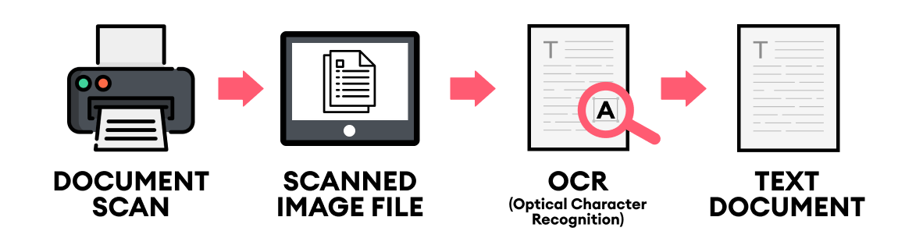
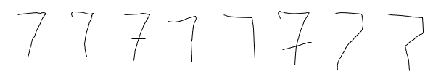
Example: OCR
Optical Character Recognition is used by devices (e.g., phones, tablets, scanners) to extract text from images
  when scanning printed text, each font has slight variations
  handwriting can have extreme variations
  programming every variation would be impossible
  instead, provide numerous examples and have the program learn to identify
    essentially, the program deduces which features are essential to each character
    uses those features to classify new examples

Slide 7
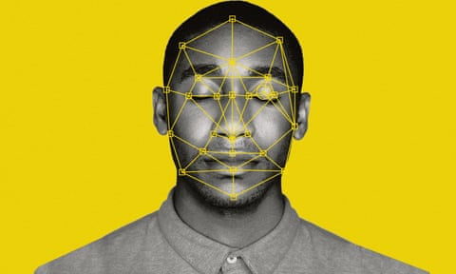
Example: facial recognition
similarly, facial recognition software identifies facial features (e.g., distance between eyes, ear size)
  can then match those features against new images to identify people
  since many features persist regardless of lighting or perspective, can be effective under varying conditions
  many smartphones utilize facial recognition for security
  has been used by law enforcement, but false matches and biases have caused many to rethink

Slide 8
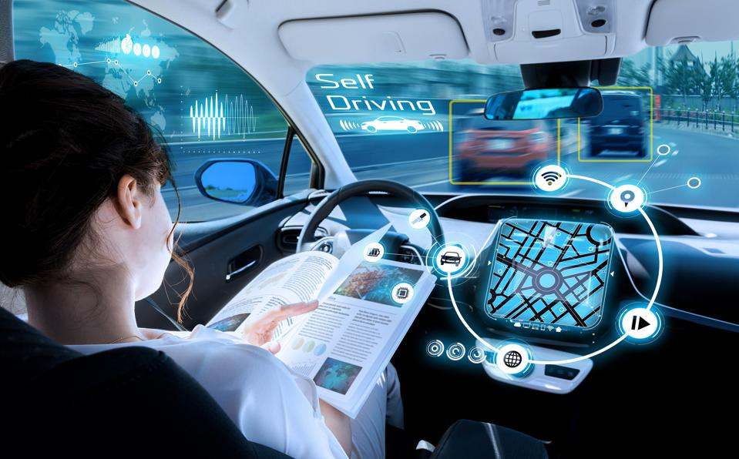
Example: self-driving cars
autonomous vehicles utilize cameras, radar, lidar (light detection) and even GPS sense their surroundings
  they are programmed to react under specific circumstance, but learn to apply rules to new situations
  they can improve over time as new circumstances are experienced
  more than 4,000 accidents (since 2021) involving autonomous or advanced driver-assisted vehicles
    9.1 accidents per million miles driven vs. 4.1 accidents in traditional cars

Slide 9
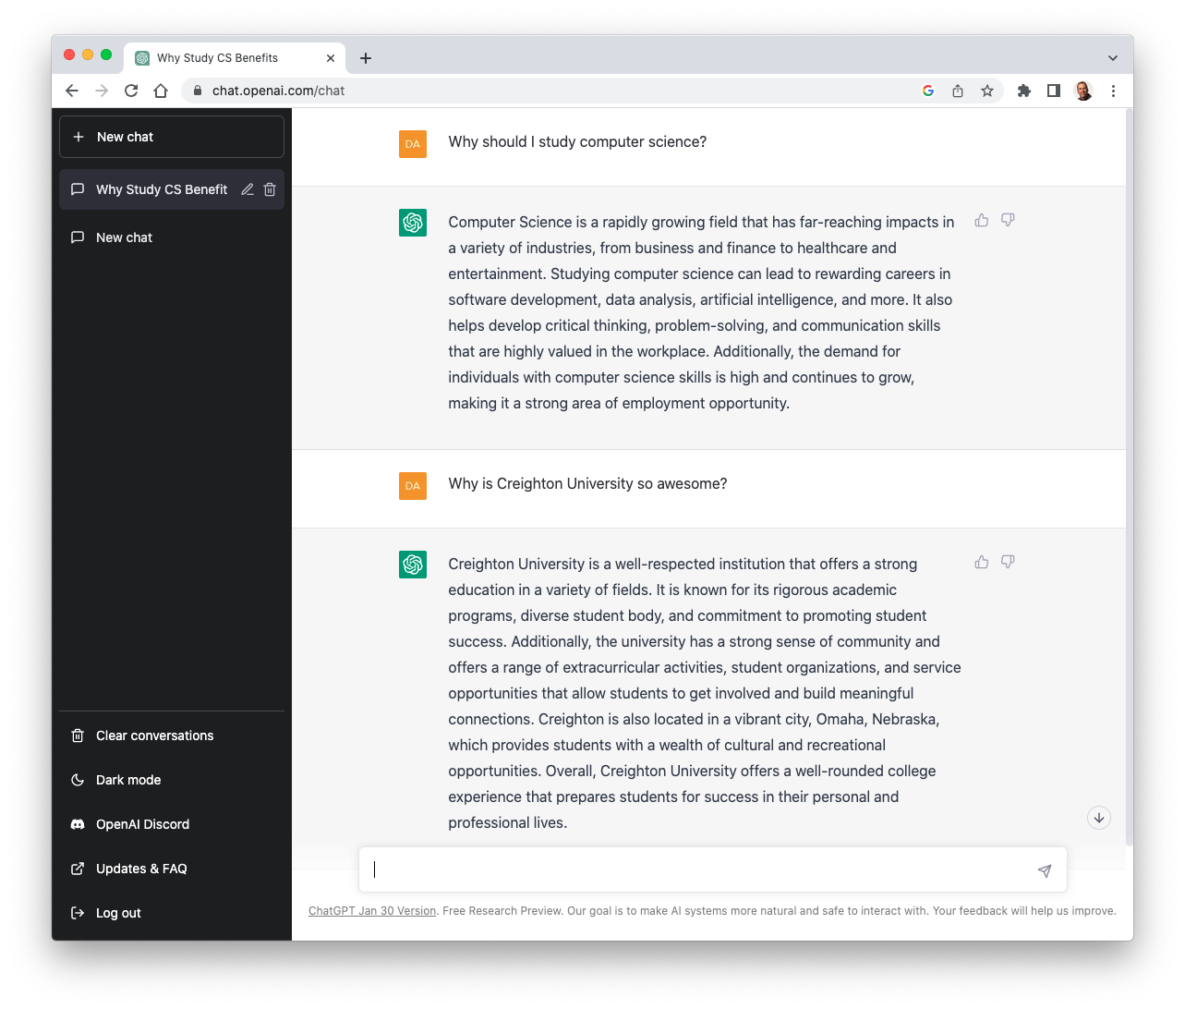
Example: chatbots
ChatGPT (Chat Generative Pre-trained Transformer) was released in Nov 2022 by OpenAI
  was trained by providing recorded conversations and Web content, also utilized human trainers to provide feedback
  in addition to answering questions, can create text, code, images, music, …
  ChatGPT and similar tools are known as
  Generative AI (GenAI) since they use AI to generate answers, writing, or art
  Large Language Models (LLM) since they are trained on massive amounts of text and art

Slide 10
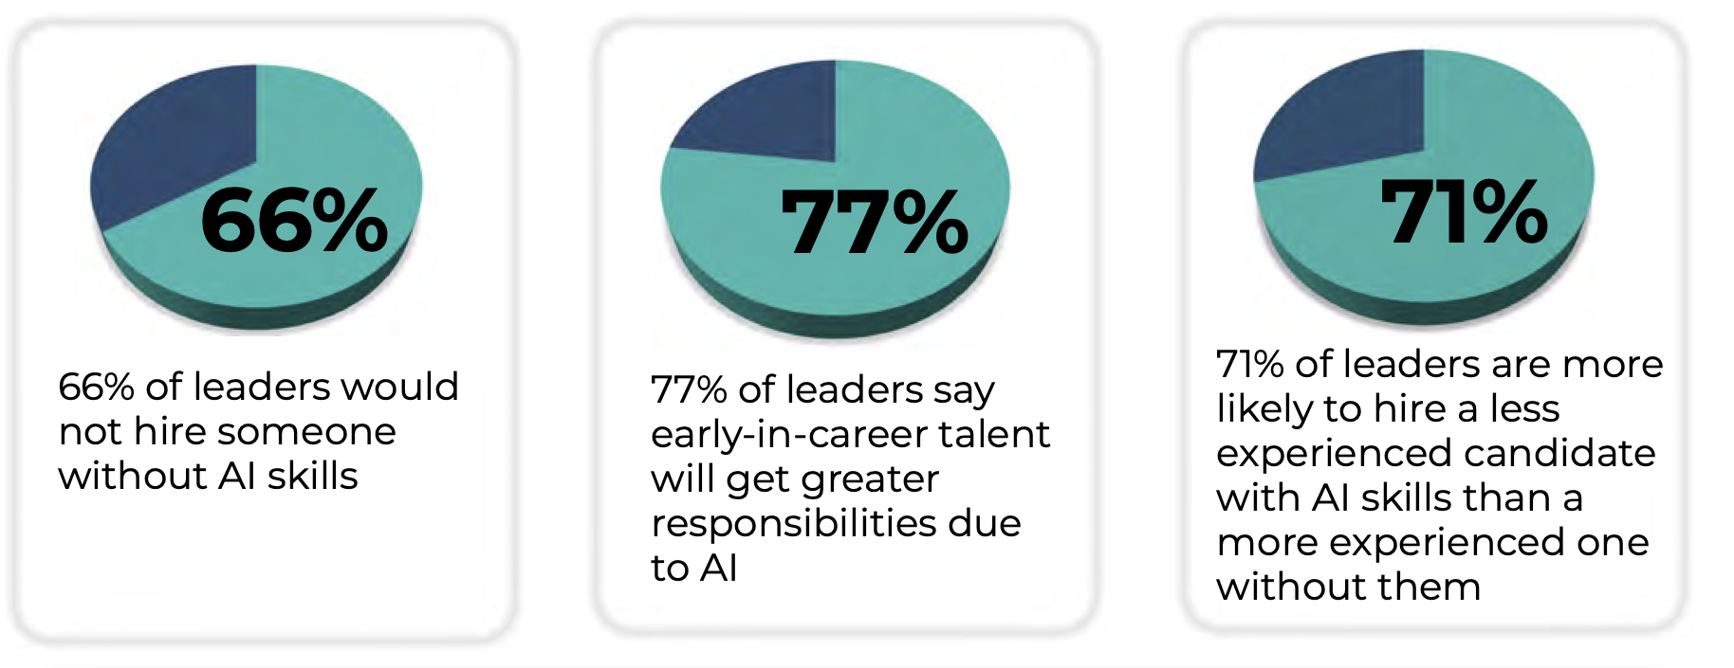
AI in the workforce
AI (especially GenAI) is increasingly being used in the workplace
AI won’t take your job. It’s someone using AI who will take your job. -- Richard Baldwin
LAB 1 will introduce resources regarding the (ethical) use of Generative AI
  from the perspectives of a student and of a future worker
  you will be asked to read/view resources, explore the behavior of AI tools, and reflect upon your own use

Slide 11
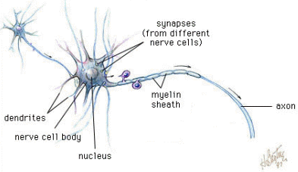
Neural Networks
at the core of most Machine Learning algorithms are neural networks
  a neural network mimics the structure of the human brain
  it utilizes supervised learning to develop proficiency in recognizing patterns
general brain architecture:
  many (relatively) slow neurons, interconnected
  dendrites serve as input channels (receive electrical impulses from other neurons)
  cell body "sums" inputs from the dendrites (possibly inhibiting or exciting)
  if sum exceeds some threshold, the neuron fires an output impulse along axon
  artificial neurons are computational units that mimic this behavior
  output depends on the number and strengths of the inputs
inputs (dendrites)
output (axon)

Slide 12
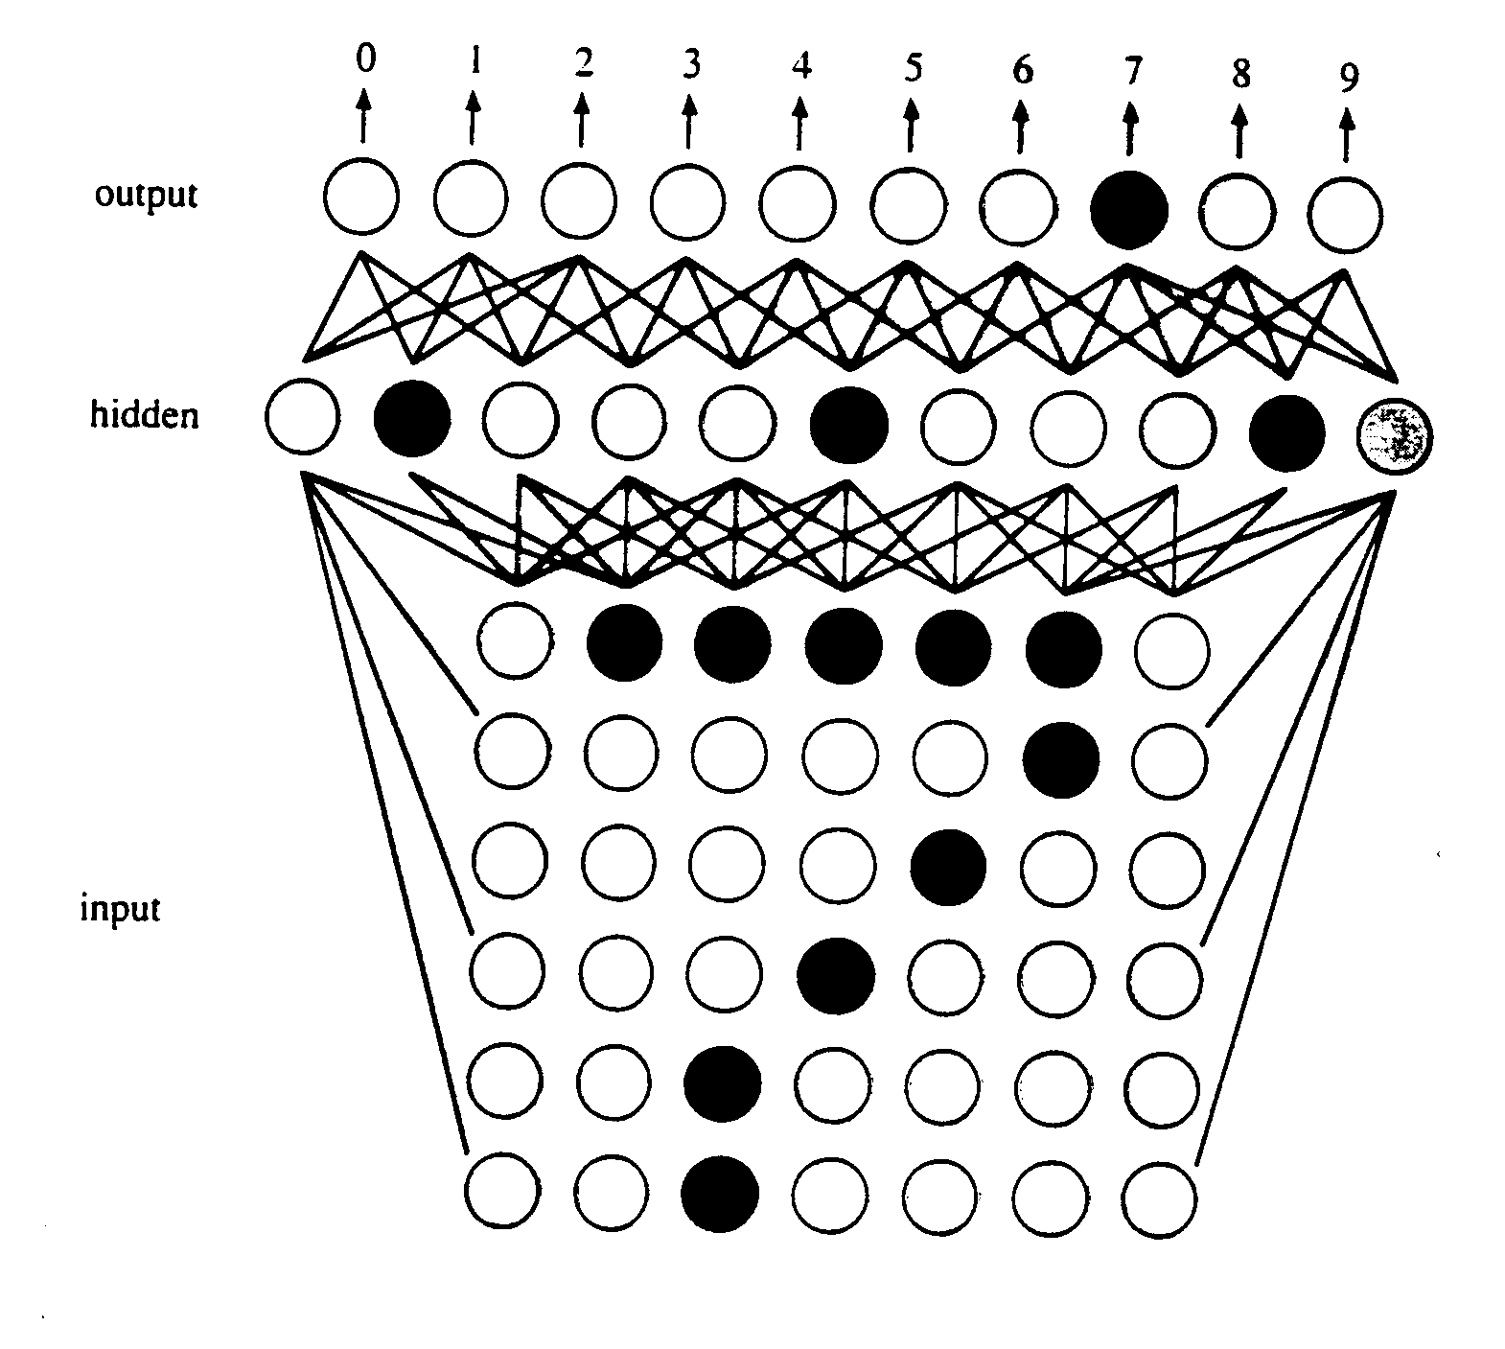
Computation via Artificial Neurons
McCulloch & Pitts (1943) designed and built the first artificial neurons
Rosenblatt (1958) devised a learning algorithm for artificial neurons
  start with a training set (example inputs & corresponding desired outputs)
  train the network to recognize the examples in the training set (by adjusting the weights on the connections)
  once trained, the network can be applied to new examples
this basic algorithm has been expanded to handle complex applications
e.g., OCR
  inputs are pixels in a scanned image
  a "hidden" layer of artificial neurons identifies relevant features (e.g., horizontal line near top, diagonal in middle)
  the combination of features discovered by the hidden layer identifies the character

Slide 13
Generalization problem
suppose a network is trained to recognize digits:
  training set for 1:
  training set for 2:
1
1
1
1
2
2
2
2
2
  when the network is asked to identify it comes back with 1. WHY?
there is always a danger that the network will focus on specific (maybe unintentional) features as opposed to general patterns
training and testing the network requires careful planning, e.g.,
  reserve some of the data set for testing when training is done
  review the training set content for biases (such as training an image recognition network on limited demographics)

Slide 14
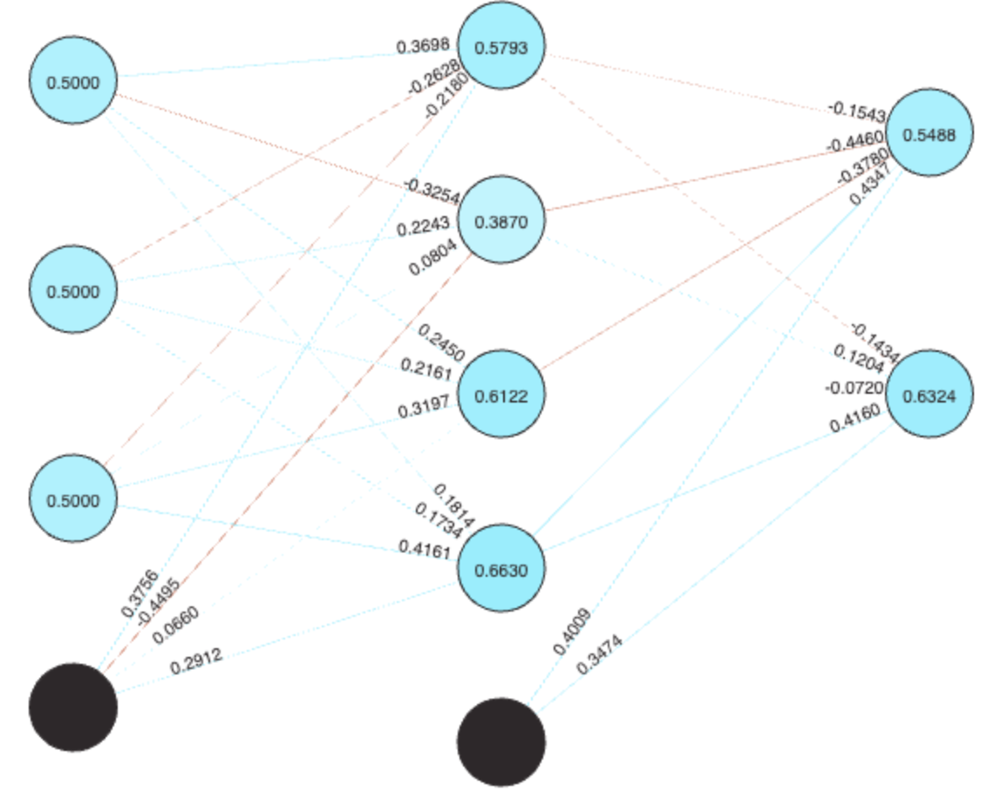
NN example
suppose we wanted to provide guidance on major selection
  hypothesis: certain personality traits or life skills suggest certain majors
  conduct a survey of students, asking them to self-assess their traits/skills on a scale of 0 to 1.0, along with their major
  build a network of artificial neurons, with three inputs (corresponding to survey skills), 4 hidden neurons (for feature extraction) and two outputs (corresponding to the majors)
 | How creative are you? | Good at problem solving? | How extraverted are you? | Major
stu1 | 0.8 | 0.6 | 0.9 | GDE
stu2 | 0.9 | 0.7 | 1.0 | GDE
stu3 | 0.8 | 0.9 | 0.6 | GDE
stu4 | 0.2 | 0.9 | 0.2 | CSC
stu5 | 0.6 | 0.8 | 0.4 | CSC
stu6 | 0.8 | 0.8 | 0.8 | CSC
https://nnplayground.com/

Slide 15
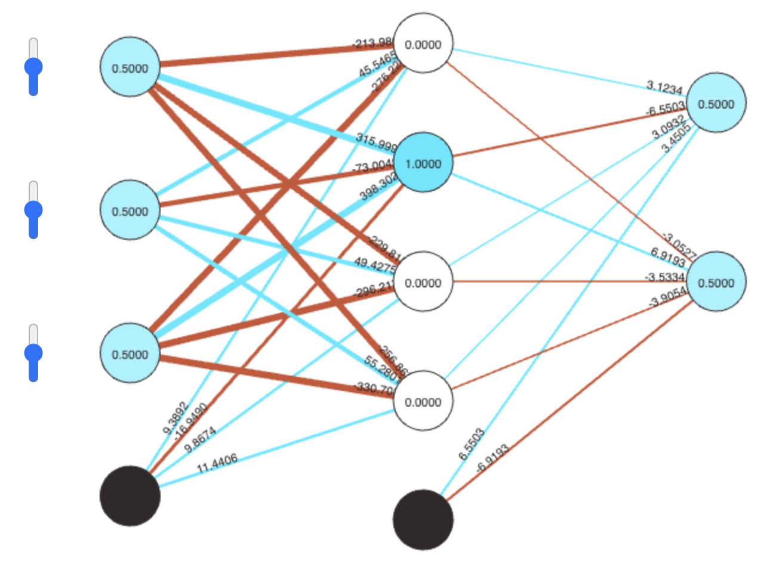
NN example
  feed those inputs and outputs to the network and train it to recognize
  once trained, it can be applied to new patterns to classify them (based on best fit)
 | How creative are you? | Good at problem solving? | How extraverted are you? | CSC | GDE
stu1 | 0.8 | 0.6 | 0.9 | 0 | 1
stu2 | 0.9 | 0.7 | 1.0 | 0 | 1
stu3 | 0.8 | 0.9 | 0.6 | 0 | 1
stu4 | 0.2 | 0.9 | 0.2 | 1 | 0
stu5 | 0.6 | 0.8 | 0.4 | 1 | 0
stu6 | 0.8 | 0.8 | 0.8 | 1 | 0
[
[[0.8, 0.6, 0.9],[0, 1]],
[[0.9, 0.7, 1.0],[0, 1]],
[[0.8, 0.9, 0.6],[0, 1]],
[[0.2, 0.9, 0.2],[1, 0]],
[[0.6, 0.8, 0.4],[1, 0]],
[[0.7, 0.7, 0.7],[1, 0]]
]
this is a very small, non-scientific example
  data scientists typically deal with massive amounts of data
  utilize analytical methods to ensure statistical significance

