Slide 1
Computer Science:
Concepts & Explorations
David Reed, Creighton University
Course Overview
and
Final Exam Prep

Slide 2
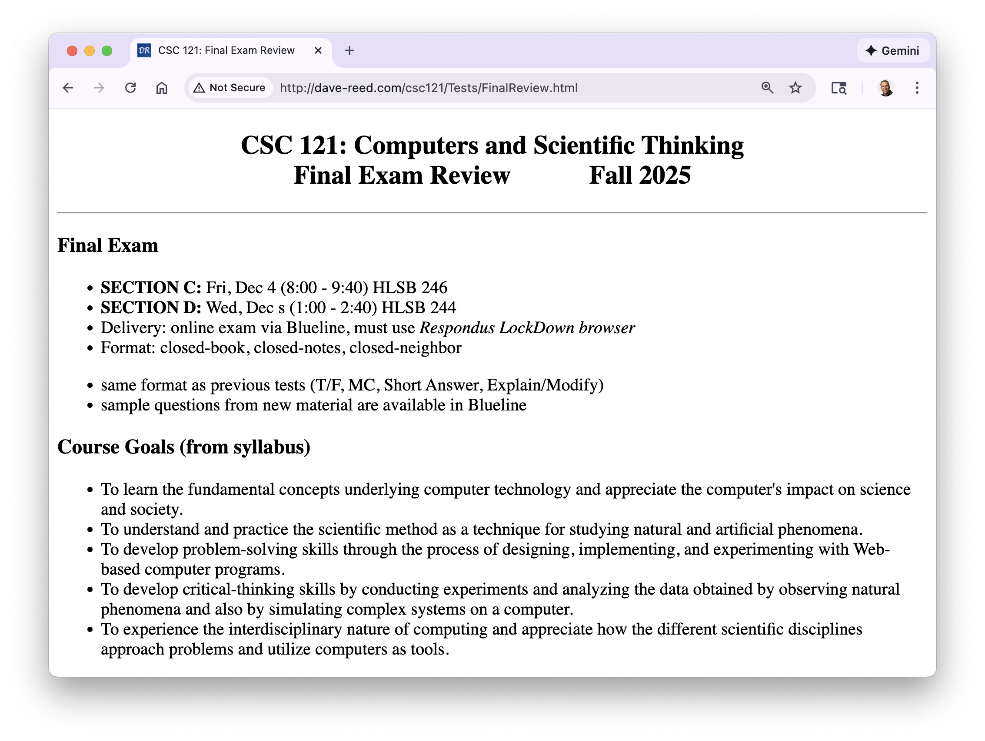
Course overview

Slide 3
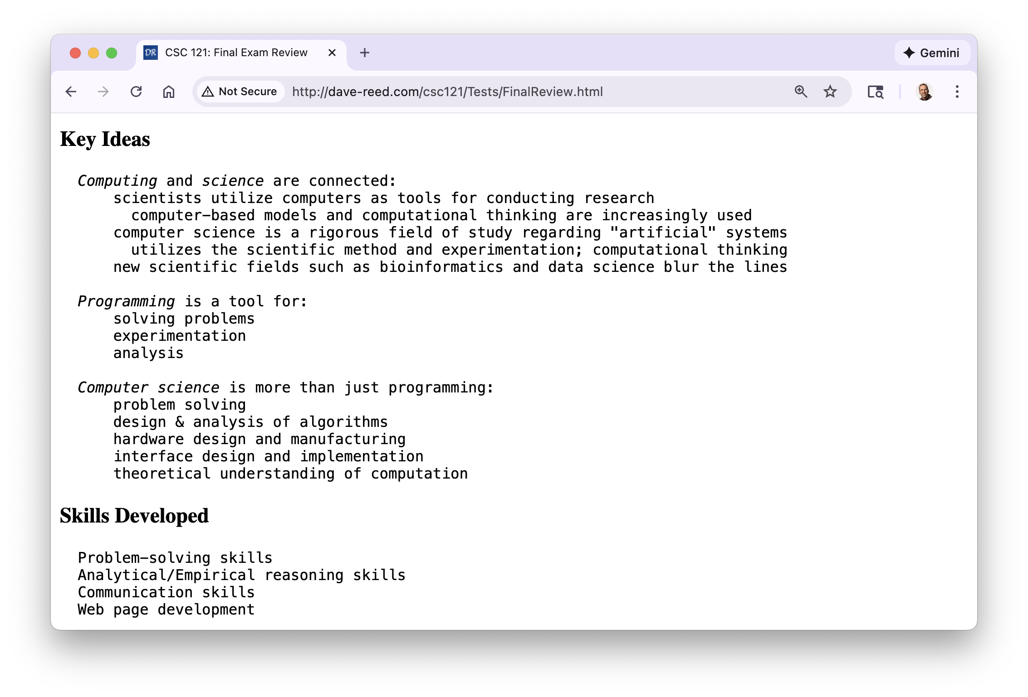
Course overview (cont.)

Slide 4
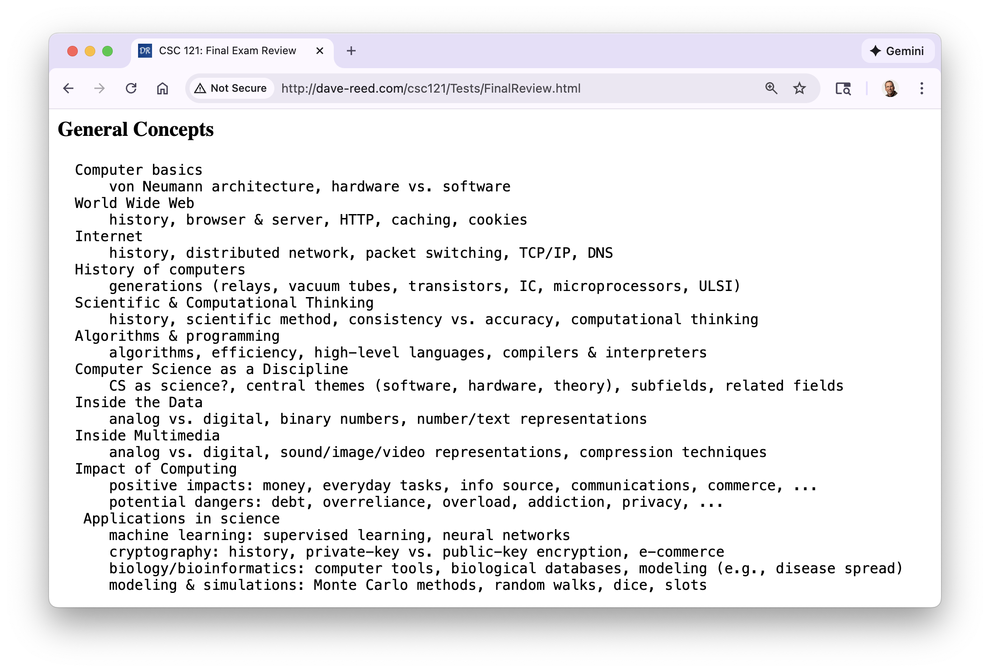
Course overview (cont.)

Slide 5
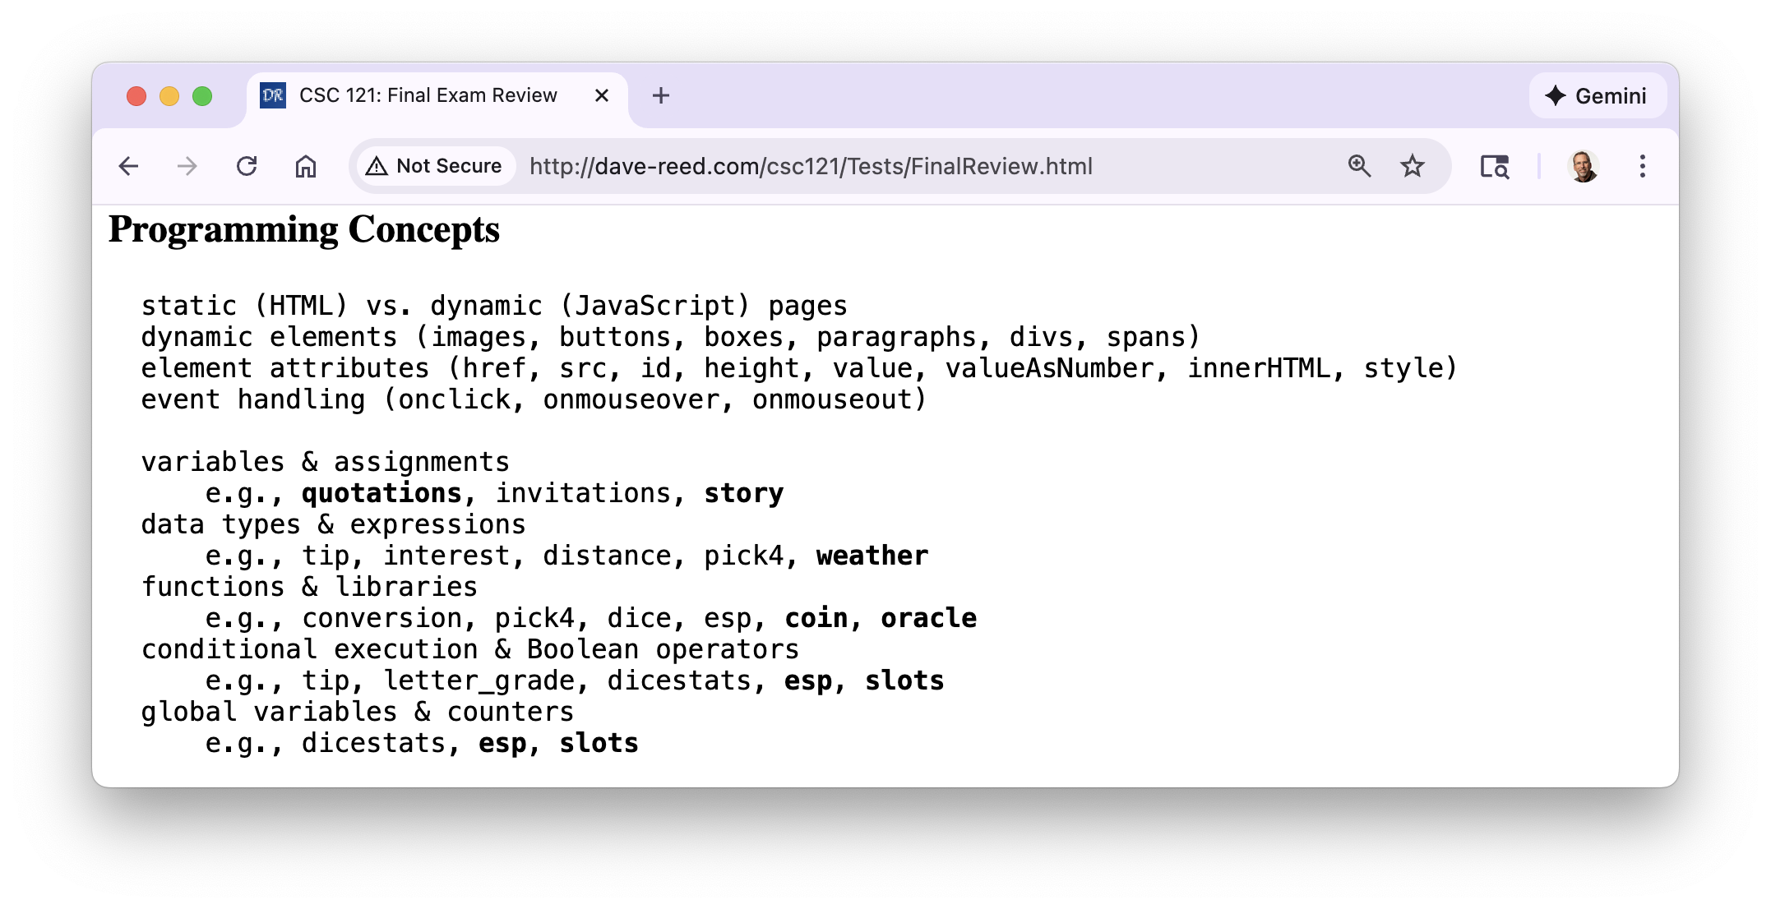
Course overview (cont.)

Slide 6
Final exam
SECTION C: Friday, Dec 12 8:00-9:40 HLSB 246
SECTION D: Wednesday, Dec 10 1:00-2:40 HLSB 244
  similar format as Test1 & Test2, but longer (100 min.)
    will be administered via Blueline, requires Lockdown browser
      bring a laptop, make sure Lockdown is installed and working
    closed notes, closed book, closed neighbor, …
    you MUST take it in-person in your assigned seat (unless arranged)
  practice questions available in Blueline
similar types of questions as Test1 & Test2
  factual knowledge: true/false or multiple choice
  conceptual understanding: short answer
  synthesis & application: describe/modify HTML and/or JavaScript
there will be 5 extra points (out of 100) on the test

Slide 7
Final exam
the exam is cumulative, but will emphasize material since Test2
  C8 (Inside Data): analog vs. digital, binary numbers, reals, characters
  C9 (Inside Multimedia): sound/image/video repr., lossy vs. lossless compression
  C11 (Impact on Society): positives & negatives (e.g., digital cash/identity theft)
  X7 (Functions & Libraries): parameters, return, libraries (random.js)
    projects: ESP test, Oracle of the Internet
  X8 (Making Choices):if statement, cascading if-else, global variables
    project: slot machine
  Lab 3 (Dino DNA): DNA sequences, genetic databases, search tools
  Lab 4 (Random Walks): turtle graphics, simulations, scientific method

Slide 8
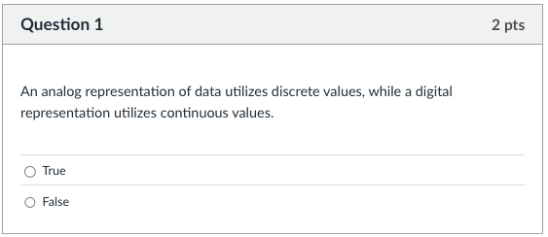
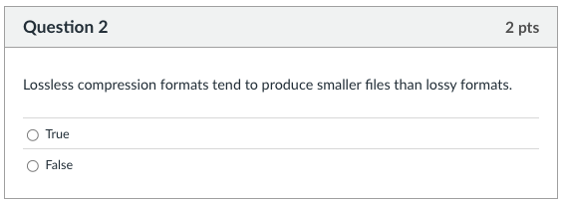
Factual knowledge: T/F

Slide 9
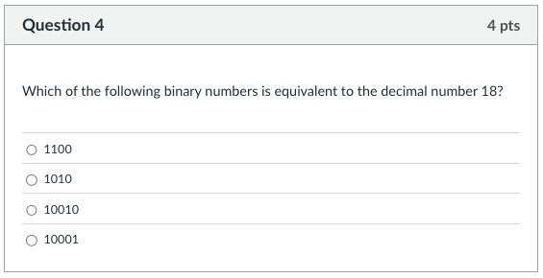
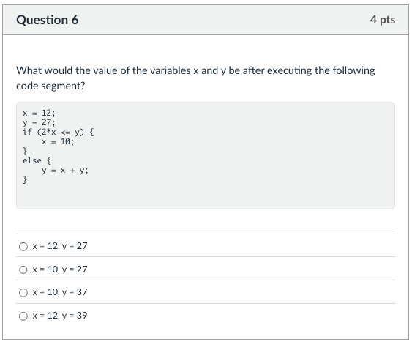
Factual knowledge: MC

Slide 10
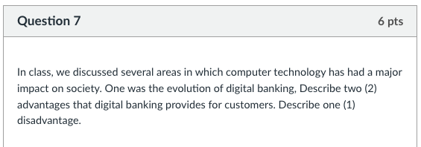
Conceptual Understanding: SA
remember: there is lots of partial credit available
  describe 1st positive impact
  describe 2nd positive impact
  describe accompanying neg.
give complete answers, but don't brain dump!

Slide 11
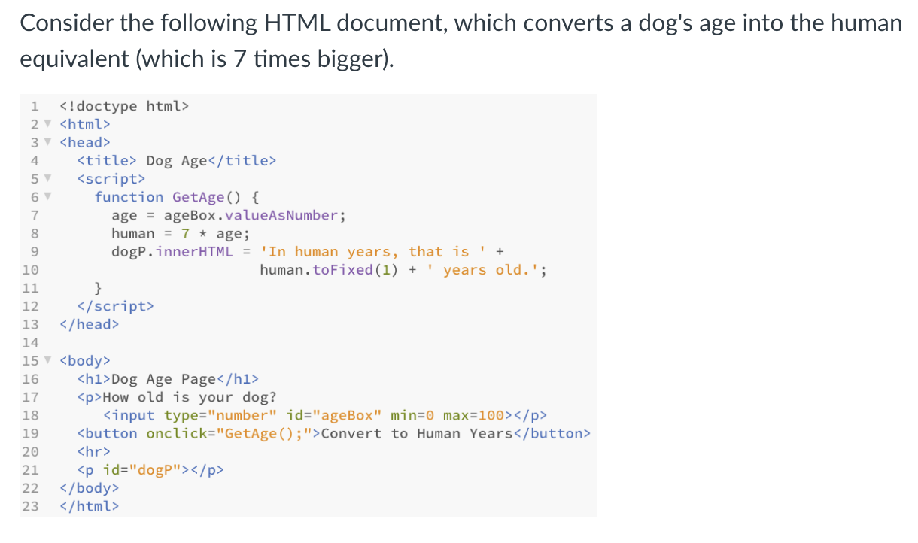
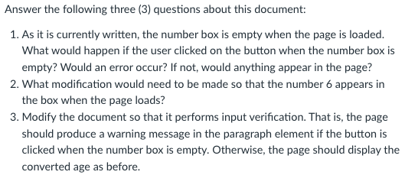
Synthesis/Application:
will emphasize new material/skills
  but build on earlier materials/skills
multi-part questions: e.g., describe page, explain elements/behavior, add features
  MAXIMIZE PARTIAL CREDIT!

Slide 12
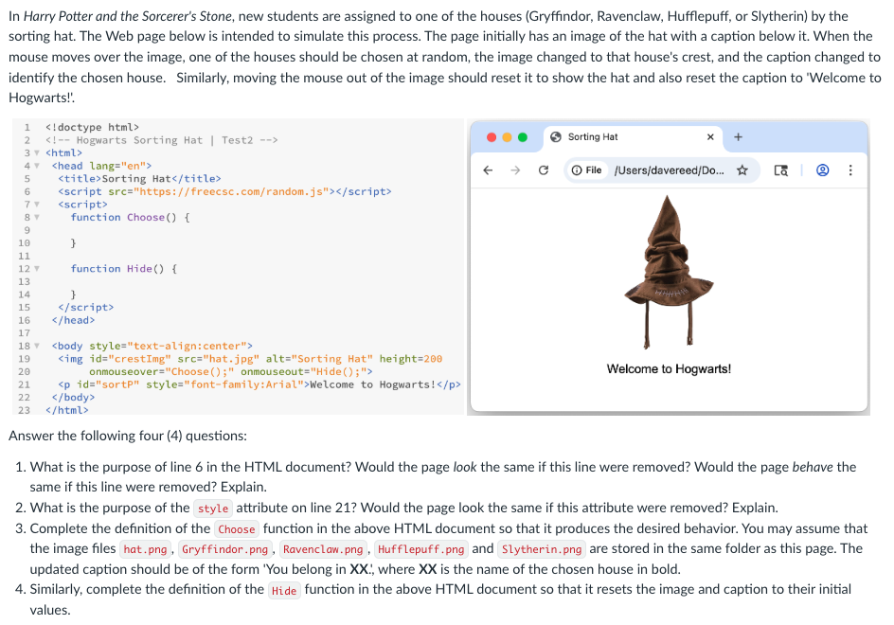
Synthesis/Application:

Slide 13
Advice
Review Sheets (linked from online syllabus)
  final exam review gives more conceptual overview of the class
preparation priorities
  reflect on earlier test performances
    did your previous study strategy work well?
    did you do better/worse on one type of question?
  review both Concepts & Explorations chapters
    reread chapters as needed for details
    summaries at end of chapters are also useful for review
    quick-check and reviews questions are fair game
  know difference between HTML and JavaScript
    if controlling the look of the page, then HTML
    if controlling the behavior of the page, then JavaScript

Slide 14
Advice
  review projects & labs - familiarize with recurring patterns
    e.g., page that calculates
      number boxes for input, button, p/div for output
      function called to access boxes, do calculation, display result
    e.g., page with random image and/or caption
      image, button, p/div for caption
      load random.js library using script element w/ src attribute
      function called to select random value (using RandomInt or RandomOneOf), change image by assigning src attribute, change caption by assigning innerHTML attribute
    e.g., input verification
      text or number boxes, button
      if statement checks box contents: if empty, show warning; else, proceed
    e.g., counter in page
      global variable initialized to 0
      increment in function when event occurs, update the page

