Slide 1
Computer Science: Concepts & Explorations David Reed, Creighton University
Test1 Prep

Slide 2
Test1
the test is Tuesday, Sep 23
75 minutes (but shouldn't take that long)
will be administered via Blueline, requires Lockdown browser
bring a laptop, make sure Lockdown is installed and working
I'd recommend coming a few minutes early to get set up
closed notes, closed book, closed neighbor, …
you MUST take it in-person in our regular classroom
unless you have arranged special accommodations ahead of time
you MUST sit in your assigned seat
a practice test is available in Blueline
same format & approximate length of actual test
can see answers after you complete the test, can retake if you desire
does not affect your grade
but HIGHLY recommended to help you prepare for the test
requires Lockdown browser, so a good way to verify your installation

Slide 3
Test1 format
three types of questions on the test
factual knowledge: true/false or multiple choice
conceptual understanding: short answer
synthesis & application: describe/modify HTML
test will be graded out of 50 points
however, there will be 52 points available
mistakes/brain freezes happen during a test, I understand that
you can miss two points and still get a perfect score!
time management is important
52 points in 75 minutes → roughly 1.5 minutes per point
so, don't spend 5 minutes thinking about a 1-point T/F question
application questions have multiple parts & appear towards the end

Slide 4
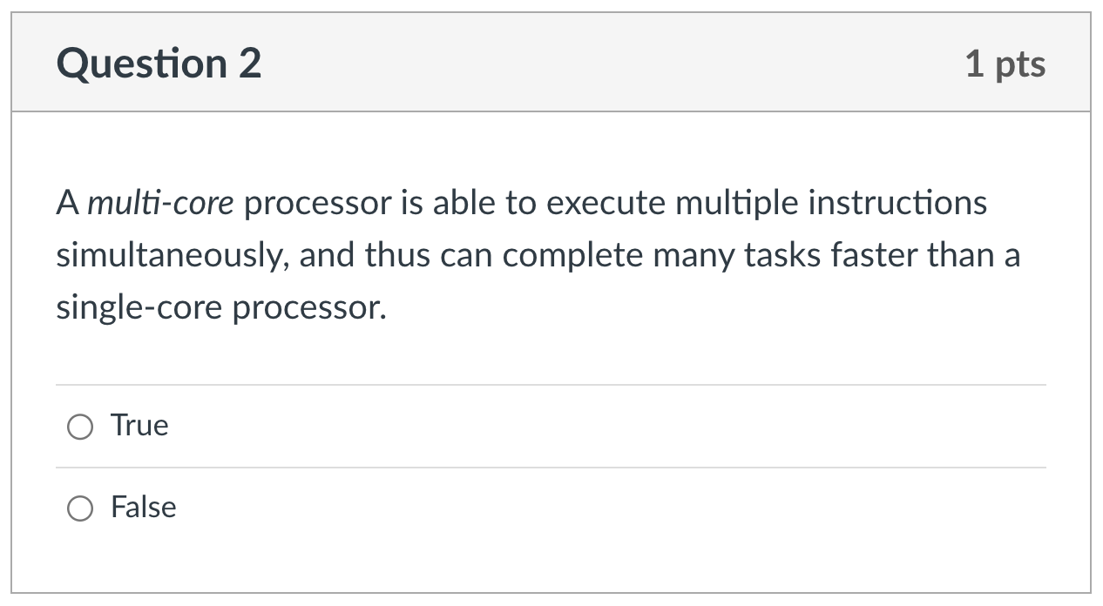
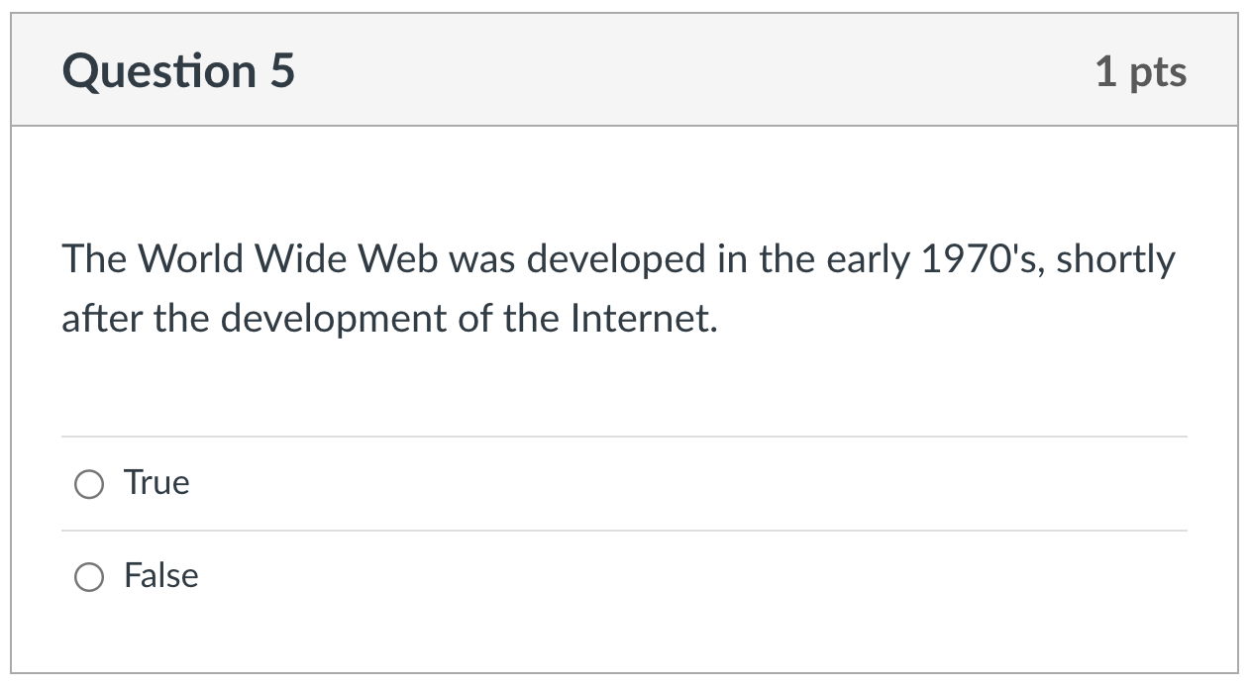
Factual knowledge: T/F

Slide 5
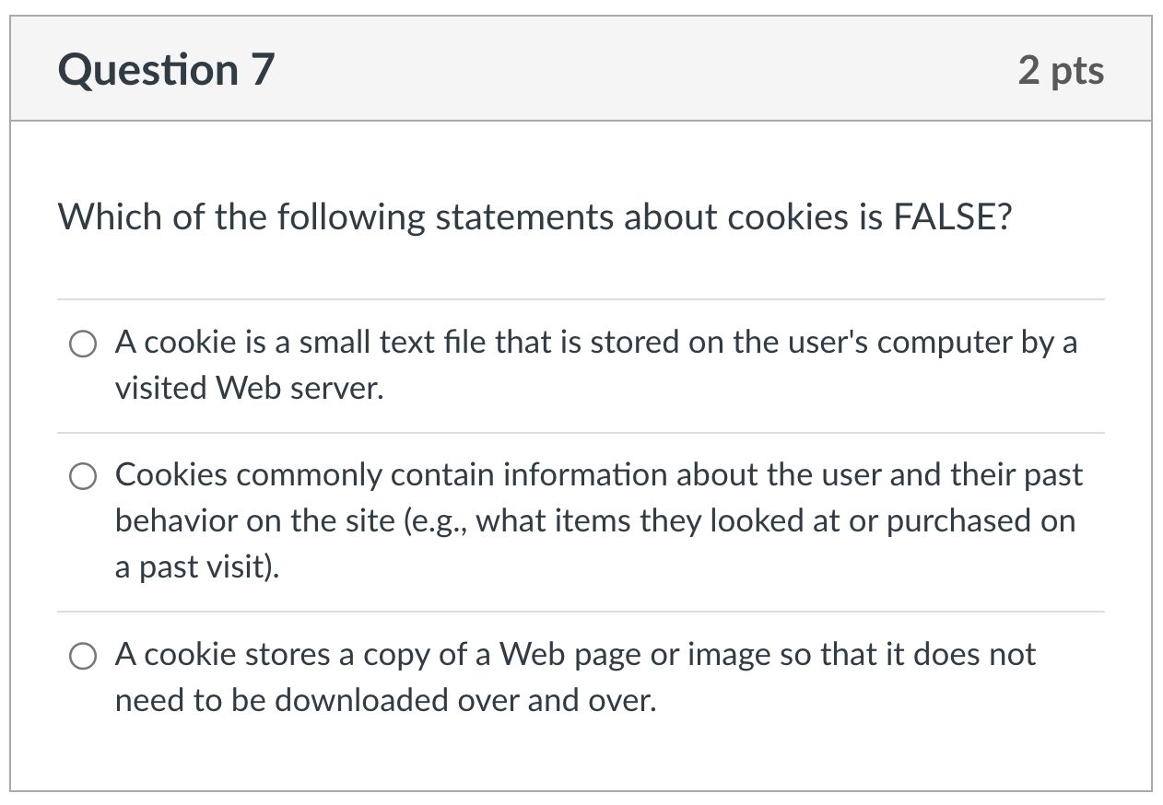
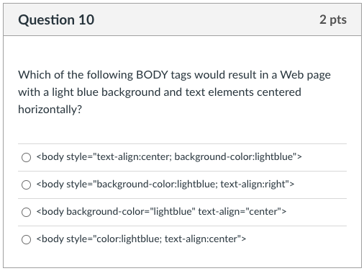
Factual knowledge: MC

Slide 6
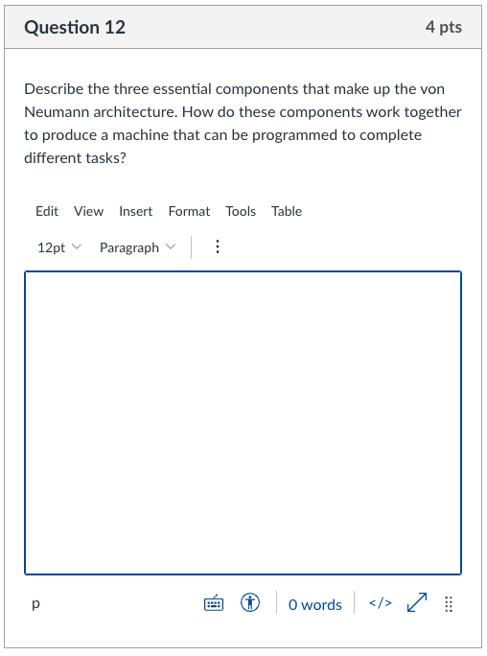
Conceptual Understanding: SA
for a 4-point question, there will be 4 ideas I am looking for:
describe CPU
describe memory
describe I/O
how programmable?
give complete answers, but don't brain dump!
typically, 3-5 sentences suffice
maximize partial credit
even if you don't know it all, answer what you can

Slide 7
Synthesis/Application:
typically, these are multi-part questions
provide an example Web page (or excerpt from a page)
you may then be asked to:
describe how the page looks or behaves
make modifications to the page
add features
these questions will focus on skills you have practiced
Project 1.A & 1.B: concepts of an editor, downloading an image, …
Project 2.C: HTML document, paragraphs, lists, images, links, …
Project 3.B & 3.C: style attributes, text-align, font-family, list-type, …
maximize partial credit
even if you don't know the entire solution, you know parts
show those parts to get credit for what you do know

Slide 8
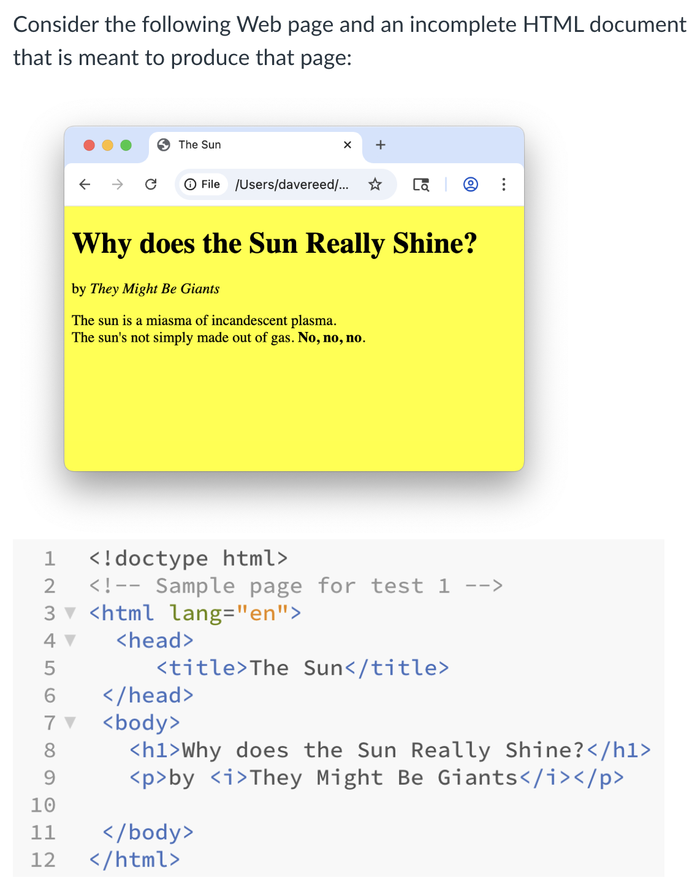
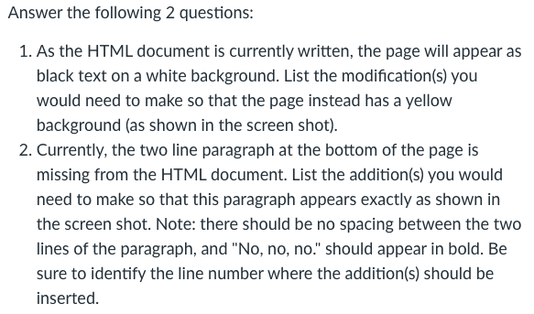
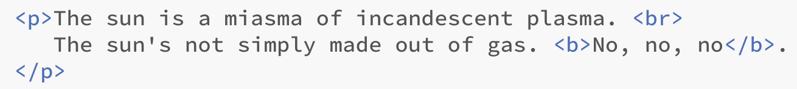
Synthesis/Application:
add style attribute to body tag:
add at line 10:

Slide 9
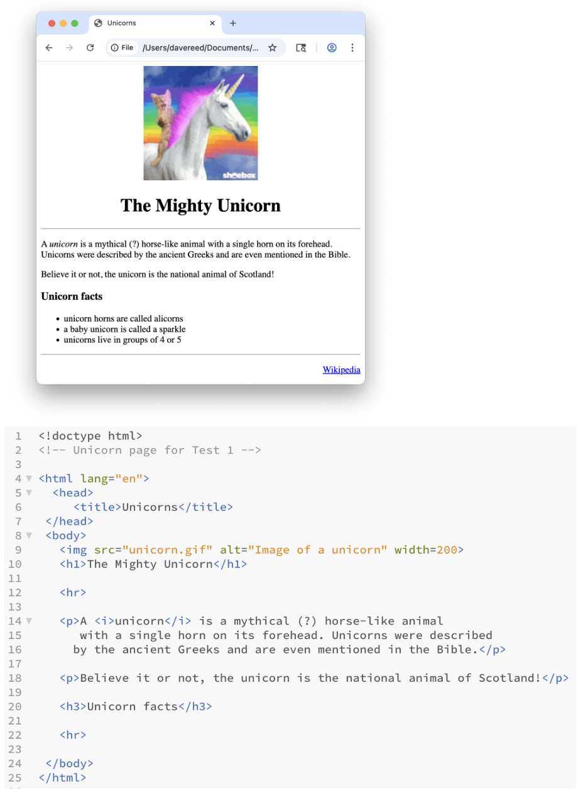
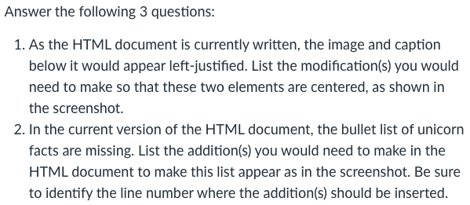
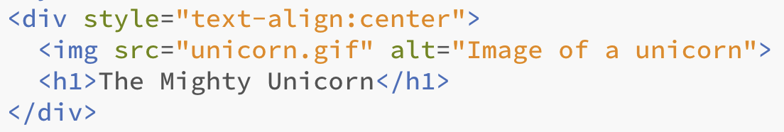
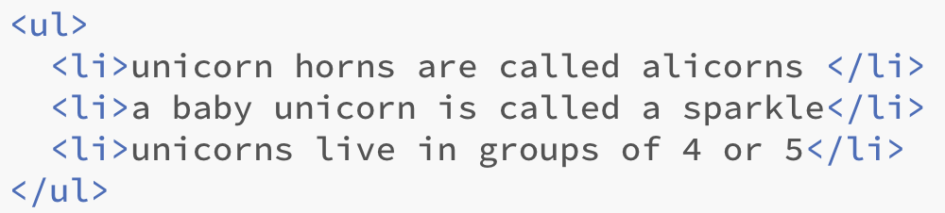
Synthesis/Application:
surround image and heading with div
add at line 21:

Slide 10
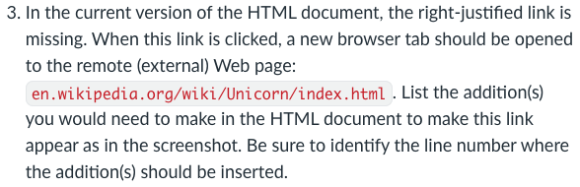
Synthesis/Application:
add at line 23:

Slide 11
Advice
Review Sheet (linked from online syllabus)
provides outline of course by topics
serves as a good study guide
preparation priorities
review the chapters (especially summaries at end)
C chapters: look at review questions at end
X chapters: try some of the exercises
review projects and quiz questions
reference outside sources (if needed)
consider a study group & share your understanding
utilize instructor and TA office hours

