Slide 1
Computer Science: Concepts & Explorations David Reed, Creighton University
Test2 Prep

Slide 2
Test2
the test is Tuesday, Nov 4
same format as Test1
75 minutes
will be administered via Blueline, requires Lockdown browser
bring a laptop, make sure Lockdown is installed and working
closed notes, closed book, closed neighbor, …
you MUST take it in-person in your assigned seat
unless you have arranged special accommodations ahead of time
a practice test is available in Blueline
similar types of questions as Test1
factual knowledge: true/false or multiple choice
conceptual understanding: short answer
synthesis & application: describe/modify HTML and/or JavaScript
as before, there will be 2 extra points on the test

Slide 3
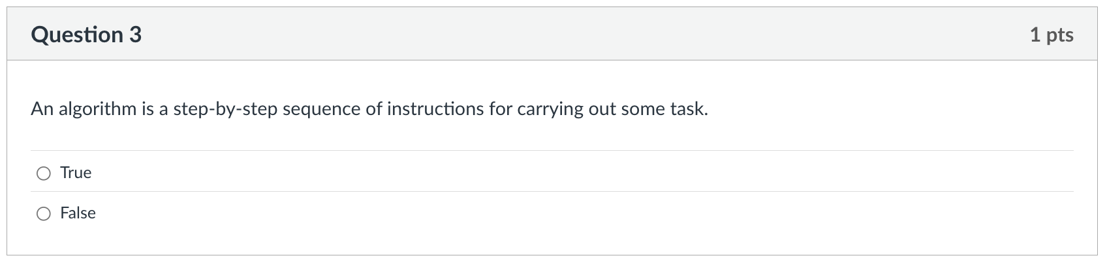
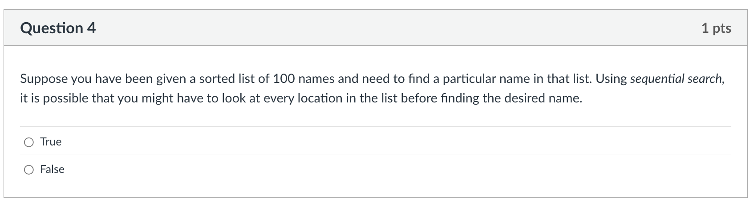
Factual knowledge: T/F

Slide 4
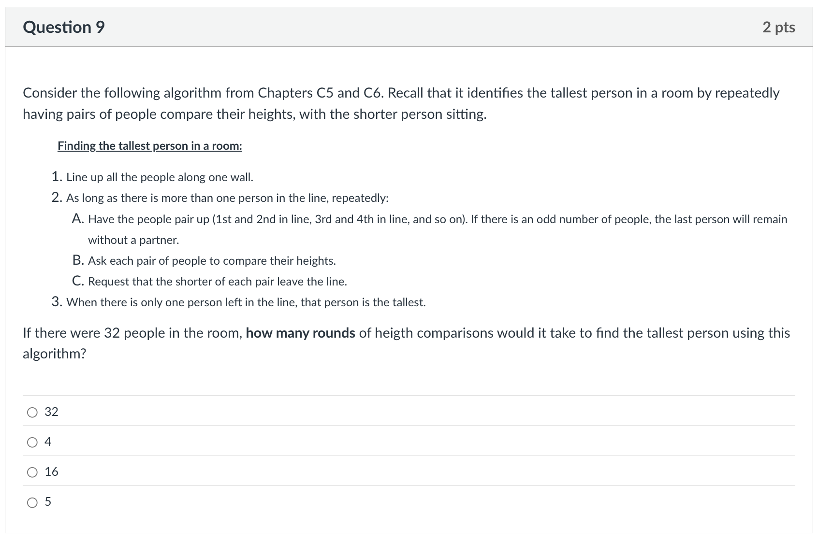
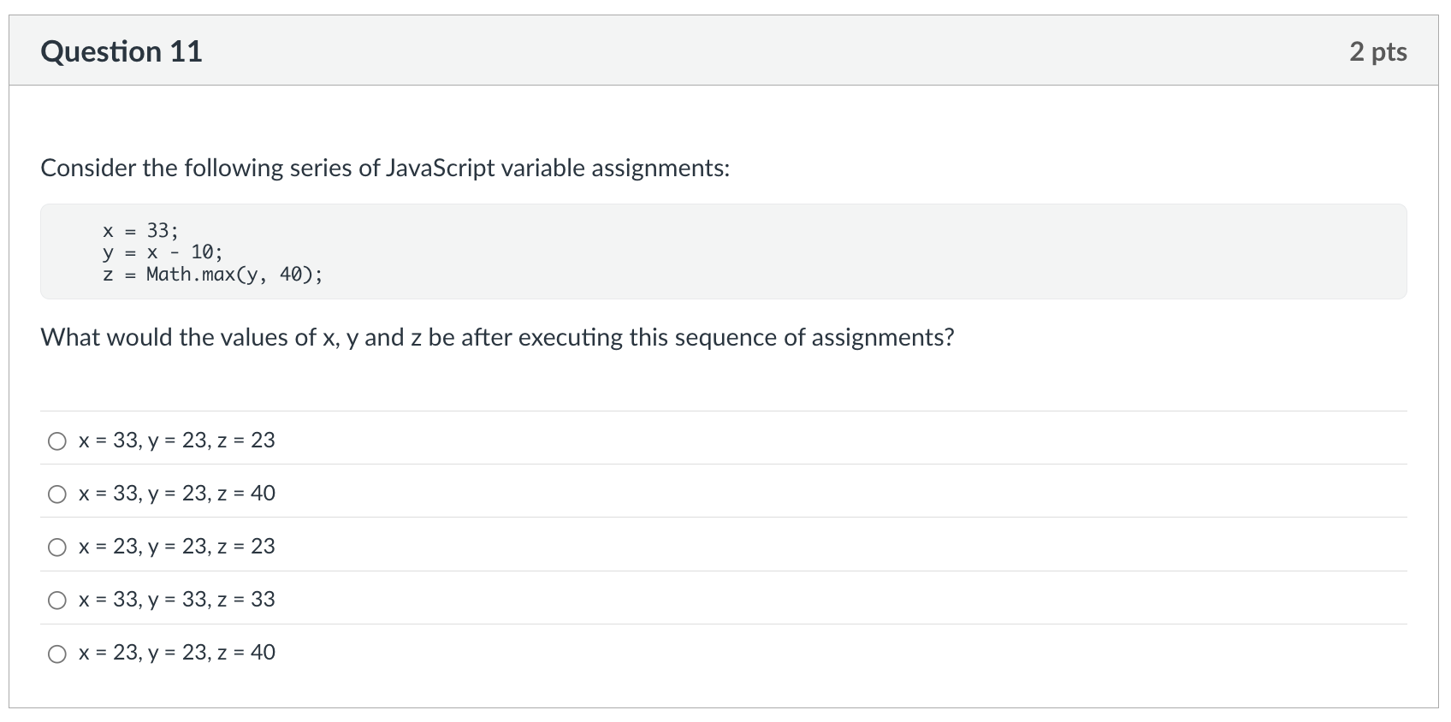
Factual knowledge: MC

Slide 5
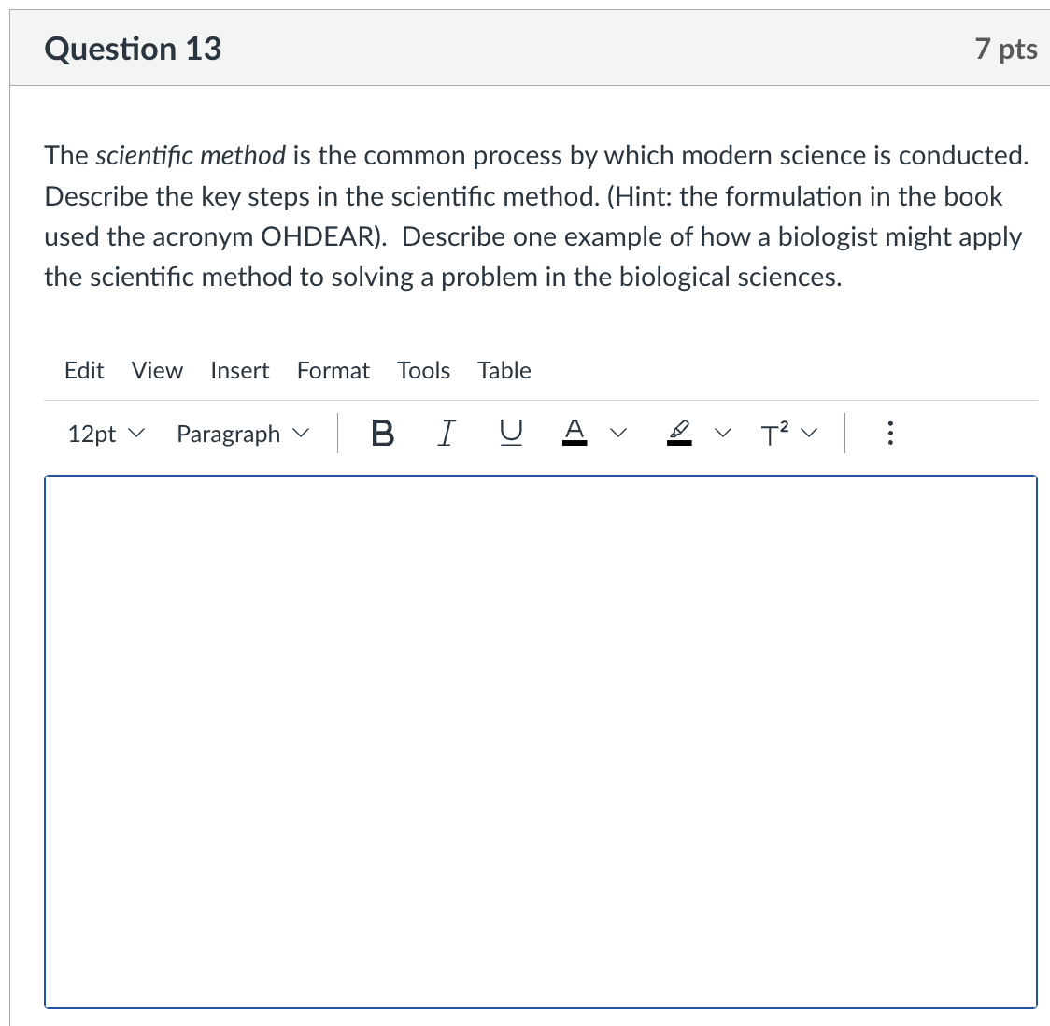
Conceptual Understanding: SA
remember: there is lots of partial credit available
describe each step
describe example
give complete answers, but don't brain dump!

Slide 6
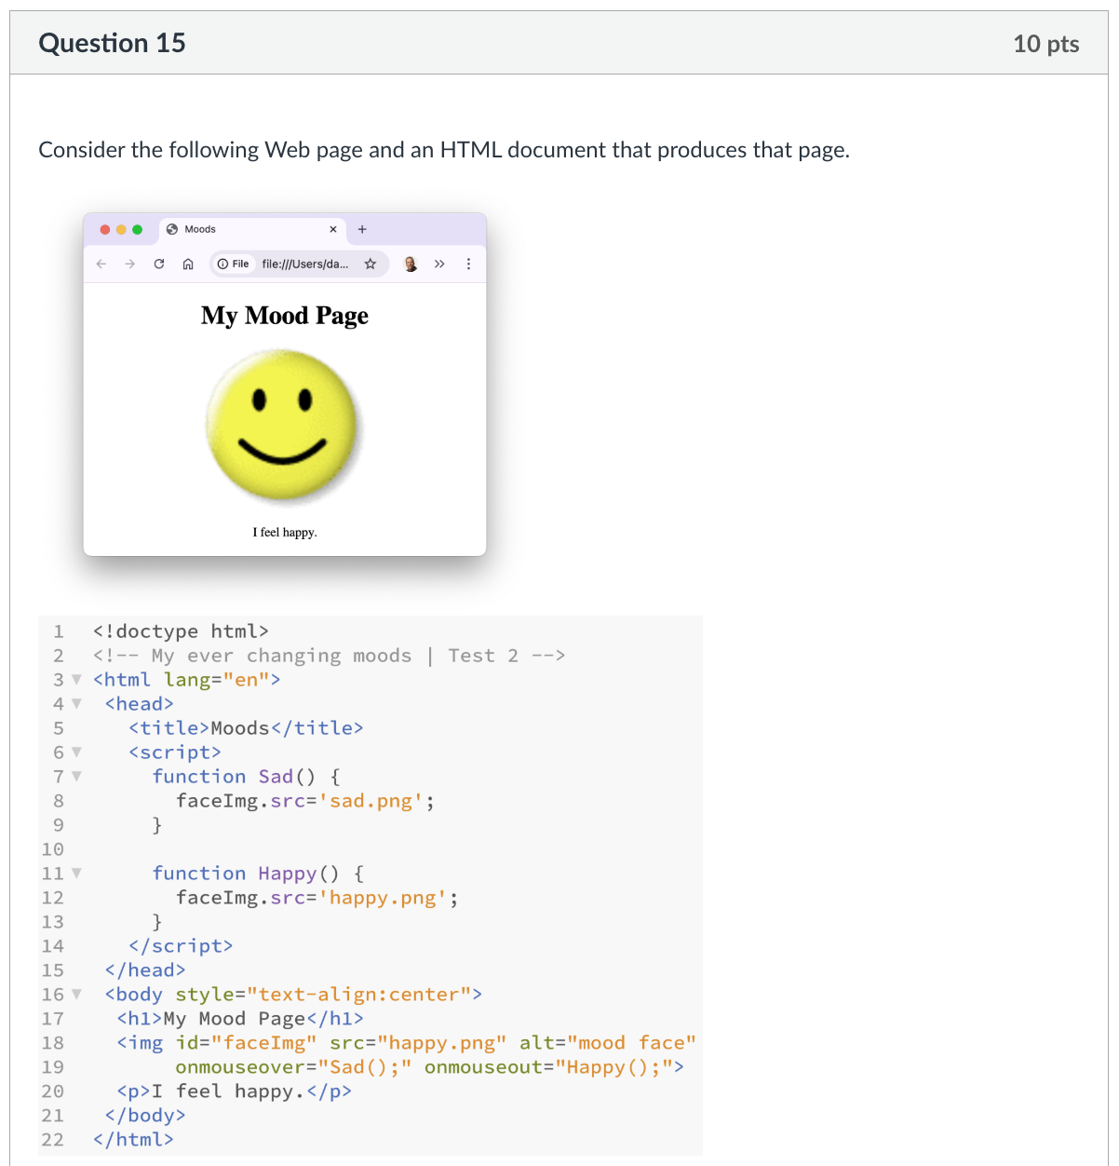
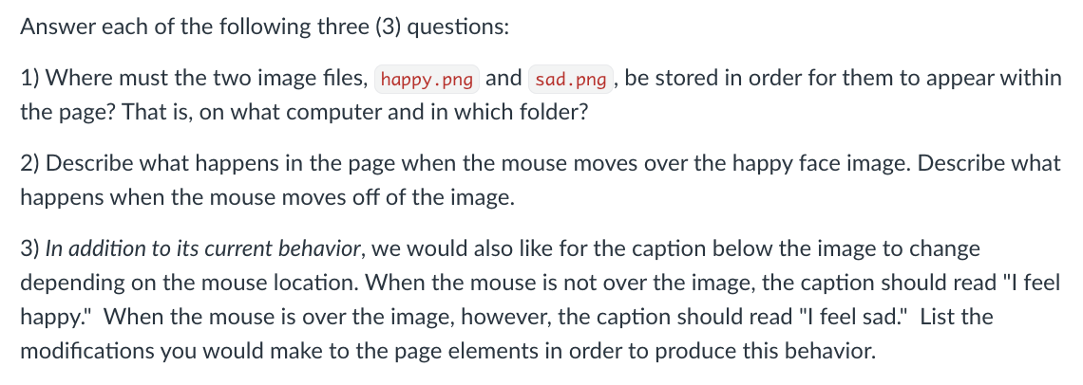
Synthesis/Application:

Slide 7
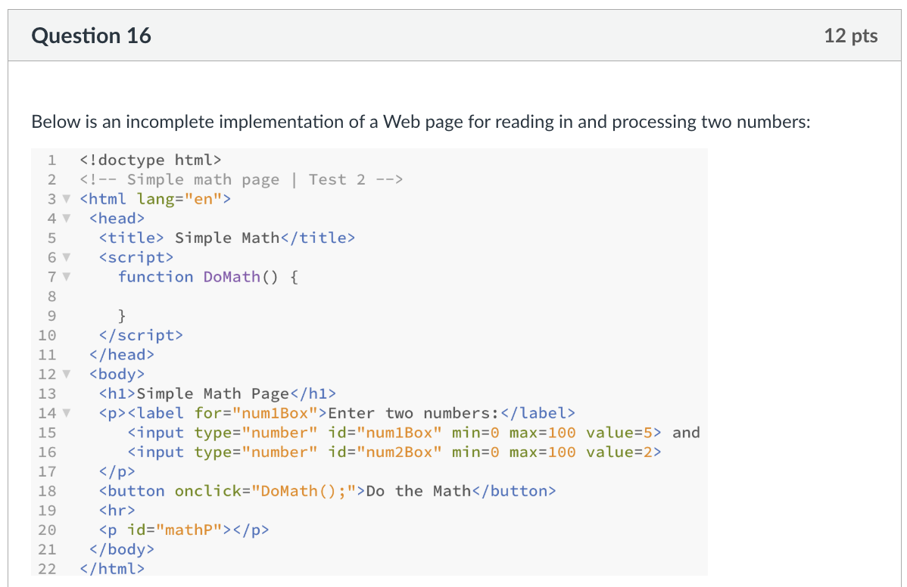
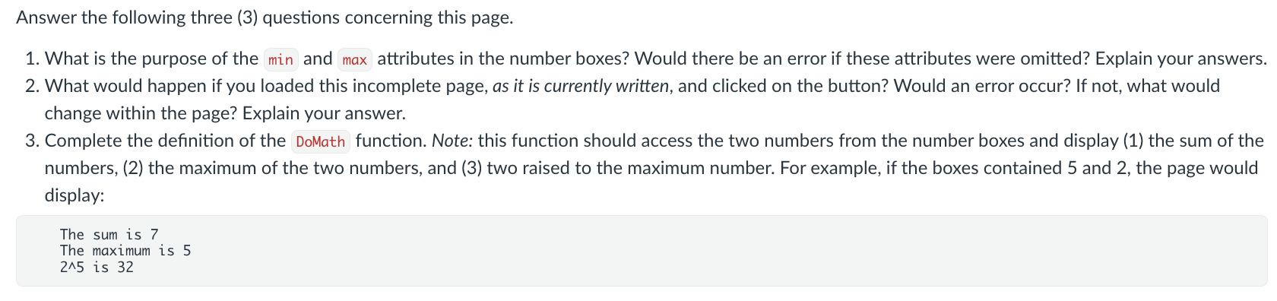
Synthesis/Application:

Slide 8
Advice
Review Sheet (linked from online syllabus)
provides outline of course by topics
serves as a good study guide
preparation priorities
reflect on your Test1 performance
review C5-7, X4-6 material
reread chapters as needed for details
all chapters have summaries at end, highlight key concepts
C chapters: quick-check & review questions
X chapters: examples and exercises,
review projects & labs
Project 4.C (quotes2): images, onmouseover/onmouseout, dynamic text
Project 5.B (story): text boxes, function, variables, dynamic text
Project 6.D (weather): number boxes, function, variables, calculation
Lab 2 (Monte Carlo): experimentation, consistency vs. accuracy
Lab 3 (Dino DNA): applications in biology

