Slide 1
Computer Science: Concepts & Explorations David Reed, Creighton University
Course Overview
and
Final Exam Prep

Slide 2
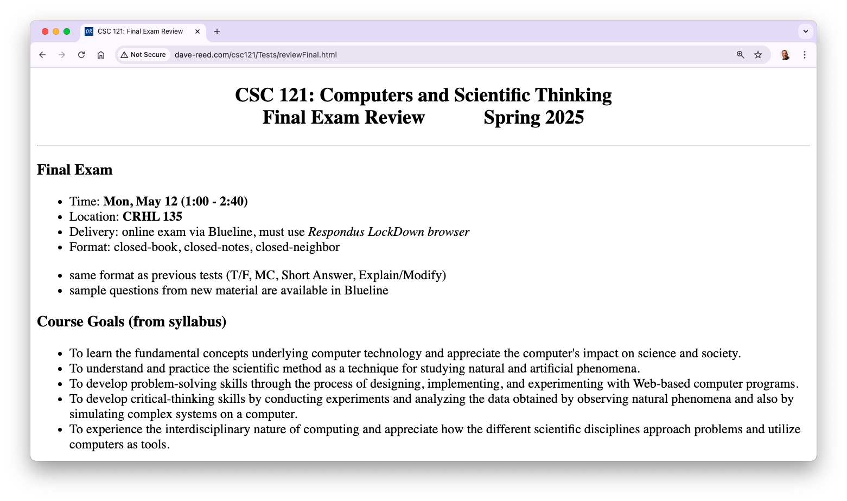
Course overview

Slide 3
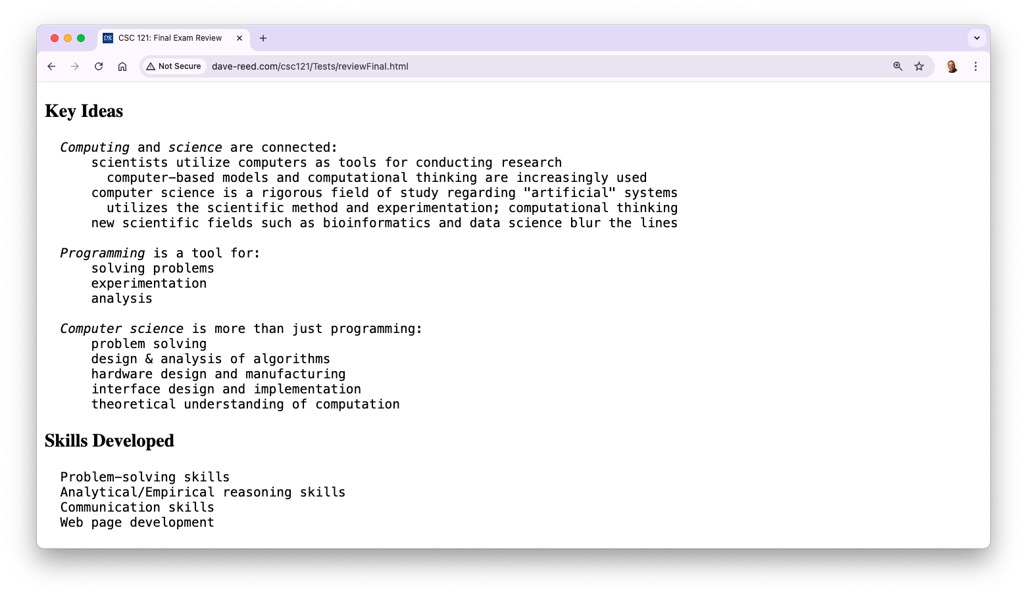
Course overview (cont.)

Slide 4
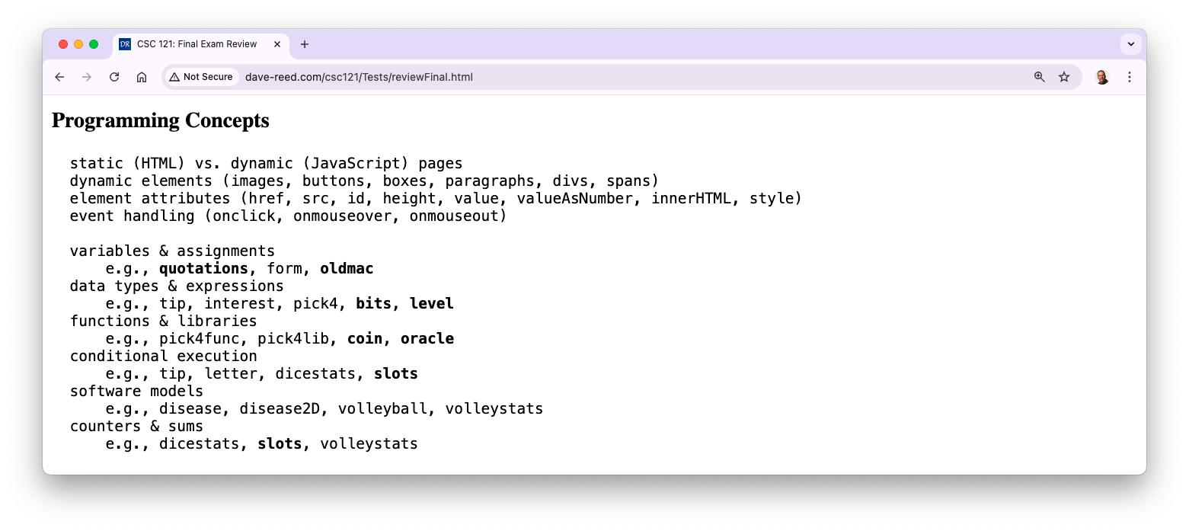
Course overview (cont.)

Slide 5
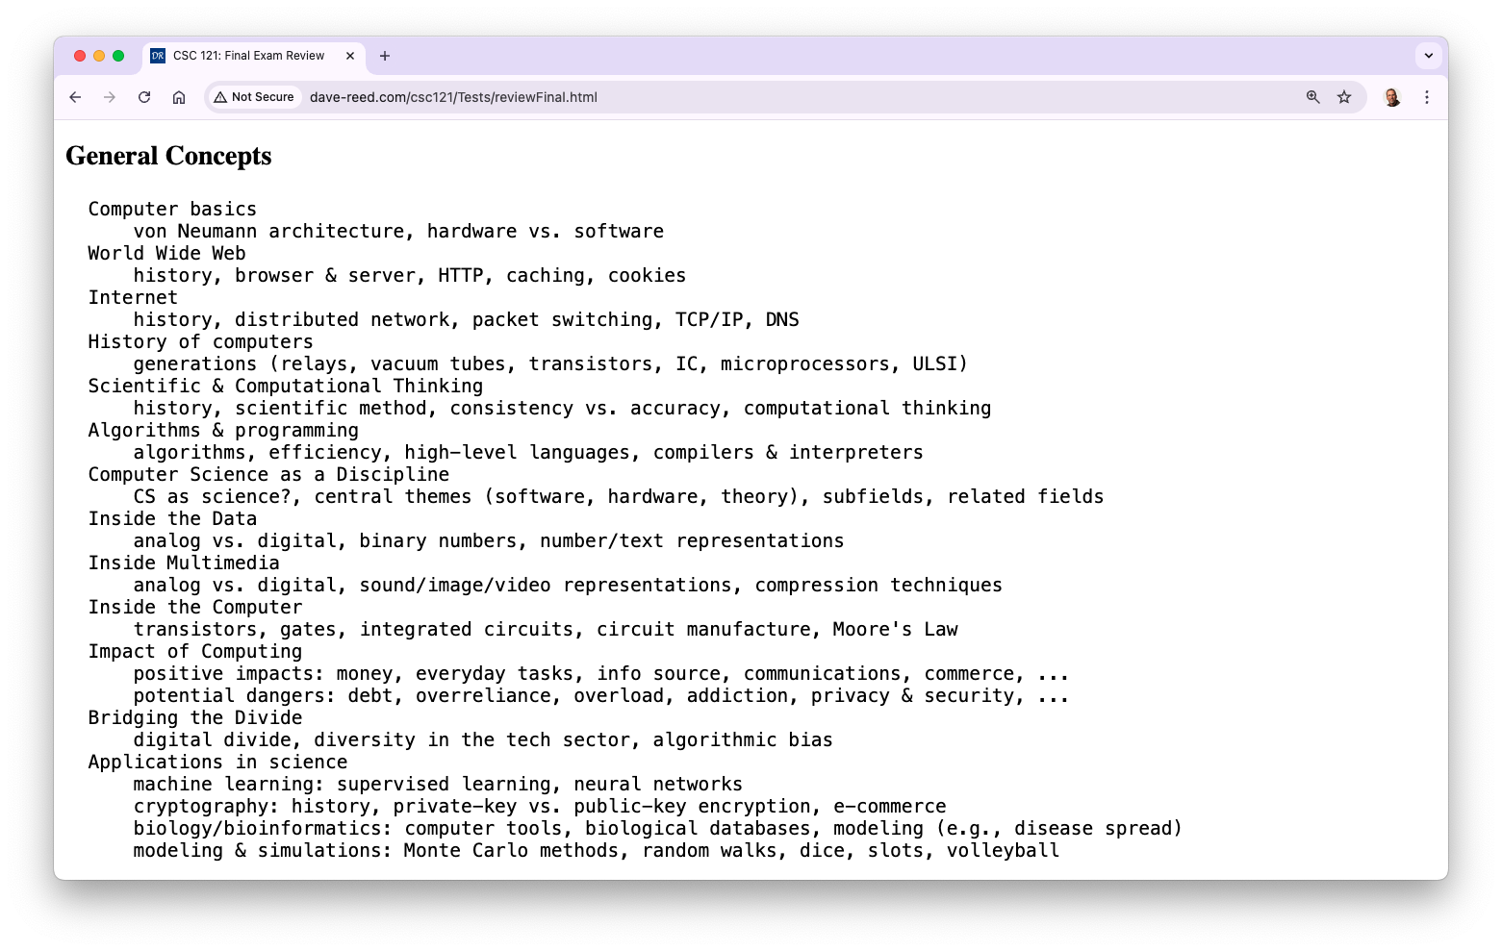
Course overview (cont.)

Slide 6
Final exam
the exam is Monday, May 12(1:00-2:40)
similar format as Test1 & Test2, but longer
100 minutes
will be administered via Blueline, requires Lockdown browser
bring a laptop, make sure Lockdown is installed and working
closed notes, closed book, closed neighbor, …
you MUST take it in-person in your assigned seat (CRHL 135)
unless you have arranged special accommodations ahead of time
practice questions available in Blueline
similar types of questions as Test1 & Test2
factual knowledge: true/false or multiple choice
conceptual understanding: short answer
synthesis & application: describe/modify HTML and/or JavaScript
there will be 5 extra points (out of 100) on the test

Slide 7
Final exam
the exam is cumulative, but will emphasize material since Test2
C9 (Inside Multimedia): sound/image/video repr., lossy vs. lossless compression
C10 (Inside the Computer): transistors, gates, circuits, Moore's Law
C11 (Impact on Society): positives & negatives (e.g. digital cash/identity theft)
C12 (Bridging the Divide): Digital Divide, tech inequities, algorithmic bias
X7 (Conditional Execution): if-else statement, counters/sums
X9 (Software Models): advantages & disadvantages of modeling
Lab 4 (Random Walks): turtle graphics, simulations, scientific method
Lab 5 (Volleyball Simulations): modeling systems, scientific method

Slide 8
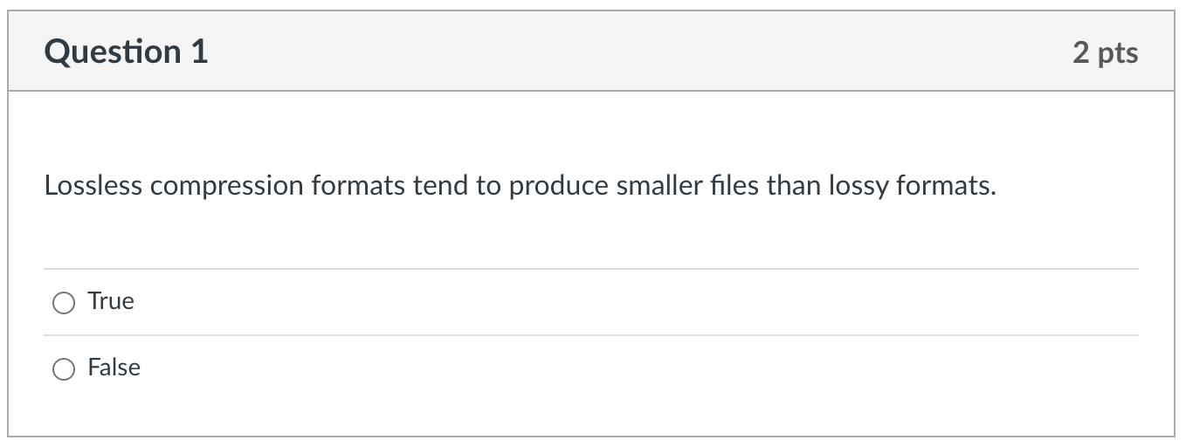
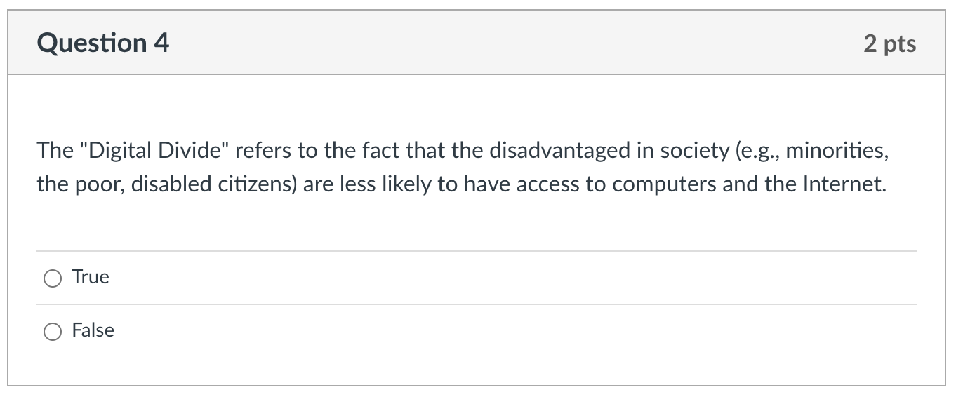
Factual knowledge: T/F

Slide 9
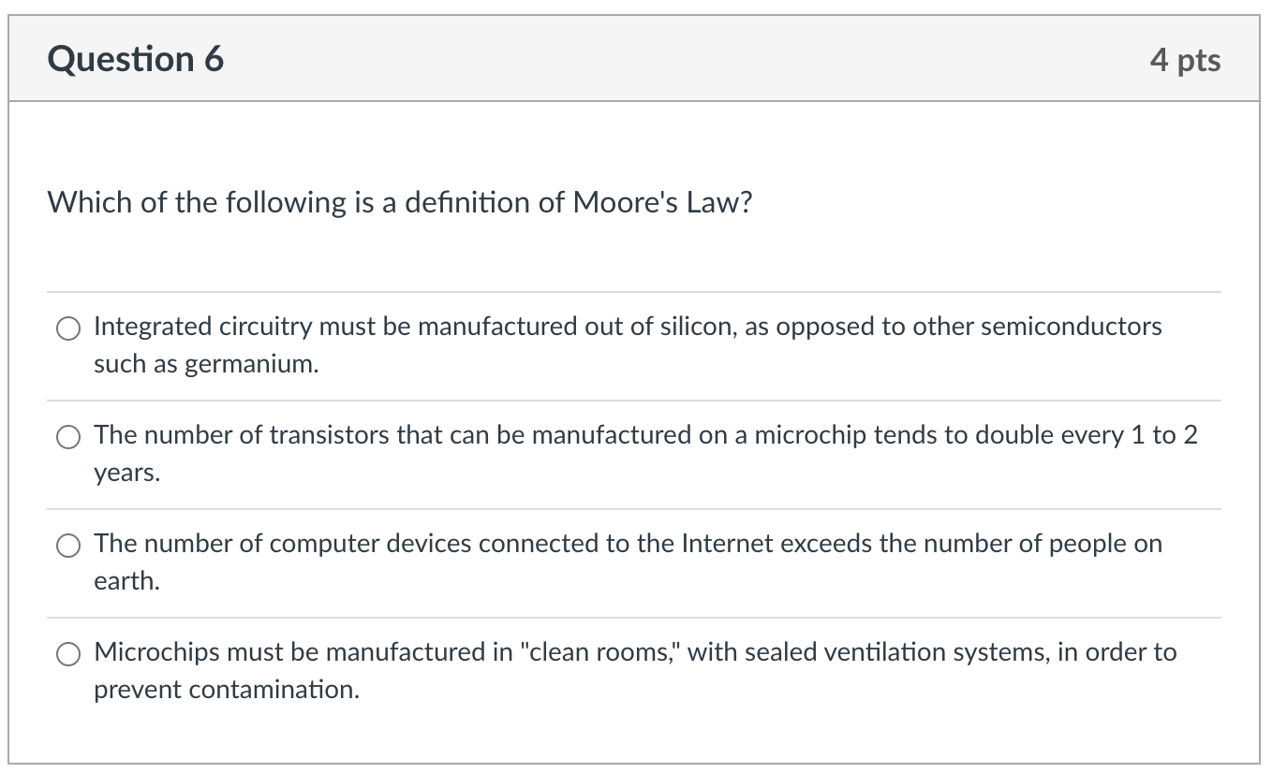
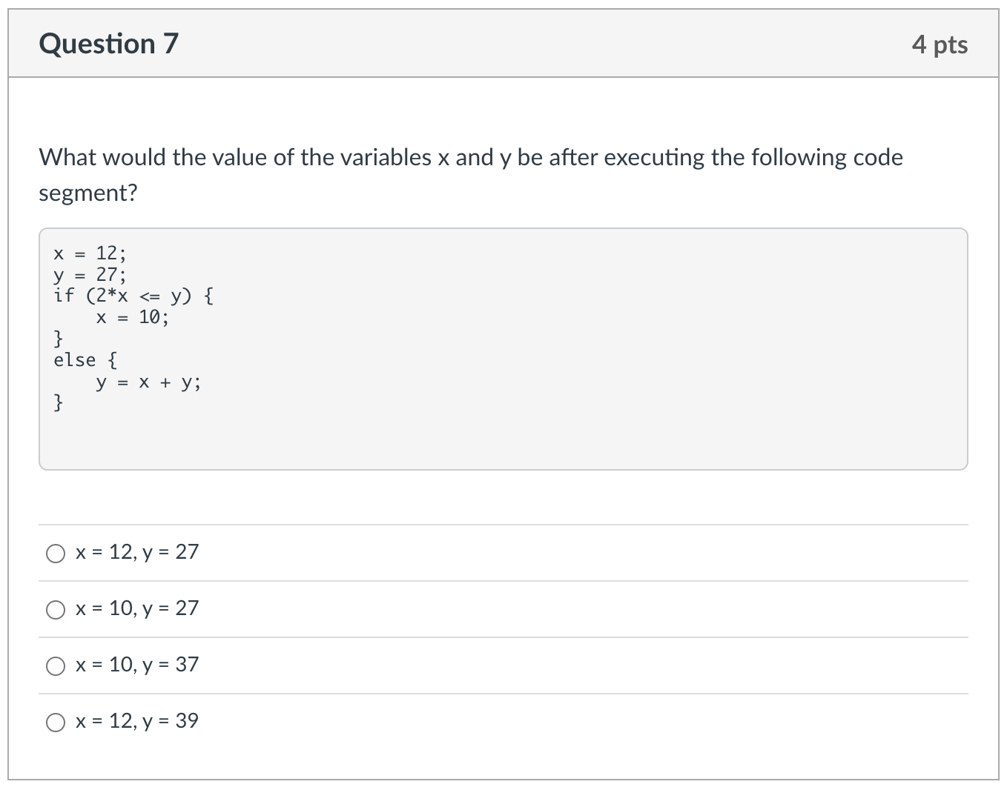
Factual knowledge: MC

Slide 10
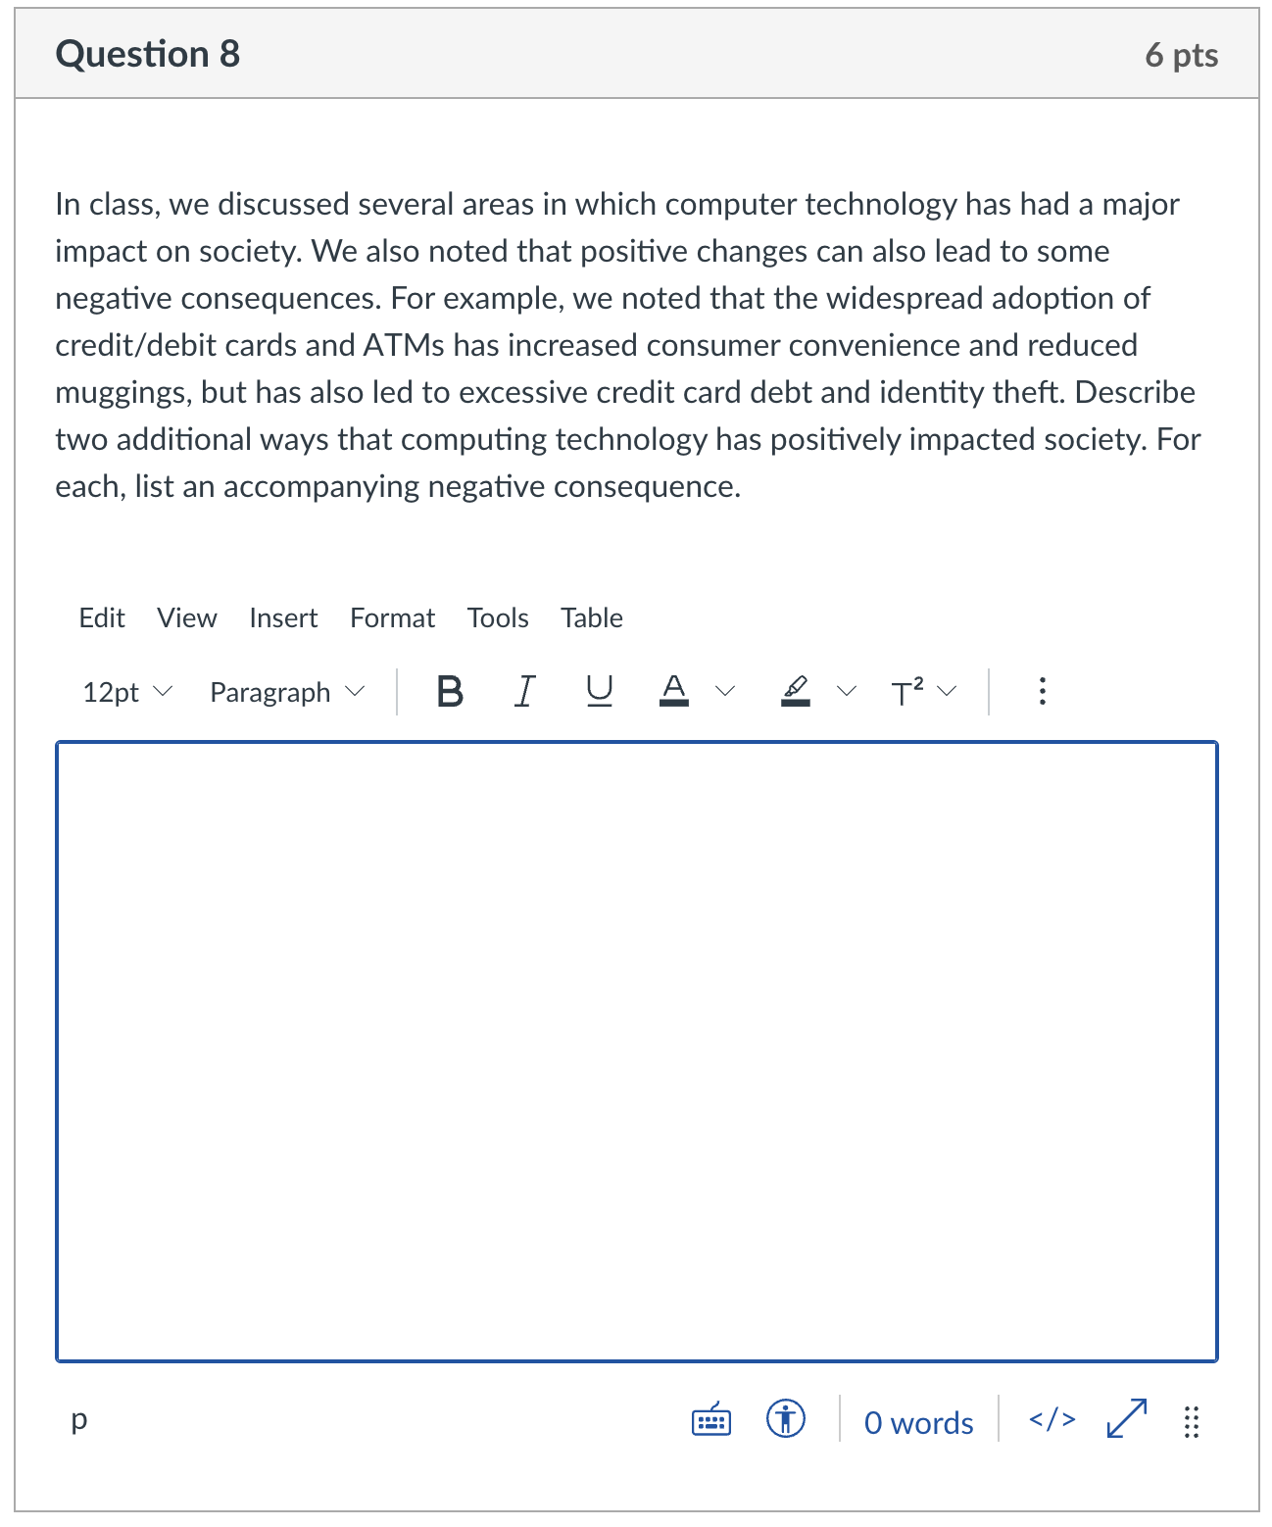
Conceptual Understanding: SA
remember: there is lots of partial credit available
describe 1st positive impact
describe accompanying neg.
describe 2nd positive impact
describe accompanying neg.
give complete answers, but don't brain dump!

Slide 11
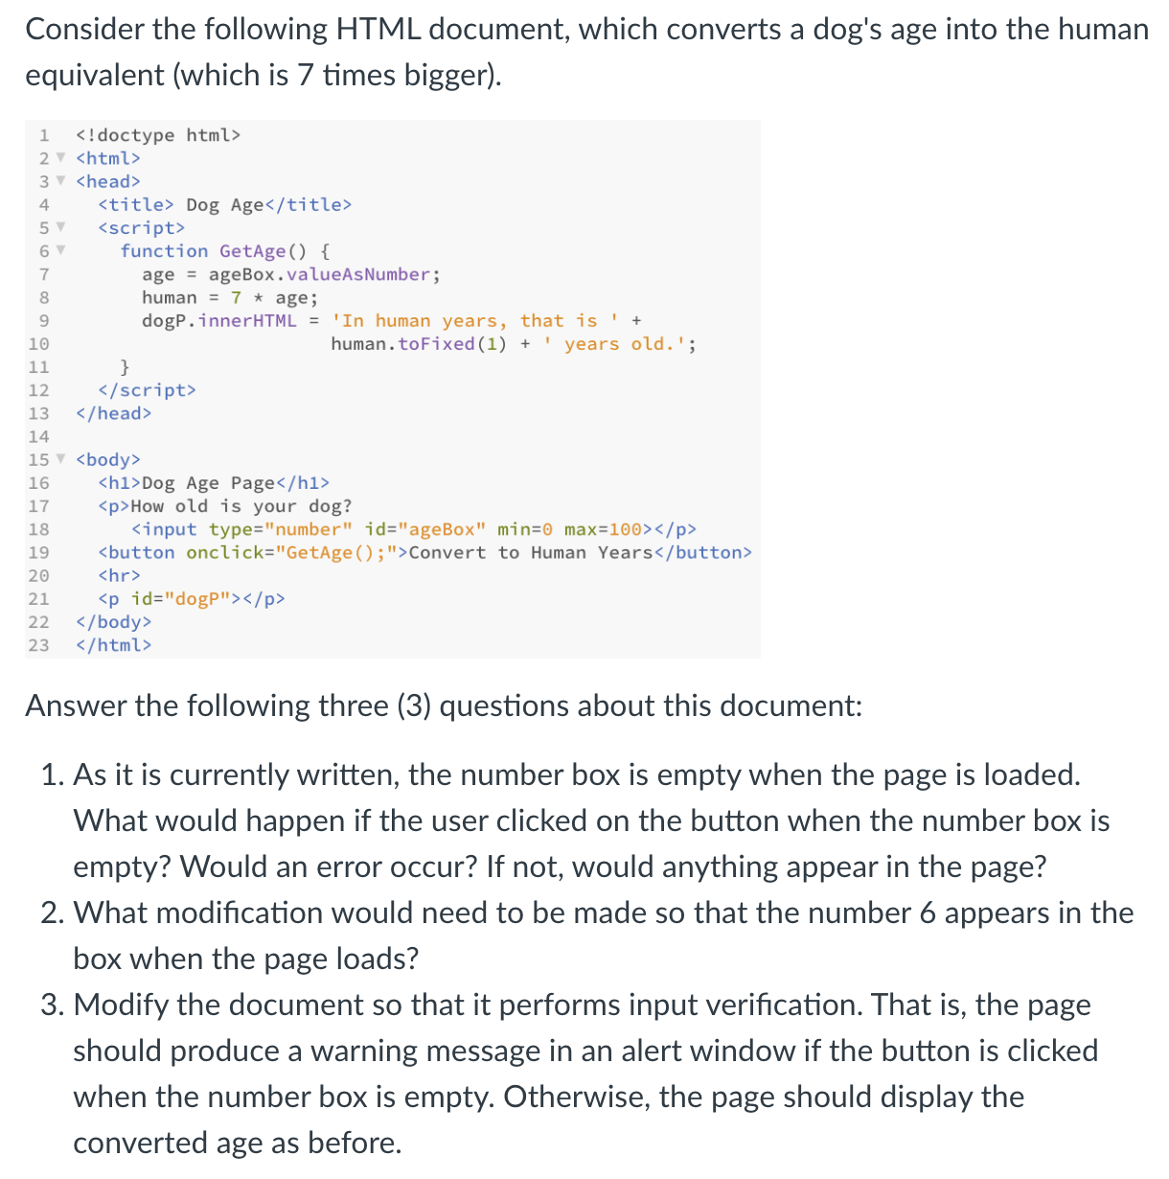
Synthesis/Application:
will emphasize new material/skills
but build on earlier materials/skills
multi-part questions:
describe page
explain behavior
add features
MAXIMIZE PARTIAL CREDIT!

Slide 12
Advice
Review Sheets (linked from online syllabus)
final exam review gives more conceptual overview of the class
preparation priorities
reflect on earlier test performances
did your previous study strategy work well?
did you do better/worse on one type of question?
review both Concepts & Explorations chapters
PowerPoints highlight main ideas & examples
reread chapters as needed for details
summaries at end of chapters are also useful for review
questions from end of chapters are fair game
know difference between HTML and JavaScript
if controlling the look of the page, then HTML
if controlling the behavior of the page, then JavaScript

Slide 13
Advice
review projects & labs - familiarize with recurring patterns
e.g., page that computes
number boxes for input, button, p/div for output
function called to access boxes, do calculation, display result
e.g., page with random image
image, button, p/div for caption
load random.js library using script element w/ src attribute
function called to select random value (using RandomInt or RandomOneOf), change image by assigning src attribute, change caption by assigning innerHTML attribute
e.g., input verification
text or number boxes, button
if statements checks box contents: if empty, alert warning; else, proceed
e.g., counter in page
span that initially contains 0
access span, convert to Number, add 1, reassign to span

