Slide 1
Computer Science:
Concepts & Explorations
David Reed, Creighton University
Test1 Prep

Slide 2
Test1
the test is Tuesday, Sep 24
  60 minutes (2:00-3:00)
  will be administered via Blueline, requires Lockdown browser
    bring a laptop, make sure Lockdown is installed and working
    I'd recommend coming a few minutes early to get set up
  closed notes, closed book, closed neighbor, …
  you MUST take it in-person in our regular classroom (Hixson-Lied 244)
    unless you have arranged special accommodations ahead of time
  you MUST sit in your assigned seat
a practice test is available in Blueline
  same format & approximate length of actual test
    can see answers after you complete the test, can retake if you desire
  does not affect your grade
    but HIGHLY recommended to help you prepare for the test
    requires Lockdown browser, so good way to verify your installation

Slide 3
Test1 format
three types of questions on the test
  factual knowledge: true/false or multiple choice
  conceptual understanding: short answer
  synthesis & application: describe/modify HTML and/or JavaScript
test will be graded out of 50 points
  however, there will be 52 points available
    mistakes/brain freezes happen during a test, I understand that
    you can miss two points and still get a perfect score!
time management is important
  52 points in 60 minutes → a little more than 1 minute per point
  don't spend 5 minutes thinking about a 1-point T/F question
  application questions are worth a lot & appear towards the end

Slide 4
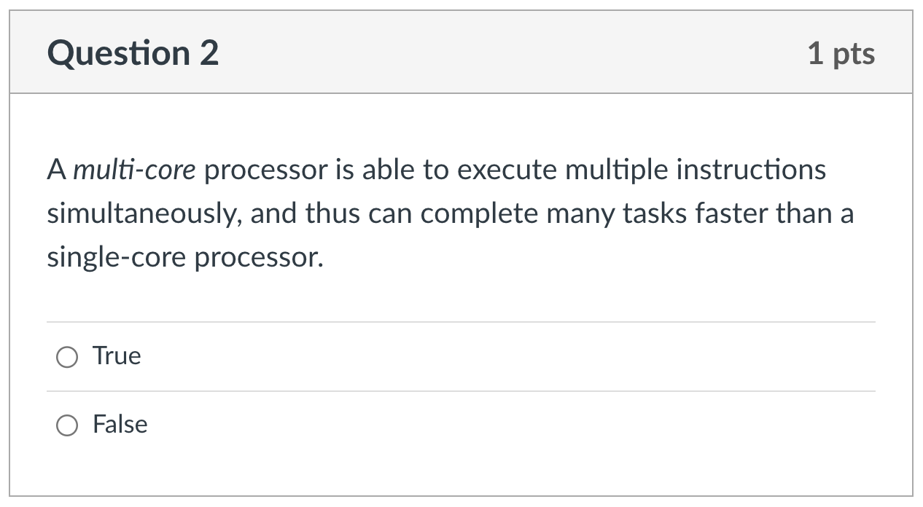
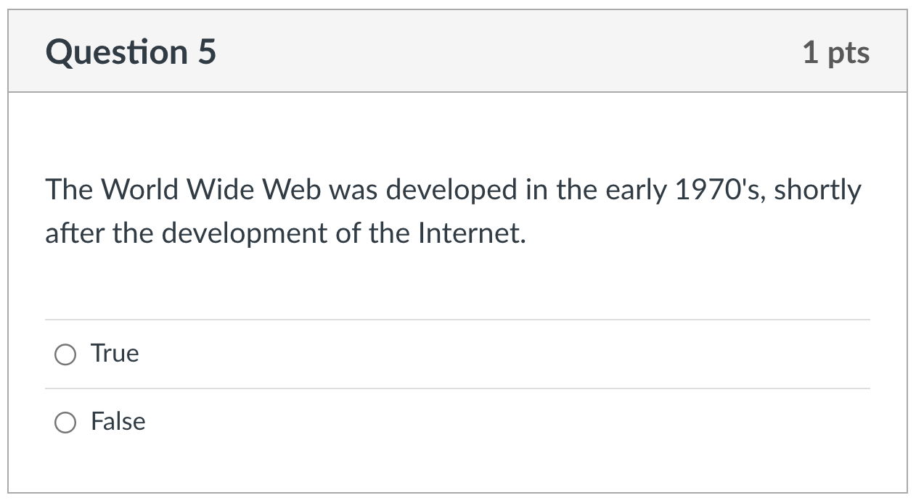
Factual knowledge: T/F

Slide 5
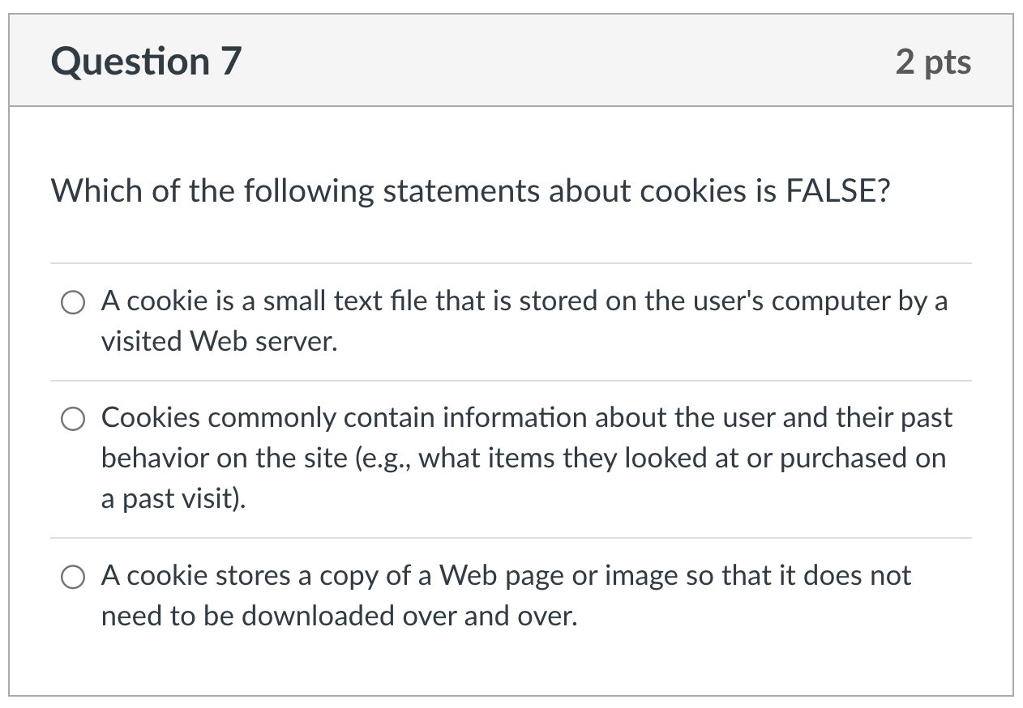
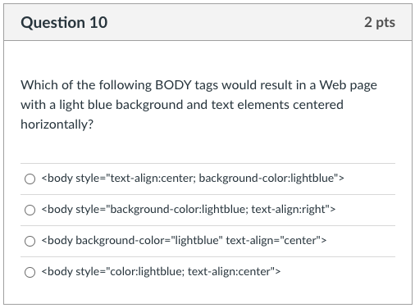
Factual knowledge: MC

Slide 6
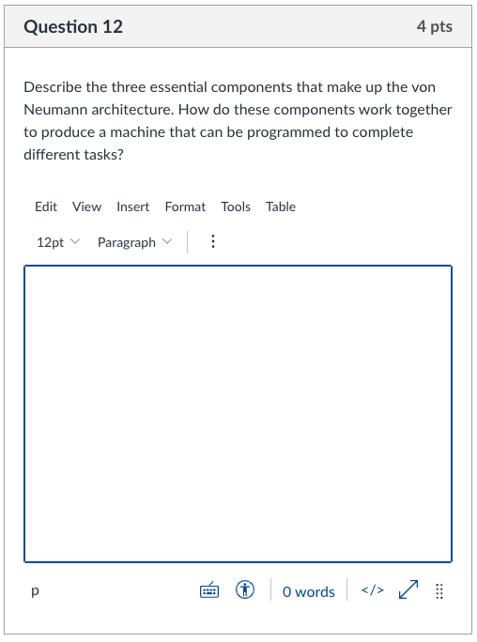
Conceptual Understanding: SA
for a 4-point question, there will be 4 ideas I am looking for:
  describe CPU
  describe memory
  describe I/O
  how programmable?
give complete answers, but don't brain dump!
  typically, 3-5 sentences suffice
maximize partial credit
  even if you don't know it all, answer what you can

Slide 7
Synthesis/Application:
typically, these are multi-part questions
  provide an example Web page (or excerpt from a page)
  you may then be asked to:
    describe how the page looks or behaves
    make modifications to the page
    add features
  these questions may focus on HTML or JavaScript (or both)
these questions will focus on skills you have practiced
  Project 1.A: HTML document, paragraphs, headings, style, …
  Project 2.A: links, images, lists, tables
  Project 3.A: JavaScript, event-handlers, dynamic images & text
maximize partial credit
  even if you don't know the entire solution, you know parts
  show those parts to get credit for what you do know

Slide 8
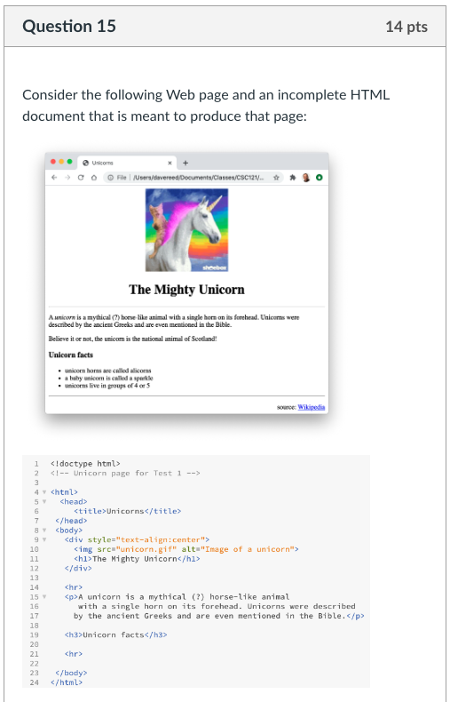
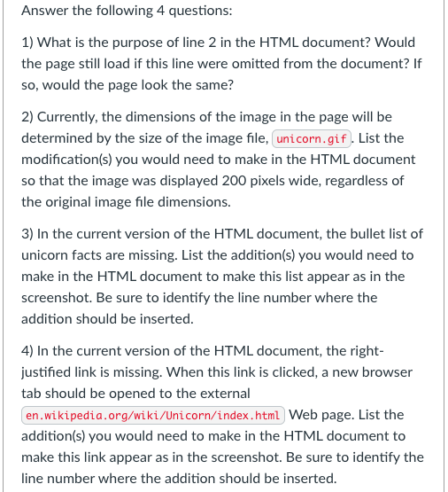
Synthesis/Application:

Slide 9
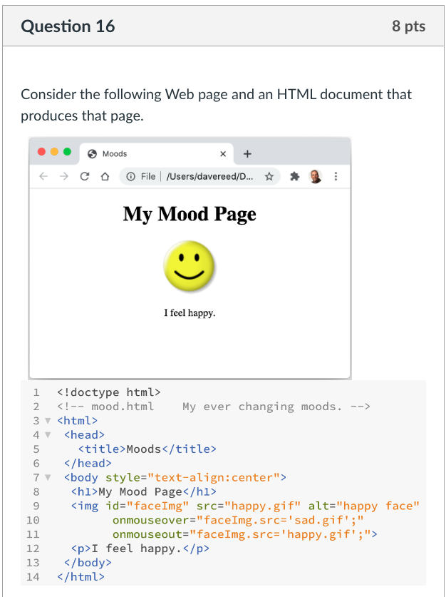
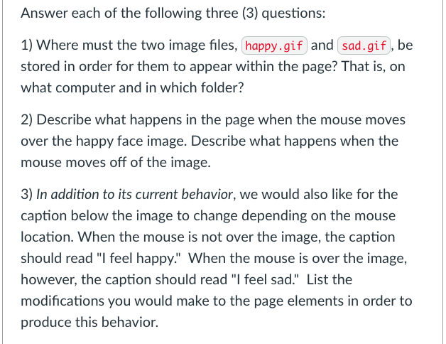
Synthesis/Application:

Slide 10
Advice
Review Sheet (linked from online syllabus)
  provides outline of course by topics
  serves as a good study guide
preparation priorities
  PowerPoints cover the main ideas from the chapters
  review projects and quiz questions
  reread the chapters (especially summaries at end)
    C chapters: look at review questions at end
    X chapters: try some of the exercises
consider a study group & share your understanding
utilize instructor and TA office hours

