Slide 1
Computer Science: Concepts & Explorations David Reed, Creighton University
Test2 Prep

Slide 2
Test2
the test is Tuesday, Apr 8
same format as Test1
60 minutes (2:00-3:00)
will be administered via Blueline, requires Lockdown browser
bring a laptop, make sure Lockdown is installed and working
closed notes, closed book, closed neighbor, …
you MUST take it in-person in your assigned seat (Hixson-Lied 244)
unless you have arranged special accommodations ahead of time
a practice test is available in Blueline
similar types of questions as Test1
factual knowledge: true/false or multiple choice
conceptual understanding: short answer
synthesis & application: describe/modify HTML and/or JavaScript
as before, there will be 2 extra points on the test

Slide 3
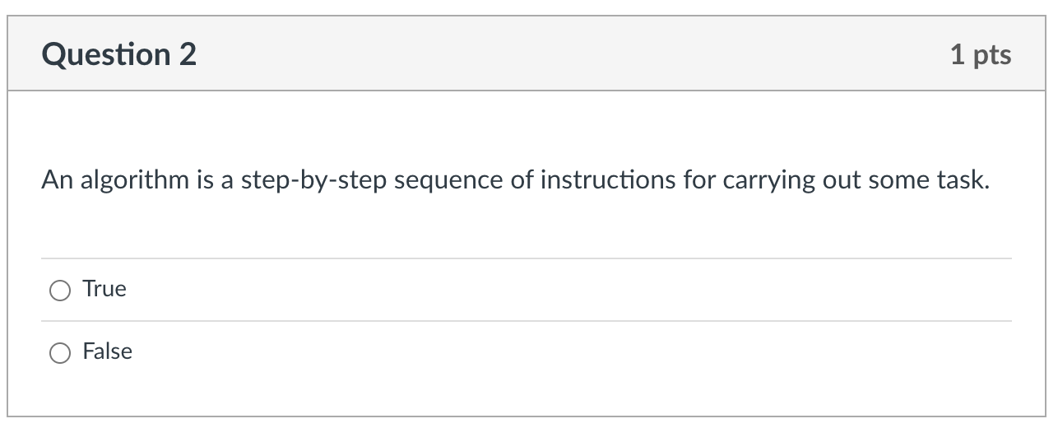
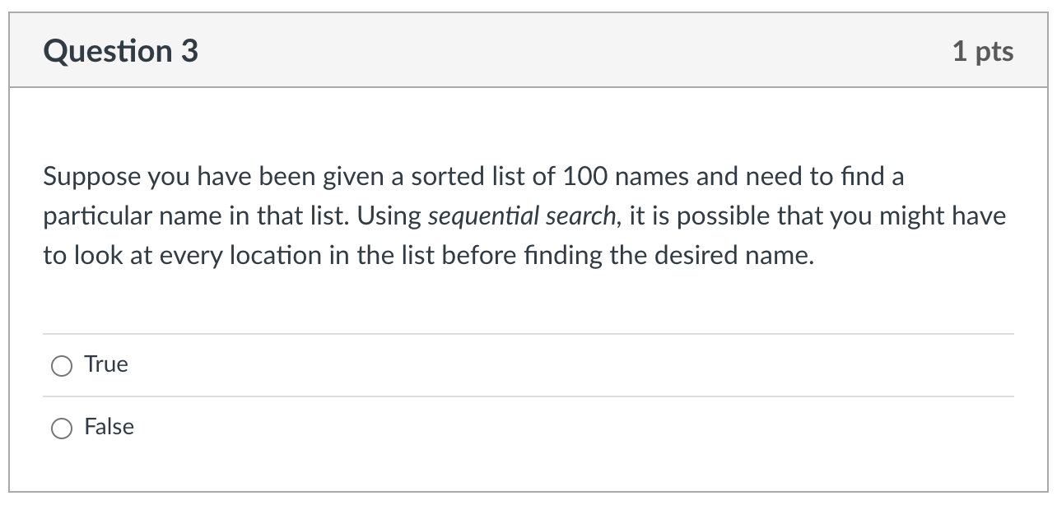
Factual knowledge: T/F

Slide 4
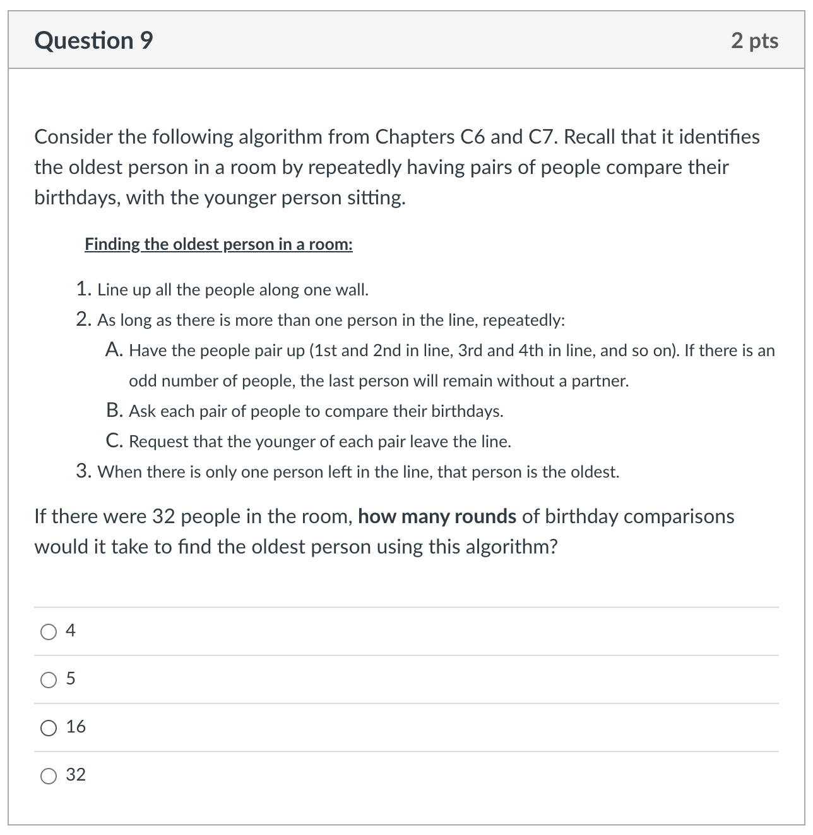
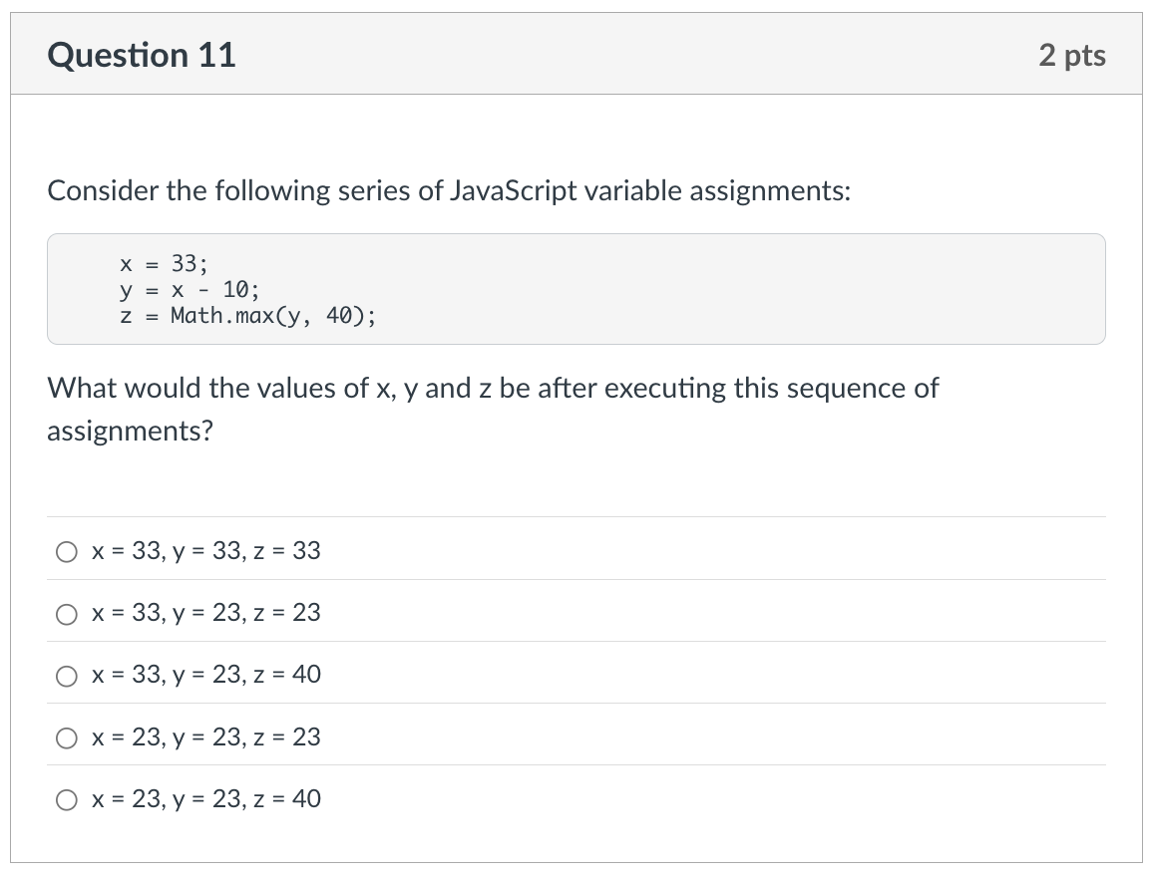
Factual knowledge: MC

Slide 5
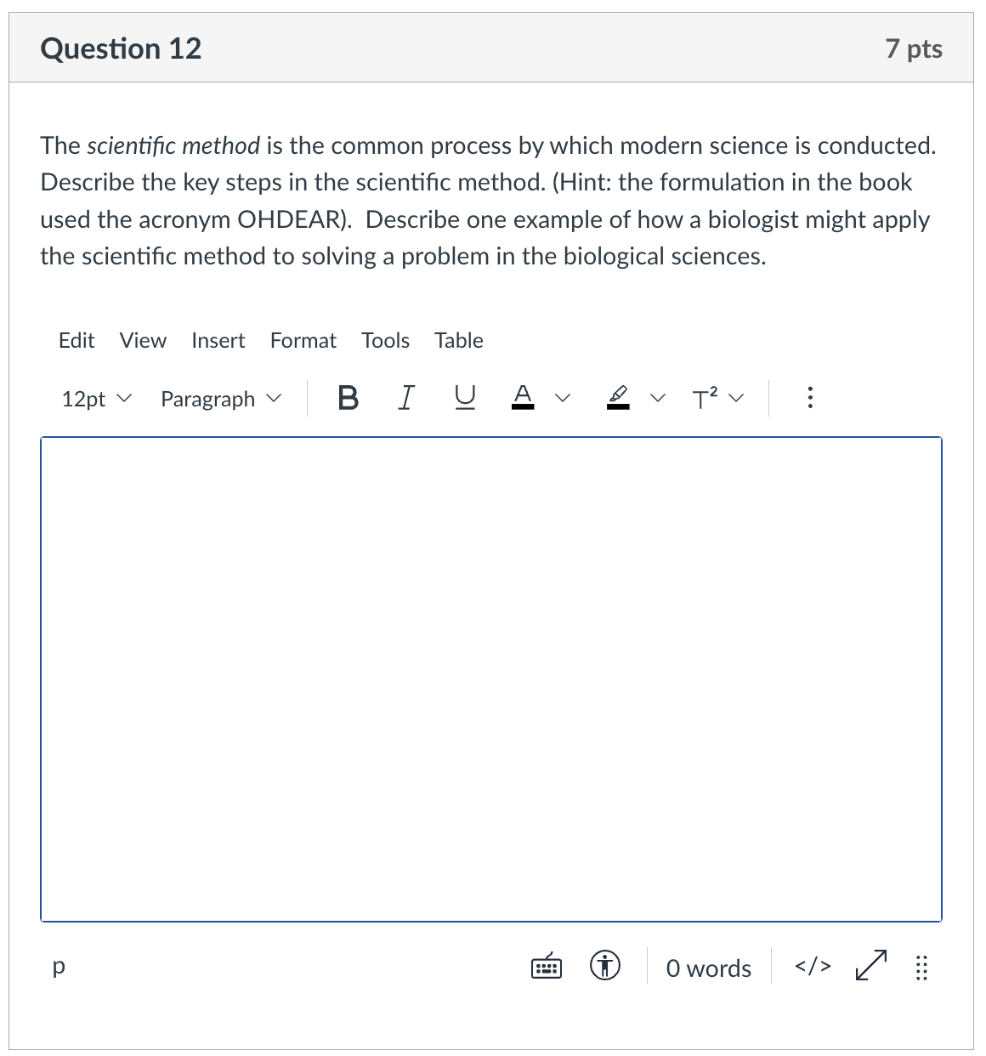
Conceptual Understanding: SA
remember: there is lots of partial credit available
describe each step
describe example
give complete answers, but don't brain dump!

Slide 6
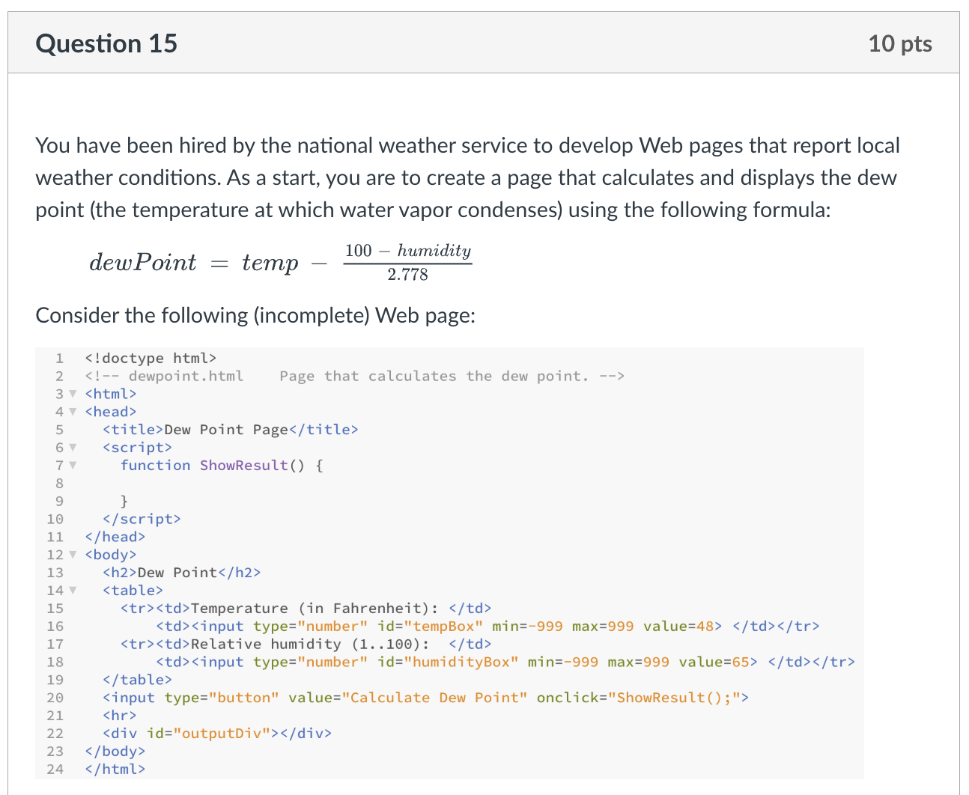
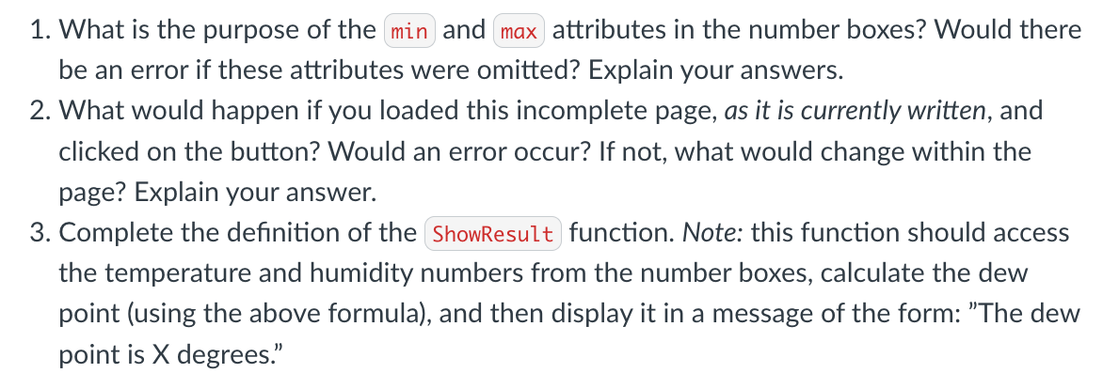
Synthesis/Application:

Slide 7
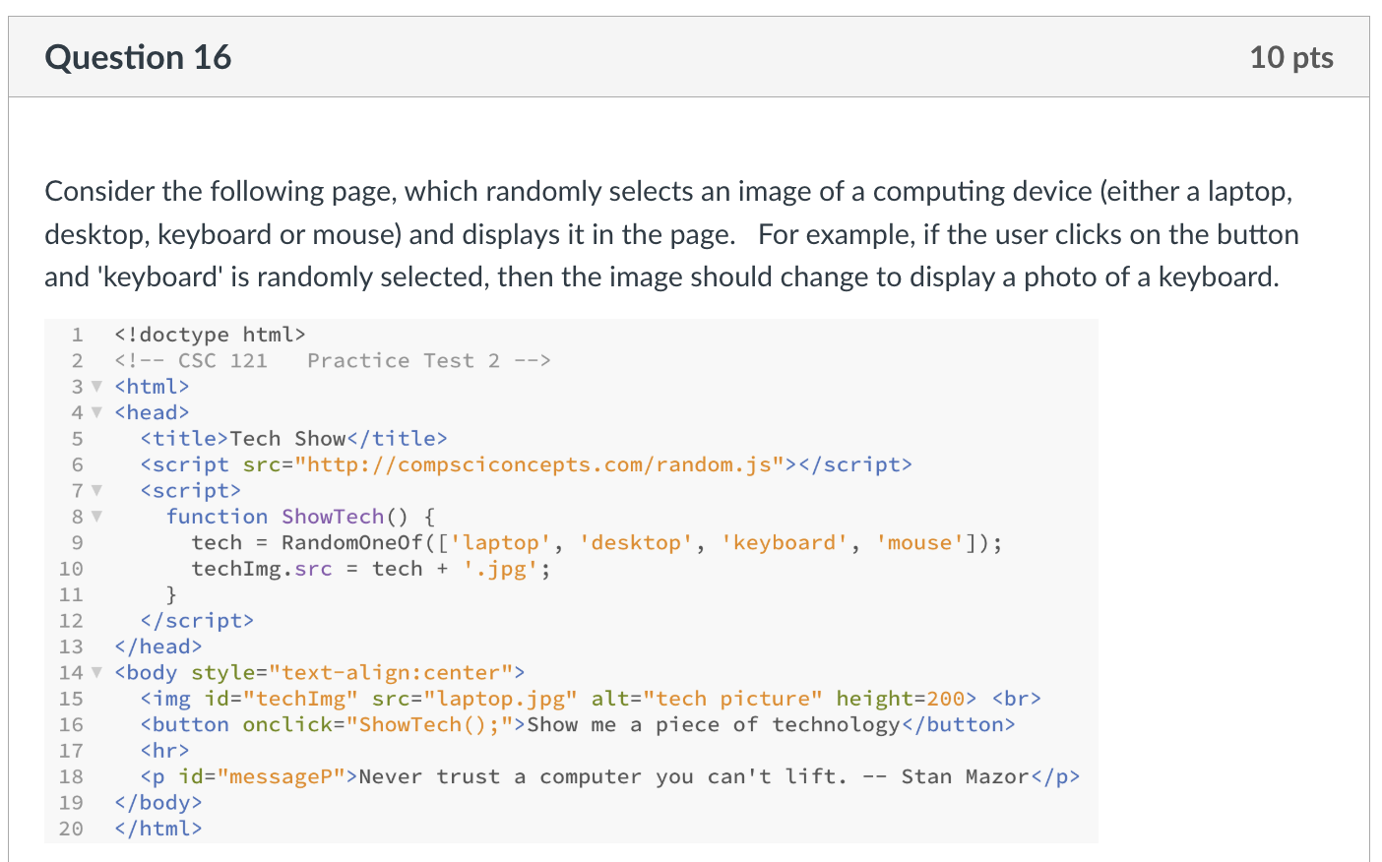
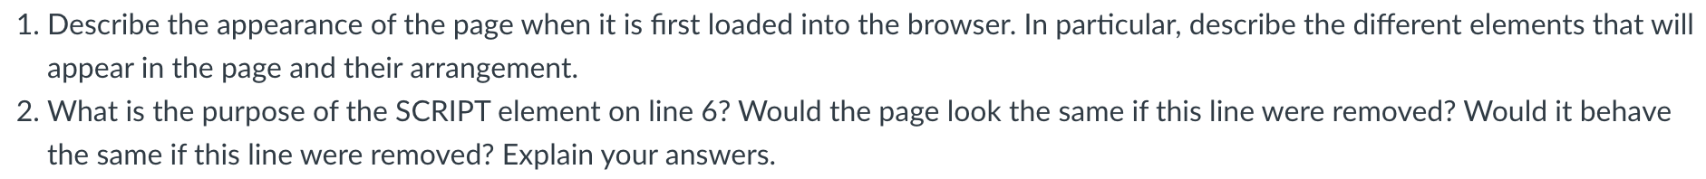
Synthesis/Application:

Slide 8
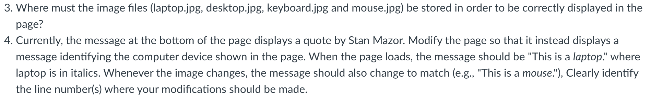
Synthesis/Application:

Slide 9
Advice
Review Sheet (linked from online syllabus)
provides outline of course by topics
serves as a good study guide
preparation priorities
reflect on your Test1 performance
review C5-8, X4-6 material
PowerPoints highlight main ideas & examples
reread chapters as needed for details
summaries at end of chapters are also useful for review
questions from end of chapters are fair game
review projects & labs
Project 4.B (oldmac): text boxes, button, dynamic text
Project 5.A (bits) & 5.C (level): number boxes, function, 3-step pattern
Project 6.B (coin) & 6.C (oracle): functions, random.js library
Lab 2 (Monte Carlo): experimentation, consistency vs. accuracy
Lab 3 (Dino DNA): applications in biology

