Slide 1
CSC 221: Introduction to Programming Fall 2018
Python control statements
counter-driven repetition: for
conditional repetition: while
simulations & modeling
counters, sums
functions vs. methods
Turtle, Pixel, Image
image manipulation

Slide 2
Repetition
an if statement provides for conditional execution
can make a choice between alternatives, choose which (if any to execute)
if we want to repeatedly execute a block of code, need a loop
loops can be counter-driven
e.g., roll a die 10 times
loops can be condition-driven
e.g., roll dice until doubles
the simplest type of Python loop is a counter-driven for loop
for i in range(NUM_REPS):
STATEMENTS_TO_BE_REPEATED

Slide 3
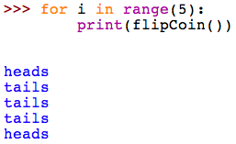
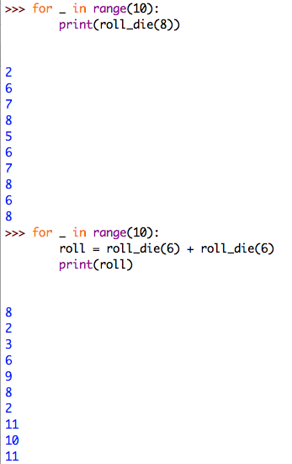
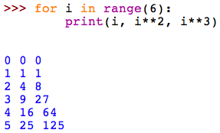
For loop examples

Slide 4
For loops & ranges
technically, a for loop ranges over a sequence of values
the simplest sequences are lists of values in brackets, separated by commas
[0, 1, 2, 3, 4]
["yes", "no", "maybe"]
[True, False]
recall that the range function returns a sequence
e.g., range(5) → [0, 1, 2, 3, 4] range(3, 6) → [3, 4, 5]
for i in range(5): is same as for i in [0, 1, 2, 3, 4]:
print(i) print(i)

Slide 5
Exercise: sum the dice rolls
suppose we wanted to define a function to sum up dice rolls
need to initialize a variable to keep track of the sum (starting at 0)
inside the loop, add each roll to the sum variable
when done with the loop, display the sum
similarly, suppose we wanted to average the dice rolls
calculate the sum, as before
return sum divided by the number of rolls

Slide 6
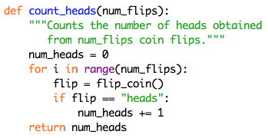
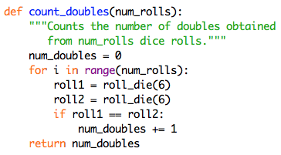
Loops & counters
for loops can be combined with if statements
common pattern: perform multiple repetitions and count the number of times some event occurs
e.g., flip a coin and count the number of heads
e.g., roll dice and count the number of doubles
e.g., traverse an employee database and find all employees making > $100K

Slide 7
Shorthand assignments
a variable that is used to keep track of how many times some event occurs is known as a counter
a counter must be initialized to 0, then incremented each time the event occurs
shorthand notation
number += 1 ⬅➔ number = number + 1
number -= 1 ⬅➔ number = number - 1
other shorthand assignments can be used for updating variables
number += 5 ⬅➔ number = number + 5
number *= 2 ⬅➔ number = number * 2

Slide 8
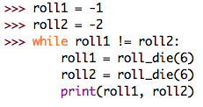
While loops
the other type of repetition in Python is the condition-driven while loop
similar to an if statement, it is controlled by a Boolean test
unlike an if, a while loop repeatedly executes its block of code as long as the test is true
while TEST_CONDITION:
STATEMENTS_TO EXECUTE_AS_LONG_AS_TEST_IS_TRUE

Slide 9
Example: hailstone sequence
interesting problem from mathematics
start a sequence with some positive integer N
if that number is even, the next number in the sequence is N/2;
if that number is odd, the next number in the sequence is 3N+1
5 → 16 → 8 → 4 → 2 → 1 → 4 → 2 → 1 → …
15 → 46 → 23 → 70 → 35 → 106 → 53 → 160 → 80 → 40 → 20 → 10
⬇
… ← 1 ← 2 ← 4 ← 8 ← 16 ← 5
it has been conjectured that no matter what number you start with, you will end up stuck in the 4-2-1 loop
has been shown for all values <= 20 × 2⁵⁸ ≈ 5.764 × 10¹⁸
but has not been proven to hold in general

Slide 10
Generating a hailstone sequence
need to be able to distinguish between even and odd numbers
recall the remainder operator, %
(x % y) evaluates to the remainder after dividing x by y
thus, (x % 2) evaluates to 0 if x is even, 1 if x is odd
EXERCISE: modify so that it also prints the length of the sequence

Slide 11
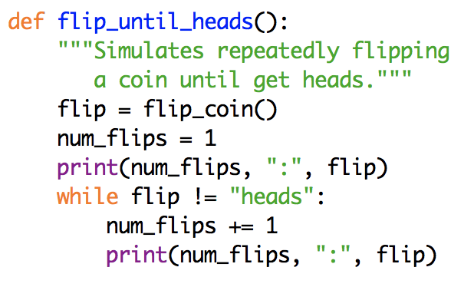
Beware of "black holes"
since while loops repeatedly execute as long as the loop test is true, infinite loops are possible (a.k.a. black hole loops)
PROBLEM?
a necessary condition for loop termination is that some value relevant to the loop test must change inside the loop
in the above example, flip doesn't change inside the loop
if the test succeeds once, it succeeds forever!
is it a sufficient condition? that is, does changing a variable from the loop test guarantee termination?
NO – "With great power comes great responsibility."
fix to above function?

Slide 12
Example: Pig
Pig is a 2-player dice game in which the players take turns rolling a die.
On a given turn, a player rolls until either
he/she rolls a 1, in which case his/her turn is over and no points are awarded, or
he/she chooses to hold, in which case the sum of the rolls from that player's turn are added to his/her score.
The winner of the game is the first player to reach 100 points.
for example:
SCORE = 0 to start
TURN 1: rolls 5, 2, 4, 6, holds → SCORE += 17 → 17
TURN 2: rolls 4, 1, done → SCORE += 0 → 17
TURN 3: rolls 6, 2, 3, hold → SCORE += 11 → 28
…

Slide 13
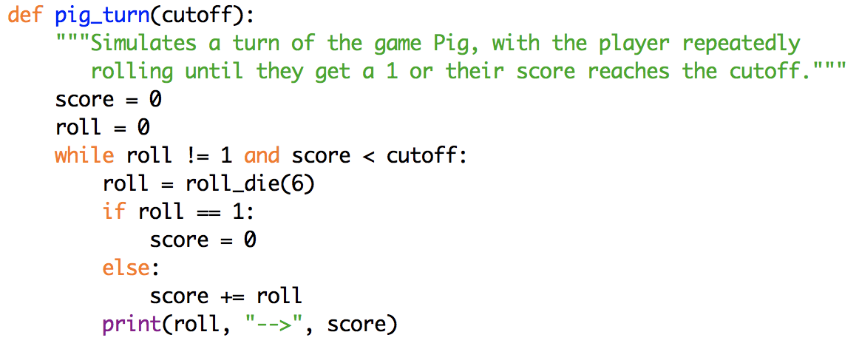
Pig simulation
we want to simulate Pig to determine the best strategy
i.e., determine the optimal cutoff such that you should keep rolling until the score for a round reaches the cutoff, then hold
i.e., what is the optimal cutoff that minimizes the expected number of turns
why is roll set to 0 before the loop? why not set it to roll_die(6)?
EXERCISE: modify the pig_turn function so that it returns the score for the round (as opposed to printing rolls/scores)

Slide 14
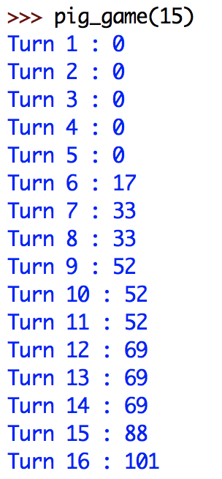
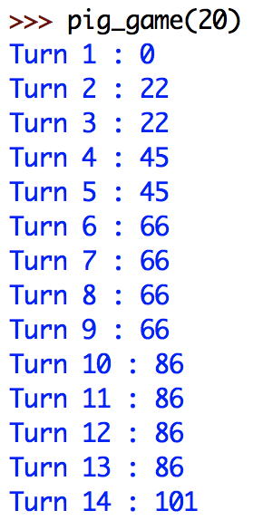
Pig simulation (cont.)
EXERCISE: define a pig_game function that simulates a Pig game
has 1 input, the cutoff value for each turn
it repeatedly calls the pig_turn function, totaling up the score for each turn (and displaying the turn # and updated score)
it stops when the score total reaches 100

Slide 15
Pig simulation (cont.)
what can we conclude from running several experiments?
Simulation 1: a cutoff of 15 yields a game of 16 turns
Simulation 2: a cutoff of 20 yields a game of 14 turns
can we conclude that a cutoff of 20 is better than a cutoff of 15?
note: because of the randomness of the die, there can be wide variability in the simulations
note: a single roll of a die is unpredictable
however: given a large number of die rolls, the distribution of the rolls can be predicted (since each die face is equally likely, each should appear ~ 1/6 of time)
Law of Large Numbers states that as the number of repetitions increases to ∞, the percentages should get closer and closer to the expected values

Slide 16
Pig simulation (cont.)
in order to draw reasonable conclusions, will need to perform many experiments and average the results
EXERCISE: modify the pig_game function so that it returns the number of turns (as opposed to printing turns/scores)
EXERCISE: define a pig_stats function that simulates numerous games
has 2 inputs, the number of games and the cutoff value for each turn
it repeatedly calls the pig_game function the specified number of times, totaling up the number of turns for each game
it returns the average number of turns over all the games
QUESTION: what is the optimal cutoff that minimizes the number of turns
how many games do you need to simulate in order to be confident in your answer?

Slide 17
Control summary
if statements provide for conditional execution
use when you need to make choices in the code
control is based on a Boolean (True/False) test
1-way: if (with no else)
2-way: if-else
multi-way: cascading if-else, if-elif-elif-…-elif-else
for loops provide for counter-driven repetition
use when you need to repeat a task a set number of times
utilizes the range function (or, in rare cases, a specific sequence of values)
while loops provide for conditional repetition
use when you need to repeat a task but you don't know how many times
control is based on a Boolean (True/False) test
as long as test continues to be True, the indented code will be executed
beware of infinite (black hole) loops

Slide 18
Functions vs. methods
typically, you call a function by specifying the name and any inputs in parentheses
int("12") float("34.5") str(300) abs(-4)
if the function is defined in a module, use . to specify the module
math.sqrt(36) random.randint(1, 6)
however, turtles were different
import turtle
alex = turtle.Turtle()
alex.forward(20)
Turtle is a new data type known as a class (more details later)
values of a class are known as objects
each object automatically has functions associated with it
these special functions, called methods, are called by specifying
object.func(. . .)

Slide 19
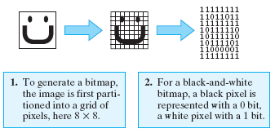
Image representation
the online book provides a pair of classes that are useful for manipulating images: Pixel & Image
first, some background on image representation
images are stored using a variety of formats and compression techniques
the simplest representation is a bitmap
bitmaps partition an image into a grid of picture elements, called pixels, and then convert each pixel into a bit pattern
resolutions refers to the number of pixels per square inch (more pixels → higher resolution → more storage)

Slide 20
Color formats
when creating a bitmap of a color image, more than one bit is required to represent each pixel
the most common system is to translate each pixel into a 24 bit code, known as its RGB value: 8 bits to represent the intensity of each red/green/blue component
common image formats implement various compression techniques to reduce storage size
GIF (Graphics Interchange Format)
a lossless format, meaning no information is lost in the compression
commonly used for precise pictures, such as line drawings
PNG(Portable Network Graphics)
more modern alternative to GIF - more colors, 10-50% more compact
JPEG (Joint Photographic Experts Group)
a lossy format, so the compression is not fully reversible (but more efficient)
commonly used for photographs

Slide 21
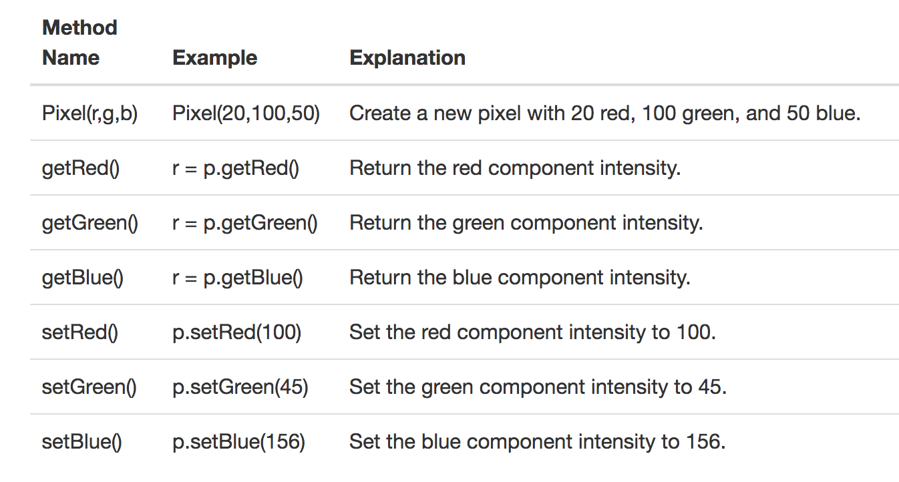
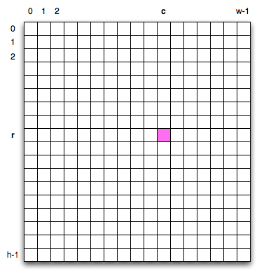
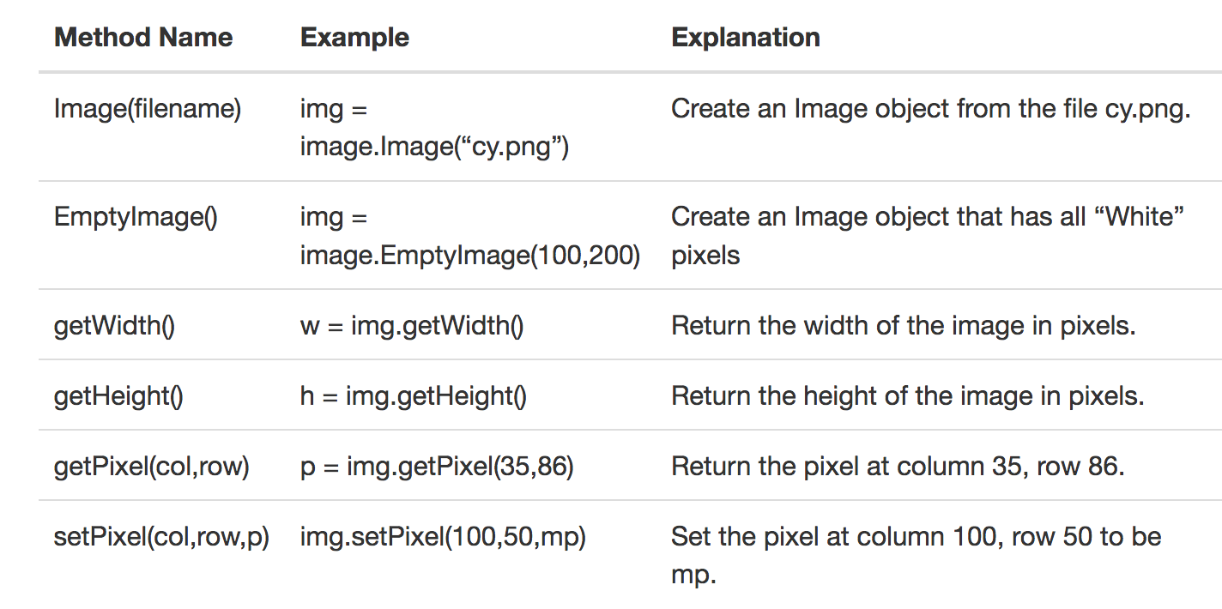
Pixel and Image classes
the author provides classes for representing pixels and images
see chapter 8.10

Slide 22
Simple image access
the interactive book has several images you can choose from
once you create an image, you can…
get its dimensions
get the RGB for a specific pixel

Slide 23
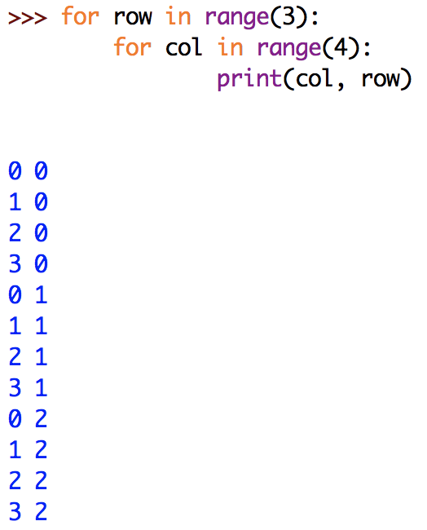
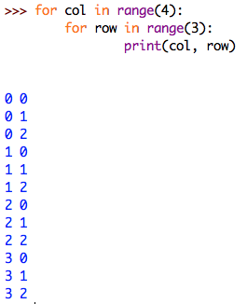
Nested loops
to traverse a 2-dimensional structure (such as an image), need nested loops

Slide 24
Manipulating images
can similarly go through the rows and columns of an image
# of rows is img.getHeight()
# of cols is img.getWidth()
for row in range(img.getHeight()):
for col in range(img.getWidth()):
p = img.getPixel(col, row)
# determine RGB value of newpixel
img.setPixel(col, row, newpixel)

Slide 25
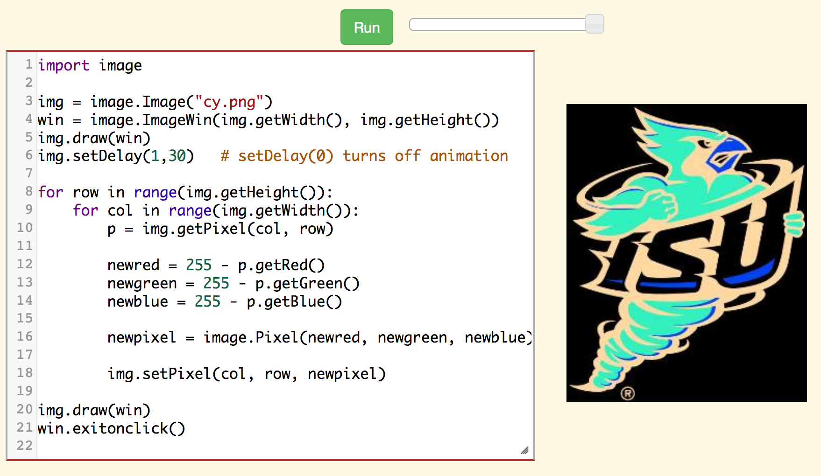
Image negative
to get a photo negative effect, invert each RGB value
e.g., (0, 0, 0) → (255, 255, 255) (100, 0, 100) → (155, 255, 155)

Slide 26
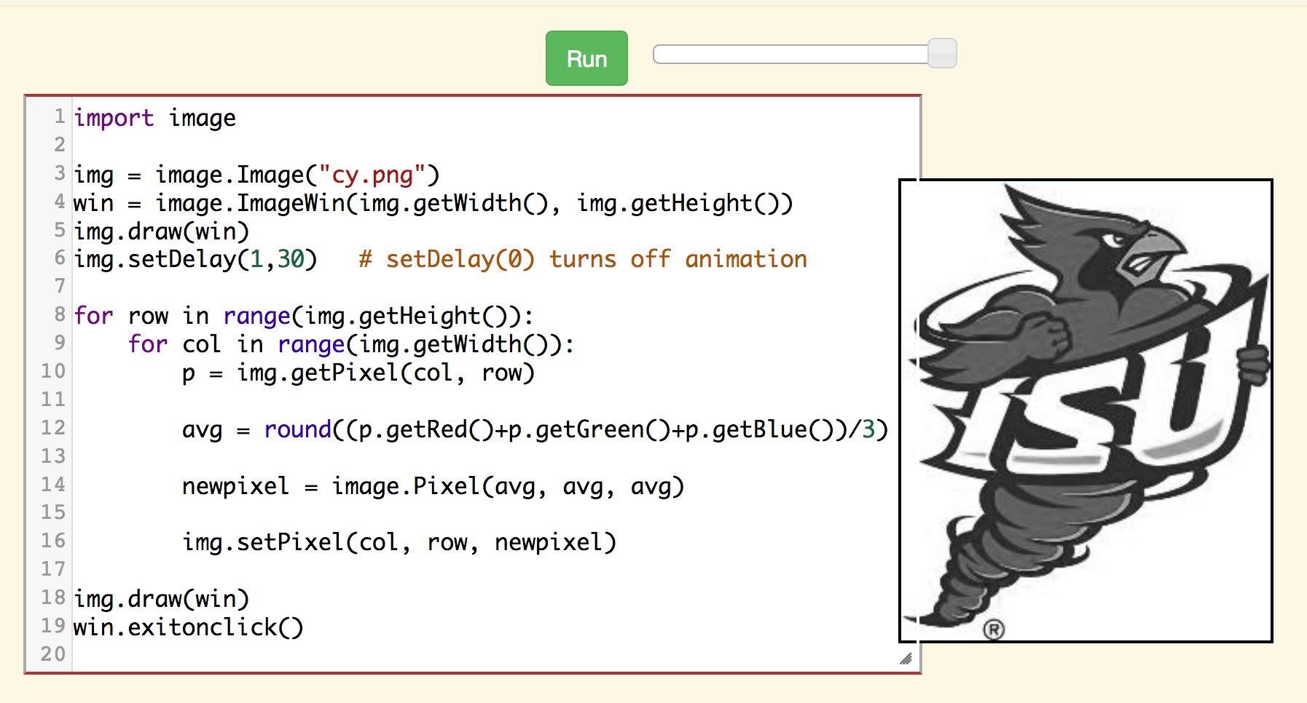
Grayscale
to make an image grayscale, assign each RGB value to the average
e.g., (40, 120, 200) → (120, 120, 120)

Slide 27
Black & white
to make an image black & white, for each pixel:
calculate the average RGB value – same as with grayscale
if avg < 128 → (0,0,0)
if avg >= 128 → (255,255,255)
EXERCISE: modify the code (chapter 10.8, ActiveCode: 4) to convert the image to black & white

Slide 28
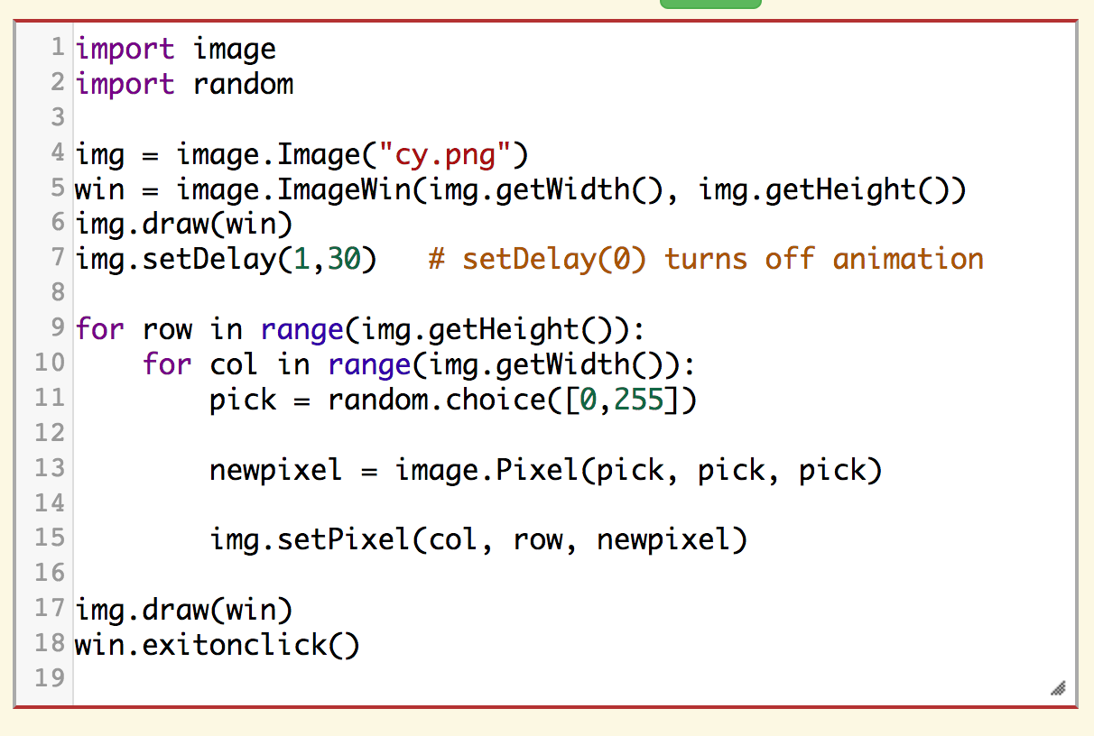
Mystery code
what will the following code do?
note: it does not even look at the original value of each pixel
replaces each pixel with a random black or white

Slide 29
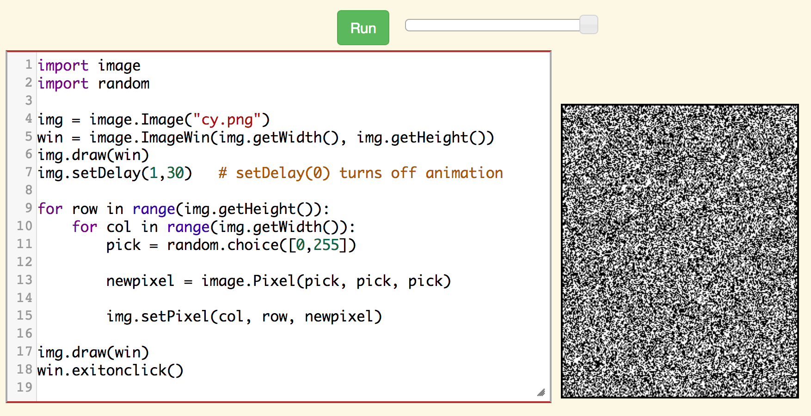
Exercises
modify this code so that it generates a random grayscale image
each pixel is of the form (V,V,V) where 0 $≤$ V ≤ 255
modify this code so that it generates a random color image
each pixel is of the form (R,G,B) where each component 0 ≤ R/G/B ≤ 255

Slide 30
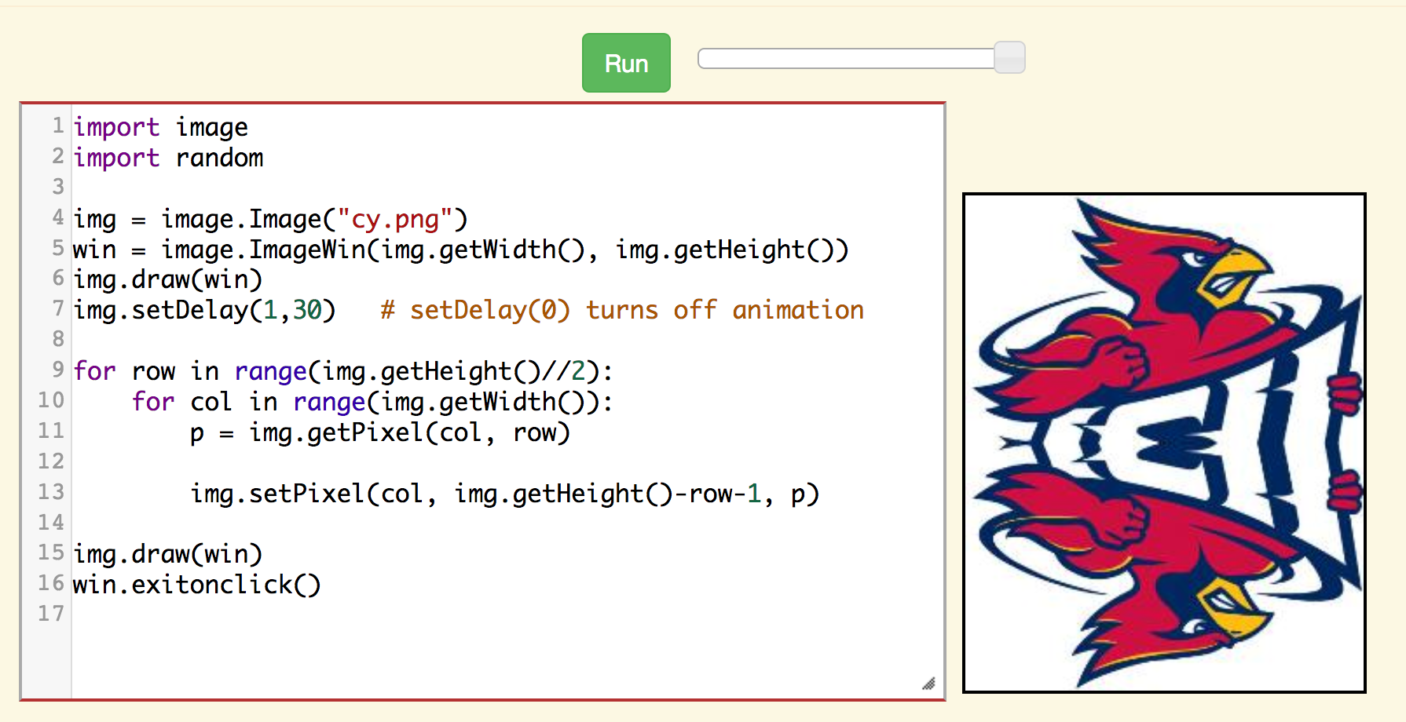
Horizontal reflection
to reflect horizontally, replace every pixel in the bottom half of the image with the corresponding pixel from the top half

Slide 31
Vertical reflection
EXERCISE: modify the code so that it performs a vertical reflection

Slide 32
Double reflection
EXERCISE: modify the code so that it performs a double reflection

