Slide 1
CSC 221: Introduction to Programming Fall 2018
Functions & conditionals
user-defined functions, computational abstraction
parameters, local variables
return statements
function doc strings using """
conditionals
if, if-else, boolean expressions
cascading if-else, elif

Slide 2
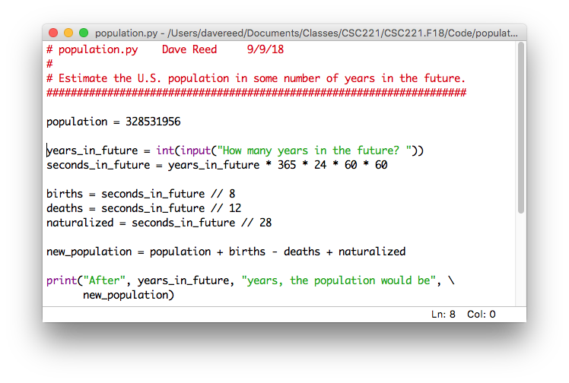
User-defined functions
in addition to built-in and standard module functions, you can organize your code into functions
recall the population growth code
as is, you have to rerun the module each time you want to calculate a new growth estimate
better solution – package the code into a function, then can call that function repeatedly

Slide 3
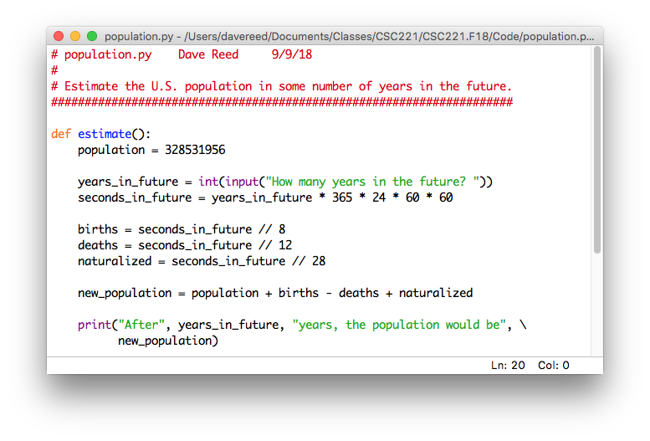
Simple functions
in its simplest form, a Python function is a sequence of statements grouped together into a block
general form: def FUNC_NAME():
SEQUENCE_OF_STATEMENTS
the statements that make up the function block must be indented (consistently)
you can have blank lines inside the function for readability
consecutive blank lines will end the function

Slide 4
Advantages of functions
functions encapsulate a series of statements under a name
once defined, a function can be called over and over without rerunning the module
a python function is analogous to a Scratch script, which combines a sequence of blocks that can be executed as a unit
4

Slide 5
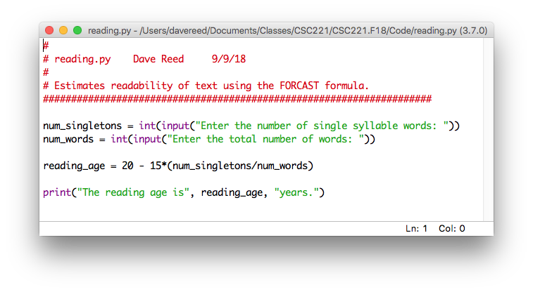
Exercise: FORCAST
convert your FORCAST reading level code into a function
encapsulate the code under a function name, e.g., reading_level
test your function by running the module and then doing multiple reading level calculations
simple functions like these are units of computational abstraction
the function encapsulates a sequence of computations into a single unit
once you know the name you no longer need to remember how it works (i.e., you abstract away the details and focus on the overall effect)
but they don't resemble math functions very closely
no inputs & no explicit output

Slide 6
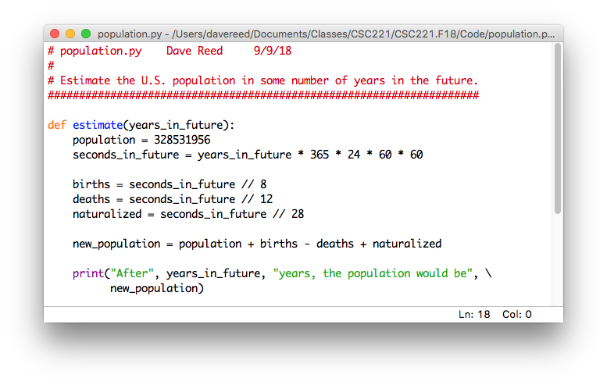
Functions with inputs
to generalize a function so that it can take inputs, must add parameters
a parameter is a variable that appears in the heading of a function definition (inside the parentheses)
when the function is called, you must provide an input value for each parameter
these input values are automatically assigned to the parameter variables

Slide 7
Exercise: parameterizing FORCAST
modify your reading+level function to have two parameters
def reading_level(single_words, total_words):
note that the input values match up with parameters in the order provided
>>> reading_level(104, 380)
prompts vs. inputs?
if your code requires many different input values, then having a function that prompts for each value is often simpler (prompts remind the user of what to enter)
if there are few inputs, then often simpler & quicker to provide them as inputs
avoids the prompts and allows the user to enter the values directly
allows you to determine the inputs some other way (e.g., another function to calculate the input values)

Slide 8
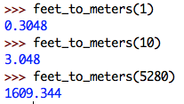
Functions that return values
consider functions that convert distances in Metric & Imperial
a return statement specifies the output value for a function
the reverse conversion could be similarly defined using the 0.3048 factor
or, could make use of the existing feetToMeters function

Slide 9
Print vs. return
when the results are complex, printing is more readable
the population results involve two numbers and description text
much easier to understand than
however, a function that prints its results is limited
the user can view the displayed results, but it cannot be used by other code
if returned, the result can be used in other computations
if the result of a computation is potentially useful for some other computation, then return that result

Slide 10
Exercise: years vs. seconds
define a function that converts a number of years into the corresponding number of seconds
similarly, define a function that does the opposite conversion

Slide 11
Function doc strings
it is considered good programming practice to put a multiline comment at the beginning of every function definition
it should briefly document the purpose of the function
in addition to making it easier to read the code in the editor, the doc string can be viewed in the interpreter shell using the built-in help function

Slide 12
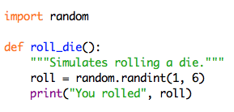
Simulating dice rolls
Consider the following function for simulating the roll of a die
what is good about this code? what is bad?
suppose we wanted to generalize the function so that it works for an N-sided die
suppose we wanted to get the sum of two die rolls

Slide 13
Example: wind chill
suppose we wanted to calculate the wind chill using this formula
would the following return statement suffice?
return 35.74 + 0.6215*temp + 0.4275*temp-35.75 * wind**0.16

Slide 14
Complex expressions
Python has rules that dictate the order in which evaluation takes place
** has higher precedence, followed by * and /, then + and –
meaning that you evaluate the part involving ** first, then * or /, then + or –
1 + 2 * 3 → 1 + (2 * 3) → 1 + 6 → 7
2 ** 10 – 1 → (2**10) – 1 → 1024 – 1 → 1023
if more than one operator, ** evaluates right-to-left, all others evaluate left-to-right
8 / 4 / 2 → (8 / 4) / 2 → 2 / 2 → 1
2 ** 3 ** 2 → 2 ** (3 ** 2) → 2 ** 9 → 512
GOOD ADVICE: don't rely on these (sometimes tricky) rules
place parentheses around sub-expressions to force the desired order
35.74 + 0.6215*temp + (0.4275*temp - 35.75)*(wind**0.16)

Slide 15
Conditional execution
so far, all of the statements in methods have executed unconditionally
when a method is called, the statements in the body are executed in sequence
different parameter values may produce different results, but the steps are the same
many applications require conditional execution
different parameter values may cause different statements to be executed
for example, consider the windChill formula
the formula only applies when wind speed > 3 mph
if wind speed is ≤ 3 mph, wind chill is the same as the temperature
wind chill $=\left\{\begin{aligned}\text{temp} , \text{if} \text{wind}\text{≤3} \\ \text{35.74+0.6215∗}\text{temp}\text{+}\left(\text{0.4275∗}\text{temp}\text{ -35.75}\right)\text{∗}{\text{wind}}^{0.16}, \text{otherwise}\end{aligned}\right.$

Slide 16
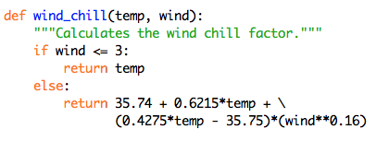
If statements
in Python, an if statement allows for conditional execution
i.e., can choose between 2 alternatives to execute
if TEST_CONDITION:
STATEMENTS_TO_EXECUTE_IF_TEST_IS_TRUE
else:
STATEMENTS_TO_EXECUTE_IF_TEST_IS_FALSE
if the test is true (wind ≤ 3), then this statement is executed
otherwise (wind > 3), then this statement is executed

Slide 17
Boolean operators
standard relational operators are provided for the if test
< less than > greater than
<= less than or equal to >= greater than or equal to
== equal to != not equal to
and or not
a comparison using a relational operator is known as a Boolean expression,
since it evaluates to a Boolean (True or False) value
EXERCISE:
reimplement using randint and an if-else statement
generate a random integer in range [1, 2]
if the number is 1, then return "heads
else, return "tails"

Slide 18
If statements (cont.)
you are not required to have an else case to an if statement
if no else case exists and the test evaluates to false, nothing is done
an if statement (with no else case) is a 1-way conditional
depending on the test condition, either execute the indented code or don't
an if-else statement (with else case) is a 2-way conditional
depending on the test condition, execute one block of indented code or the other

Slide 19
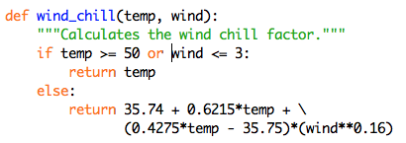
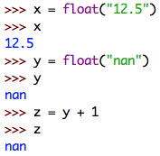
If examples
one more revision: wind chill is not intended for temperatures ≥ 50°
could add a check for temp ≥ 50, then return what? temp?
really want to signify that the value is undefined
the float function will convert a string into its corresponding number
e.g., float("12.5") → 12.5
the expression float("nan") returns a special value, nan, that stands for 'not a number'
whenever nan appears in an expression, the result is still nan

Slide 20
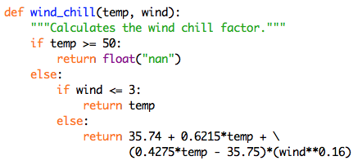
Cascading if-else
now have 3 different cases, so need a 3-way conditional
can accomplish this by nesting if-else statements
known as a cascading if-else (control cascades down from one test to the next)
reminder: Python uses indentation to determine code structure
must make sure to align statements inside the appropriate if-else case

Slide 21
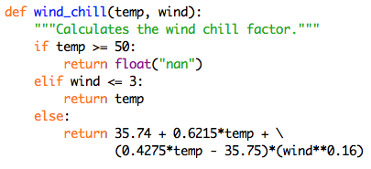
Cascading if-else: elif
because multi-way conditionals are fairly common, a variant exists to simplify the structure
elif is shorthand for else-if
introduces the next case without having to nest

Slide 22
Exercise: letter grades
define a Python function named letter_grade, that takes one input (a course average) and returns the corresponding letter grade
assume grades of "A", "B", "C", "D", and "F" (no + or -)
assume standard grade cutoffs
e.g., letter_grade(90) should return "A"
letter_grade(89) should return "B"
def letter_grade(average):
????

