Slide 1
CSC 221: Introduction to Programming Fall 2018
Text processing
Python strings
indexing & slicing, len function
functions vs. methods
string methods: capitalize, lower, upper, find, remove
string traversal: in, indexing
examples: palindromes, encryption

Slide 2
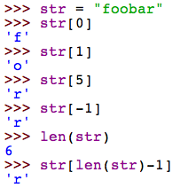
Python strings
so far, we have used Python strings to represent simple pieces of text
displayed messages with a print statement
passed in a name to a function
the + operator concatenates strings, appends them end-to-end
strings are composite values, made of a sequence of individual characters
can access individual characters using an index in brackets
first character is at index 0; can specify negative index to count from end
the built-in len function will return the length (number of chars) in a string
str = "foobar"
char at index 0
char at index 5
char at index 1
char at index 4
char at index 2
char at index 3

Slide 3
Example: glitch
consider the following function
what would be returned by glitch("hello") ?
note: you can multiply strings by an integer, appends that number of copies

Slide 4
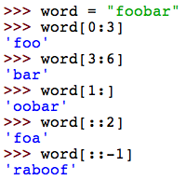
String slicing
can also slice off a substring by specifying two indices
word[low:high] evaluates to the substring, starting at index low and ending at high-1
if you omit either number, it assumes the appropriate end
word[low:high:step] can specify a step distance to skip characters

Slide 5
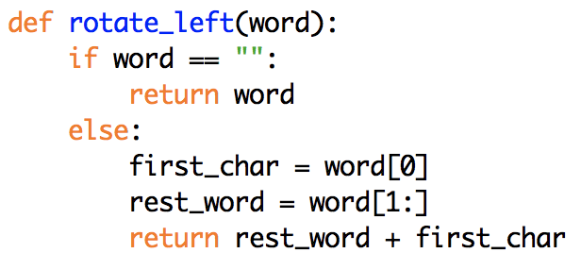
Example: rotating a string
consider the following function for rotating the characters in a string
why do we need to test if word == "" ?
an error occurs if you index a character out of bounds (but slicing ignores out-of-bounds indices)
EXERCISE: define a rotate_right function that rotates the string in the opposite direction

Slide 6
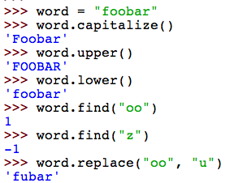
Strings vs. primitives
like Turtles, Pixels and Images, Python strings are objects
an object has its own state (here, a sequence of characters) and methods (functions that manipulate that state)
methods are applied to a particular object and are dependent upon its internal state (e.g., the character sequence in a string object)
OBJECT.METHOD(PARAMETERS)
e.g.,
note: each of these methods returns a value based on the string's state – the string is NOT altered

Slide 7
Common string methods
capitalize( ) Return a copy of the string with only its first character capitalized
lower( ) Return a copy of the string converted to lowercase.
upper( ) Return a copy of the string converted to uppercase.
center(width) Return centered in a string of length width.
rjust(width) Return the string right justified in a string of length width.
strip( ) Return a copy of the string with the leading and trailing whitespace characters removed.
count(sub) Return the number of occurrences of substring sub in string. Can provide two additional inputs, low & high, to limit to [low:high] slice.
find(sub) Return the lowest index in the string where substring sub is found; -1 if not found. Can similarly provide low & high inputs to limit the range.
replace(old, new) Return a copy of the string with all occurrences of substring old replaced by new. Can similarly provide low & high inputs to limit the range.

Slide 8
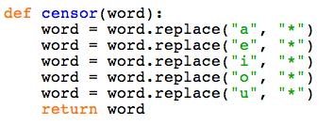
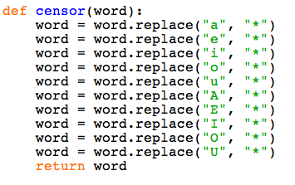
Example: censoring words
what does the following function do?
what if we wanted to censor capital vowels as well?
this is getting tedious!

Slide 9
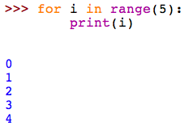
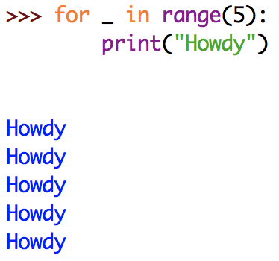
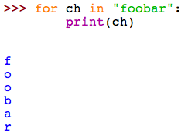
Looping through a string
behind the scenes of a for loop
a for loop works because the built-in range function returns a sequence of numbers
e.g., range(5) → [0,1,2,3,4]
the variable i steps through each number in that sequence – one loop iteration per number
if you don't need to access the varialbe inside the loop, can use _ instead
similarly, can use a for loop to step through the characters in a string

Slide 10
Example: censor revisited
using a for loop, can greatly simplify our censor function
EXERCISE: generalize the censor function so that the letters to be censored are provided as inputs
note: lowercase and uppercase occurrences of the letters should be censored

Slide 11
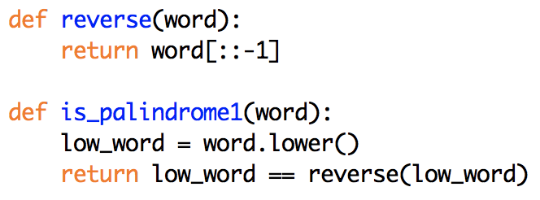
Palindrome
suppose we want to define a method to test whether a word or phrase is a palindrome (i.e., same forwards and backwards, ignoring non-letters)
"bob"
"madam"
"Madam, I'm Adam."
"Able was I ere I saw Elba."
"A man, a plan, a canal: Panama."
if we ignore the non-letters issue, it's fairly straightforward

Slide 12
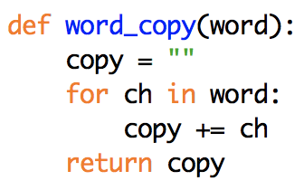
Building up a string
to strip non-letters from a string, could try to
call remove to remove every possible non-letter character
way too many possibilities, most of which won't appear in the string
traverse the string, character by character
for each non-letter encountered, call remove to remove that letter
could work, but inefficient (remove has to search for the char all over again)
better solution: build up a copy of the string, omitting non-letter characters
this simple function copies word, char-by char:
word= "foot"
copy = ""
= "f"
= "fo"
= "foo"
= "foot"

Slide 13
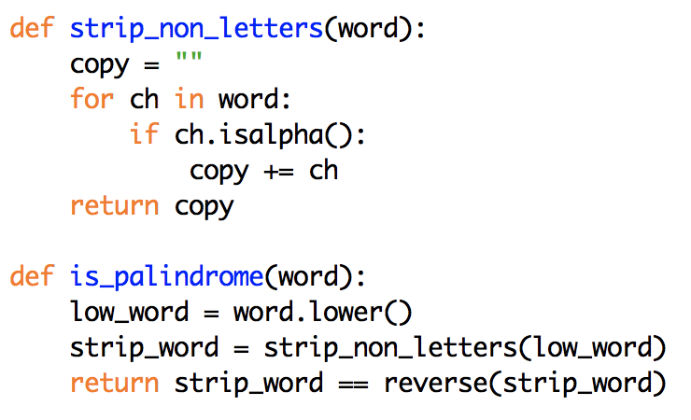
Example: strip_non_letters
to strip non-letters, make the character copying conditional
traverse the string character by character, as in word_copy
check each char to see if it is a letter (using the isalpha method)
if it is, then concatenate it onto the copy; otherwise, ignore it
can then use this in the final version of is_palindrome

Slide 14
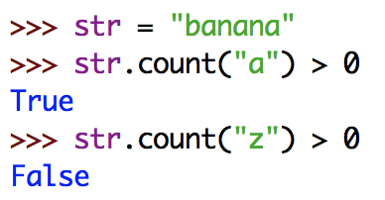
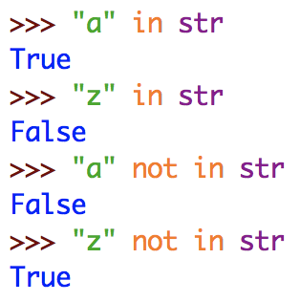
Searching a string
suppose we want to determine if a character or substring appears somewhere in a string
call count or find and test the result
could also use in and not in to test this directly

Slide 15
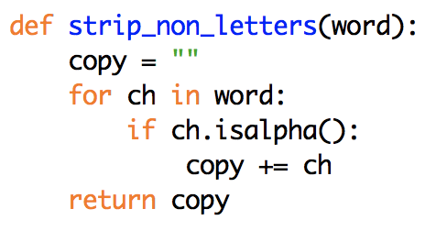
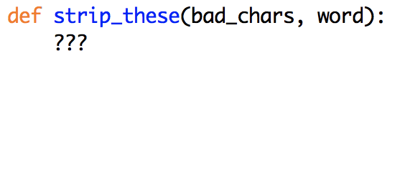
Exercise: generalize the stripping
recall that we generalized the censor function so that you could specify the characters to censor
similarly, generalize the strip_non_letters function so that it has an additional input specifying the characters to strip

Slide 16
Example: Caesar cipher
one of the earliest examples of encryption (secret codes for protecting messages) was the Caesar cipher
used by Julius Caesar in 50-60 B.C. to encrypt military messages
worked by shifting each letter three spots in the alphabet
e.g., ET TU BRUTE → HW WX EUXWH
for each letter in the message:
need to be able to find its position in the alphabet
then find the character three spots later (wrapping around to the front for "XYZ")
there are numerous ways of doing this
simplest: construct a string made up of all the letters in the alphabet,
use the find method to find the index of a char in that string,
use indexing to find the char at (index+3)

Slide 17
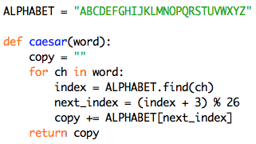
Example: Caesar cipher
for simplicity, we'll assume the message is made of uppercase letters only
ALPHABET is constant, a variable that is assigned once and accessible to all
the convention is to write constant in all-caps
wrap-around is handled using the remainder operator
for the letter "Z", index = 25
nextIndex = (25+3)%26 = 28%26 = 2
so, "Z" → "C"

Slide 18
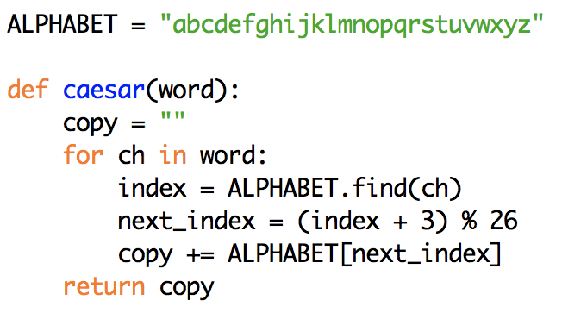
Exercise: Caesar update
enter the definition of the caesar function and try it out on different strings
what would happen if we changed the alphabet?
e.g., the the Classical Roman alphabet did not have the letters 'J', 'U', or 'W'
if we removed those letters from the ALPHABET string, would the function still work?

Slide 19
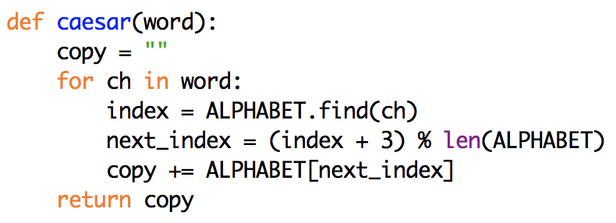
Avoiding dependencies in code
the problem here is that calculation of next_index is dependent on the ALPHABET length (using the % operator)
if we change the ALPHABET string, we also have to change this number
as a general rule in programming, we want to avoid these kinds of dependencies
when possible, write code so that a single change is propagated everywhere

Slide 20
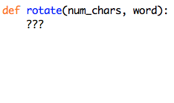
Exercise: generalized rotation cipher
generalize the Caesar cipher so that it can be used to perform any rotation
including negative rotations, which could be used to decode messages
rotate(3, str) → encode using Caesar cipher
rotate(-3, str) → decode using Caesar cipher
rotate(13, str) → encode/decode using rot13 (used in many online forums)

Slide 21
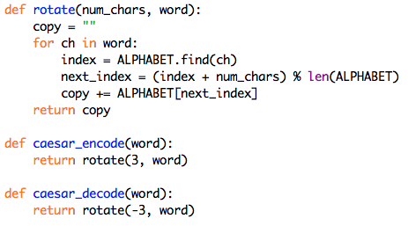
Caesar revisited
once we have the generalized rotation cipher function
we could use it to perform a Caesar cipher encodings/decodings

