Slide 1
CSC 221: Introduction to Programming Fall 2023
Conditionals
if statement
Boolean operators & expressions
for loop variable
if vs. if-else
logical connectives
cascading if-else, elif

Slide 2
Conditional execution
so far, all of the statements in methods have executed unconditionally
when code is executed, the statements are executed in sequence
different input values may produce different results, but the steps are the same
many applications require conditional execution
different input values may cause different statements to be executed
for example, consider the formula for calculating the wind chill factor
the formula only applies when wind speed > 3 mph
if wind speed is ≤ 3 mph, wind chill is the same as the temperature
wind chill $=\left\{\begin{aligned}\text{temp} , \text{if} \text{wind}\text{≤3} \\ \text{35.74+0.6215∗}\text{temp}\text{+}\left(\text{0.4275∗}\text{temp}\text{ −35.75}\right)\text{∗}{\text{wind}}^{0.16}, \text{otherwise}\end{aligned}\right.$

Slide 3
If statements
in Python, an if statement allows for conditional execution
i.e., can choose between 2 alternatives to execute
if TEST_CONDITION:
STATEMENTS_TO_EXECUTE_IF_TEST_IS_TRUE
else:
STATEMENTS_TO_EXECUTE_IF_TEST_IS_FALSE
if the test is true (wind ≤ 3 mph), then the temp is returned
otherwise (wind > 3 mph), then wind chill is calculated & returned

Slide 4
Boolean operators
standard relational operators are provided for the if test
< less than > greater than
<= less than or equal to >= greater than or equal to
== equal to != not equal to
a comparison using a relational operator is known as a Boolean expression,
since it evaluates to a Boolean (True or False) value – named after George Boole
if num >= 0:
print("positive")
else:
print("negative")
if grade < 60:
status = "failing"
else:
status = "passing"
if a == b:
print("same")
else:
print("different")
if num < 0:
print("negative")
else:
print("positive")
if grade >= 60:
status = "passing"
else:
status = "failing"
if a != b:
print("different")
else:
print("same")

Slide 5
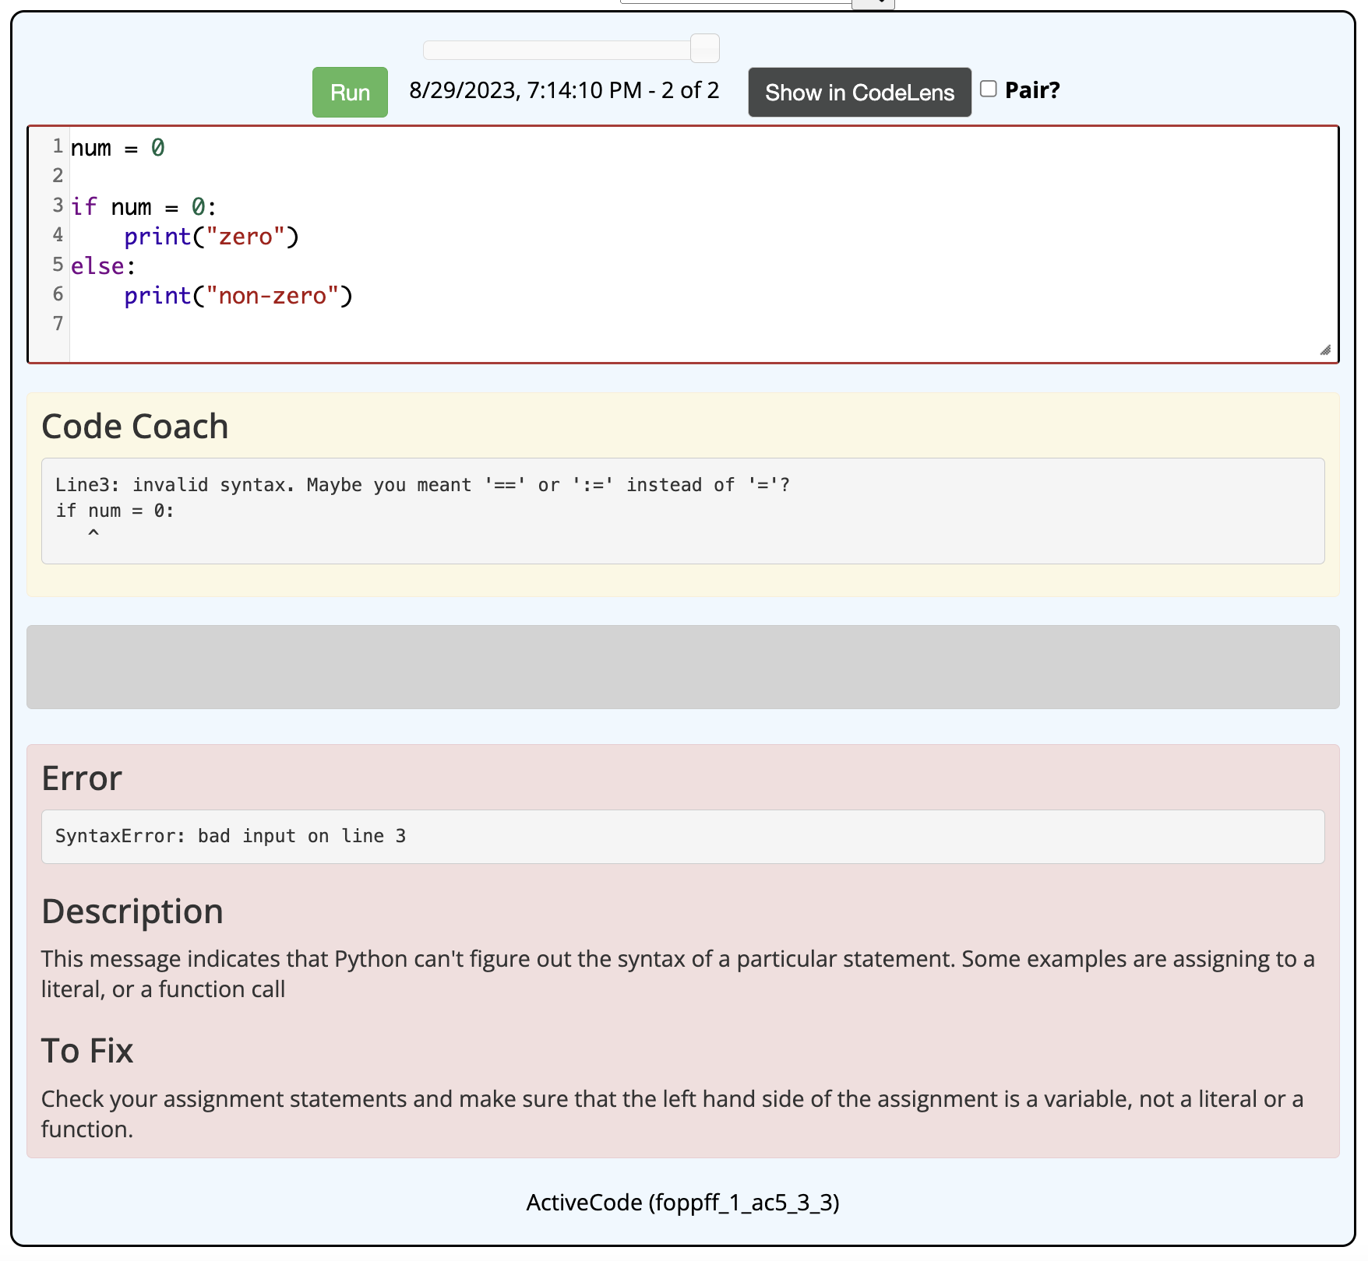
Careful!
= is the assignment operator
== is the comparison operator (equality)
a common error is to type = when you mean ==
this is a syntax error that will be caught by the interpreter

Slide 6
Conditional turtles
consider the following function for drawing a polygon
Which are legal?
>>> polygon()
>>> polygon(6)
>>> polygon(5, 100)
suppose we wanted to change the colors of the sides, alternating blue & red
if even numbered side, display in blue; if odd numbered side, display in red
how could we keep track of the side number?

Slide 7
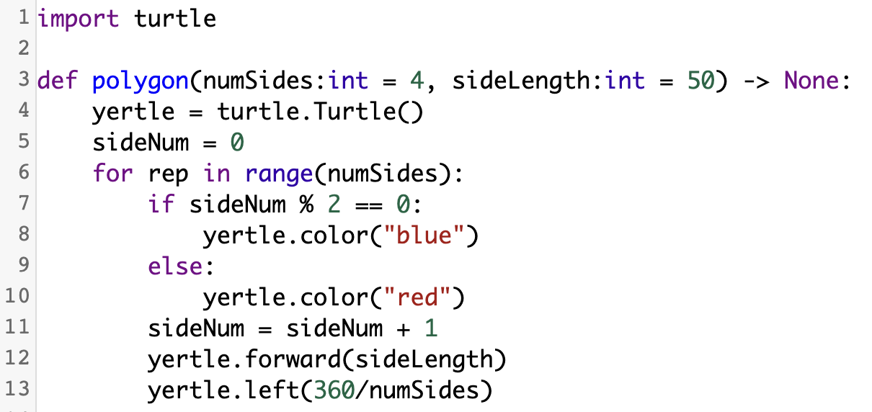
Colorful polygons (v. 1)
we could add a variable to keep track of the side number
initialize it to be 0 (computer scientists often start counting at 0)
then, as each side is drawn, change the pen color based on even/odd number and add one to the side number
what would happen if we forgot to initialize sideNum?
what would happen if we forgot to increment sideNum?

Slide 8
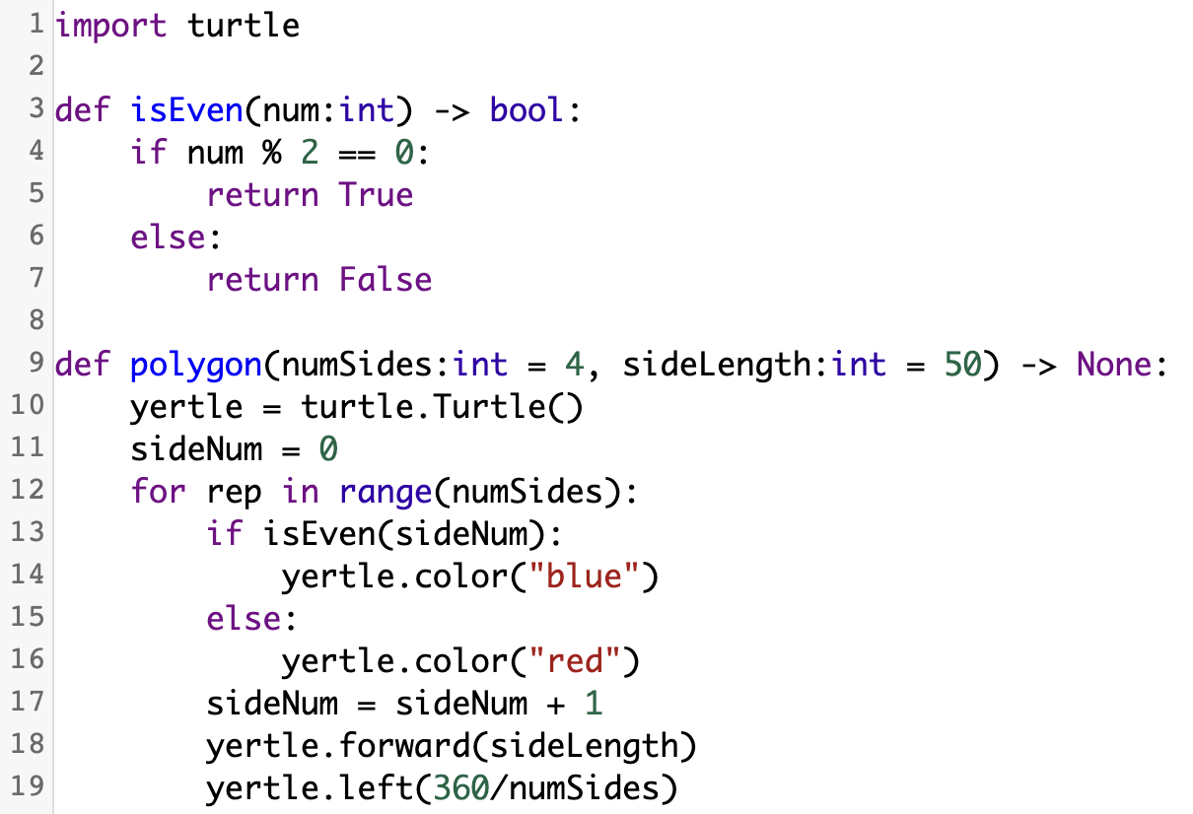
Colorful polygons (v. 2)
to be more transparent, we could define a function to determine even/odd

Slide 9
Simplifying returns
note: any time you have an if-else of this form:
if TEST:
return True
else:
return False
you can simplify do this:
return TEST
WHY?

Slide 10
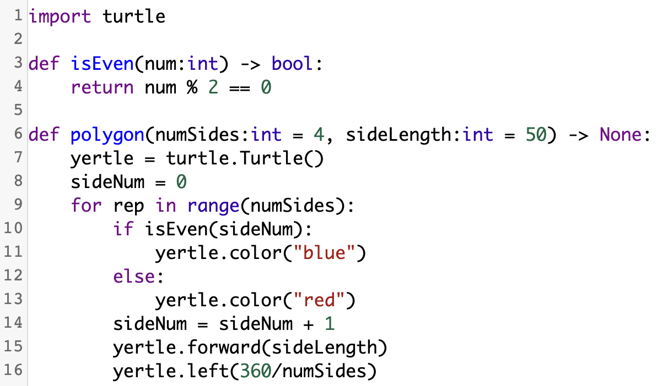
Colorful polygons (v. 3)
here, we can simplify the isEven function to avoid the if-else
in general, not overly concerned with low-level optimizations such as this

Slide 11
For loop variable
it turns out, we don’t need to keep track of the side number
instead, we can access the loop variable
for rep in range(N):
DO_SOMETHING
the 1st time through the loop, rep=0
the 2nd time through the loop, rep=1
the 3rd time through the loop, rep=2
. . .
the N^{th} time through the loop, rep=N-1
what output would each of the following produce?
for rep in range(4):
print(rep)
sum = 0
for rep in range(10):
sum = sum + (rep+1)
print(sum)
for rep in range(4):
print(rep+1)

Slide 12
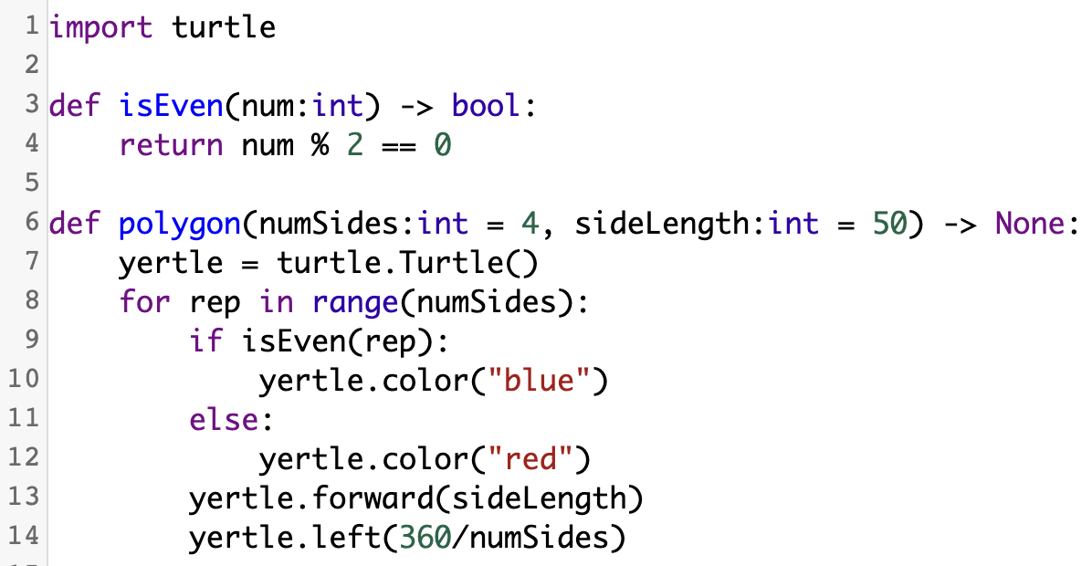
Colorful polygons (v. 4)
so, we could just use rep instead of sideNum
is automatically initialized and updated as part of the for loop

Slide 13
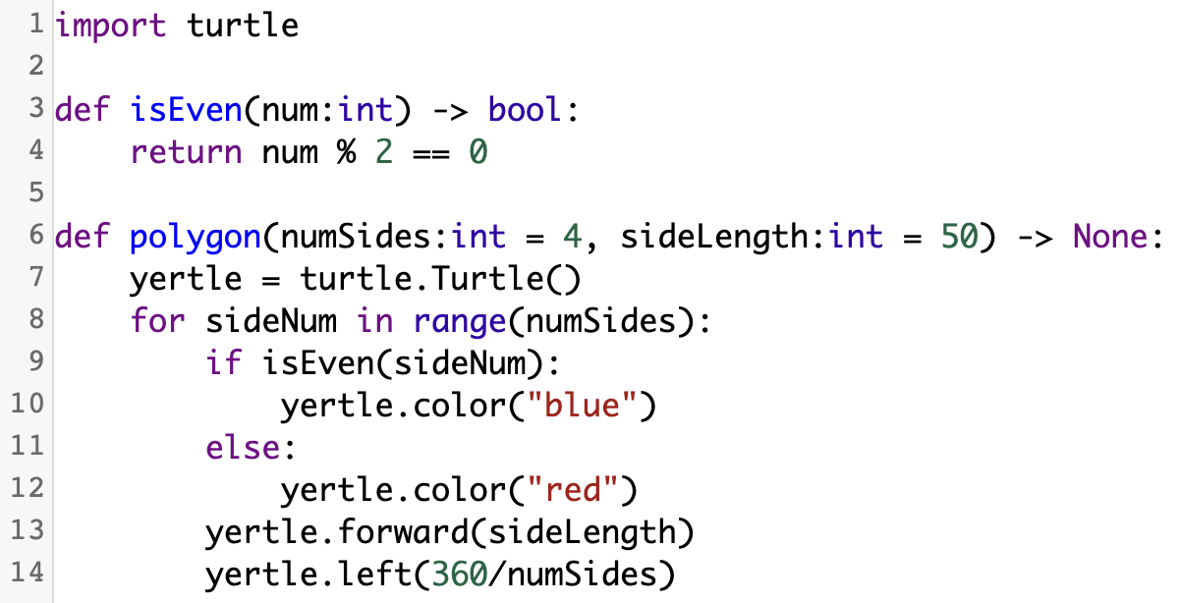
Colorful polygons (v. 5)
the loop variable does not need to be named rep
we have used rep as a generic name, identifying the repetition count
if a more specific name makes sense, use it

Slide 14
Coin flips revisited
recall the function (from casino.py) that simulates a coin flip
EXERCISE: reimplement this function using randint, i.e.,
generate a random integer in range [1, 2]
if the number is 1, then return side1
else, return side2

Slide 15
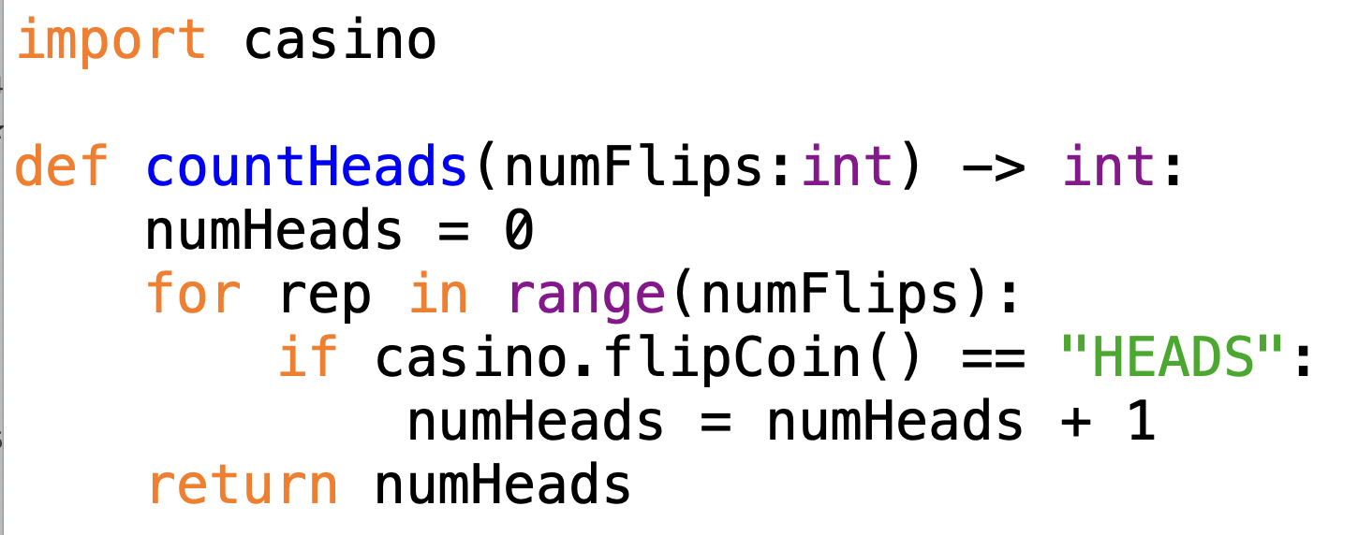
if vs. if-else
you are not required to have an else case to an if statement
if no else case exists and the test evaluates to False, nothing is done
suppose we wanted to simulate coin flips & keep track of the # of HEADS
initialize a variable to 0
repeatedly simulate a coin flip, if HEADS then add to the count
don’t need to keep track of TAILS, so no else case needed
EXERCISE: define a similar function that simulates dice rolls and keeps track of # of doubles

Slide 16
if vs. if-else (cont.)
another example:
want to add bonus points to grades, but grades can't exceed 100
an if statement (with no else case) is a 1-way conditional
depending on the test condition, either execute the indented code or don't
an if-else statement (with else case) is a 2-way conditional
depending on the test condition, execute one block of indented code or the other

Slide 17
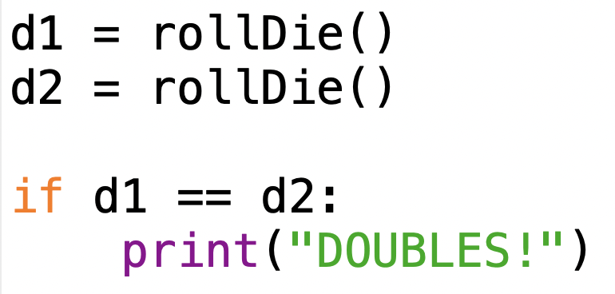
More complex tests
if we roll two dice, testing for doubles is fairly simple:
however, testing for double fours is not so simple
will the following work?
no, because it would say that 5 & 3 is double fours!
we need to test for multiple conditions: d1 is 4 AND s2 is 4

Slide 18
Logical connectives
in addition to the comparison operators, Python provides operators for combining simple tests
TEST1 and TEST2 → True IF TEST1 is True AND TEST2 is True
TEST1 or TEST2 → True IF TEST1 is True OR TEST2 is True
not TEST1 → True IF TEST1 is False

Slide 19
Short-circuit evaluation
the Python interpreter is smart when it evaluates and/or expressions
True or X → is True regardless of X
False and Y → is False regardless of Y
expressions involving and/or are evaluated left-to-right
if 1st value makes the 2nd irrelevant (as shown above), it stops evaluating
when writing an expression using and/or, be sure each side is a complete Boolean expression
roll == 3 or 4 → INVALID
roll == 3 or roll == 4 → VALID

Slide 20
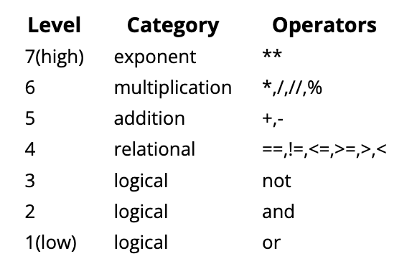
Operator precedence
the logical connectives have lower precedence than other operators
roll == 3 or roll == 4 → (roll == 3) or (roll == 4)
num >= 0 and 2*num < 100 → (num >= 0) and ((2*num) < 100))
not True or False → (not True) or False
ADVICE: use parentheses if there is any chance of confusion

Slide 21
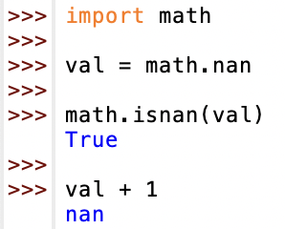
Wind chill revisited
one more revision: wind chill is not intended for temperatures ≥ 50°
could add a check for temp ≥ 50, then return what? temp?
really want to signify that the value is undefined
recall the math.nan constant, which represents not-a-number
we could use that here to denote that wind chill is not defined when temp ≥ 50
note that applying any math operations to math.nan just produces math.nan

Slide 22
Nested if-else
now have 3 different cases, so need to break one case into two
an if statement can be embedded inside another if-else case
temp >= 50
case
temp < 50 case
reminder: Python uses indentation to determine code structure
must make sure to align statements inside the appropriate if-else case

Slide 23
Cascading if-else
because of indentation, nested if-else statements can get messy
an alternative known as a cascading if-else tends to be much cleaner
add an arbitrary number of elif (else-if) cases to encode as many options as needed
called a cascading if-else because control cascades down from one case to the next (also called chained if-else)
if a test fails, try the next one
if a test succeeds, execute its statement(s) and exit the cascading if-else

Slide 24
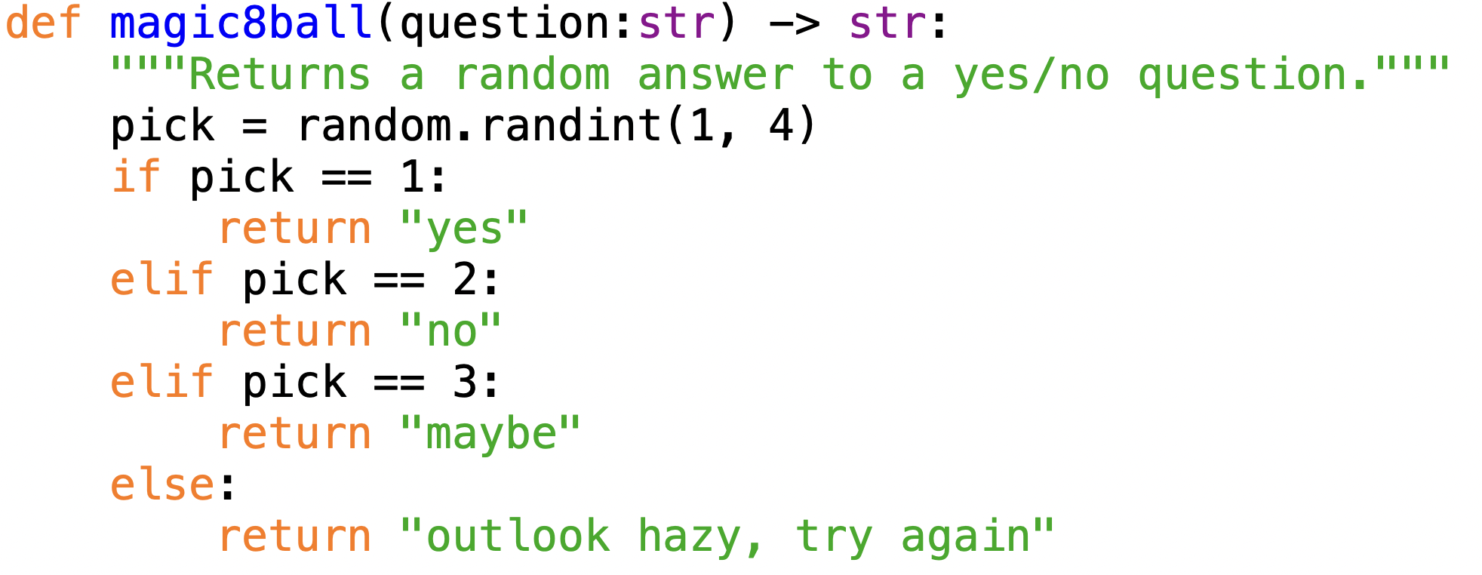
Multi-way conditionals
cascading if-else allows for an arbitrary number of cases

Slide 25
Exercise: letter grades
consider the rather basic function for determining a letter grade
modify so that it can assign assign "A", "B", "C", "D", or "F", assuming standard grade cutoffs (no + or -)
e.g., letterGrade(80) should return "B"
letterGrade(79) should return "C"

