Slide 1
CSC 221: Introduction to Programming Fall 2023
Functions
modules: math, random, turtle
sneak peek: for loops
user-defined functions, computational abstraction
parameters, local variables
return statements
function doc strings using """

Slide 2
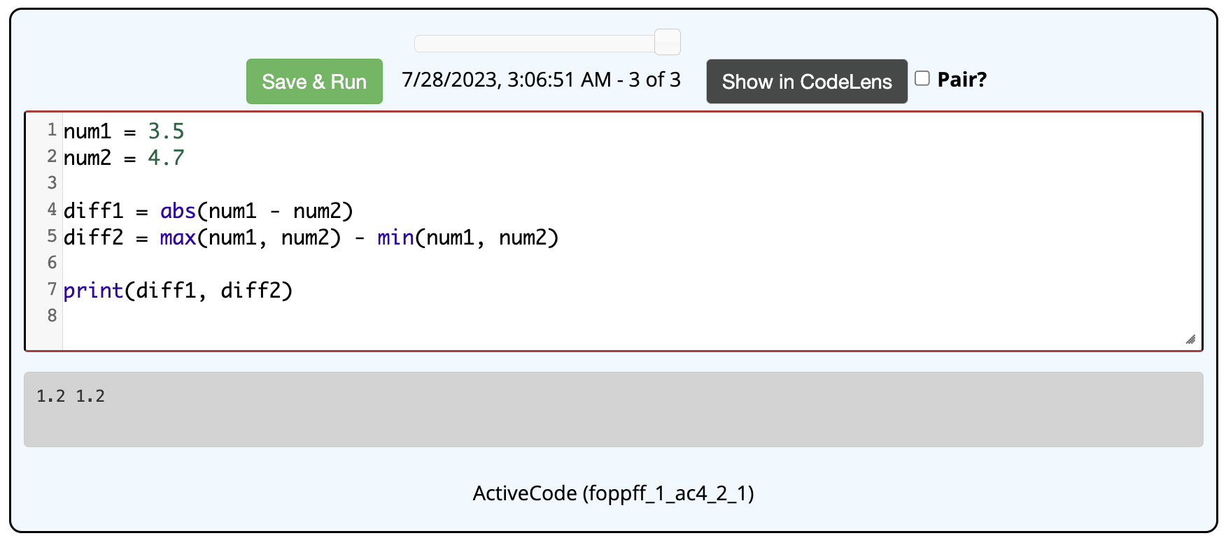
Built-in functions
recall: Python provides many built-in functions
mathematically, a function is a mapping from some number of inputs to an output
note that these functions do not print the output, they return it
that is, a function call can appear in an expression, its value is the output value

Slide 3
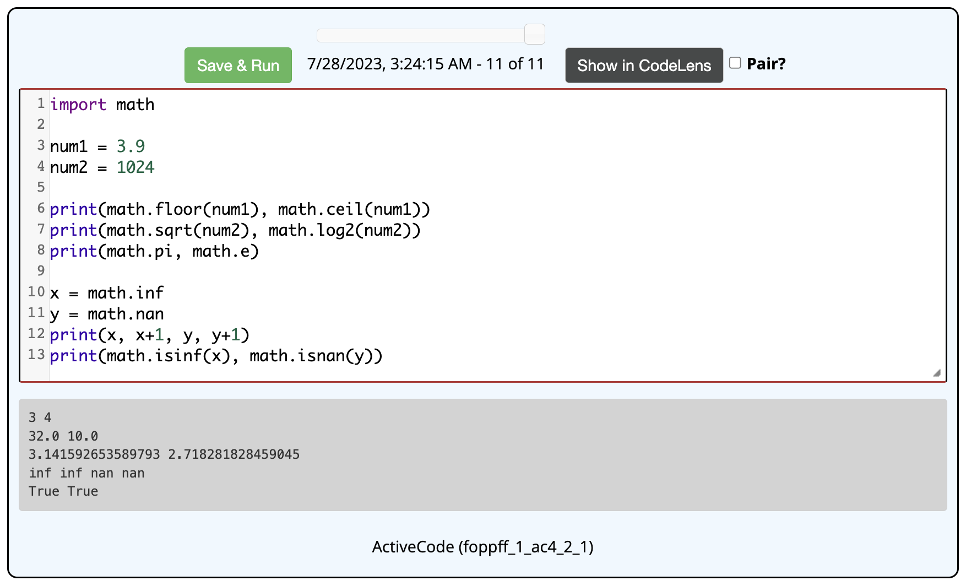
Modules
in addition to these basic functions, Python provides special-purpose functions packaged into modules
e.g., the math module contains math functions and constants
you load a module using import
can then call functions from the module as MODULE.FUNC(…)
math.inf and math.nan are useful constants for representing infinity and not-a-number

Slide 4
Why the prefix?
the round function does not have a prefix: round(3.2)
but the sqrt function does: math.sqrt(9)
it is possible (and often useful) to import multiple modules in a program
math module has a floor function that rounds down
suppose a construction module has a floor function for suggesting flooring materials
the module prefix is required to clearly identify which function is intended
note that this is not an issue for the built-in functions (e.g., round, type) since those are reserved words and can't be redefined in a module

Slide 5
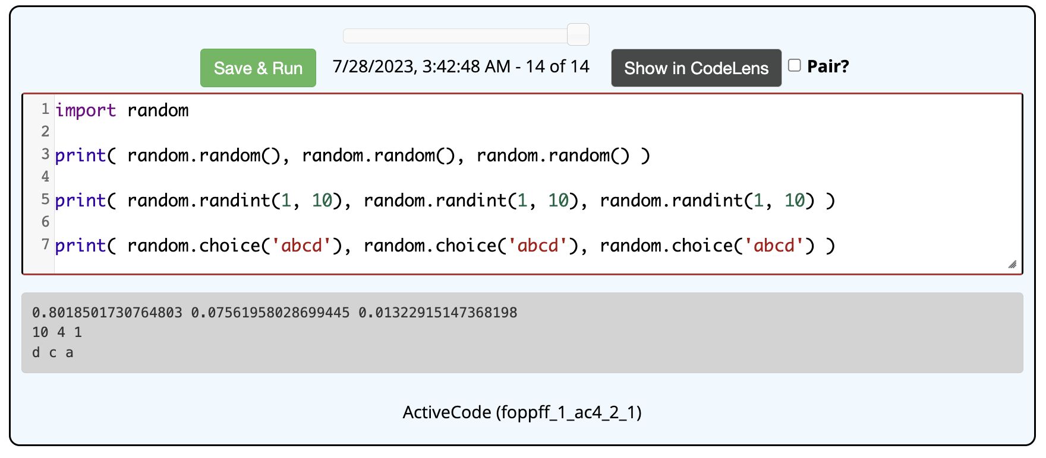
random module
the random module contains functions for generating random values
random.random() returns a random number from the range [0, 1)
random.randint(LOW, HIGH) returns a random int from the range [LOW, HIGH]
random.choice(S) returns a random char from the string S

Slide 6
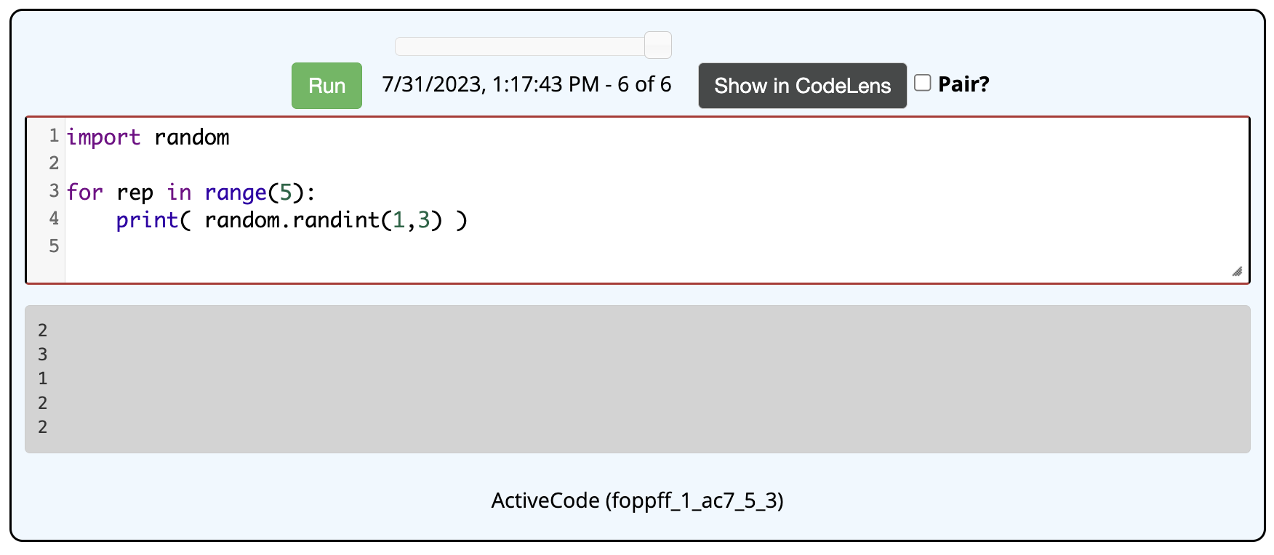
Sneak peek: for loop
if we want to try out the random functions, may want to make many calls
instead of copy-pasting each call, we can use a for loop
for VAR in range(N):
STATEMENT(S)
will execute the indented statement(s) N times in succession
BE CAREFUL: the statement(s) controlled by the loop MUST be indented

Slide 7
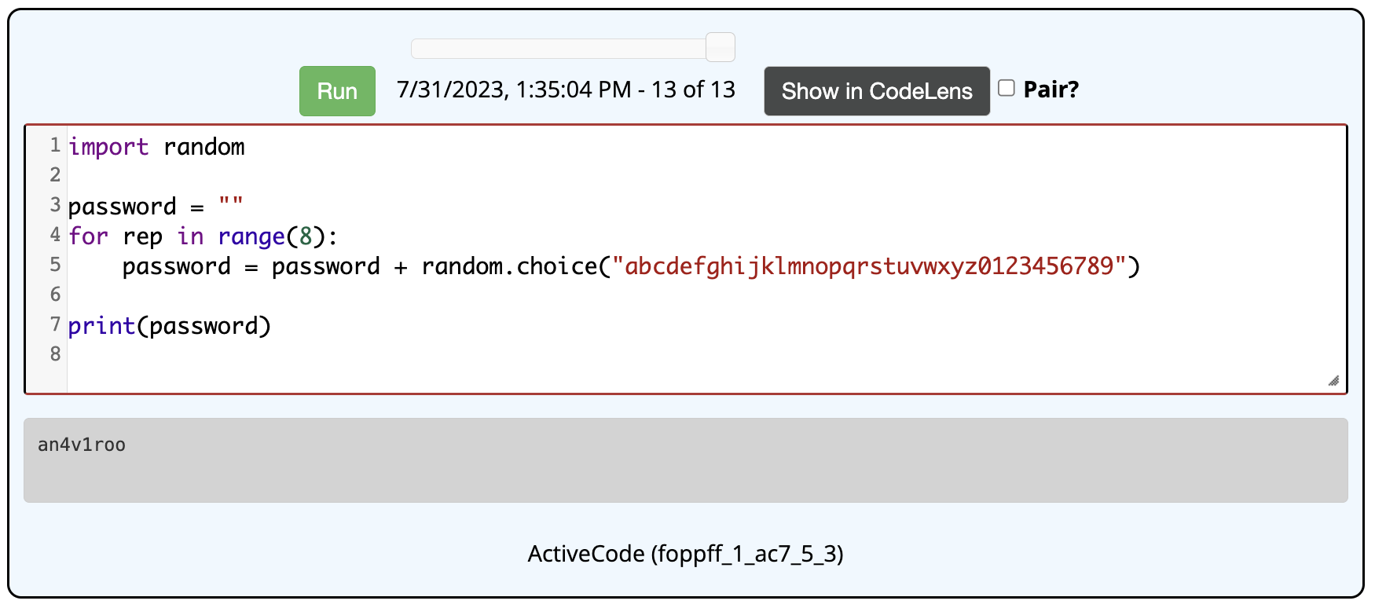
Looping & strings
can combine a loop with string concatenation to build strings
EXERCISE: modify the above code to generate a 3-letter sequence (using only letters). How many sequences to get an English word?
note: the Scrabble dictionary recognizes 1,065 3-letter words
since there are 26³ different 3-letter sequences, roughly 1/17 sequences is a word

Slide 8
Looping & strings (cont.)
can combine a loop with string concatenation to build strings
EXERCISE: modify the above code to generate a 4-letter sequence (using only letters). How many sequences to get an English word?
note: the Scrabble dictionary recognizes 3,996 4-letter words
since there are 26⁴ different 4-letter sequences, roughly 1/114 sequences is a word

Slide 9
Looping & strings (cont.)
can combine a loop with string concatenation to build strings
EXERCISE: now modify your code so that only the letters "etaoinshrd" are used. Does that drastically change the odds?

Slide 10
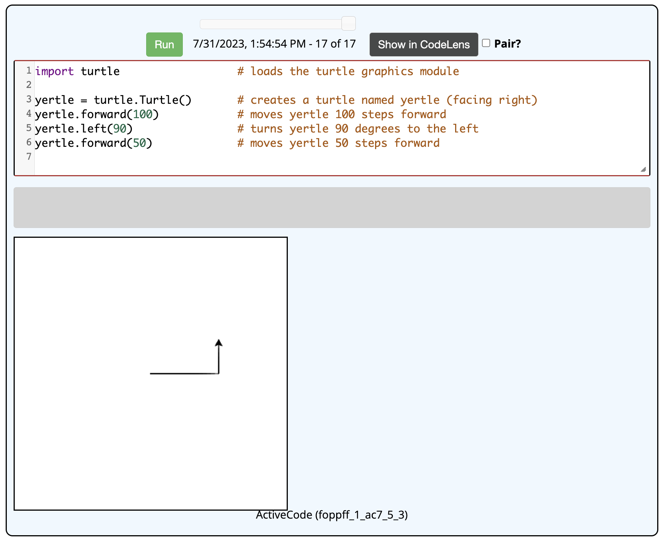
Turtle graphics module
Python comes with a built-in module for turtle graphics
note: # denotes a comment in Python
anything after # is ignored by the interpreter

Slide 11
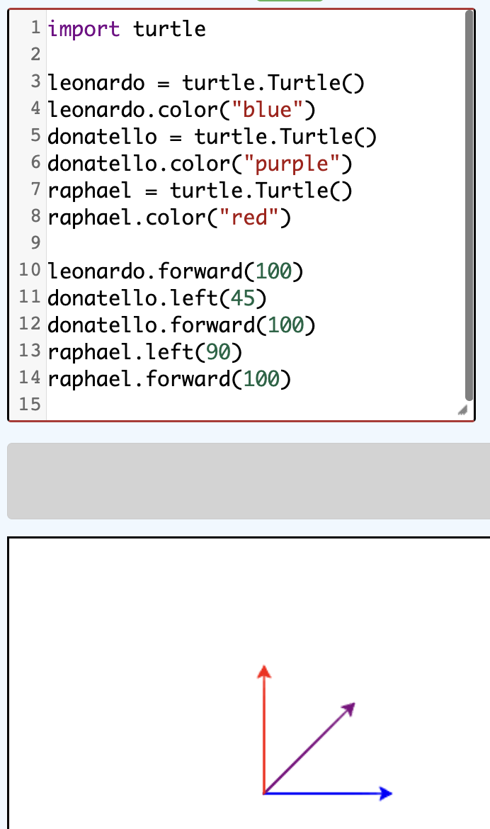
Again, why the prefix?
it is possible to create multiple turtles, that move independently
specifying the turtle name in the prefix makes clear which one is being used
we will learn more about this later in the course
technically, each turtle is an object
a function that is applied to an object is called a method

Slide 12
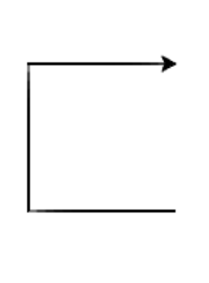
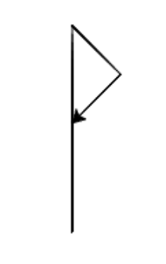
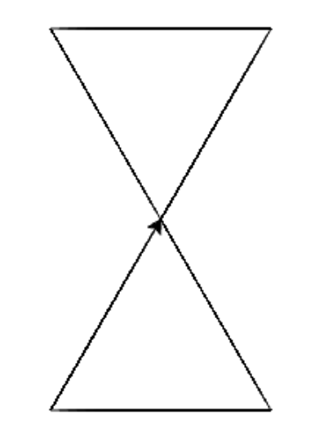
Turtle play
explore the turtle graphics functions
try to draw interesting shapes, such as the ones below

Slide 13
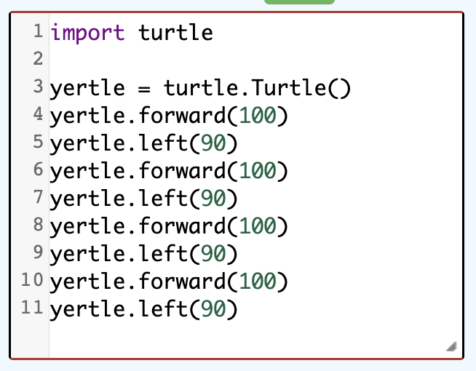
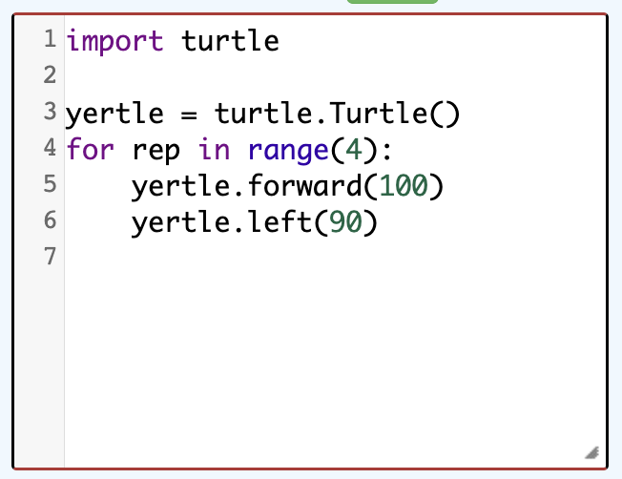
Turtles & loops
suppose we wanted to draw a square
we could do it with 8 function calls
or better yet, use a for loop
EXERCISE: what would need to change to draw a triangle? a pentagon? a hexagon?

Slide 14
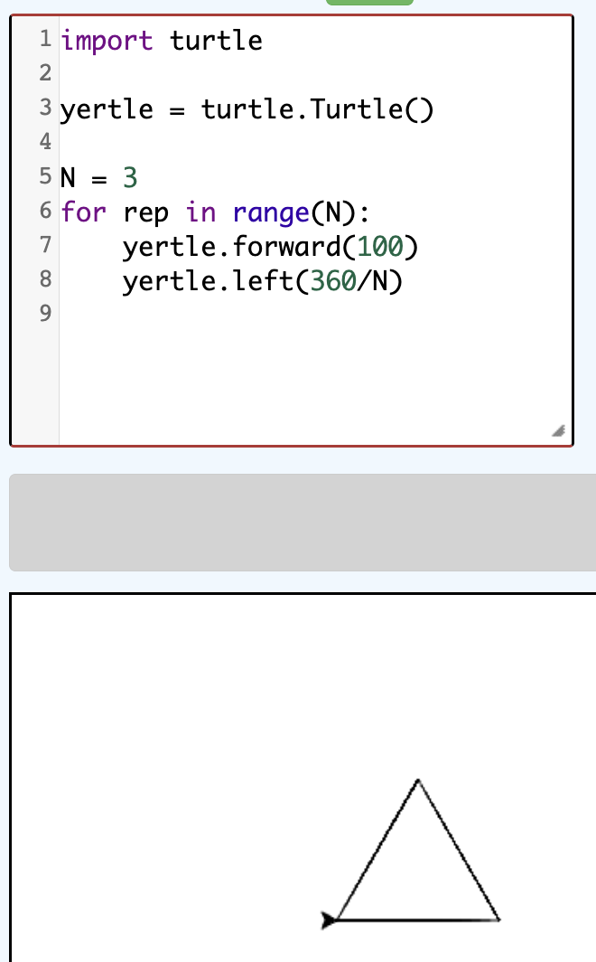
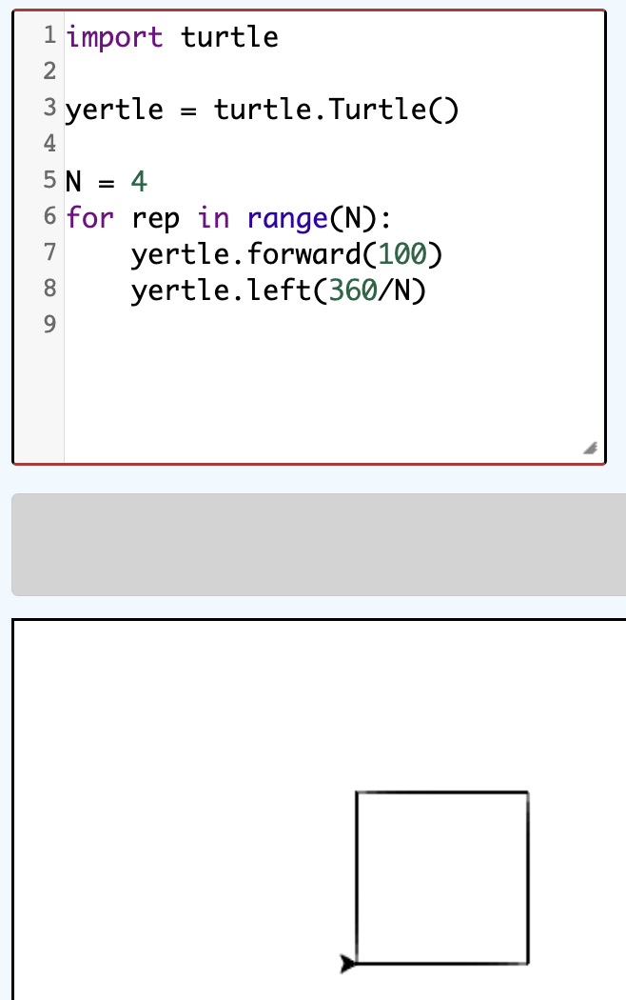
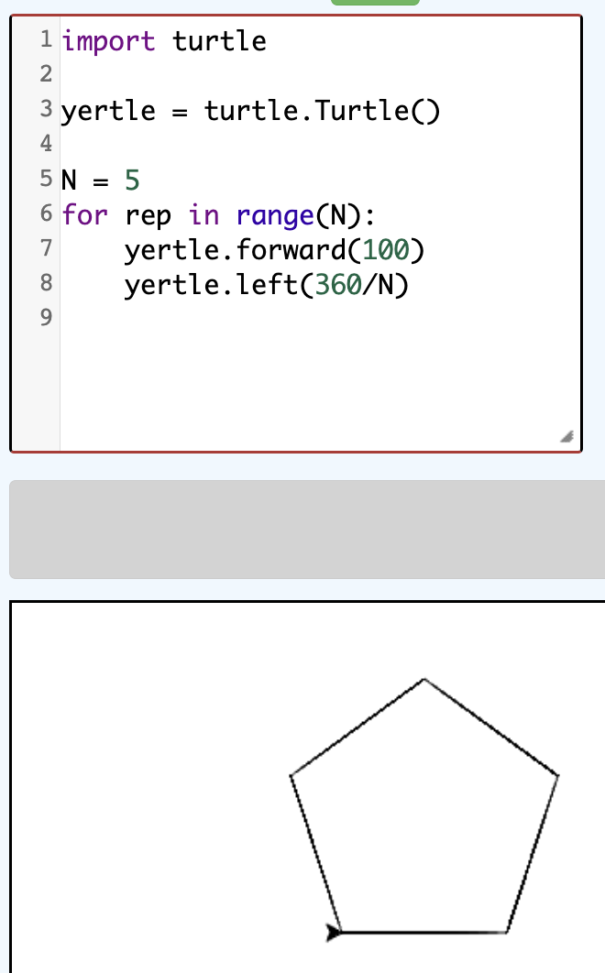
Turtles & variables
could generalize drawing an N-sided polygon using a variable
need to loop N times (once for each side)
the turn angle must be 360/N

Slide 15
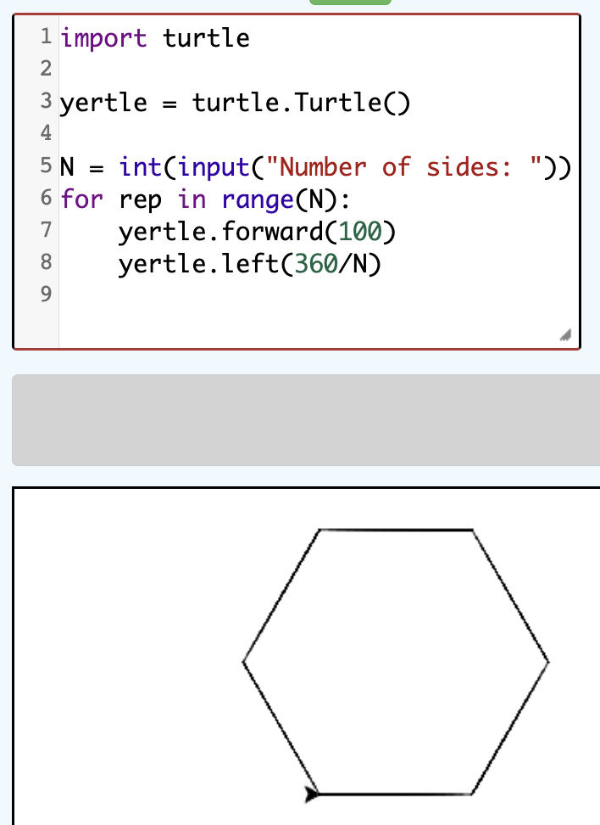
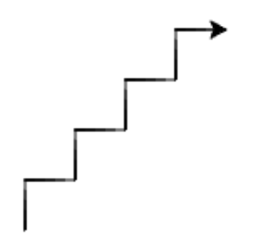
Turtles & input
could even have the number of sides input by the user
EXERCISE: modify this code to draw stairs, with the number of steps input by the user
e.g., the following has 4 steps

Slide 16
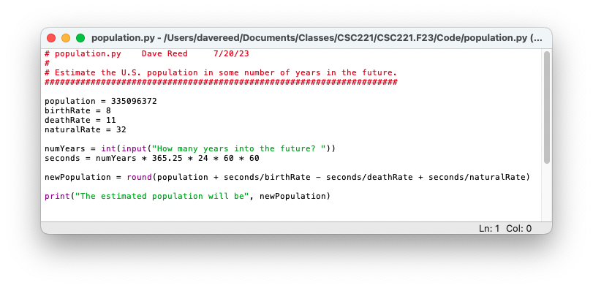
User-defined functions
as we saw earlier, you can define your own modules with code
recall the population growth code
as is, you have to rerun the module each time you want to calculate a new growth estimate
better solution – package the code into a function, then can call that function repeatedly

Slide 17
Simple functions
in its simplest form, a Python function is a sequence of statements grouped together into a block
general form: def FUNC_NAME():
STATEMENT(S)
the statements that make up the function block must be indented (consistently)
you can have blank lines inside the function for readability
consecutive blank lines will end the function

Slide 18
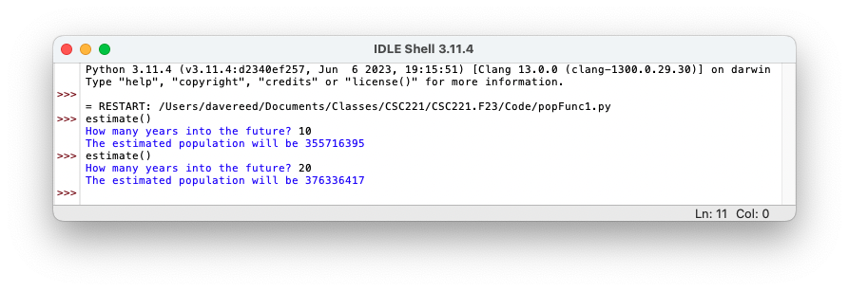
Advantages of functions
functions encapsulate a series of statements under a name
once defined, a function can be called over and over without rerunning the module
18

Slide 19
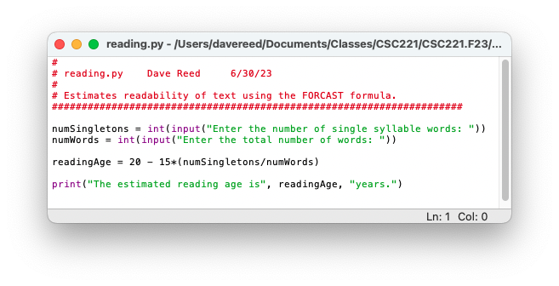
Exercise: FORCAST
convert the FORCAST reading level code into a function
encapsulate the code under a function name, e.g., readingLevel
test your function by running the module and then doing multiple reading level calculations
simple functions like these are units of computational abstraction
the function encapsulates a sequence of computations into a single unit
once you know the name you no longer need to remember how it works (i.e., you abstract away the details and focus on the overall effect)
but they don't resemble math functions very closely
no inputs & no explicit output

Slide 20
Functions with inputs
to generalize a function so that it can take inputs, must add parameters
a parameter is a variable that appears in the heading of a function definition (inside the parentheses)
when the function is called, you must provide an input value for each parameter
these input values are automatically assigned to the parameter variables

Slide 21
Exercise: parameterizing FORCAST
modify your readingLevel function to have two parameters
def readingLevel(singleWords, totalWords):
note that the input values match up with parameters in the order provided
>>> readingLevel(104, 380)
prompts vs. inputs?
if your code requires many different input values, then having a function that prompts for each value is often simpler (prompts remind the user of what to enter)
if there are few inputs, then often simpler & quicker to provide them as inputs
avoids the prompts and allows the user to enter the values directly
allows you to determine the inputs some other way (e.g., another function to calculate the input values)

Slide 22
Function outputs
suppose we wanted to use the results of the function calculation
e.g., we wanted a 10% margin of error on population estimate
we could build that into the function code & print (as before), but not generalizable
better option – have the function return the estimate instead of print it
a return statement specifies the output value of the function

Slide 23
(Optional) input/output types
to aid readability, Python allows you to add types to inputs & outputs
makes it clear to the reader what the intended types are
if types are known, it is good practice to specify them in function definitions
note: you can always provide an int when a float is expected
for a function with no return value, the None type can be specified

Slide 24
Exercise
modify your readingLevel function to utilize inputs and outputs
what types should the inputs and output be?

Slide 25
Metric module
can define a module that contains related functions, e.g., metric conversions
always have a comment block at the top describing the module
each function should begin with a doc string that describes its behavior (specified with triple quotes)
download metric.py from the class directory, open in IDLE, explore

Slide 26
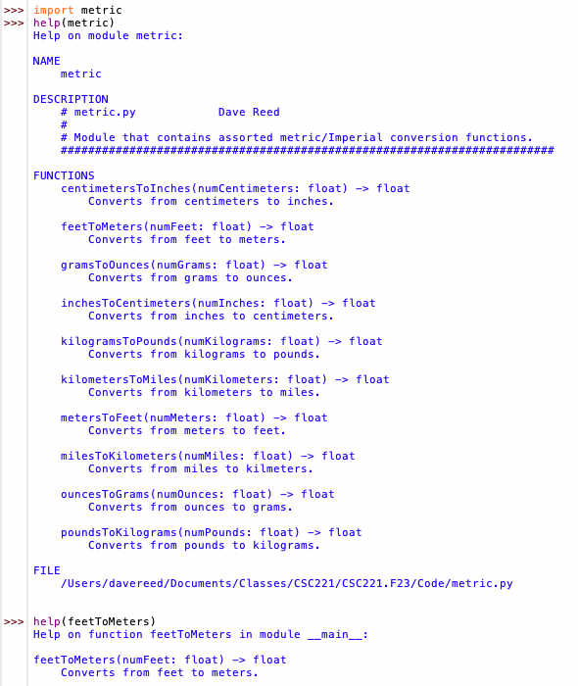
Modules & help
the comment block at the top of a module and the function comments are used by help to provide documentation
help(MODULE) displays a full description of the module and its functions
help(FUNCTION) displays a description of the specific function

Slide 27
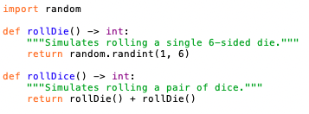
Another example
note: functions can call other functions (often to avoid redundancy)
suppose we wanted to conduct simulations using dice
we could just use random.randint(1, 6) to simulate a die roll
better to define functions with easily recognizable names
but what if we want dice with varying numbers of sides?

Slide 28
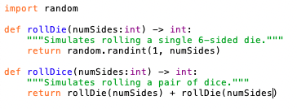
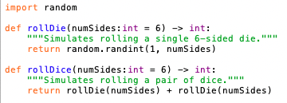
Parameterized dice
we could add parameters to the dice functions to generalize
this works, but inconvenient since most dice are 6-sided
we would like to have 6 be the default, assumed if no number is provided
but, if a number is provided, it is used

Slide 29
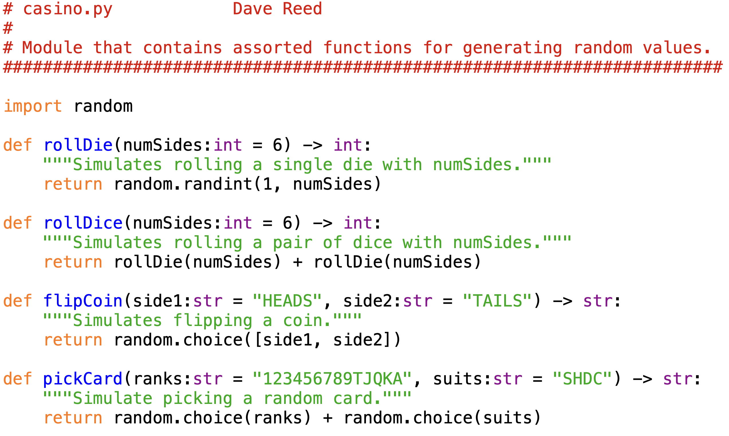
Casino module
the dice functions might be part of a larger casino-related module
download casino.py from the class directory, open in IDLE, explore

