Slide 1
CSC 221: Introduction to Programming Fall 2023
Iteration
counter-driven vs. logic driven loops
for loop
loops & counters, shorthand assignments
while loop
black-hole loops
counters
listener loop, input validation
simulations

Slide 2
Iteration
an if statement provides for conditional execution
can make a choice between alternatives, choose which (if any to execute)
if we want to repeatedly execute a block of code, need a loop
loops can be counter-driven
e.g., roll a die 10 times
loops can be condition-driven
e.g., roll dice until doubles
we already saw a simple for loop for counter-driven iteration
for VAR in range(NUM_REPS):
STATEMENTS_TO_BE_REPEATED

Slide 3
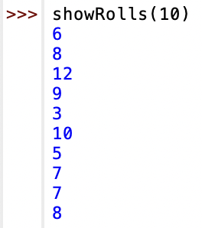
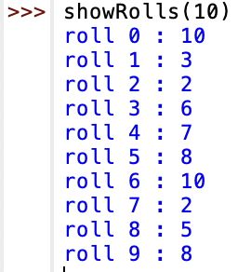
Simple for loops
suppose we wanted to simulate a set number of dice rolls & display them
to make it more readable, can add more text to the display message
QUESTION: what if we wanted the roll #s to start at 1?
QUESTION: what if we didn’t want a space before :

Slide 4
Exercise: sum the dice rolls
suppose we wanted to define a function to sum up dice rolls
need to initialize a variable to keep track of the sum (starting at 0)
inside the loop, add each roll to the sum variable
when done with the loop, display the sum
QUESTION: what modifications would be needed to return the average?

Slide 5
Loops & counters
for loops can be combined with if statements
common pattern: perform multiple repetitions and count the number of times some event occurs
e.g., flip a coin and count the number of heads
e.g., roll dice and count the number of doubles
e.g., traverse an employee database and find all employees making > $100K

Slide 6
Shorthand assignments
a variable that is used to keep track of how many times some event occurs is known as a counter
a counter must be initialized to 0, then incremented each time the event occurs
shorthand notation
number += 1 ⬅➔ number = number + 1
number -= 1 ⬅➔ number = number - 1
other shorthand assignments can be used for updating variables
number += 5 ⬅➔ number = number + 5
number *= 2 ⬅➔ number = number * 2

Slide 7
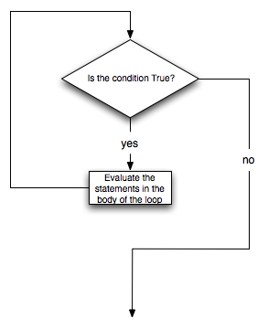
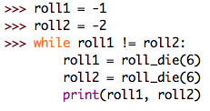
While loops
the other type of repetition in Python is the condition-driven while loop
similar to an if statement, it is controlled by a Boolean test
unlike an if, a while loop repeatedly executes its block of code as long as the test is true
while TEST_CONDITION:
STATEMENTS_TO EXECUTE_AS_LONG_AS_TEST_IS_TRUE

Slide 8
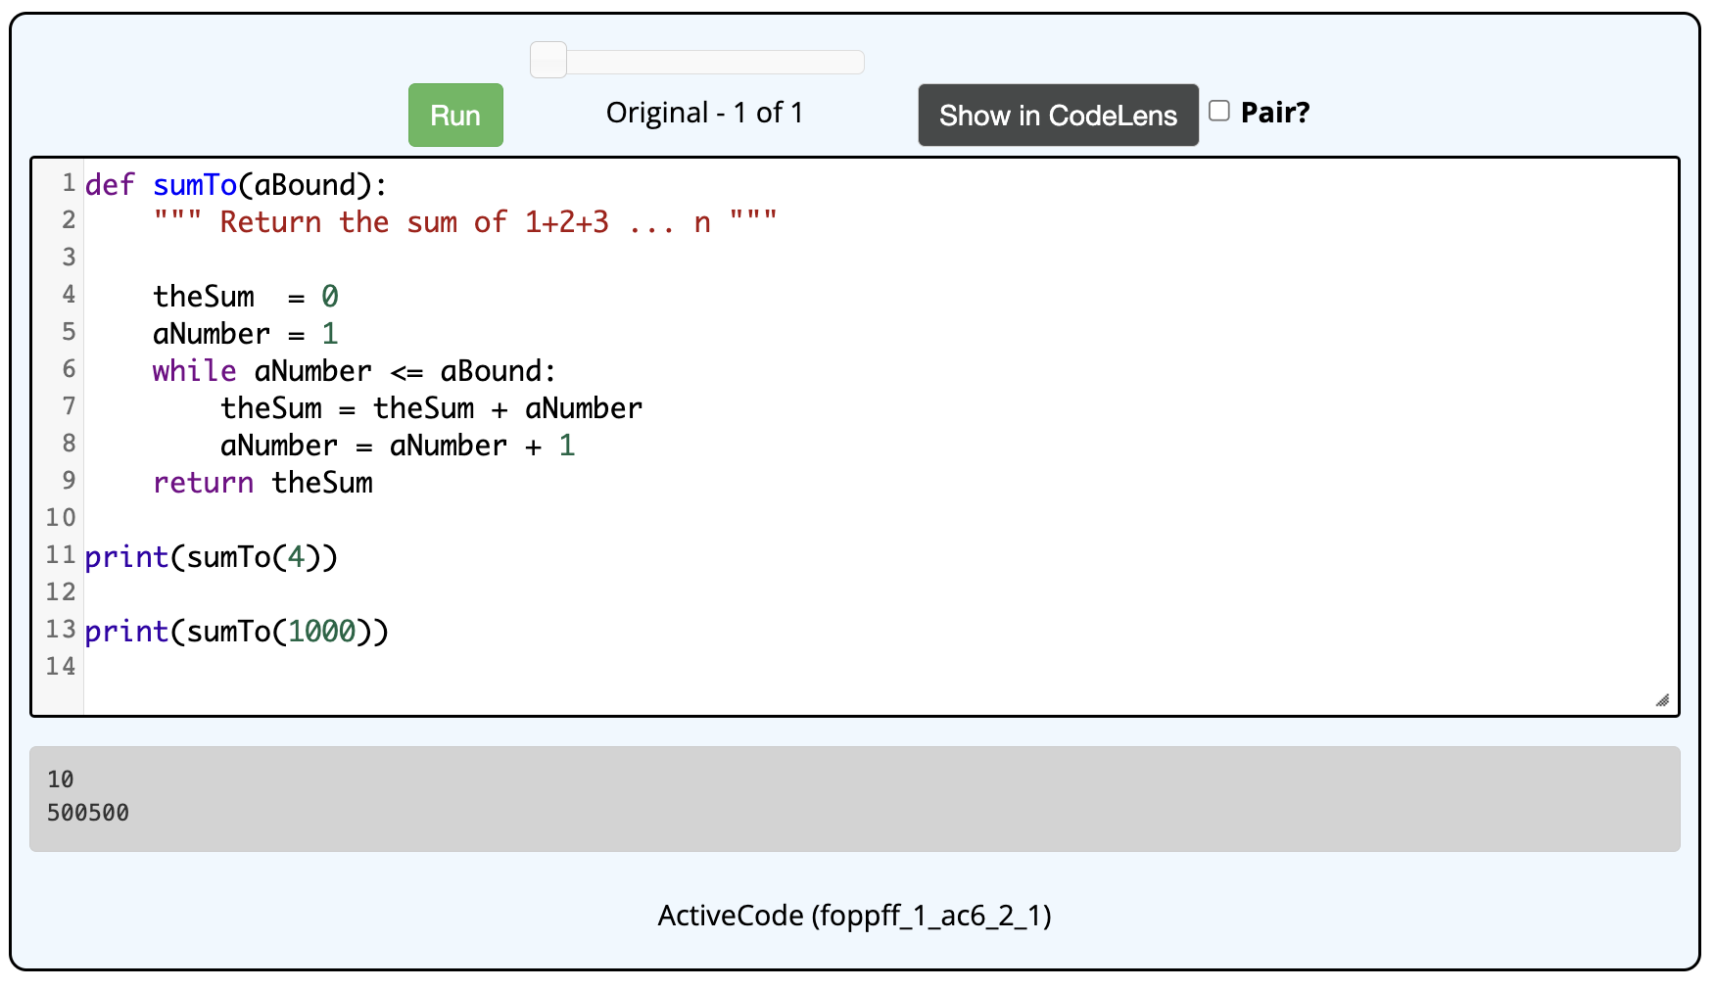
Example: summing numbers
in Chapter 6.2, use the CodeLab to trace this code
suppose we wanted to sum the integers in a range low…high
e.g., sumBetween(3, 6) → 3+4+5+6 → 18

Slide 9
Example: hailstone sequence
interesting problem from mathematics
start a sequence with some positive integer N
if that number is even, the next number in the sequence is N/2;
if that number is odd, the next number in the sequence is 3N+1
5 → 16 → 8 → 4 → 2 → 1 → 4 → 2 → 1 → …
15 → 46 → 23 → 70 → 35 → 106 → 53 → 160 → 80 → 40 → 20 → 10
⬇
… ← 1 ← 2 ← 4 ← 8 ← 16 ← 5
it has been conjectured that no matter what number you start with, you will end up stuck in the 4-2-1 loop
has been shown for all values <= 20 × 2⁵⁸ ≈ 5.764 × 10¹⁸
but has not been proven to hold in general

Slide 10
Generating a hailstone sequence
need to be able to distinguish between even and odd numbers
recall the remainder operator, %
(x % y) evaluates to the remainder after dividing x by y
thus, (x % 2) evaluates to 0 if x is even, 1 if x is odd
EXERCISE: modify so that it also prints the length of the sequence

Slide 11
Beware of "black holes"
since while loops repeatedly execute as long as the loop test is true, infinite loops are possible (a.k.a. black hole loops)
PROBLEM?
a necessary condition for loop termination is that some value relevant to the loop test must change inside the loop
in the above example, flip doesn't change inside the loop
if the test succeeds once, it succeeds forever!
is it a sufficient condition? that is, does changing a variable from the loop test guarantee termination?
NO – "With great power comes great responsibility."

Slide 12
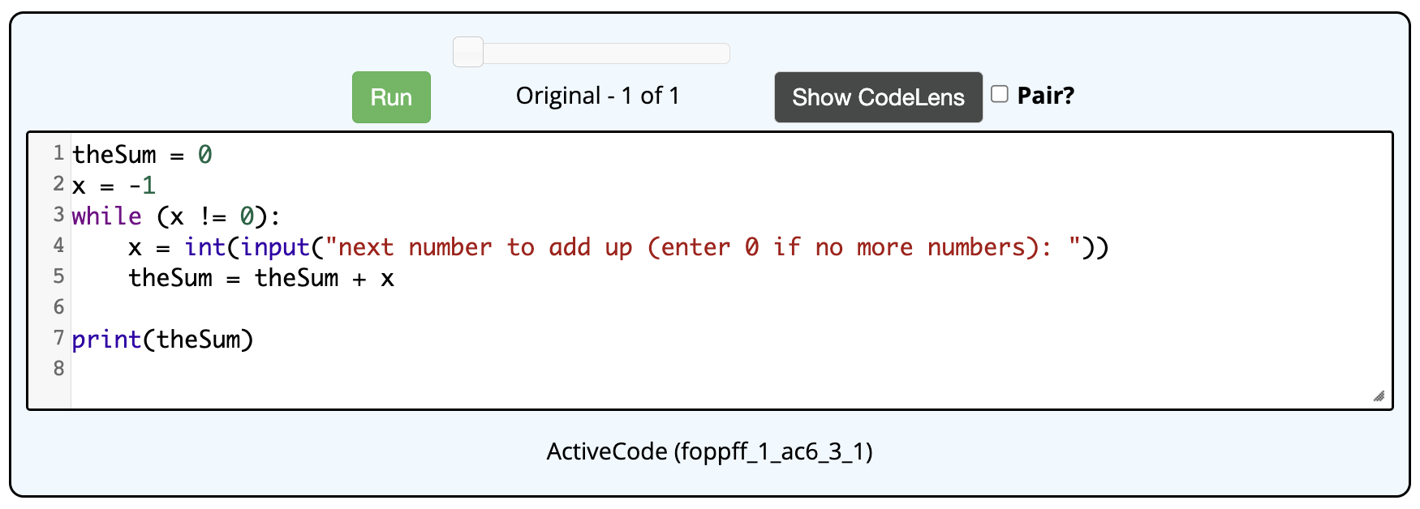
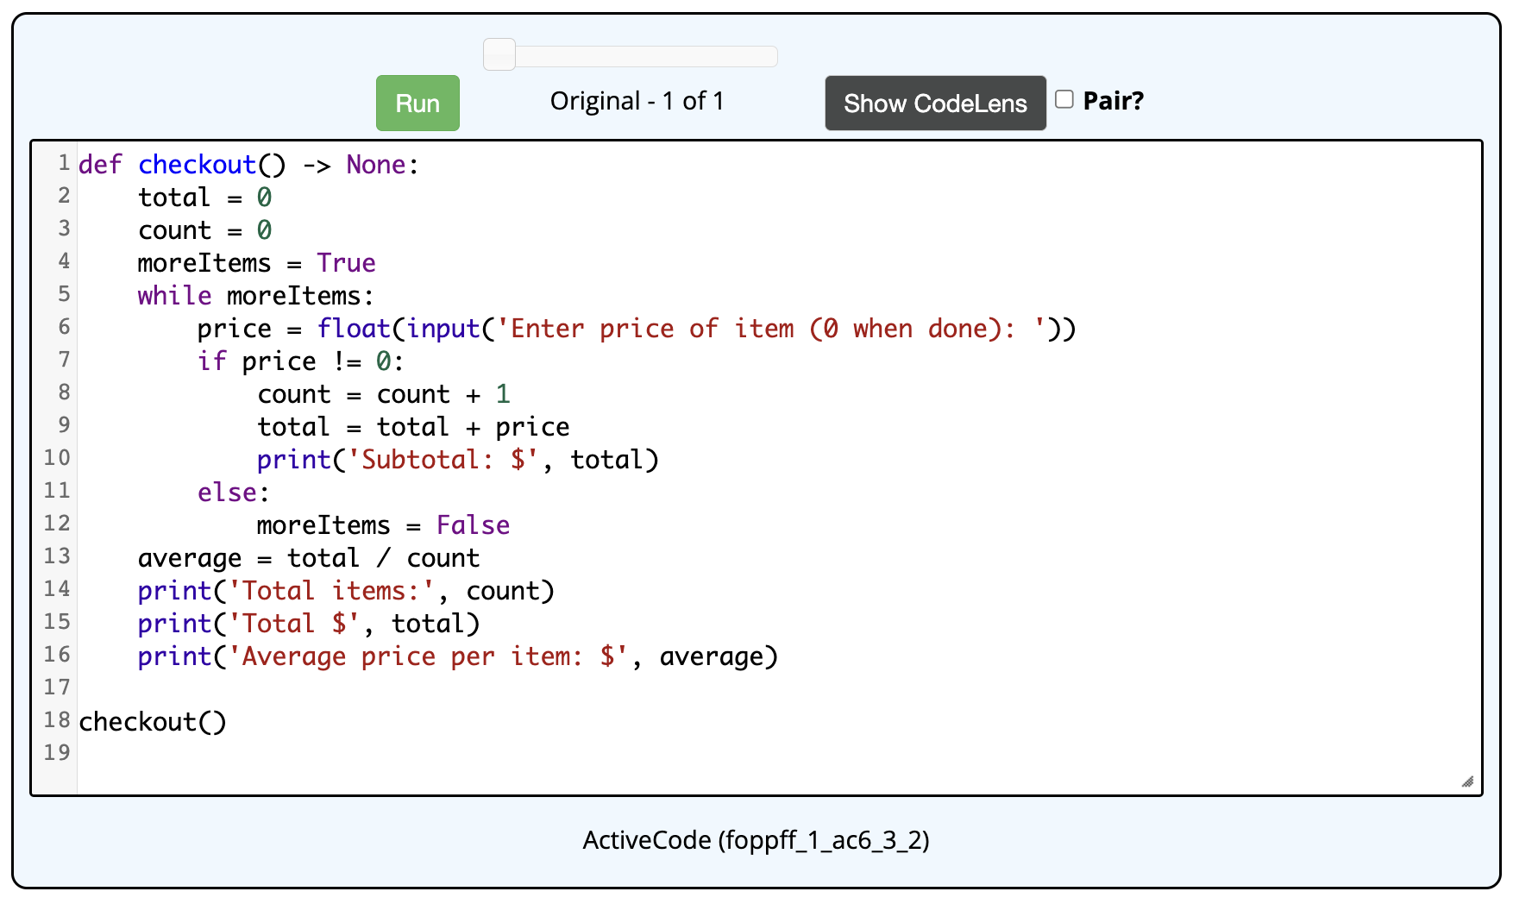
Listener loop
a common use of a while loop is in processing a sequence of inputs
loop to read in values, stop when a special value is entered

Slide 13
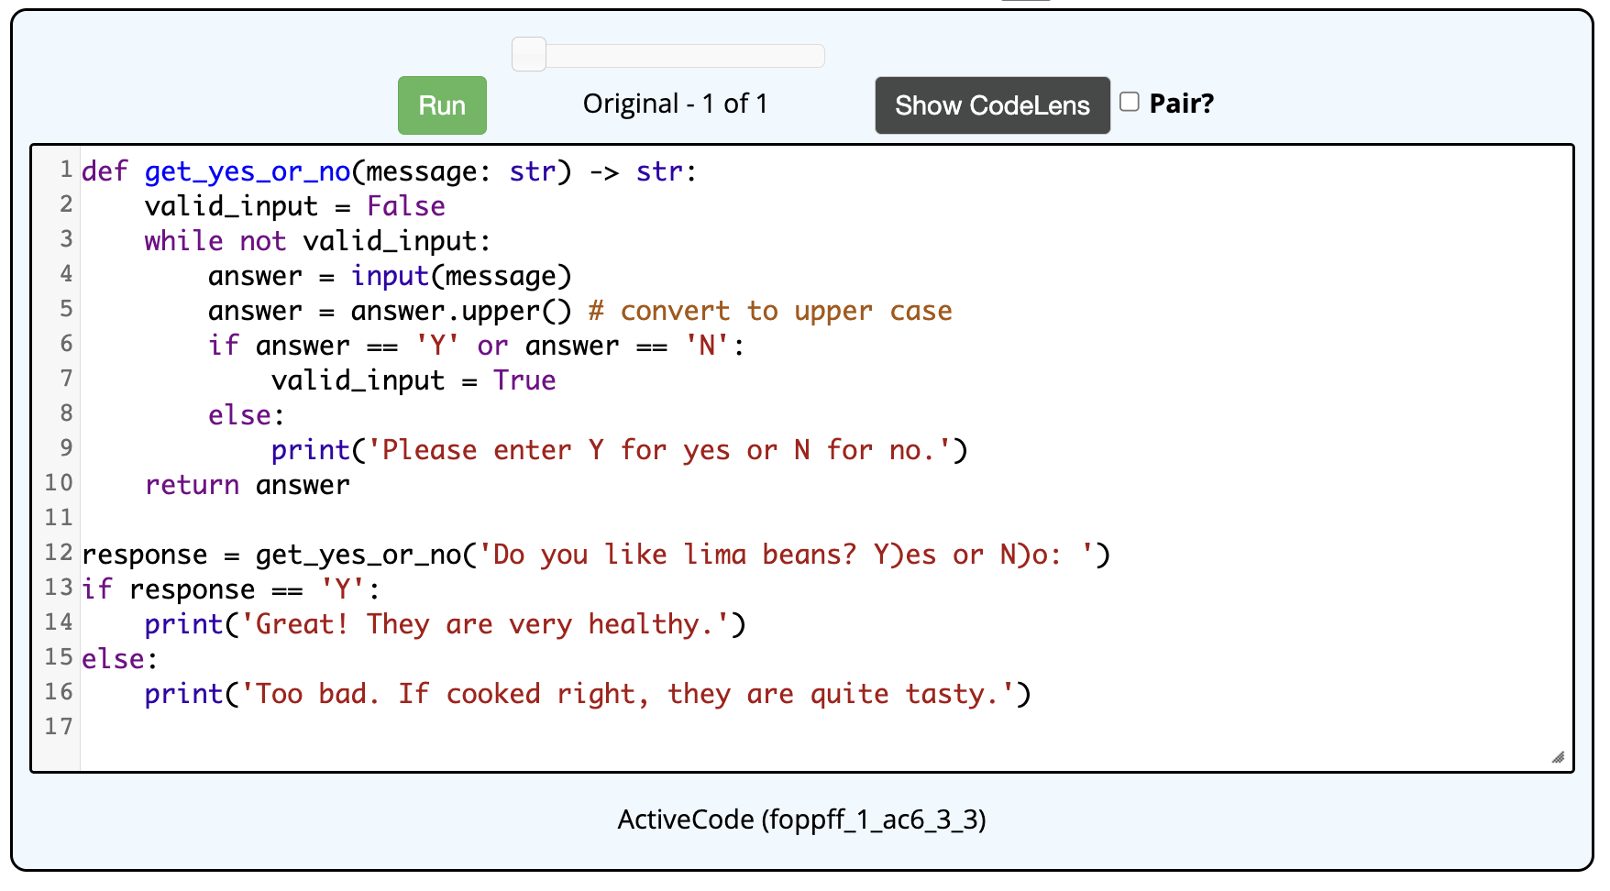
Input validation
a while loop can also be used to keep reading inputs until a valid entry

Slide 14
Example: Pig
Pig is a 2-player dice game in which the players take turns rolling a die.
On a given turn, a player rolls until either
he/she rolls a 1, in which case his/her turn is over and no points are awarded, or
he/she chooses to hold, in which case the sum of the rolls from that player's turn are added to his/her score.
The winner of the game is the first player to reach 100 points.
for example:
SCORE = 0 to start
TURN 1: rolls 5, 2, 4, 6, holds → SCORE += 17 → 17
TURN 2: rolls 4, 1, done → SCORE += 0 → 17
TURN 3: rolls 6, 2, 3, hold → SCORE += 11 → 28
…

Slide 15
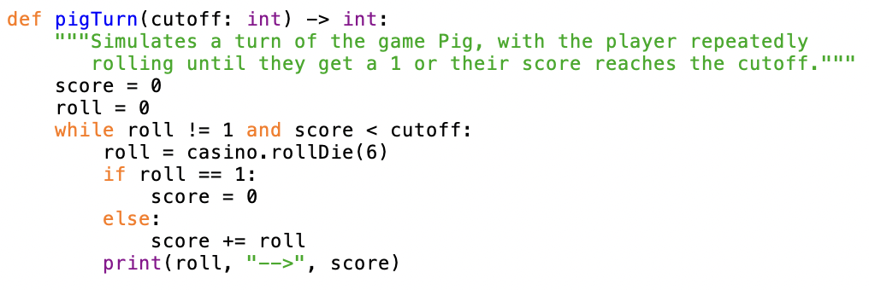
Pig simulation
we want to simulate Pig to determine the best strategy
i.e., determine the optimal cutoff such that you should keep rolling until the score for a round reaches the cutoff, then hold
i.e., what is the optimal cutoff that minimizes the expected number of turns
why is roll set to 0 before the loop? why not set it to roll_die(6)?
EXERCISE: modify the pigTurn function so that it returns the score for the round (as opposed to printing rolls/scores)

Slide 16
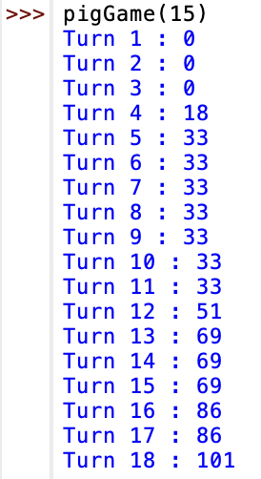
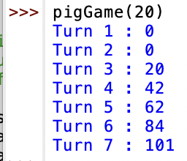
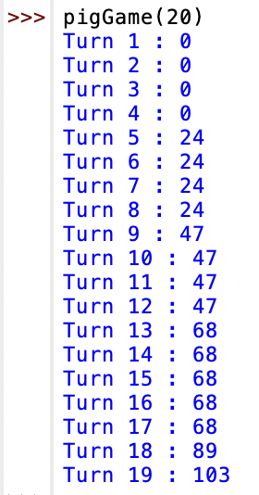
Pig simulation (cont.)
EXERCISE: define a pigGame function that simulates a Pig game
has 1 input, the cutoff value for each turn
it repeatedly calls the pigTurn function, totaling up the score for each turn (and displaying the turn # and updated score)
it stops when the score total reaches 100

Slide 17
Pig simulation (cont.)
what can we conclude from running several experiments?
Simulation 1: a cutoff of 15 yields a game of 18 turns
Simulation 2: a cutoff of 20 yields a game of 7 turns
can we conclude that a cutoff of 20 is better than a cutoff of 15?
note: because of the randomness of the die, there can be wide variability in the simulations
note: a single roll of a die is unpredictable
however: given a large number of die rolls, the distribution of the rolls can be predicted (since each die face is equally likely, each should appear ~ 1/6 of time)
Law of Large Numbers states that as the number of repetitions increases to ∞, the percentages should get closer and closer to the expected values

Slide 18
Pig simulation (cont.)
in order to draw reasonable conclusions, will need to perform many experiments and average the results
EXERCISE: modify the pigGame function so that it returns the number of turns (as opposed to printing turns/scores)
EXERCISE: define a pigStats function that simulates numerous games
has 2 inputs, the number of games and the cutoff value for each turn
it repeatedly calls the pigGame function the specified number of times, totaling up the number of turns for each game
it returns the average number of turns over all the games
QUESTION: what is the optimal cutoff that minimizes the number of turns
how many games do you need to simulate in order to be confident in your answer?

Slide 19
Control summary
if statements provide for conditional execution
use when you need to make choices in the code
control is based on a Boolean (True/False) test
1-way: if (with no else)
2-way: if-else
multi-way: if-elif-elif-…-elif-else
for loops provide for counter-driven repetition
use when you need to repeat a task a set number of times
utilizes the range function
while loops provide for conditional repetition
use when you need to repeat a task but you don't know how many times
control is based on a Boolean (True/False) test
as long as test continues to be True, the indented code will be executed
beware of infinite (black hole) loops

