Slide 1
CSC 221: Introduction to Programming Fall 2023
Lists
lists as sequences
+, *, len, indexing, slicing, for-in, in
from strings to lists
literary fingerprints (HW5)
lists of counters
dice stats, letter frequencies
list methods
index, count, append, insert, remove, sort, reverse
mutable vs. immutable

Slide 2
String review
recall that a Python string is a sequence of characters
basic operations on strings:
+ concatenates strings
* concatenates multiple copies
len function
indexing via [i]
slicing via [s:e], [s:e:n], [:e], [s:], …
string methods:
isupper, islower, isalpha, isdigit, isspace
capitalize, upper, lower
find, rfind, count, replace
strip, lstrip, rstrip
center, ljust, rjust

Slide 3
Lists
also recall: a list is a sequence of arbitrary items
can specify the contents of a list in brackets, separated by commas
the same sequence operations apply to lists:
+ concatenates lists
* concatenates multiple copies
len function
indexing via [i]
slicing via [s:e], [s:e:n], [:e], [s:], …

Slide 4
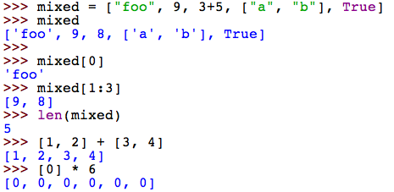
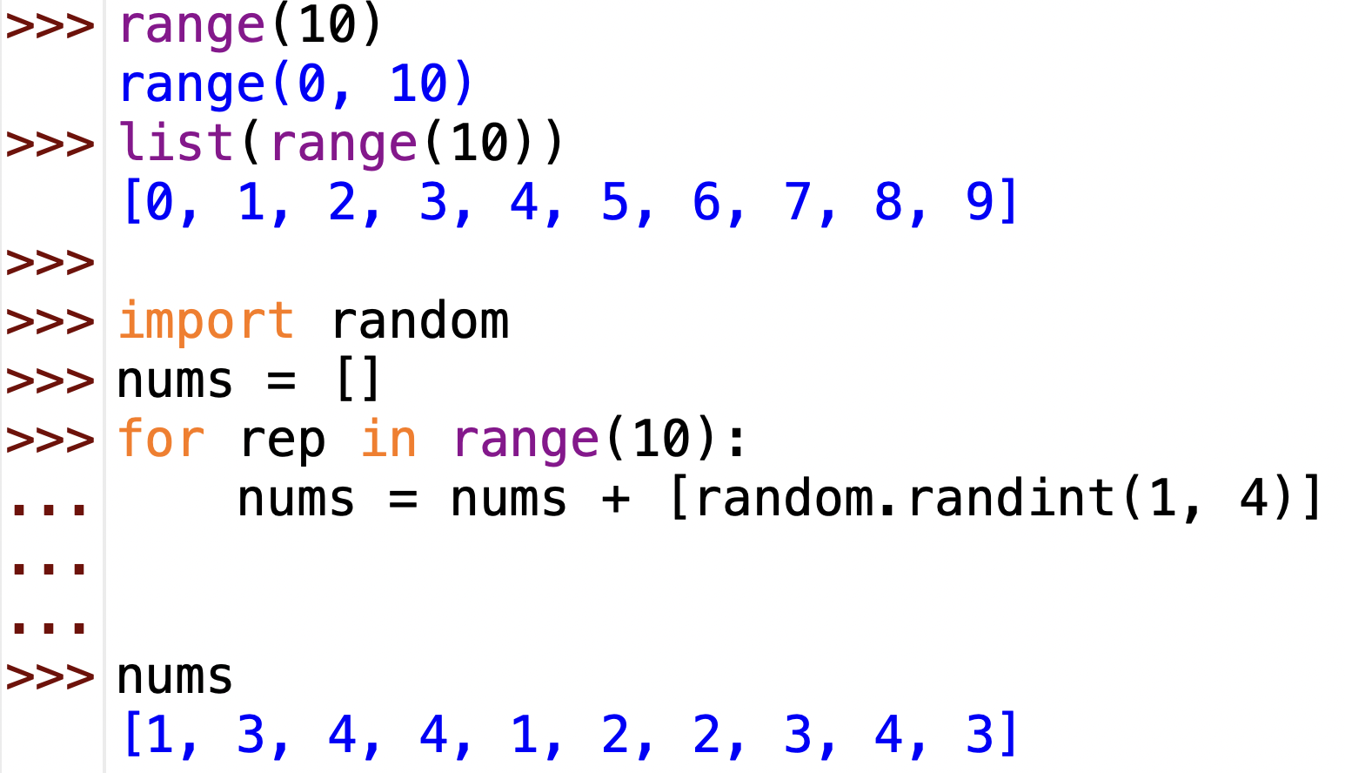
List operation examples
note: a range is sequence similar to a list
can be converted into a list using list

Slide 5
Exercises
grab a partner and go to codingbat.com
solve problems (in order) from the List-1 category
all of these problems can be solved using list indexing, slicing, +, and *

Slide 6
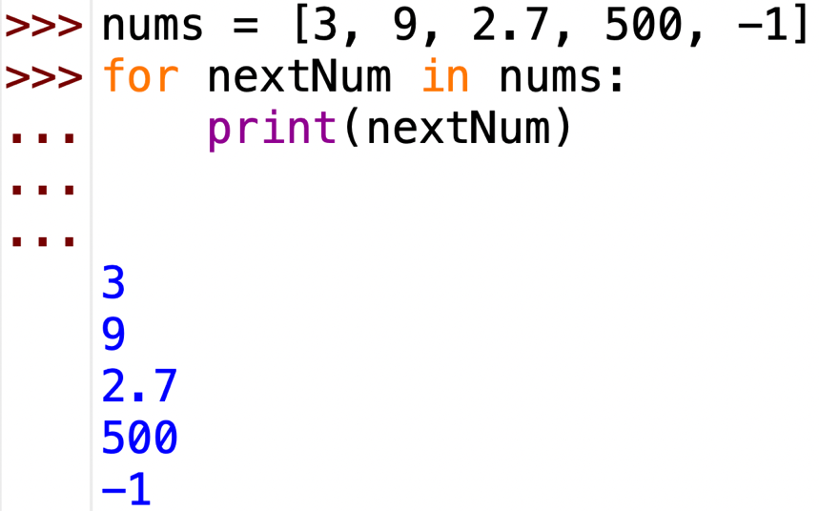
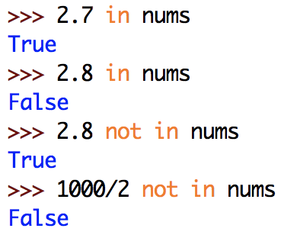
Traversing a list sequence
as with strings (character sequences), can traverse a list using for-in
likewise, can test for list membership using in and not-in

Slide 7
Example: averaging numbers
suppose you have a list of numbers (e.g., grades)
want to calculate the average of those numbers
there is a sum function defined for lists of numbers
any potential problems?
i.e., will this function work correctly on all possible lists of numbers?
modify this function so that it returns 0.0 on an empty list

Slide 8
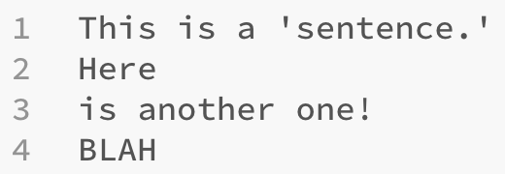
Files & lists
recall: can read in the contents of a file using read() or readlines()
readlines() returns a list containing each line from the file
short.txt

Slide 9
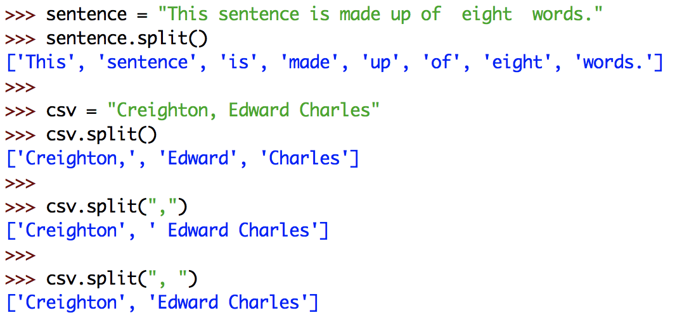
Counting words
suppose we wanted to count the number of words in a file
unfortunately, there is no easy way to read one word at a time
however, can read the contents and then split into words
str.split() returns a list of the separate words in str
by default, it uses whitespace to separate the words, but can provide an optional argument to specify different separators

Slide 10
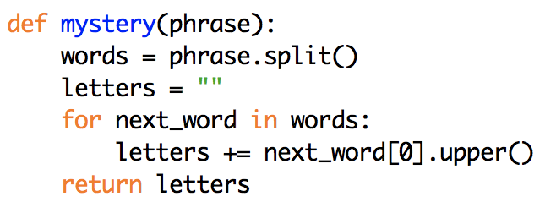
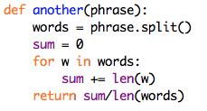
Examples using split
recall:
X += Y
is the same as:
X = X + Y

Slide 11
Reading one line at a time
reading a file using read() or readlines() has a drawback
the entire contents of the file is read in and stored
for very large files, this is wasteful (and may even exceed memory limits)
alternatively, can use a for-in loop to read from a file
each pass through the loop, the variable is the next line from the file
infile = open(filename, "r")
for line in infile:
# PROCESS THE LINE
infile.close()
note: only one line is stored at a time

Slide 12
New versions

Slide 13
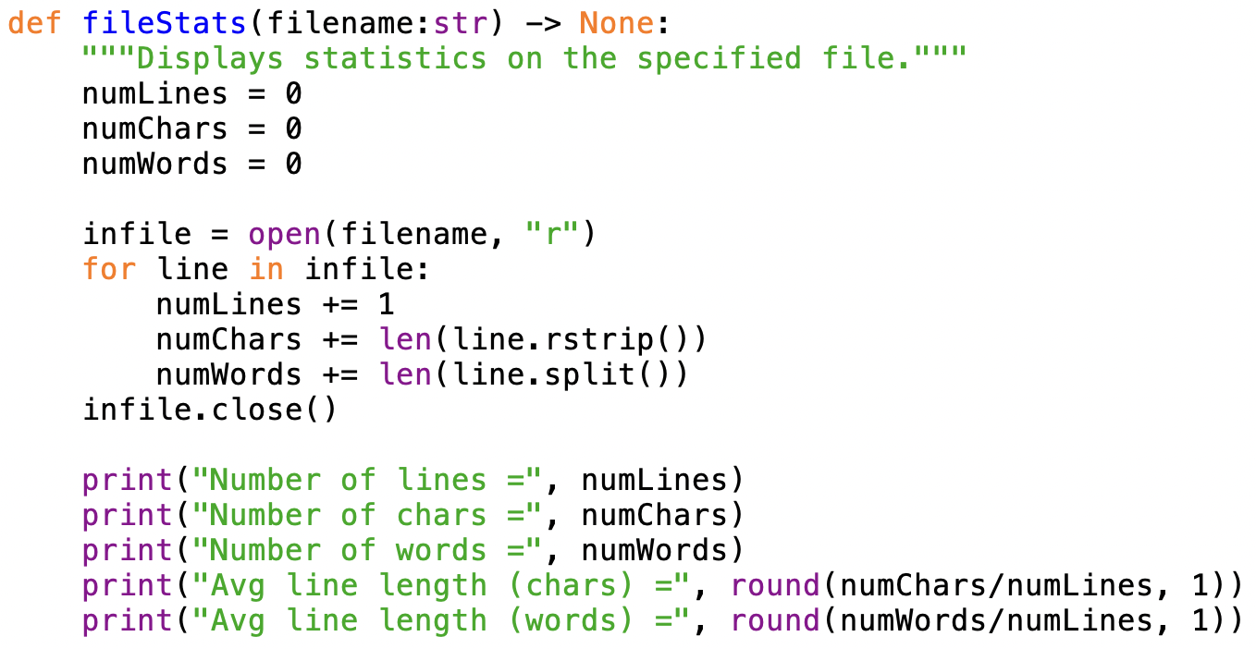
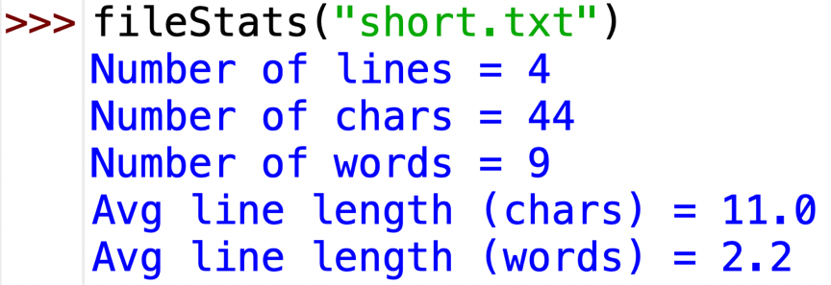
Adding more stats
could generalize into a function that generates file stats
note: calls rstrip() to remove the end-of-line character ('\n') from lines

Slide 14
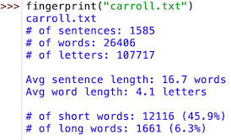
HW5 (part 1)
you are to write a function (or functions) that processes a file and produces statistics on the patterns of word and letter usage
could be used to produce literary fingerprints for authors
e.g., for Alice's Adventures in Wonderland (by Lewis Carroll)
we are making several simplifying assumptions:
any sequence of characters (surrounded by whitespace) that ends in one of these denotes the end of a sentence:
. ! ? .' !' ?' ." !" ?"
any sequence of characters (surrounded by whitespace) containing at least one letter is a word
we only count letters (uppercase and lowercase)
short words are $≤$ 3 letters; long are $≥$ 8 letters
2 sentences, 9 words, 34 letters
4 short words, 1 long word

Slide 15
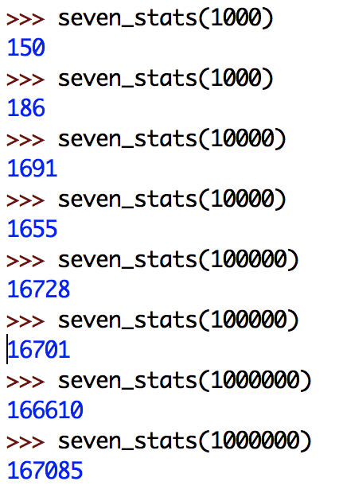
Example: dice stats
recall earlier examples involving simulated dice rolls
suppose we wanted to perform repeated rolls, keep track of the number of 7's

Slide 16
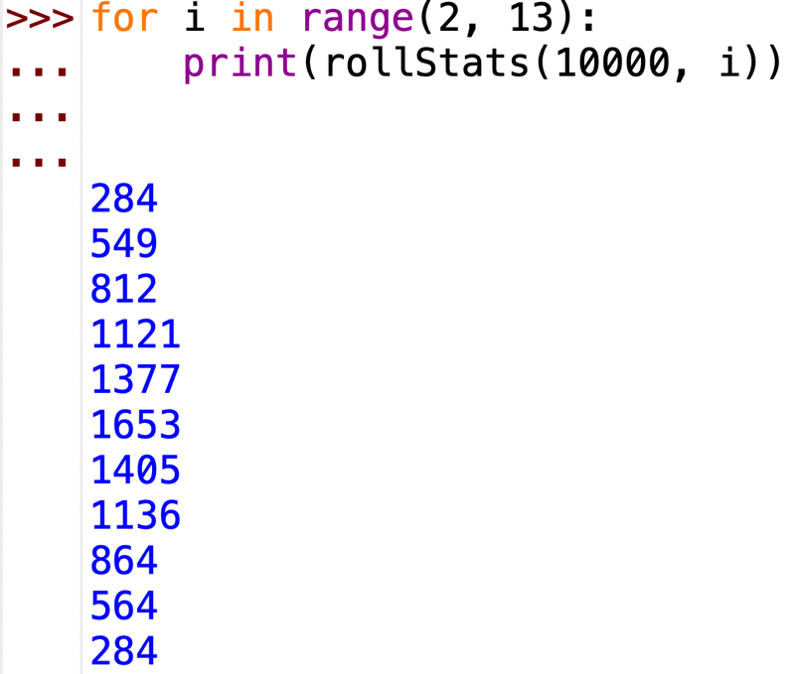
Dice stats (cont.)
we could similarly define functions for the other dice totals
or, could generalize by adding a parameter for the desired total
do these totals add up to 10,000?
should they?

Slide 17
Dice stats (cont.)
the problem with separate calls for each dice total is that each call is independent of the others
actually simulating 10,000 x 11 different rolls
WASTEFUL, and leads to inconsistent results
what we need is to be able to count all the totals at the same time
could do it by having 11 variables, each keeping count for a dice total
would need an 11-case if-elif-else to check for each dice total
would then need to return or print each count

Slide 18
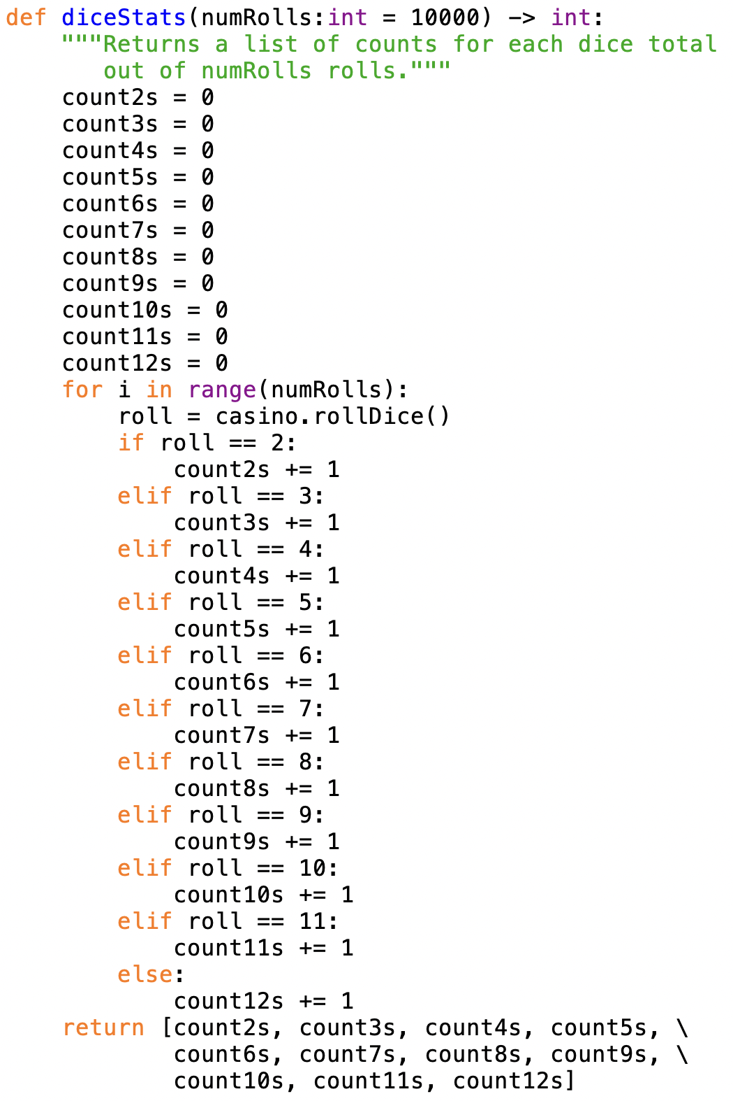
UGLY!
extremely tedious
what if we wanted to extend this example to 8-sided dice?
what would have to change?

Slide 19
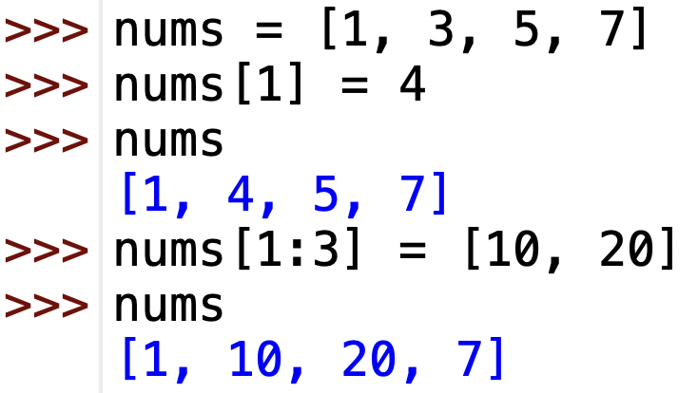
Lists are mutable!
unlike string, lists are mutable values
you can change the contents of a list by assigning to an index or slice
in contrast, trying to change the contents of a string values produces an error

Slide 20
Better solution
11 separate variables are unwieldy – no way to test/update uniformly
alternatively, could place all 11 counters in a single list
actually, to simplify things will create a list with 13 numbers
count2s will be stored in rollCount[2]
count3s will be stored in rollCount[3]
…
count12s will be stored in rollCount[12]

Slide 21
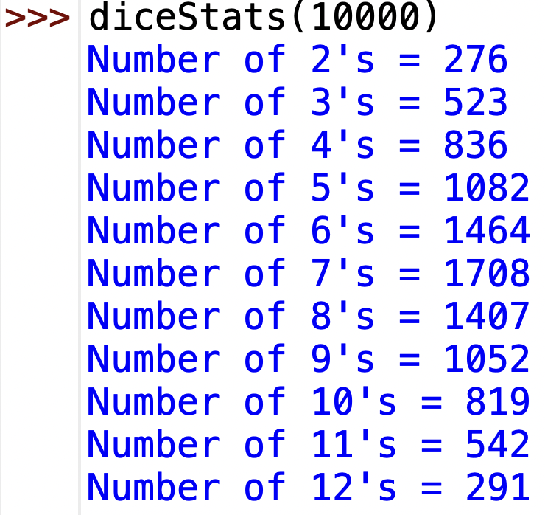
Nicer output
simply returning the list of counts is not ideal
difficult to see which number goes with which dice total

Slide 22
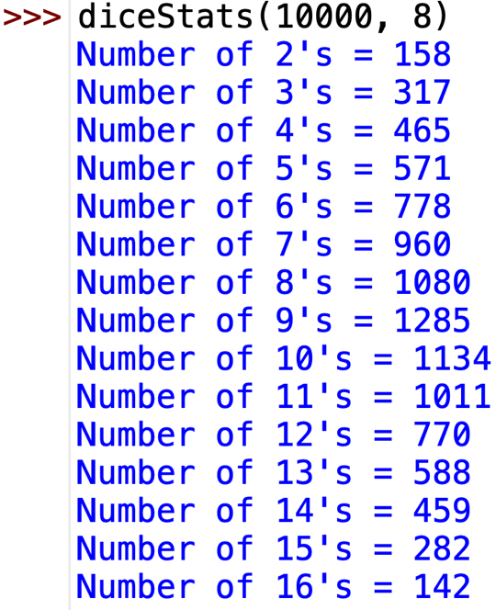
Generalized version
could generalize to work for different dice
specify number of die sides as an additional parameter
need a list with 2*die_sides+1 counters (but ignore first two entries)

Slide 23
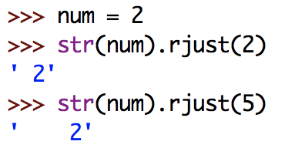
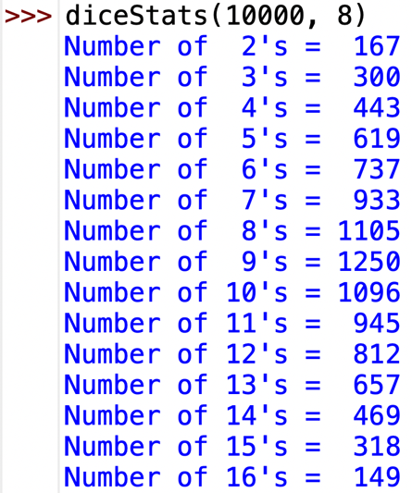
Aligned output
could even use rjust to align the output
recall: rjust pads with spaces on the left

Slide 24
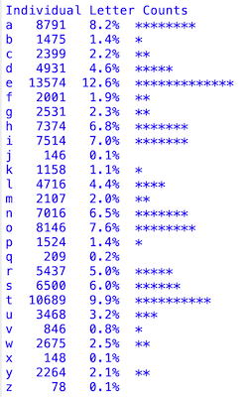
HW5 (part 2)
in addition, you need to generate letter frequency statistics for the file
number of occurrences of each letter (case-insensitive)
percentage for each letter (with respect to total number of letters)
a histogram, with a * for each (rounded) percentage point
you will need to:
maintain a list of 26 counters, one for each letter (similar to dice stats)
align the data into columns (also similar to dice stats)

Slide 25
List methods
similar to string, the list type has useful methods defined for it
index(x) return the index of the first occurrence of x (error if not in the list)
count(x) return the number of times x appears in the list
the following methods actually modify the contents of the list (mutability)
append(x) add x to the end of the list
note: nums.append(3) is the same as nums += [3]
insert(i, x) insert x at a given position i
remove(x) remove the first occurrence of x (error if not in the list)
sort() sort the items of the list, in place
reverse() reverse the elements of the list, in place

Slide 26
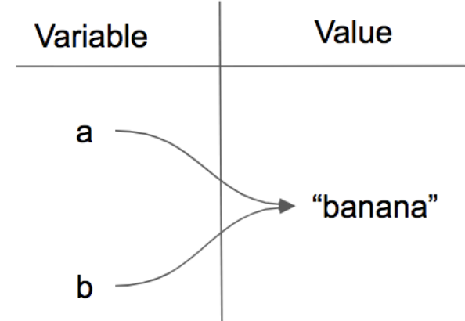
Mutable vs. immutable
recall: lists are mutable (can change their contents using index or slice) but strings are not
why is this the case?
it is fairly common for a string value to be used over and over
to save memory, only one instance of a string value is stored
any variable assigned that value will point to the same memory location

Slide 27
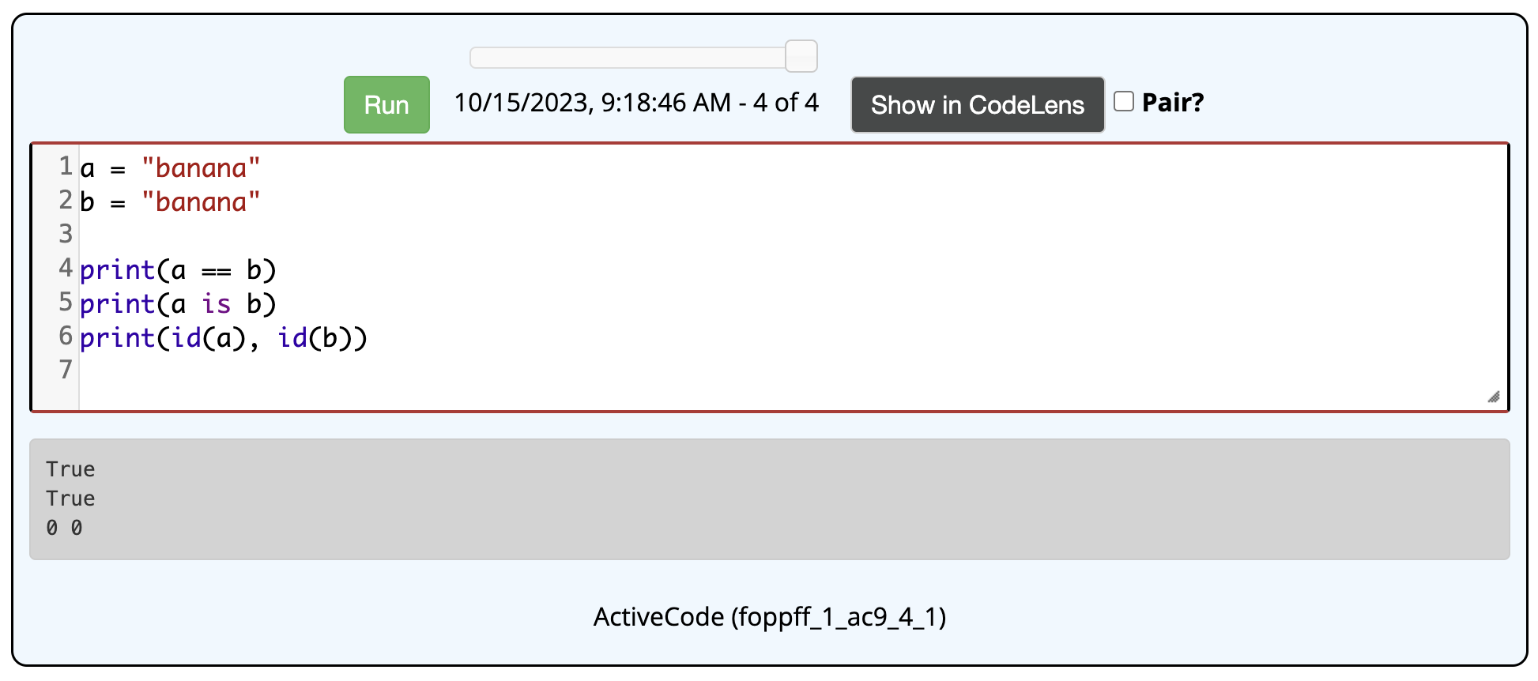
Structure sharing with strings
to verify this behavior:
the == operator determines if two values are equivalent
the is operator determines if two values are the same (same location in memory)
the id() function will return a unique identifier for the memory location

Slide 28
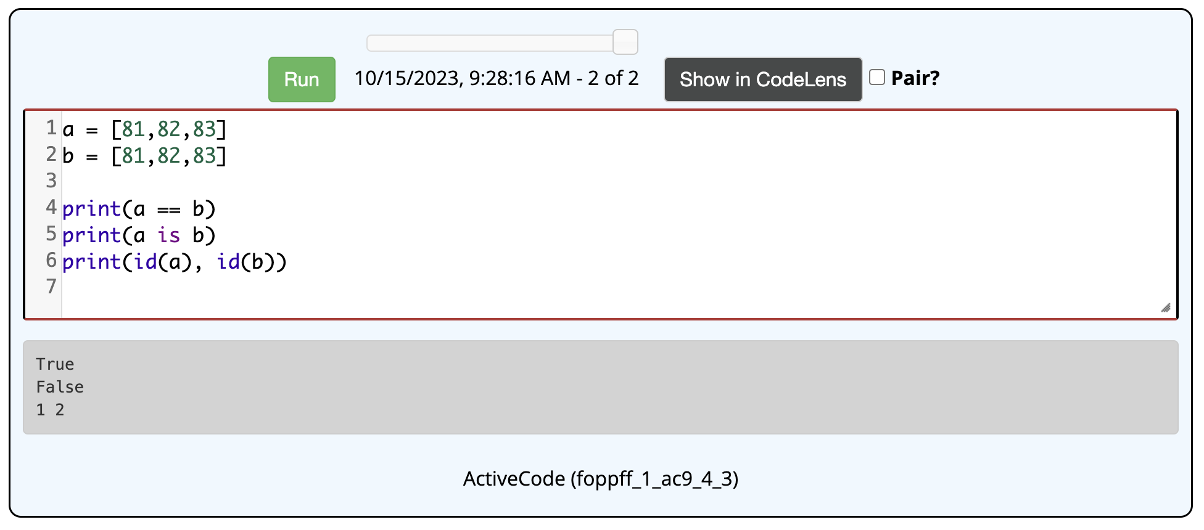
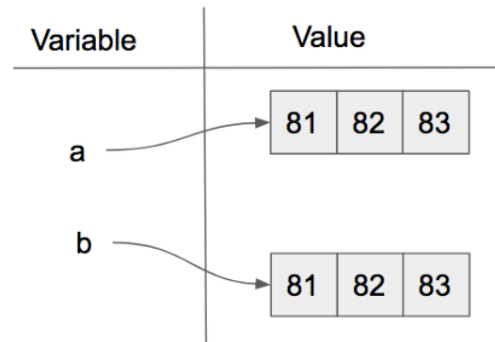
Mutable vs. immutable
in contrast, list values are rarely duplicated and tend to be dynamic
can grow or shrink over time, want to be able to modify contents
lists are stored independently

Slide 29
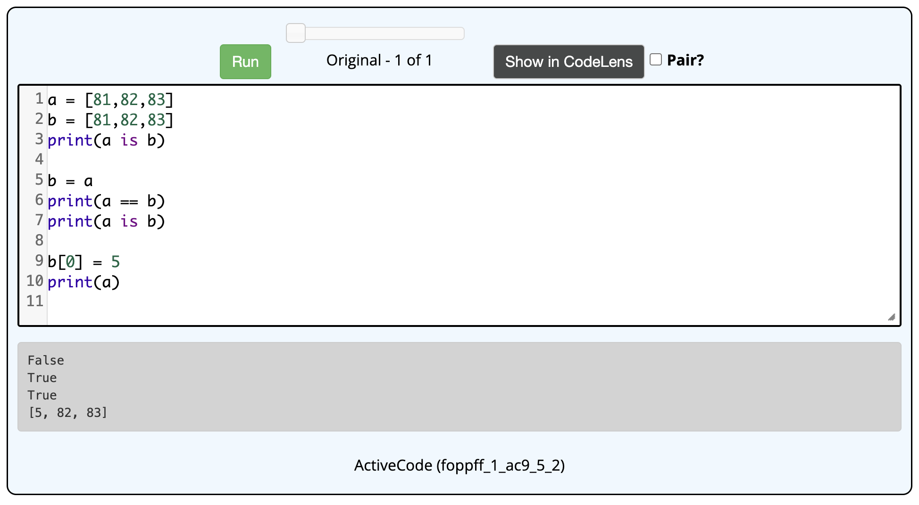
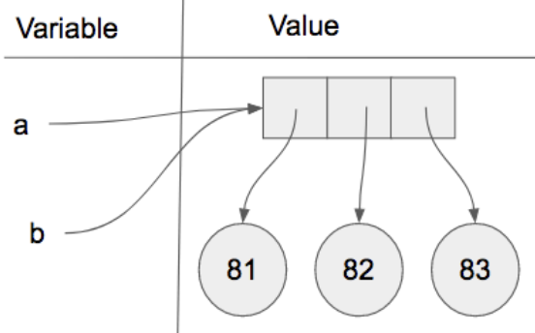
Aliasing
must be careful with lists and assignments
assigning a new variable to an existing list does not create a copy of the list
instead, it just creates an alias for the existing list

Slide 30
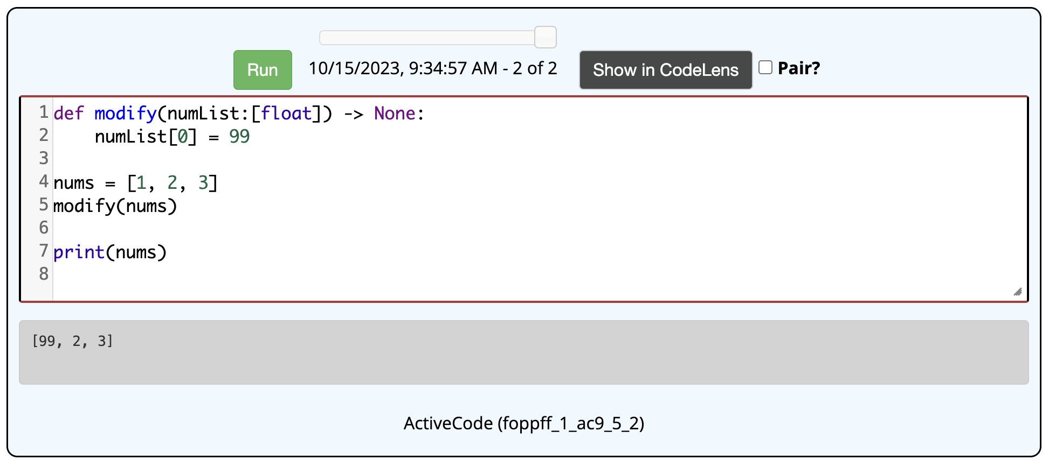
Parameters and aliasing
when you call a function, the parameters are assigned to the inputs
this is another example of aliasing
as a result, a function can change the contents of a list passed to it

Slide 31
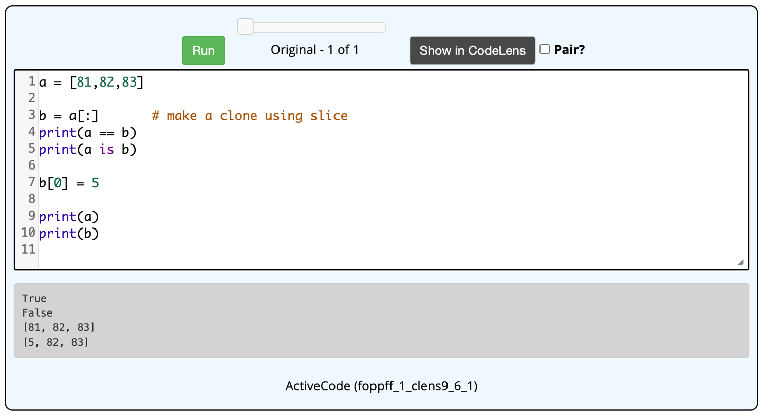
Aliasing is good
aliasing avoids copying list contents
lists can be very large → copying would take time and waste memory
when passing a list to a function, the size of the list doesn't matter
the parameter is just assigned to point to the same memory location
if you really do want to copy a list, slicing will create a clone

Slide 32
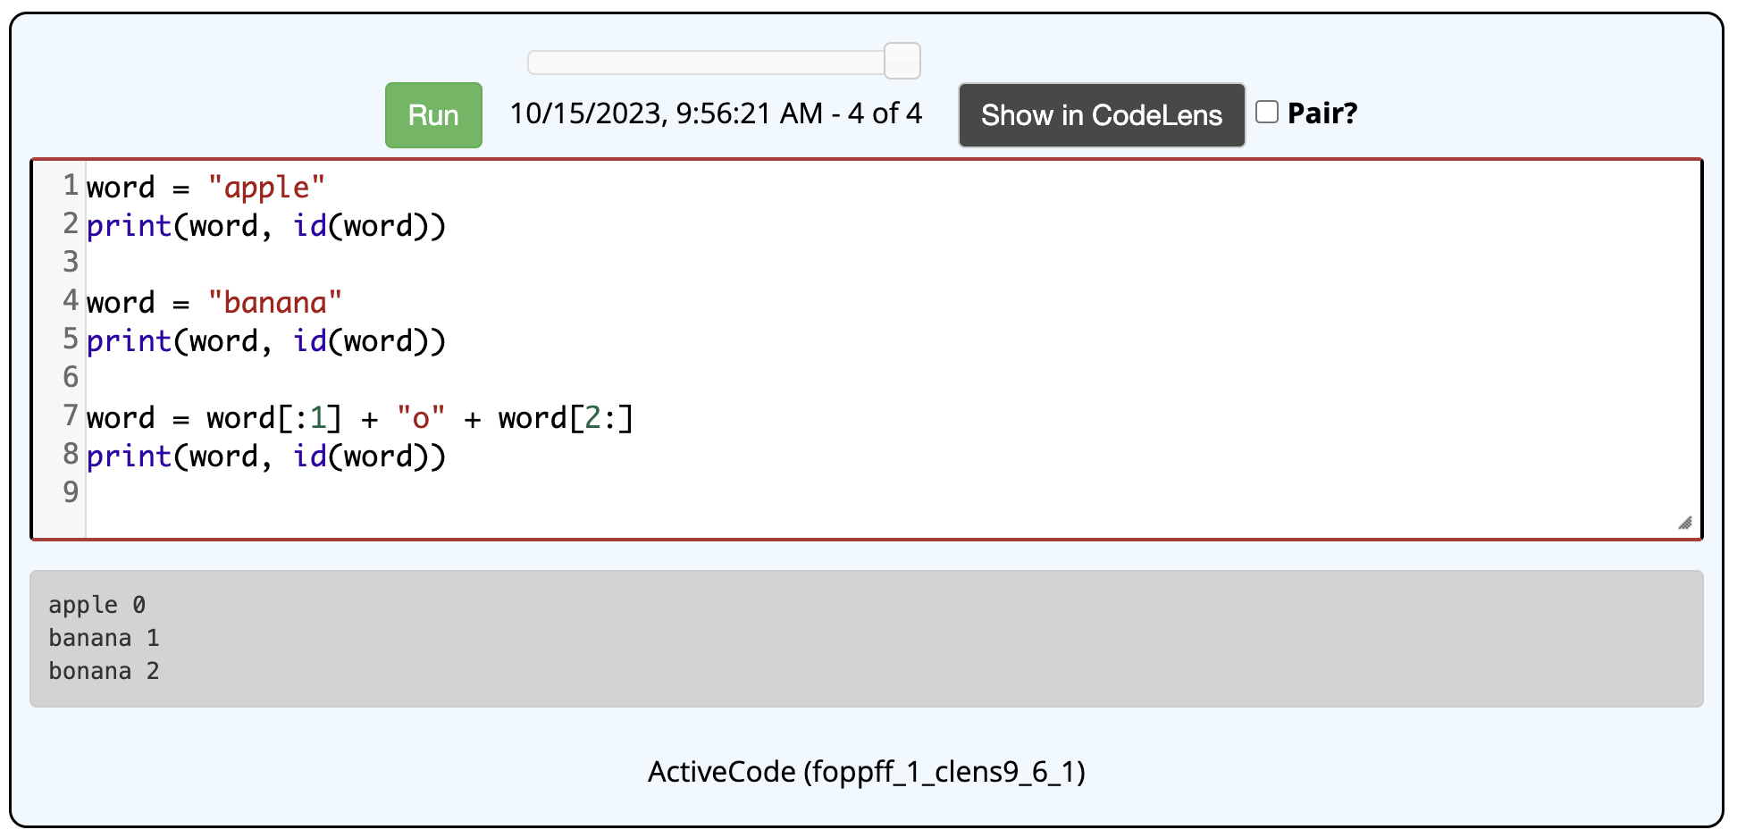
Important distinction
values are mutable/immutable, not variables
you can assign a variable different string values at different times
an assignment causes the variable to point to the value's memory location
word[1] = "o" ➔ ILLEGAL
word = word[:1] + "o" + word[2:] ➔ LEGAL

