Slide 1
CSC 221: Introduction to Programming Fall 2023
Variables, statements & expressions
Python interpreters
data types
operators & operands
function calls
variables
expressions
user input
IDLE modules

Slide 2
Python
Python is a programming language
similar to a spoken/written language, consists of statements that communicate ideas
print('Hello') num = 27
unlike a spoken/written language, the intended audience is a computer
more specifically, a Python interpreter that processes the statements and carries out the actions they specify
we will utilize two different Python interpreters in this class
the online text has an embedded interpreter
can execute Python statements → good for learning and exploring
for larger projects, we need an interpreter with more built-in support
will download and install IDLE from python.org → use for homework

Slide 3
Embedded Python interpreter
See the example in Chapter 2.2
the numbered lines contain Python statements
line 1 is a print statement, intended to print a number
line 2 is another print statement, intended to print a string (text enclosed in quotes)
when you click the Run button, the statements are executed in order
the values specified by the print statements are displayed, one per line

Slide 4
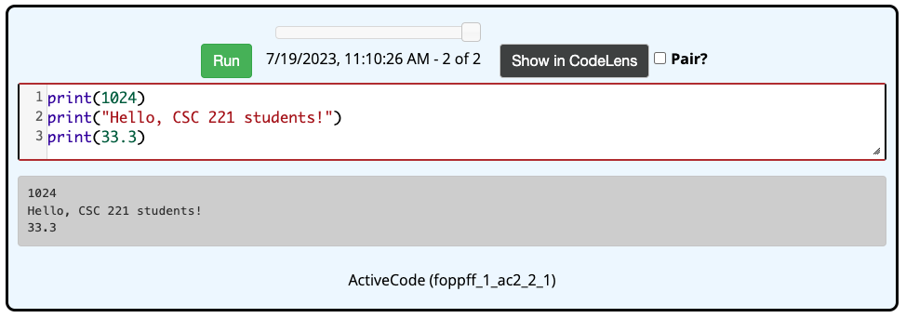
Embedded Python interpreter (cont.)
you can modify and/or add to the code in the boxes
feel free to explore
as you read about new concepts, try them out
if you refresh the page, it will return to its original form
also, there is a blank box at the bottom of each chapter

Slide 5
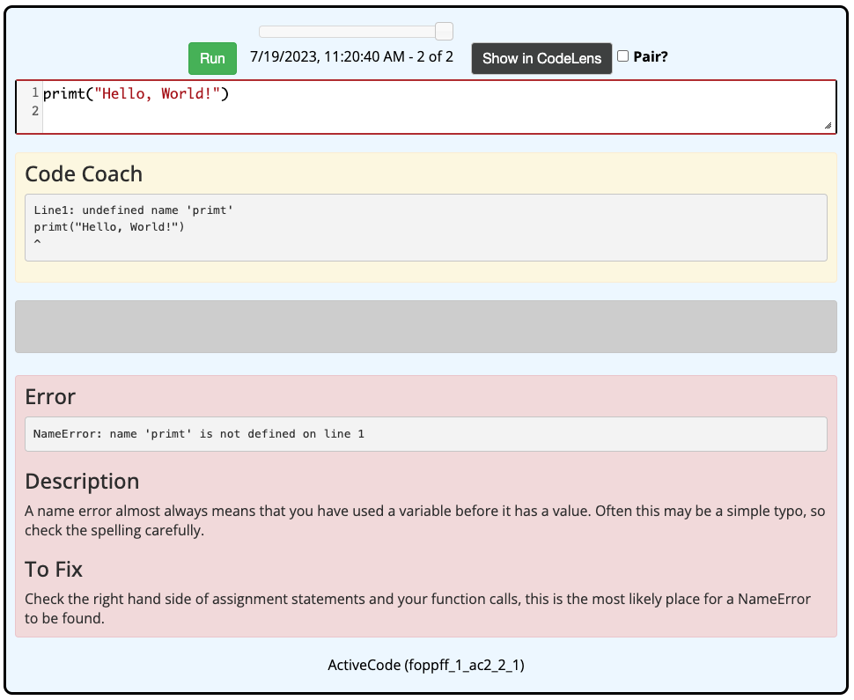
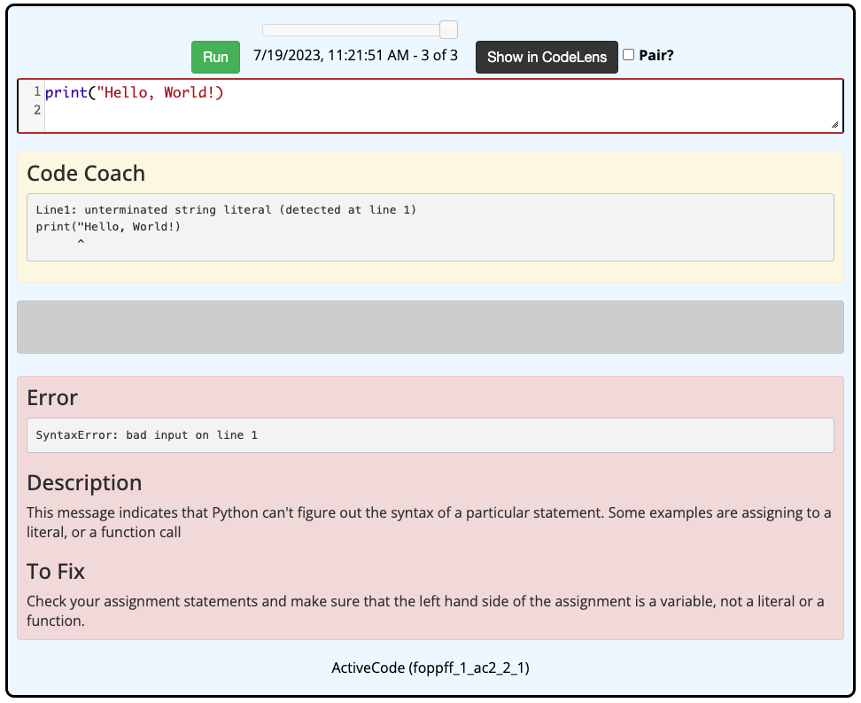
Computers are dumb!
humans are smart enough to deal with many spelling/grammatical errors
Everyone raise your leeft hand.
Did your neighbor raise they're hand as instructed?
computers are not nearly as flexible
statements must be perfect or the interpreter will not know what to make of it
fortunately, the interpreter provides guidance as to what the problem is

Slide 6
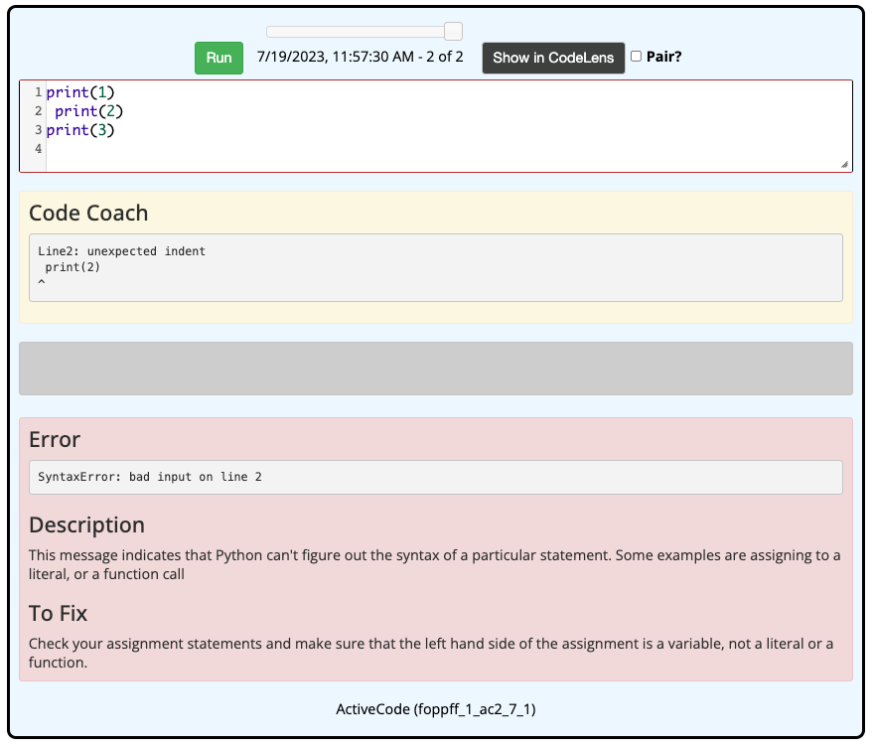
Indentation matters
Python is somewhat unique in that indentation is meaningful
statements must be aligned all the way to the left
this will make more sense later

Slide 7
Data types
a print statement displays one or more values when executed
if multiple values (separated by commas), will be printed with space in between
print(12) print("Hi") print("Hello", "there.")
the types of values we will utilize are
int integer values, e.g., 2 -10 1024 99999999999999
ICYI: can be specified in binary, octal or hexidecimal using '0b', '0o', and '0x' prefixes
0b1011 → 1011₂ → 11₁₀ 0o23 → 23₈ → 19₁₀ 0x1A → 1A₁₆ → 26₁₀
float floating point (real) values, e.g., 3.14 -2.0 1.9999999
ICYI: scientific notation can be used to make very small/large values clearer
1.234e5 → 1.234 x 10⁵ → 123400 9e-5 → 9 x 10⁻⁵ → 0.00009
string text enclosed in quotes, e.g., "Hello!" 'Guido von Rossum'
Boolean logical values, e.g., True False

Slide 8
Numbers & expressions
standard numeric operators are provided
+ addition 2+3 → 5 2+3.5 → 5.5
– subtraction 10–2 → 8 99–99.5 → -0.5
* multiplication 2*10 → 20 2*0.5 → 1.0
/ division 10/2.5 → 4.0 10/3 → 3.333…
** exponent 2**10 → 1024 9**0.5 → 3.0
less common but sometimes useful
% remainder 10%3 → 1 10.5%2 → 0.5
// integer division 10//4 → 2 10//4.0 → 2.0
note: spacing around an operator is optional: 2/3 = 2 / 3

Slide 9
Precedence & associativity
by default, ** has highest precedence, then * and /, then + and –
1+2**10 → 1+(2**10) → 1+1024 → 1025
4+2*3 → 4+(2*3) → 4+6 → 10
2*3+3**2 → 2*3+(3**2) → 2*3+9 → (2*3)+9 → 6+9 → 15
by default, ** is right-associative and the others are left-associative
4**3**2 → 4**(3**2) → 4**9 → 262144
8/4/2 → (8/4)/2 → 2/2 → 1
try to avoid relying on these rules in complex expressions
you can always add parentheses to force the order you want

Slide 10
Expressions vs. statements
an expression is NOT a statement
in particular, evaluating an expression does not produce any output
to see the result of a calculation, you must print that result

Slide 11
Exercise:
use the embedded interpreter at the end of Chapter 2.3 to calculate:
the number of seconds in a year (assume 365 days in a year)
your age in seconds
the number of inches in a mile
the distance to the sun in inches
the solution to the Wheat & Chessboard problem

Slide 12
Python strings
strings can be written using either single- or double-quote symbols
OK: "Creighton" 'Billy Bluejay' "Bob's your uncle"
not OK: "Creighton' 'Bob's your uncle'
can nest different quote symbols or use the escape '\' character
"Bob's your uncle" 'Bob\'s your uncle'
use three quotes on rare occasions when you want a string to span lines
"""This is
a single string"""
'''So is
this'''

Slide 13
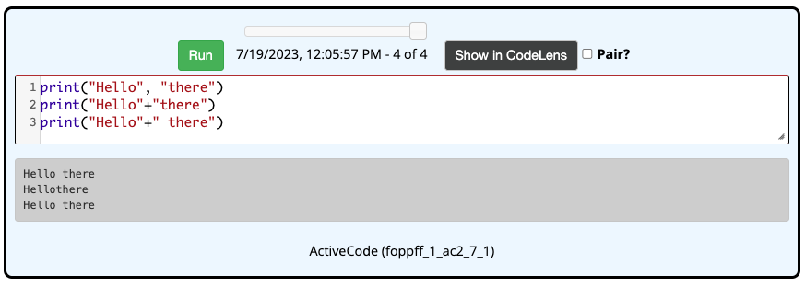
String concatenation
the + operator, when applied to strings, concatenates
i.e., text is appended together, with no spacing
"abc" + "def" → "abcdef"

Slide 14
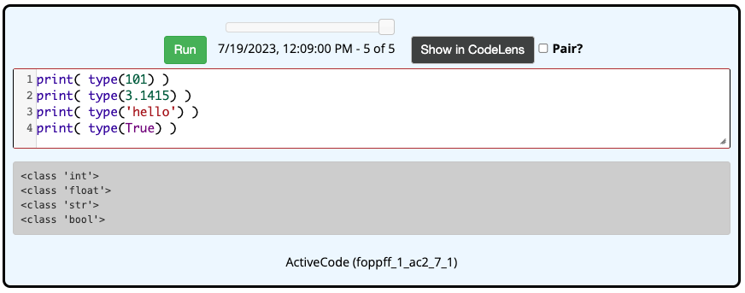
type function
in mathematics, a function is a mapping from some number of inputs to a single output
e.g., square root function $\sqrt{9}$ → 3
e.g., maximum function max(3.8, 4.2) → 4.2
Python provides numerous built-in functions for performing useful tasks
you call a function by specifying its name then any inputs in parentheses
e.g., the type function takes one input, a value, and returns its type as output

Slide 15
Other built-in functions
max(X, Y) returns larger of X and Y max(3.2, 5.1) → 5.1
max("gray", "blue") → "gray"
min(X, Y) returns smaller of X and Y max(3.2, 5.1) → 3.2
max("gray", "blue") → "blue"
abs(X) returns absolute value of X abs(-12) → 12
abs(12) → 12
round(X) returns nearest integer to X round(4.6) → 5 round(7.5) → 8
round(4.2) → 4 round(6.5) → 6
str(X) returns X as a string str(12) → '12'
str(True) → 'True'
int(X) returns X as an integer, if poss. int('150') → 150 int(3.8) → 3
int('abc') → ERROR
float(X) returns X as a float, if poss. float('9.7') → 9.7 float(3) → 3.0
float('abc') → ERROR
bool(X) returns X as a Boolean value bool('any') → True bool('') → False
bool(5) → True bool(0) → False

Slide 16
Variables & assignments
a variable is a name that can be assigned a value for convenience
once assigned, can be accessed and updated
age = 20
secondsInDay = 24 * 60 * 60
name = "Prudence"
general form of an assignment statement:
VARIABLE = VALUE_OR_EXPRESSION
a variable name must start with a letter, consist of letters, digits & underscores
the right-hand side of an assignment can include variables
secondsInYear = 365 * secondsInDay
greeting = "Dear " + name

Slide 17
Variable names
some reserved words cannot be used for variable names
for multi-word variable names, I will use camel-back notation
firstName numberOfSides feetToMeters
you may also see examples that use underscores
first_name number_of_sides feet_to_meters
note: capitalization matters, so firstname ≠ firstName

Slide 18
Assignment statements
note: there is a directionality to assignment statements
the right-hand side is evaluated first, then assigned to variable on left-hand side
if a variable appears on the right-hand side, its current value is used
x = 20 x is assigned the value 20
y = 3 + 2 the expression 3 + 2 evaluates to 5
y is assigned the value 5
z = x + y the expression x + y evaluates to 20 + 5 → 25
z is assigned the value 25
x = x + 1 the expression x + 1 evaluates to 20 + 1 → 21
x is assigned the value 21
when reading an assignment statement, always say "is assigned" or "gets"

Slide 19
Exercise: population growth
visit http://www.census.gov/popclock for a current U.S. population estimate
e.g., 335,096,372 at 2:10 pm (CDT) on 7/19/23
according to U.S. Census Bureau:
one birth every 8 seconds
one death every 11 seconds
we want to predict the population some number of years in the future
e.g., what would be the population 10 years from now? (assume 365.25 day/year)

Slide 20
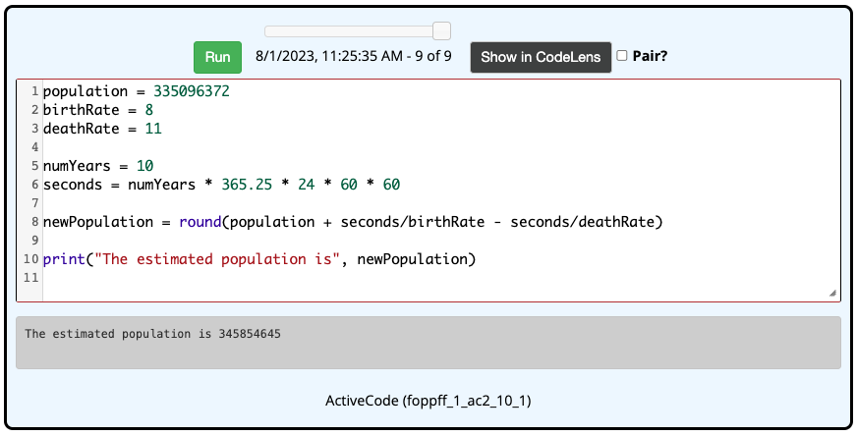
Issues (pt. 1)
not readable
significant duplication
difficult to edit/fix/change
we can address readability & duplication by introducing variables

Slide 21
Issues (pt. 2)
variables make the code more readable and reduce duplication, but the number of years is still hard-coded into the formula
if want to estimate 20 years in future, must edit the formula and re-run
better to automate the process: prompt the user for the duration
the input function prompts the user for a value and returns it
general form: VARIABLE = input(PROMPT)
name = input("Please enter your name: ")
color = input('What is your favorite color? ')
when executed, the prompt is displayed and whatever text the user enters is assigned to the variable

Slide 22
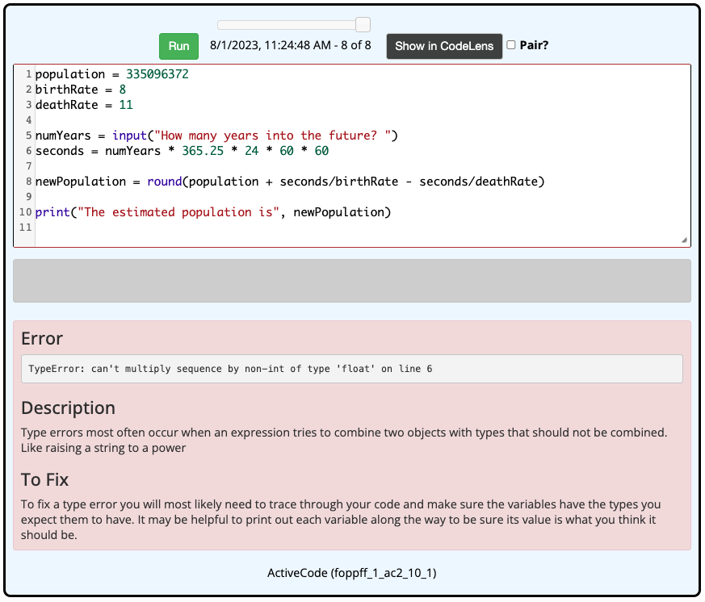
Population w/ input
this does not work
the input function always returns a string
if user enters 10, read in as "10"
can't multiply a string with a number
need to combine input with the int conversion function

Slide 23
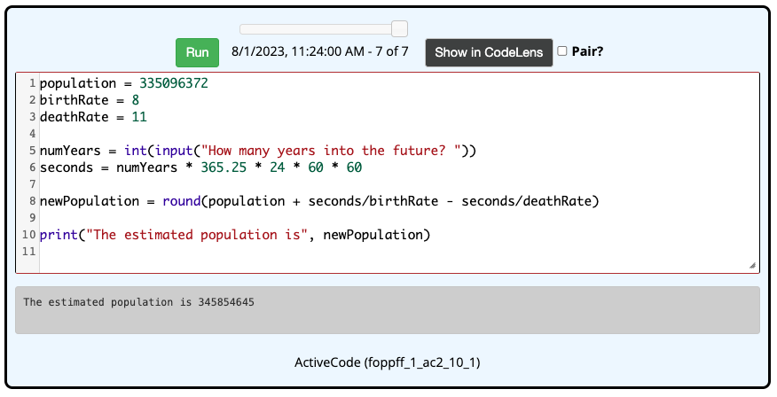
Inputting numbers
whenever you want to read in a number, need to add int or float:
numYears = int(input("How many years into the future? "))
gpa = float(input("What is your GPA? "))

Slide 24
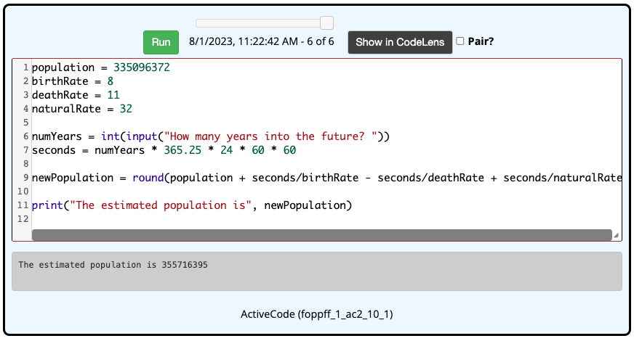
Exercise
there is actually a third factor in population growth: immigration
a naturalized citizen is added to the U.S. population every 32 seconds
how would we modify the code to account for this additional factor?

Slide 25
Exercise: reading level
in the 1970's, the U.S. military developed a formula for measuring the readability of text (*for young adults)
the FORCAST formula assigns a reading age to text based on the following:
$$\text{reading} \text{age}\text{ = 20 }–\text{ 15 }× \frac{\text{\# }\text{single} \text{syllable} \text{words}}{\text{total}\text{ \# }\text{of} \text{words}}$$
in one of the book's interpreter boxes, write Python code that
prompts the user for the # of single syllable words and total # of words in a text
calculates the reading age for that text
prints that reading age (in a readable format)

Slide 26
Exercise solution
note the pattern
statement(s) to read in input(s) and store in variable(s)
statement(s) tocalculate value(s) using the input(s)
print statement(s) to display the result(s)

Slide 27
Issues (pt. 3)
this version is more readable and easier to execute repeatedly
no way to save the code for later use (other than copy-paste)
limited assistance with editing/debugging
better to use a full-featured development environment
if you have not already done so, download Python from python.org
current distribution is 3.11.4
download includes the Python interpreter & the IDLE development environment
accept all the defaults when installing, place a shortcut to IDLE on your taskbar

Slide 28
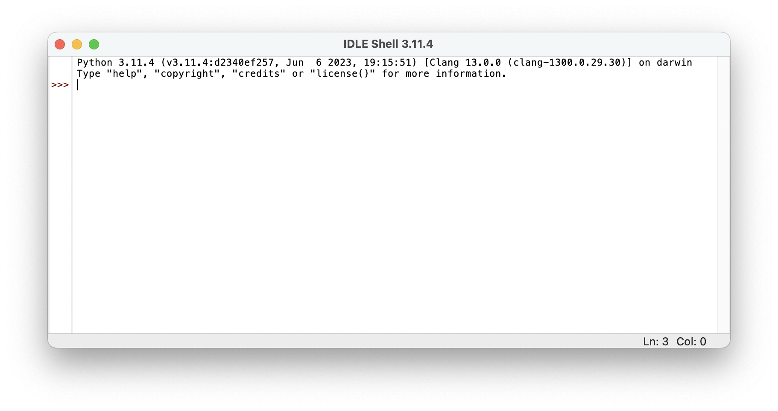
IDLE
IDLE stands for Integrated Development and Learning Environment
when you execute IDLE, it opens an interpreter shell
the IDLE shell is similar to the embedded interpreter boxes in the textbook
can enter statements at the >>> prompt, output is displayed below

Slide 29
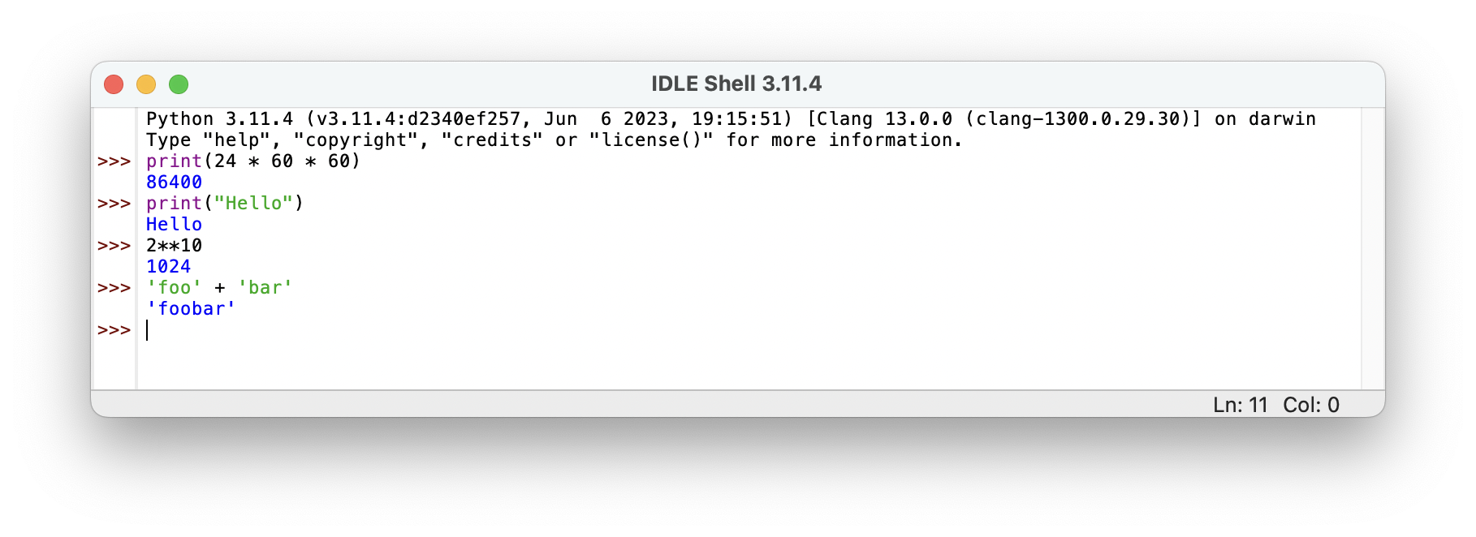
IDLE shell
the IDLE shell different in several ways
you can enter an expression and it will display its value (handy for exploration)
the shell uses color to differentiate parts of statements
(reserved words: purple, strings: green, output: blue, Booleans: orange)
can copy-paste from previous lines
Edit menu (at top of screen) has many useful commands

Slide 30
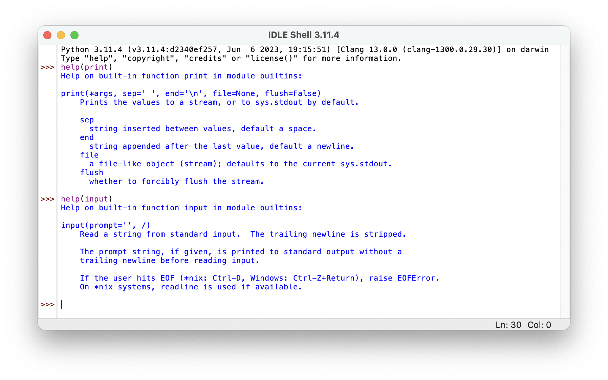
IDLE help
IDLE has a link to Python documentation under the Help menu
you can also get help on any function by typing help(FUNC_NAME)

Slide 31
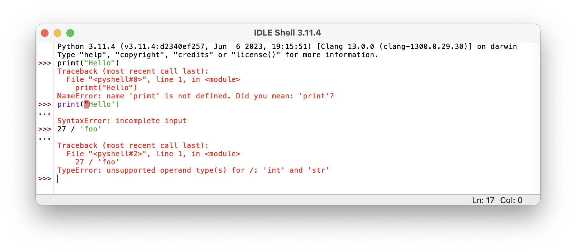
IDLE error messages
when an error occurs in the code, a helpful message appears in the shell
maybe not as detailed as the textbook interpreter, but still helpful
the real value of the IDLE environment is the ability to create modules
a module is a file containing a sequence of Python statements
can create, edit, save, execute code in a module much easier than in the book

Slide 32
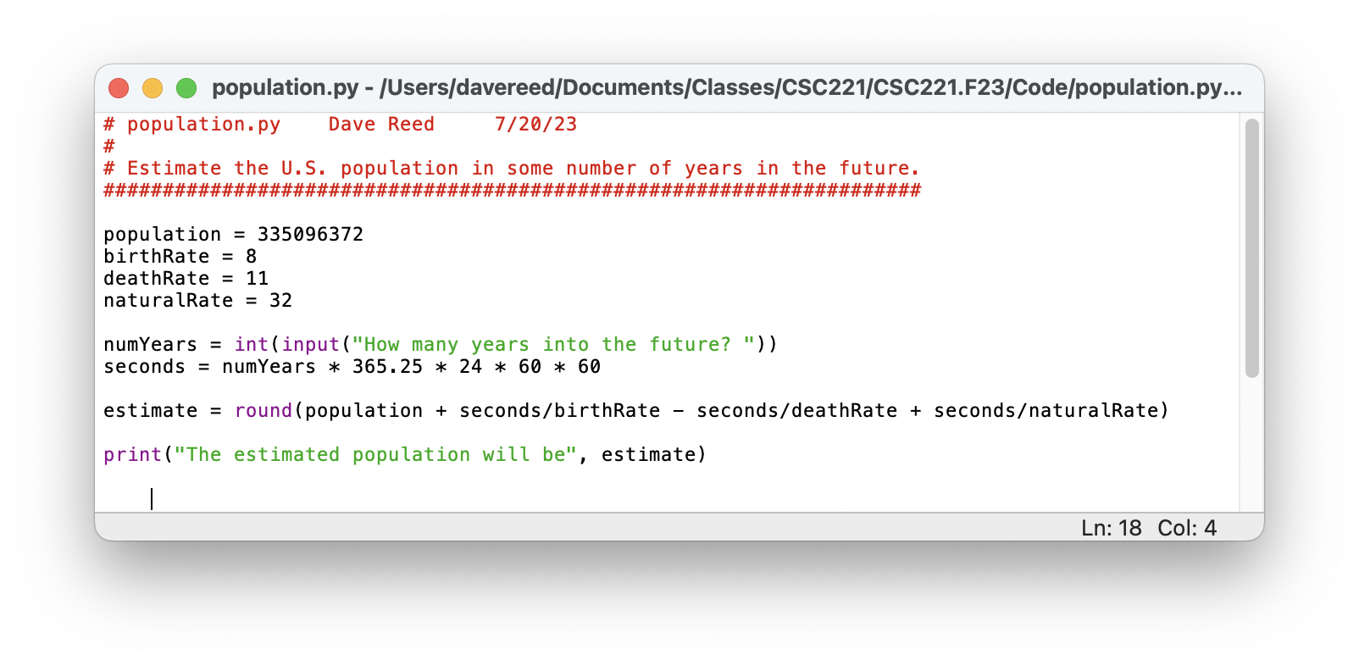
Modules
to create a new module, select "New File" from the File menu
can then enter the statements into the module window
to save a module, select "Save" from the file menu
be sure to specify the desired folder and file name (end with .py extension)
to execute the statements in a module, select "Run Module" from the Run menu
can repeatedly edit, save & run as you develop your program
to open an existing module, select "Open Module" from the File menu
note: # is used for comments in Python
any text on a line following # is ignored by the interpreter

Slide 33
Reading level example
EXERCISE: create a new module named surface.py
write Python code to
prompt the user for their height (in cm) and weight (in kg)
calculate their body surface area & display it
surface area = 0.007184 x height^{0.725} x weight^{0.425}

Slide 34
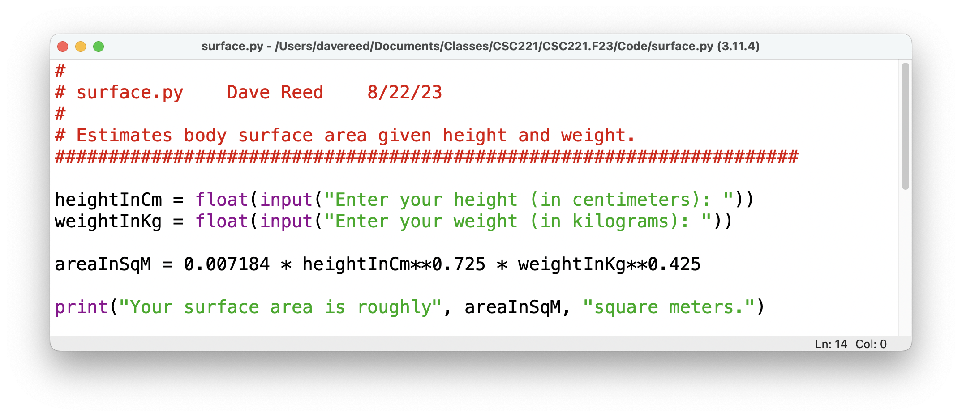
Exercise solution
we don't need that many decimal places in the answer
can round to the desired number of places by adding an input to round
round(num, N) → returns num rounded to N decimal places
EXERCISE: modify your module code to round the surface area to 2 decimal places

Slide 35
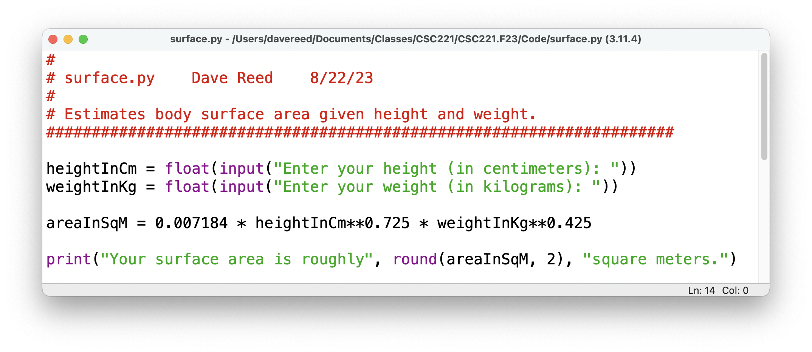
Updated solution
note the following conversions:
1 inch = 2.54 centimeters 1 pound = 0.453592 kilograms
1 square foot = 0.092903 square meters
EXERCISE: modify your code so that height/weight are entered in inches/pounds and area is displayed in square feet

Slide 36
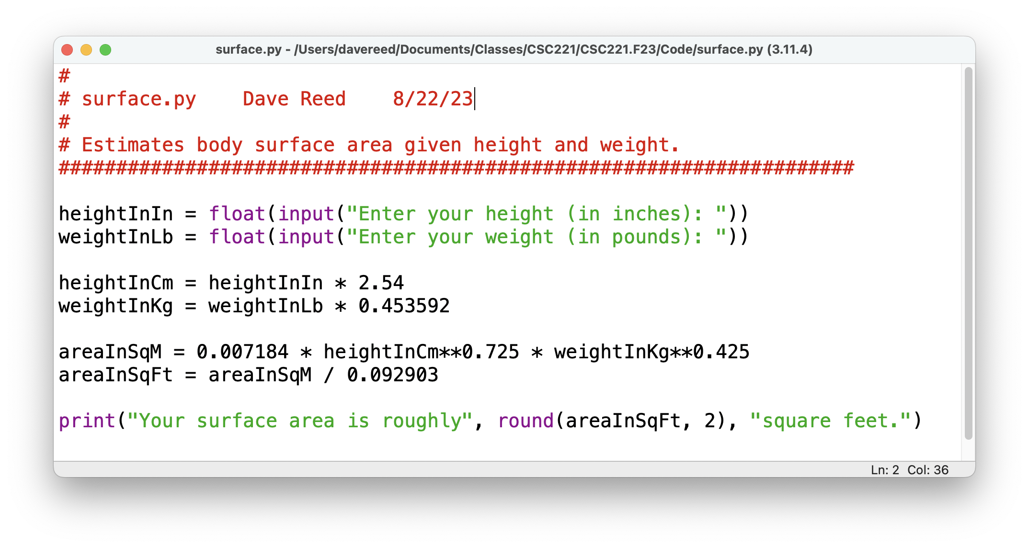
Final version
note that the variable names make it clear not only what is being measured but also the unit of measurement

Slide 37
HW2
you will create three different modules
display a verse of the children's song The Wheels on the Bus
calculate and display a baseball team's expected record based on the number of runs they score and allow (using the Pythagorean Winning Percentage)
calculate and display the differences between absolute and relative time experienced at extreme speeds
be sure to name the module files exactly as specified
submit a ZIP file containing all three modules

