Slide 1
CSC 321: Data Structures
Spring 2024
Balanced and other trees
  self-balancing BSTs: AVL trees, red-black trees
    TreeSet & TreeMap implementations
  heaps
    priority queue implementation
    heap sort

Slide 2
Balancing trees
recall: on average, N random insertions into a BST yields O(log N) height
  however, degenerative cases exist (e.g., if data is close to ordered)
we can ensure logarithmic depth by maintaining balance
maintaining full balance can be costly
  however, full balance is not needed to ensure O(log N) operations
  just need to guarantee O(log N) height

Slide 3
Potential Balance Conditions
simple but too weak
  left and right subtrees of the root
  have equal number of nodes
  left and right subtrees of the root have equal height

Slide 4
Potential Balance Conditions
complex but too strong
  left and right subtrees of every node
  have equal number of nodes
  left and right subtrees of every node have equal height
  these both force minimal height, too costly to implement

Slide 5
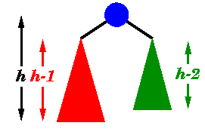
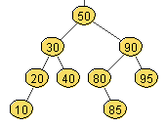
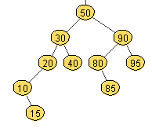
AVL trees
an AVL tree is a binary search tree where
  for every node, the heights of the left and right subtrees differ by at most 1
  first self-balancing binary search tree variant
  named after Adelson-Velskii & Landis (1962)
  see www.cs.usfca.edu/~galles/visualization/AVLtree.html
AVL tree
not an AVL tree – WHY?

Slide 6
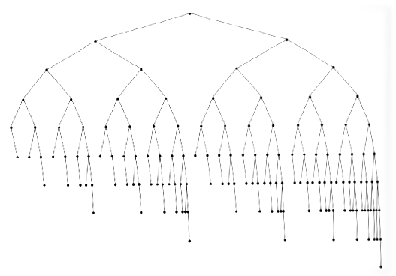
AVL trees and balance
the AVL property is weaker than full balance, but sufficient to ensure logarithmic height
  CLAIM: height of AVL tree with N nodes < 2 log₂N → searching is O(log N)

Slide 7
How do we prove this?
Proving O(log n) depth bound
let S(H) = the minimum number of nodes in an AVL tree of height h
  if we can prove that S(H) grows exponentially in H, then a tree with n nodes has a logarithmic height
Step 1: define S(H) inductively using AVL property
  S(0)=0, S(1)=1, S(2)=2
  for H ≥ 1, S(H) = 1+S(H-1)+S(H-2)
Step 2: show this recurrence grows exponentially
  can prove for all H, S(H) > ɸ^{H} – 1, where ɸ = (1+√5)/2 ≅ 1.62
= m(h-1) + m(h-2) + 1

Slide 8
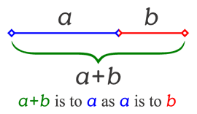
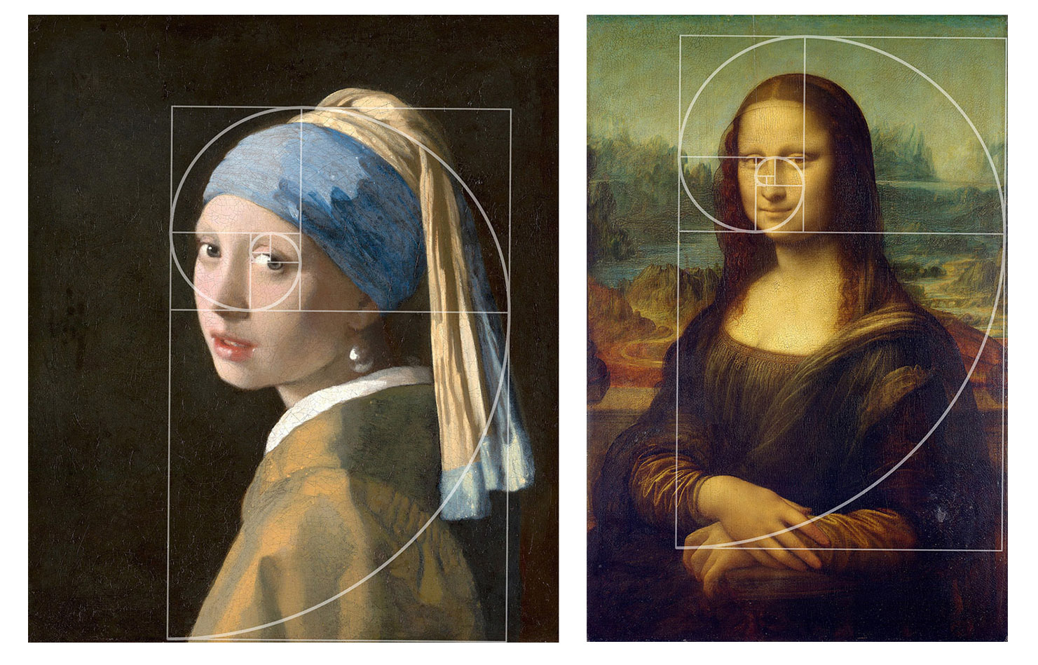
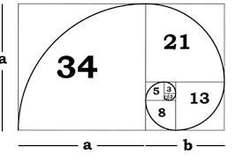
The Golden Ratio
Golden Ratio: ɸ = a/b = (a+b)/a
  since the Renaissance, many artists and architects have proportioned their work (e.g., length:height) to approximate the golden ratio.

Slide 9
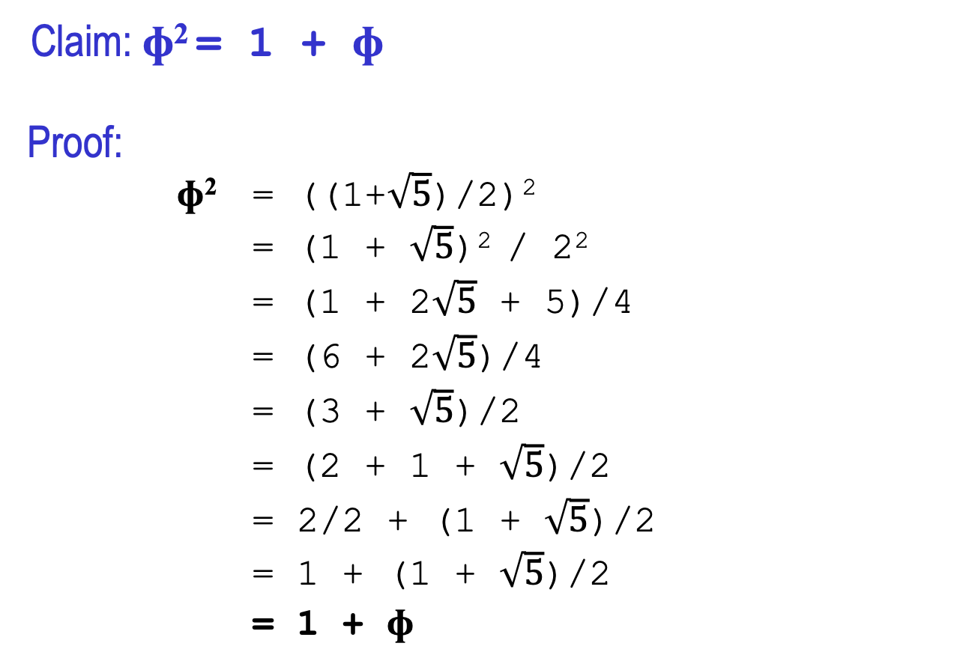
Interesting property
Claim: ɸ² = 1 + ɸ
Proof:
ɸ² = ((1+$\sqrt{5}$)/2)²
= (1 + $\sqrt{5}$)² / 2²
= (1 + 2$\sqrt{5}$ + 5)/4
= (6 + 2$\sqrt{5}$)/4
= (3 + $\sqrt{5}$)/2
= (2 + 1 + $\sqrt{5}$)/2
= 2/2 + (1 + $\sqrt{5}$)/2
= 1 + (1 + $\sqrt{5}$)/2
= 1 + ɸ

Slide 10
  Proof that the AVL property is sufficient
S(H) = the minimum number of nodes in an AVL tree of height H
Theorem: for all heights H, S(H) > ɸ^{H} – 1
Proof (by induction):
BASE CASE(S):
  S(0) = 0 > ɸ⁰ – 1 = 0
  S(1) = 1 > ɸ¹– 1 ≅ 0.62
INDUCTION HYPOTHESIS:
  Assume for all H < X, S(H) > ɸ^{H} – 1
INDUCTIVE STEP:
Must show S(X) > ɸ^{X} – 1 → next slide

Slide 11
Inductive step
must show S(X) > ɸ^{X} – 1:
S(X) = 1 + S(X-1) + S(X-2) by definition of S(H)
> 1 + (ɸ^{(X-1)} – 1) + (ɸ^{(X-2)} – 1) by Induction Hypothesis
= ɸ^{(X-1)} + ɸ^{(X-2)} – 1 by regrouping
= ɸ^{(X-2)} (ɸ + 1) – 1 by factoring
= ɸ^{(X-2)} ɸ² – 1 by property: (ɸ + 1) = ɸ²
= ɸ^{X} – 1 by simplifying
Note: AVL tree of height H has > ɸ^{H} – 1 nodes
➔ AVL tree with ɸ^{H} – 1 nodes has height < H
➔ AVL tree with ɸ^{H} nodes has height ≤ H
➔ AVL tree with N nodes has height ≤ log_{ɸ}N ≅ 1.44 log₂ N
➔ AVL tree with N nodes is O(log N)

Slide 12
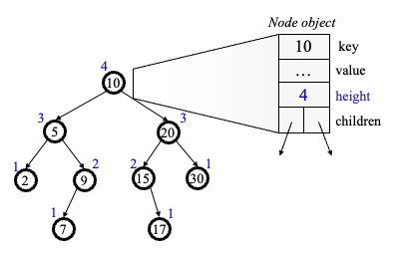
AVL trees
recall: the whole point of AVL trees was to define a weaker property (than full balance) that ensures O(log N) height
  since an AVL tree IS_A binary search tree, guaranteed that search is O(log N)
to be practical, also need to ensure that add/remove are at worst O(log N)
  add field to each node to keep track of its height
  after each add/remove, if new height violates AVL property, FIX IT in O(log N) time

Slide 13
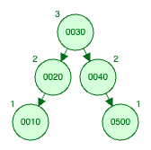
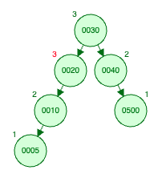
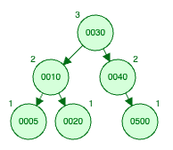
AVL add
to add to an AVL tree:
  add exactly as with any BST (& update height fields on the way down to the leaf)
  note any node on that path that becomes unbalanced (children differ by > 1)
  if we can "fix" that lowest such node, the whole tree is "fixed"
add 5
fix it

Slide 14


Single rotation
the basic "fix" operation is a rotation
  move the child of the unbalanced node into the parent position
  parent becomes the other child (always OK in a BST)
note: after rotation, node is at same height as before add, so AVL property assured

Slide 15
Example generalized
in general, a subtree may have to be carried with the rotation
  e.g., suppose we add to the left-subtree of b in the AVL tree below
  this causes an imbalance at a
  when the rotation occurs, b's right subtree becomes a's left subtree
a
h+2
h+1
b
h
h
Z
a
h+3
h
h+2
X
Y
b
h
h+1
Z
h
b
h+2
X
Y
a
h+1
h+1
h
h
X
Y
Z

Slide 16
Another example
15
8
22
4
10
19
24
3
6
17
20
16
15
8
19
4
10
17
22
3
6
16
20
24

Slide 17
Right-right case
if the tree is flipped and the addition is on the far right
  perform the same rotation but in the opposite direction
h+3
a
h+2
h
h+2
b
X
h+1
b
a
h+1
h
Z
h
h+1
h
Y
Z
X
Y

Slide 18
What about left-right and right-left?
a
h+3
h+3
a
h+2
h
h+2
b
h
X
b
Z
h
h+1
X
Y
h+1
h
Y
Z
unfortunately, a single rotation does not work
b
h+3
b
h+3
h+2
a
h+2
a
h
h
Z
h
h+1
X
h
X
Y
h+1
Y
Z

Slide 19
Double rotation
two rotations are needed to handle this case
h+3
a
h+2
h
h+1
b
X
h
h
c
Z
h-1
U
V
h+3
a
h+2
h
c
X
h
h+1
U
h-1
b
V
h
h+2
Z
c
h+1
h+1
a
b
h
h
X
U
h-1
h
V
Z

Slide 20
Left-right and right-left
h+3
h+2
a
h+2
c
h
h+1
b
h+1
X
h
b
h+1
c
a
h
h
h-1
Z
h
h
V
X
U
h-1
U
V
Z
h+3
a
h+2
h+2
c
b
h
h+1
h+1
Z
a
h+1
c
b
h
h
h
U
h-1
h
X
h
X
V
Z
U
h-1
V

Slide 21
AVL tree summary
search: O(log N)
  BST search is O(height)
  AVL property ensures height is O(log N) → O(log N)
add: O(log N)
  BST add is O(height) → O(log N)
  can maintain AVL property in O(log N)
    update height fields on altered path → O(1) at each node → O(log N)
    may need to perform single or double rotation if unbalanced → O(1)
remove: O(log N)
  BST remove is O(height) → O(log N)
  can maintain AVL property in O(log N)
    update height fields on altered path → O(1) at each node → O(log N)
    may need to perform single or double rotation if unbalanced → O(1)

Slide 22
Self-balancing BSTs
AVL trees were the first self-balancing BST
  ensured O(log N) height, search/add/remove all O(log N)
other self-balancing BST variants have been developed
  B-tree 1970
  Red-black tree 1978
  Scapegoat tree 1989
  Treap 1989
  AA tree 1993
  Tango tree 2004
Java's TreeSet and TreeMap utilize red-black trees
  comparable in speed to AVL trees, more memory efficient

Slide 23
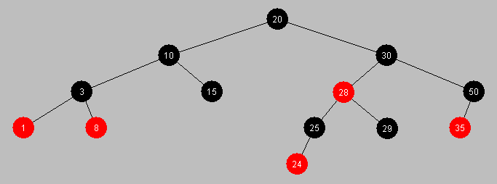
Red-black trees
a red-black tree is a binary search tree in which each node is assigned a color (either red or black) such that
    the root is black
    a red node never has a red child
    every path from root to leaf has the same number of black nodes
  add & remove preserve these properties (complex, but still O(log N))
  red-black properties ensure that tree height < 2 log(N+1) → O(log N) search
see a demo at www.cs.usfca.edu/~galles/visualization/RedBlack.html

Slide 24
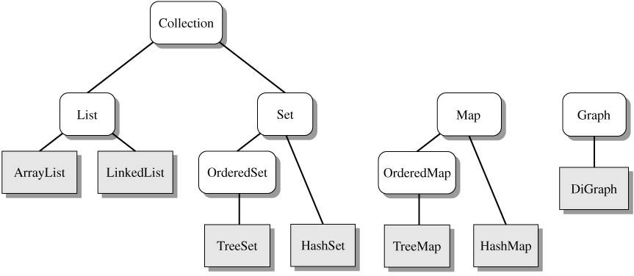
Java Collection classes
recall the Java Collection Framework
  defined using interfaces abstract classes, and inheritance
in some languages, a Map is referred to as an "associative list" or "dictionary"
array
doubly-linked list
red-black tree
hash table
red-black tree
hash table

Slide 25
Sets
java.util.Set interface: an unordered collection of items, with no duplicates
  public interface Set<E> extends Collection<E> {
  boolean add(E o); // adds o to this Set
  boolean remove(Object o); // removes o from this Set
  boolean contains(Object o); // returns true if o in this Set
  boolean isEmpty(); // returns true if empty Set
  int size(); // returns number of elements
  void clear(); // removes all elements
  Iterator<E> iterator(); // returns iterator
  . . .
  }
implemented by TreeSet and TreeMap classes
  TreeSet implementation
    implemented using a red-black tree; items stored in the nodes (must be Comparable)
    provides O(log N) add, remove, and contains (guaranteed)
    iteration over a TreeSet accesses the items in order (based on compareTo)
  HashSet implementation
    HashSet utlizes a hash table data structure LATER
    HashSet provides O(1) add, remove, and contains (on average, but can degrade)

Slide 26
Dictionary revisited
import java.util.Set;
import java.util.TreeSet;
import java.util.Scanner;
import java.io.File;
public class Dictionary {
private Set<String> words;
public Dictionary() {
this.words = new TreeSet<String>();
}
public Dictionary(String filename) {
this();
try {
Scanner infile = new Scanner(new File(filename));
while (infile.hasNext()) {
String nextWord = infile.next();
this.add(nextWord);
}
}
catch (java.io.FileNotFoundException e) {
System.out.println("FILE NOT FOUND");
}
}
public void add(String newWord) {
this.words.add(newWord.toLowerCase());
}
public void remove(String oldWord) {
this.words.remove(oldWord.toLowerCase());
}
public boolean contains(String testWord) {
return this.words.contains(testWord.toLowerCase());
}
}
note: our Dictionary class could have been implemented using a Set
  Strings are Comparable, so could use either implementation
  TreeSet has the advantage that iterating over the Set elements gives them in order (here, alphabetical order)

Slide 27
Maps
java.util.Map interface: a collection of key → value mappings
  public interface Map<K, V> {
  boolean put(K key, V value); // adds key→value to Map
  V remove(Object key); // removes key→? entry from Map
  V get(Object key); // returns true if o in this Set
  boolean containsKey(Object key); // returns true if key is stored
  boolean containsValue(Object value); // returns true if value is stored
  boolean isEmpty(); // returns true if empty Set
  int size(); // returns number of elements
  void clear(); // removes all elements
  Set<K> keySet(); // returns set of all keys
  . . .
  }
implemented by TreeMap and HashMap classes
  TreeMap implementation
    utilizes a red-black tree to store key/value pairs; ordered by the (Comparable) keys
    provides O(log N) put, get, and containsKey (guaranteed)
    keySet() returns a TreeSet, so iteration over the keySet accesses the keys in order
  HashMap implementation
    HashSet utlizes a HashSet to store key/value pairs LATER
    HashSet provides O(1) put, get, and containsKey (on average, but can degrade)

Slide 28
Word frequencies
import java.util.Map;
import java.util.TreeMap;
import java.util.Scanner;
import java.io.File;
public class WordFreq {
private Map<String, Integer> words;
public WordFreq() {
words = new TreeMap<String, Integer>();
}
public WordFreq(String filename) {
this();
try {
Scanner infile = new Scanner(new File(filename));
while (infile.hasNext()) {
String nextWord = infile.next();
this.add(nextWord);
}
}
catch (java.io.FileNotFoundException e) {
System.out.println("FILE NOT FOUND");
}
}
public void add(String newWord) {
String cleanWord = newWord.toLowerCase();
if (words.containsKey(cleanWord)) {
words.put(cleanWord, words.get(cleanWord)+1);
}
else {
words.put(cleanWord, 1);
}
}
public void showAll() {
for (String str : words.keySet()) {
System.out.println(str + ": " + words.get(str));
}
}
}
a variant of Dictionary is WordFreq
  stores words & their frequencies (number of times they occur)
  can represent the word→counter pairs in a Map
  again, could utilize either Map implementation
  since TreeMap is used, showAll displays words + counts in alphabetical order

Slide 29
Other tree structures
a heap is a common tree structure that:
  can efficiently implement a priority queue (a list of items that are accessed based on some ranking or priority as opposed to FIFO/LIFO)
  can also be used to implement another O(N log N) sort
motivation: many real-world applications involve optimal scheduling
  choosing the next in line at the deli
  prioritizing a list of chores
  balancing transmission of multiple signals over limited bandwidth
  selecting a job from a printer queue
  multiprogramming/multitasking
all these applications require
  storing a collection of prioritizable items, and
  selecting and/or removing the highest priority item

Slide 30
Priority queue
priority queue is the ADT that encapsulates these 3 operations:
  add item (with a given priority)
  find highest priority item
  remove highest priority item
  e.g., assume printer jobs are given a priority 1-5, with 1 being the most urgent
a priority queue can be implemented in a variety of ways
  unsorted list
    efficiency of add? efficiency of find? efficiency of remove?
  sorted list (sorted by priority)
    efficiency of add? efficiency of find? efficiency of remove?
  others?
job1
3
job 2
4
job 3
1
job 4
4
job 5
2
job4
4
job 2
4
job 1
3
job 5
2
job 3
1

Slide 31
java.util.PriorityQueue
Java provides a PriorityQueue class
  public class PriorityQueue<E extends Comparable<? super E>> {
  /** Constructs an empty priority queue
  */
  public PriorityQueue<E>() { … }
  /** Adds an item to the priority queue (ordered based on compareTo)
  * @param newItem the item to be added
  * @return true if the items was added successfully
  */
  public boolean add(E newItem) { … }
  /** Accesses the smallest item from the priority queue (based on compareTo)
  * @return the smallest item
  */
  public E peek() { … }
  /** Accesses and removes the smallest item (based on compareTo)
  * @return the smallest item
  */
  public E remove() { … }
  public int size() { … }
  public void clear() { … }
  . . .
  }
the underlying data structure is a special kind of binary tree called a heap

Slide 32
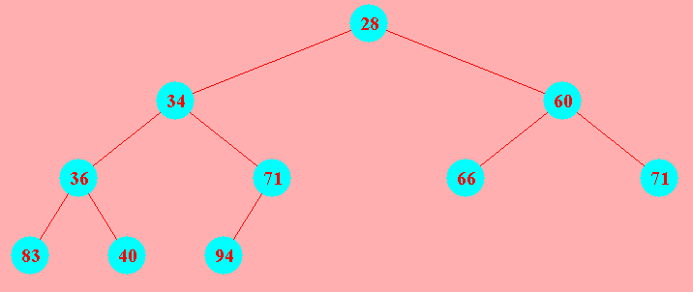
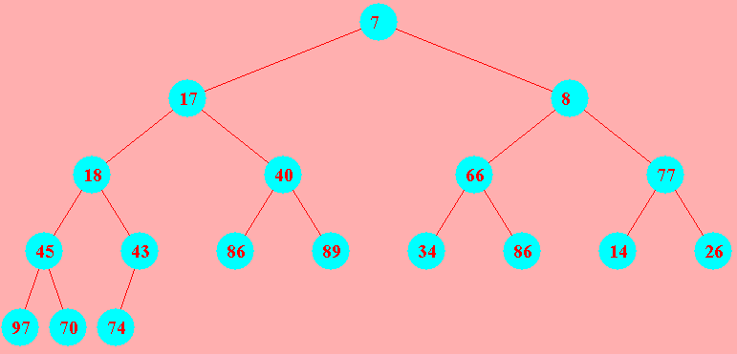
Heaps
a complete tree is a tree in which
  all leaves are on the same level or else on 2 adjacent levels
  all leaves at the lowest level are as far left as possible
a heap is complete binary tree in which
  for every node, the value stored is ≤ the values stored in both subtrees
    (technically, this is a min-heap -- can also define a max-heap where the value is ≥ )
since complete, a heap has minimal height = ⎣log₂ N⎦+1
  can insert in O(height) = O(log N), but searching is O(N)
  not good for general storage, but perfect for implementing priority queues
    can access min value in O(1), remove min value in O(height) = O(log N)

Slide 33
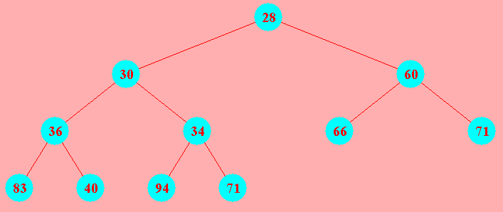
Inserting into a heap
to insert into a heap
  place new item in next open leaf position
  if new value is smaller than parent, then swap nodes
  continue up toward the root, swapping with parent, until smaller parent found
  see www.cs.usfca.edu/~galles/JavascriptVisual/Heap.html
add 30
note: insertion maintains completeness and the heap property
  worst case, if add smallest value, will have to swap all the way up to the root
  but only nodes on the path are swapped → O(height) = O(log N) swaps

Slide 34
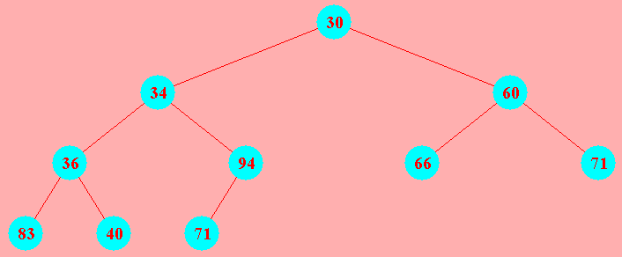
Removing from a heap
to remove the min value (root) of a heap
  replace root with last node on bottom level
  if new root value is greater than either child, swap with smaller child
  continue down toward the leaves, swapping with smaller child, until smallest
  see www.cs.usfca.edu/~galles/JavascriptVisual/Heap.html
note: removing root maintains completeness and the heap property
  worst case, if last value is largest, will have to swap all the way down to leaf
  but only nodes on the path are swapped → O(height) = O(log N) swaps

Slide 35
Implementing a heap
a heap provides for O(1) find min, O(log N) insertion and min removal
  also has a simple, List-based implementation
  since there are no holes in a heap, can store nodes in an ArrayList, level-by-level
root is at index 0
last leaf is at index size()-1
for a node at index i, children are at 2*i+1 and 2*i+2
to add at next available leaf, simply add at end
30 | 34 | 60 | 36 | 71 | 66 | 71 | 83 | 40 | 94

Slide 36
MinHeap class
import java.util.ArrayList;
public class MinHeap<E extends Comparable<? super E>> {
private ArrayList<E> values;
public MinHeap() {
this.values = new ArrayList<E>();
}
public E minValue() {
if (this.values.size() == 0) {
throw new java.util.NoSuchElementException();
}
return this.values.get(0);
}
public void add(E newValue) {
this.values.add(newValue);
int pos = this.values.size()-1;
while (pos > 0) {
if (newValue.compareTo(this.values.get((pos-1)/2)) < 0) {
this.values.set(pos, this.values.get((pos-1)/2));
pos = (pos-1)/2;
}
else {
break;
}
}
this.values.set(pos, newValue);
}
. . .
we can define our own simple min-heap implementation
  minValue returns the value at index 0
  add places the new value at the next available leaf (i.e., end of list), then moves upward until in position

Slide 37
MinHeap class (cont.)
. . .
public void remove() {
E newValue = this.values.remove(this.values.size()-1);
int pos = 0;
if (this.values.size() > 0) {
while (2*pos+1 < this.values.size()) {
int minChild = 2*pos+1;
if (2*pos+2 < this.values.size() &&
this.values.get(2*pos+2).compareTo(this.values.get(2*pos+1)) < 0) {
minChild = 2*pos+2;
}
if (newValue.compareTo(this.values.get(minChild)) > 0) {
this.values.set(pos, this.values.get(minChild));
pos = minChild;
}
else {
break;
}
}
this.values.set(pos, newValue);
}
}
  remove removes the last leaf (i.e., last index), copies its value to the root, and then moves downward until in position

Slide 38
Heap sort
the priority queue nature of heaps suggests an efficient sorting algorithm
  start with the ArrayList to be sorted
  construct a heap out of the elements
  repeatedly, remove min element and put back into the ArrayList
public static <E extends Comparable<? super E>>
void heapSort(ArrayList<E> items) {
MinHeap<E> itemHeap = new MyMinHeap<E>();
for (int i = 0; i < items.size(); i++) {
itemHeap.add(items.get(i));
}
for (int i = 0; i < items.size(); i++) {
items.set(i, itemHeap.minValue());
itemHeap.remove();
}
}
  N items in list, each insertion can require O(log N) swaps to reheapify
    →construct heap in O(N log N)
  N items in heap, each removal can require O(log N) swaps to reheapify
    copy back in O(N log N)
thus, overall efficiency is O(N log N), which is as good as it gets!
  can also implement so that the sorting is done in place, requires no extra storage

Slide 39
Red-black sort
heap sort suggests an additional O(N log N) sort
  start with the ArrayList to be sorted
  construct a balanced-ish binary search tree out of the elements
  iterate over the binary search tree and put back into the ArrayList
public static <E extends Comparable<? super E>>
void redBlackSort(ArrayList<E> items) {
TreeSet<Integer> itemSet = new TreeSet<Integer>();
for (int i = 0; i < items.size(); i++) {
itemSet.add(items.get(i));
}
int i = 0;
for (int val : itemSet) {
items.set(i, val);
i++;
}
}
  since TreeSet stores values in a red-black tree, each add is O(log N)
    →construct tree in O(N log N)
  using an iterator, can traverse the items in order
    copy back in O(N)
thus, overall efficiency is O(N log N), which is as good as it gets!
  but it does require extra storage for the tree

