Slide 1
CSC 421: Algorithm Design & Analysis
Spring 2019
Divide & conquer
divide-and-conquer approach
familiar examples: merge sort, quick sort
other examples: closest points, large integer multiplication
tree operations: binary trees, BST

Slide 2
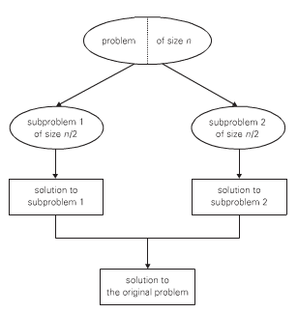
Divide & conquer
probably the best-known problem-solving paradigm
divide the problem into several subproblems of the same type (ideally of about equal size)
solve the subproblems, typically using recursion
combine the solutions to the subproblems to obtain a solution to the original problem

Slide 3
Not always a win
some problems can be thought of as divide & conquer, but are not efficient to implement that way
e.g., counting the number of 0's in a list of numbers:
recursively count the number of 0's in the 1st half of the list
recursively count the number of 0's in the 2nd half of the list
add the two counts
Cost(N) = 2 Cost(N/2) + C
= 2 [2 Cost(N/4) + C] + C
= 4 Cost(N/4) + 3C
= 4 [2 Cost(N/8) + C] + 3C
= 8 Cost(N/8) + 7C
= . . .
= N Cost(N/N) + (N-1)C
= NC' + (N-1)C
= (C + C')N - C
O(N)
the overhead of recursion makes this much slower than a simple iteration (i.e., decrease & conquer)

Slide 4
Master Theorem
Suppose Cost(N) = a Cost(N/b) + C N^{d}.
that is, divide & conquer is performed with polynomial-time overhead
O(N^{d}) if a < b^{d}
Cost(N) = O(N^{d} log N) if a = b^{d}
O(N ^{log}_{b} ª) if a > b^{d}
e.g., zero count algorithm has Cost(N) = 2Cost(N/2) + C
a = 2, b = 2, d = 0 ➔ 2 > 2⁰ ➔ O(N ^{log}₂ ²) ➔ O(N)

Slide 5
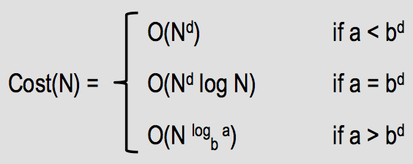
Merge sort
we have seen divide-and-conquer algorithms that are more efficient than brute force
e.g., merge sort list[0..N-1]
if list N <= 1, then DONE
otherwise,
merge sort list[0..N/2]
merge sort list[N/2+1..N-1]
merge the two sorted halves
recall: Cost(N) = 2Cost(N/2) +CN
merging is O(N), but requires O(N) additional storage and copying
we can show this is O(N log N) by unwinding, or
a = 2, b = 2, d = 1 ➔ 2 = 2¹ ➔ O(N log N) by Master Theorem

Slide 6
Why is halving most common?
consider a variation of merge sort that divides the list into 3 parts
if list N <= 1, then DONE
otherwise,
merge sort list[0..N/3]
merge sort list[N/3+1..2N/3]
merge sort list[2N/3+1..N-1]
merge the three sorted parts
Cost(N) = 3Cost(N/3) + CN
a = 3, b = 3, d = 1 ➔ 3 = 3¹ ➔ O(N log N)
in general, X Cost(N/X) + CN ➔ O(N log N)
X Cost(N/X) + C ➔ O(N)
dividing into halves is simplest, and just as efficient as thirds, quarters, …

Slide 7
Quick sort
Collections.sort implements quick sort, another O(N log N) sort which is faster in practice
e.g., quick sort list[0..N-1]
if list N <= 1, then DONE
otherwise,
select a pivot element (e.g., list[0], list[N/2], list[random], …)
partition list into [items < pivot] + [items == pivot] + [items > pivot]
quick sort the < and > partitions
best case: pivot is median
Cost(N) = 2Cost(N/2) +CN ➔ O(N log N)
worst case: pivot is smallest or largest value
Cost(N) = Cost(N-1) +CN ➔ O(N²)

Slide 8
Quick sort (cont.)
average case: O(N log N)
there are variations that make the worst case even more unlikely
switch to selection sort when small
median-of-three partitioning
instead of just taking the first item (or a random item) as pivot, take the median of the first, middle, and last items in the list
if the list is partially sorted, the middle element will be close to the overall median
if the list is random, then the odds of selecting an item near the median is improved
refinements like these can improve runtime by 20-25%
however, O(N²) degradation is still possible

Slide 9
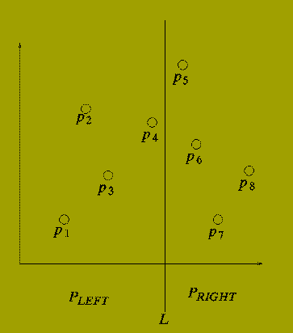
Closest pair
given a set of N points, find the pair with minimum distance
brute force approach:
consider every pair of points, compare distances & take minimum
big Oh?
O(N²)
there exists an O(N log N) divide-and-conquer solution
Assume the points are sorted by x-coordinate (can be done in O(N log N))
partition the points into equal parts using a vertical line in the plane
recursively determine the closest pair on left side (Ldist) and the closest pair on the right side (Rdist)
find closest pair that straddles the line (Cdist), each within min(Ldist,Rdist) of the line (can be done in O(N))
answer = min(Ldist, Rdist, Cdist)
Cost(N) = 2 Cost(N/2) + CN ➔ O(N log N)

Slide 10
Multiplying large integers
many CS applications, e.g., cryptography, involve manipulating large integers
long multiplication: 123456
× 213121
123456
+ 2469120
+ 12345600
+ 370368000
+ 1234560000
+ 24691200000
26311066176
long multiplication of two N-digit integers requires N² digit multiplications

Slide 11
Divide & conquer multiplication
can solve (a x b) by splitting the numbers in half & factoring
consider a₁ = 1st N/2 digits of a, a₀ = 2nd N/2 digits of a (similarly for b₁ and b₀)
(a x b) = (a₁10^{N/2} + a₀) x (b₁10^{N/2} + b₀)
= (a₁ x b₁)10^{N} + (a₁ x b₀ + a₀ x b₁)10^{N/2} + (a₀ x b₀)
= c₂10^{N} + c₁10^{N/2} + c₀
where
c₂ = a₁ x b₁
c₀ = a₀ x b₀
c₁ = (a₁ + a₀) x (b₁ + b₀) – (c₂ + c₀)
EXAMPLE: a = 123456 b = 213121
c₂ = a₁ x b₁ = 123 x 213 = 26199
c₀ = a₀ x b₀ = 456 x 121 = 55176
c₁ = (a₁ + a₀) x (b₁ + b₀) – (c₂ + c₀) = (123 + 456) x (213 + 121) – (26199 + 55176)
= 579 x 334 – 81375 = 193386 – 81375 = 112011
(a x b) = c₂10^{N} + c₁10^{N/2} + c₀ = 26199000000 + 55176000 + 112011 = 26311066176

Slide 12
Efficiency of divide & conquer multiplication
in order to multiply N-digit numbers
calculate c₂, c₁, and c₀, each of which involves multiplying N/2-digit numbers
MultCost(N) = 3 MultCost(N/2) + C
from Master Theorem: a = 3, b = 2, d = 0 ➔ 3 > 2⁰ ➔ O(N^{log}₂ ³) ≈ O(N^{1.585})
worry: in minimizing the number of multiplications, we have increased the number of additions & subtractions
a similar analysis can show that AddCost(N) is also O(N^{log}₂ ³)
does O(N ^{log}₂ ³) really make a difference vs. O(N²) ?
has been shown to improve performance for as small as N = 8
for N = 300, can run more than twice as fast

Slide 13
Dividing & conquering trees
since trees are recursive structures, most tree traversal and manipulation operations can be classified as divide & conquer algorithms
can divide a tree into root + left subtree + right subtree
most tree operations handle the root as a special case, then recursively process the subtrees
e.g., to display all the values in a (nonempty) binary tree, divide into
displaying the root
(recursively) displaying all the values in the left subtree
(recursively) displaying all the values in the right subtree
e.g., to count number of nodes in a (nonempty) binary tree, divide into
(recursively) counting the nodes in the left subtree
(recursively) counting the nodes in the right subtree
adding the two counts + 1 for the root

Slide 14
BinaryTree class
public class BinaryTree<E> {
protected TreeNode<E> root;
public BinaryTree() {
this.root = null;
}
public void add(E value) { … }
public boolean remove(E value) { … }
public boolean contains(E value) { … }
public int size() { … }
public String toString() { … }
}
to implement a binary tree, need to store the root node
the root field is "protected" instead of "private" to allow for inheritance
the empty tree has a null root
then, must implement methods for basic operations on the collection

Slide 15
size method
divide-and-conquer approach:
BASE CASE: if the tree is empty, number of nodes is 0
RECURSIVE: otherwise, number of nodes is
(# nodes in left subtree) + (# nodes in right subtree) + 1 for the root
note: a recursive implementation requires passing the root as parameter
will have a public "front" method, which calls the recursive "worker" method
public int size() {
return this.size(this.root);
}
private int size(TreeNode<E> current) {
if (current == null) {
return 0;
}
else {
return this.size(current.getLeft()) +
this.size(current.getRight()) + 1;
}
}

Slide 16
contains method
divide-and-conquer approach:
BASE CASE: if the tree is empty, the item is not found
BASE CASE: otherwise, if the item is at the root, then found
RECURSIVE: otherwise, search the left and then right subtrees
public boolean contains(E value) {
return this.contains(this.root, value);
}
private boolean contains(TreeNode<E> current, E value) {
if (current == null) {
return false;
}
else {
return value.equals(current.getData()) ||
this.contains(current.getLeft(), value) ||
this.contains(current.getRight(), value);
}
}

Slide 17
toString method
must traverse the entire tree and build a string of the items
there are numerous patterns that can be used, e.g., in-order traversal
BASE CASE: if the tree is empty, then nothing to traverse
RECURSIVE: recursively traverse the left subtree, then access the root,
then recursively traverse the right subtree
public String toString() {
if (this.root == null) {
return "[]";
}
String recStr = this.toString(this.root);
return "[" + recStr.substring(0,recStr.length()-1) + "]";
}
private String toString(TreeNode<E> current) {
if (current == null) {
return "";
}
return this.toString(current.getLeft()) +
current.getData().toString() + "," +
this.toString(current.getRight());
}

Slide 18
Other tree operations?
add?
remove?
numOccur?
height?
weight?

Slide 19
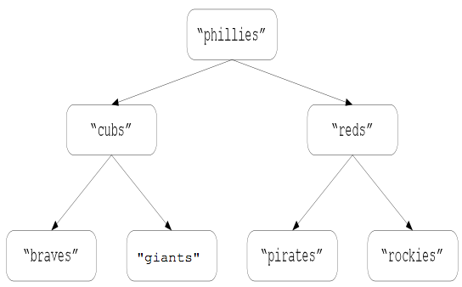
Binary search trees
a binary search tree is a binary tree in which, for every node:
the item stored at the node is ≥ all items stored in its left subtree
the item stored at the node is < all items stored in its right subtree
are BST operations divide & conquer?
contains?
add?
remove?
what about balanced BSTs?
(e.g., red-black trees, AVL trees)

