Slide 1
CSC 421: Algorithm Design Analysis
Spring 2019
Transform & conquer
transform-and-conquer approach
presorting, balanced search trees, heaps, Horner's Rule
problem reduction
space/time tradeoffs
heap sort, data structure redundancy, hashing
string matching: Horspool algorithm, Boyer-Moore algorithm

Slide 2
Transform & conquer
the idea behind transform-and-conquer is to transform the given problem into a slightly different problem that suffices
e.g., presorting data in a list can simplify many algorithms
suppose we want to determine if a list contains any duplicates
BRUTE FORCE: compare each item with every other item
(N-1) + (N-2) + … + 1 = (N-1)N/2 → O(N²)
TRANSFORM & CONQUER: first sort the list, then make a single pass through the list and check for adjacent duplicates
O(N log N) + O(N) → O(N log N)
finding the mode of a list, finding closest points, …

Slide 3
Balanced search trees
recall binary search trees – we need to keep the tree balanced to ensure O(N log N) search/add/remove
OR DO WE?
it suffices to ensure O(log N) height, not necessarily minimal height
transform the problem of "tree balance" to "relative tree balance"
several specialized structures/algorithms exist:
AVL trees
2-3 trees
red-black trees

Slide 4
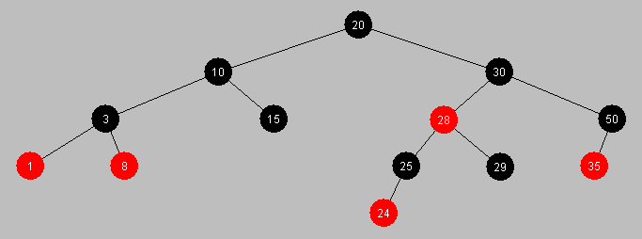
Red-black trees
a red-black tree is a binary search tree in which each node is assigned a color (either red or black) such that
the root is black
a red node never has a red child
every path from root to leaf has the same number of black nodes
add & remove preserve these properties (complex, but still O(log N))
red-black properties ensure that tree height < 2 log(N+1) → O(log N) search

Slide 5
TreeSets & TreeMaps
java.util.TreeSet uses red-black trees to store values
O(log N) efficiency on add, remove, contains
java.util.TreeMap uses red-black trees to store the key-value pairs
O(log N) efficiency on put, get, containsKey
thus, the original goal of an efficient tree structure is met
even though the subgoal of balancing a tree was transformed into "relatively balancing" a tree

Slide 6
Scheduling & priority queues
many real-world applications involve optimal scheduling
balancing transmission of multiple signals over limited bandwidth
selecting a job from a printer queue
selecting the next disk sector to access from among a backlog
multiprogramming/multitasking
a priority queue encapsulates these three optimal scheduling operations:
add item (with a given priority)
find highest priority item
remove highest priority item
can be implemented as an unordered list
→ add is O(1), findHighest is O(N), removeHighest is O(N)
can be implemented as an ordered list
→ add is O(N), findHighest is O(1), removeHighest is O(1)

Slide 7
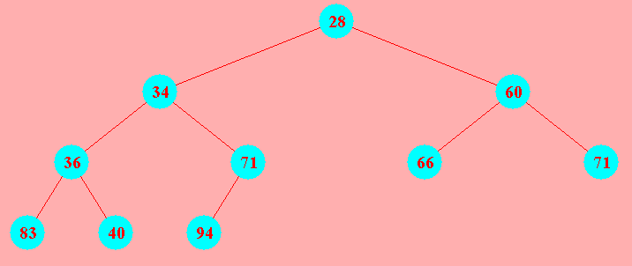
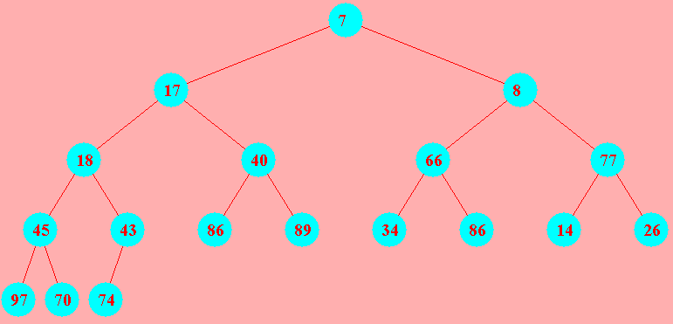
Heaps
Java provides a java.util.PriorityQueue class
the underlying data structure is not a list or queue at all
it is a tree structure called a heap
a complete tree is a tree in which
all leaves are on the same level or else on 2 adjacent levels
all leaves at the lowest level are as far left as possible
note: a complete tree with N nodes will have minimal height = ⎣log2 N⎦+1
a heap is complete binary tree in which
for every node, the value stored is ≤ the values stored in both subtrees
(technically, this is a min-heap -- can also define a max-heap where the value is ≥ )

Slide 8
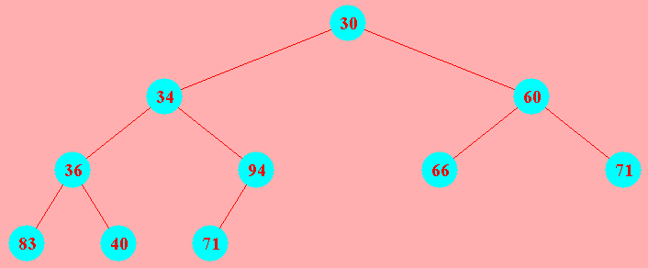
Implementing a heap
a heap provides for O(1) find min, O(log N) insertion and min removal
also has a simple, List-based implementation
since there are no holes in a heap, can store nodes in an ArrayList, level-by-level
root is at index 0
last leaf is at index size()-1
for a node at index i, children are at 2*i+1 and 2*i+2
to add at next available leaf, simply add at end
30 | 34 | 60 | 36 | 71 | 66 | 71 | 83 | 40 | 94

Slide 9
Horner's rule
polynomials are used extensively in mathematics and algorithm analysis
p(x) = a_{n}x^{n} + a_{n-1}x^{n-1} + a_{n-2}x^{n-2} + ... + a₁x + a₀
how many multiplications would it take to evaluate this function for some value of x?
W.G. Horner devised a new formula that transforms the problem
p(x) = ( … (((a_{n}x + a_{n-1})x + a_{n-2})x + ... + a₁)x + a₀
can evaluate in only n multiplications and n additions

Slide 10
Problem reduction
in CSC321, we looked at a number of examples of reducing a problem from one form to another
e.g., generate the powerset (set of all subsets) of an N element set
S = { x₁, x₂, x₃, x₄ } powerset_{S} = { {}, {x₁}, {x₂}, {x₃}, {x₄},
{x₁, x₂}, {x₁, x₃}, {x₁, x₄}, {x₂, x₃}, {x₂, x₄}, {x₃, x₄},
{x₁, x₂, x₃}, {x₁, x₂, x₄}, {x₁, x₃, x₄}, {x₂, x₃, x₄},
{x₁, x₂, x₃, x₄} }
PROBLEM REDUCTION: simplify by reducing it to a problem about bit sequences
can map each subset into a sequence of N bits: b_{i} = 1 → x_{i} in subset
{ x₁, x₄, x₅ } ←→ 10011000…0
much simpler to generate all possible N-bit sequences
{ 0000, 0001, 0010, 0011, 0100, 0101, 0110, 0111,
1000, 1001, 1010, 1011, 1100, 1101, 1110, 1111 }

Slide 11
lcm & gcd
consider calculating the least common multiple of two numbers m & n
BRUTE FORCE: reduce each number to its prime factors
then multiply (factors in both m & n) (factors only in m) (factors only in n)
24 = 2 • 2 • 2 • 3
60 = 2 • 2 • 3 • 5
lcm(24, 60) = (2 • 2 • 3) • (2) • (5) = 12 • 2 • 5 = 120
PROBLEM REDUCTION: can recognize a relationship between lcm & gcd
lcm(m, n) = m x n / gcd(m, n)
lcm(24, 60) = 24 • 60 / 12 = 2 • 60 = 120
gcd can be calculated efficiently using Euclid's algorithm:
gcd(a, 0) = a gcd(a, b) = gcd(b, a % b)

Slide 12
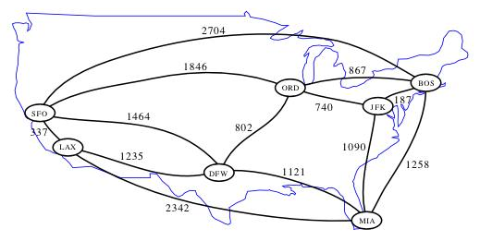
Reduction to graph searches
many problems can be transformed into graph problems
25¢
Q
D
D
35¢
0¢
N
N
5¢
D
15¢
Q
N
N
N
N
D
Q
30¢
10¢
N
D
20¢
D

Slide 13
Water jug problem
recall from Die Hard with a Vengeance
you have two empty water jugs (4 gallon & 3 gallon capacity) & water supply
want to end up with exactly 2 gallons in a jug
0-0
4-0
0-3
3-0
1-3
4-3
3-3
0-2
4-2

Slide 14
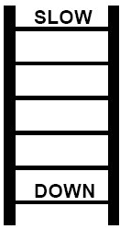
Other interesting examples
multiplication can be transformed into squaring
a × b = ( (a + b)² – (a – b)² ) / 4
find the shortest word ladder
construct a graph:
vertices are the words in the dictionary
there is an edge between v_{i} and v_{j} if they differ by one letter
perform a breadth first search, from start word to end word
Andrew's algorithm for complex hull
transforms the graph into a sorted list of coordinates, then traverses & collects

Slide 15
Space vs. time
for many applications, it is possible to trade memory for speed
i.e., additional storage can allow for a more efficient algorithm
ArrayList wastes space when it expands (doubles in size)
each expansion yields a list with (slightly less than) half empty
improves overall performance since only log N expansions when adding N items
linked structures sacrifice space (reference fields) for improved performance
e.g., a linked list takes twice the space, but provides O(1) add/remove from either end
hash tables can obtain O(1) add/remove/search if willing to waste space
to minimize the chance of collisions, must keep the load factor low
HashSet & HashMap resize (& rehash) if load factor every reaches 75%

Slide 16
Heap sort
can utilize a heap to efficiently sort a list of values
start with the ArrayList to be sorted
construct a heap out of the elements
repeatedly, remove min element and put back into the ArrayList
public static <E extends Comparable<? super E>>
void heapSort(ArrayList<E> items) {
MinHeap<E> itemHeap = new MinHeap<E>();
for (int i = 0; i < items.size(); i++) {
itemHeap.add(items.get(i));
}
for (int i = 0; i < items.size(); i++) {
items.set(i, itemHeap.minValue());
itemHeap.remove();
}
}
N items in list, each insertion can require O(log N) swaps to reheapify
→construct heap in O(N log N)
N items in heap, each removal can require O(log N) swap to reheapify
copy back in O(N log N)
can get the same effect by copying the values into a TreeSet, then iterating

Slide 17
Other space vs. time examples
we have made similar space/time tradeoffs often in code
AnagramFinder (find all anagrams of a given word)
can preprocess the dictionary & build a map of words, keyed by sorted letters
then, each anagram lookup is O(1)
BinaryTree (implement a binary tree & eventually extend to BST)
kept track of the number of nodes in a field (updated on each add/remove)
turned the O(N) size operation into O(1)
other examples?

Slide 18
String matching
many useful applications involve searching text for patterns
word processing (e.g., global find and replace)
data mining (e.g., looking for common parameters)
genomics (e.g., searching for gene sequences)
TTAAGGACCGCATGCCCTCGAATAGGCTTGAGCTTGCAATTAACGCCCAC…
in general
given a (potentially long) string S and need to find (relatively small) pattern P
an obvious, brute force solution exists: O(|S|•|P|)
however, utilizing preprocessing and additional memory can reduce this to O(|S|)
in practice, it is often < |S| HOW CAN THIS BE?!?

Slide 19
Brute force
String: FOOBARBIZBAZ
Pattern: BIZ
the brute force approach would shift the pattern along, looking for a match:
FOOBARBIZBAZ
FOOBARBIZBAZ
FOOBARBIZBAZ
FOOBARBIZBAZ
FOOBARBIZBAZ
FOOBARBIZBAZ
FOOBARBIZBAZ
at worst:
|S|-|P|+1 passes through the pattern
each pass requires at most |P| comparisons
➔ O(|S|•|P|)

Slide 20
Smart shifting
FOOBARBIZBAZ
BIZ
suppose we look at the rightmost letter in the attempted match
here, compare Z in the pattern with O in the string
since there is no O in the pattern, can skip the next two comparisons
FOOBARBIZBBAZ
BIZ
again, no R in BIZ, so can skip another two comparisons
FOOBARBIZBBAZ
BIZ

Slide 21
Horspool algorithm
given a string S and pattern P,
Construct a shift table containing each letter of the alphabet.
if the letter appears in P (other than in the last index) → store distance from end
otherwise, store |P|
e.g., P = BIZ
Align the pattern with the start of the string S, i.e., with S₀S₁…S_{|P|-1}
Repeatedly,
compare from right-to-left with the aligned sequence S_{i}S_{i+1…}S_{i+|P|-1}
if all |P| letters match, then FOUND.
if not, then shift P to the right by shiftTable[S_{i+|P|-1}]
if the shift falls off the end, then NOT FOUND
A | B | C | … | I | … | X | Y | Z
3 | 2 | 3 | … | 1 | … | 3 | 3 | 3

Slide 22
Horspool example 1
S = FOOBARBIZBAZ P=BIZ
shiftTable for "BIZ"
FOOBARBIZBAZ
BIZ Z and O do not match, so shift shiftTable[O] = 3 spots
FOOBARBIZBAZ
BIZ Z and R do not match, so shift shiftTable[R] = 3 spots
FOOBARBIZBAZ
BIZ pattern is FOUND
total number of comparisons = 5
A | B | C | … | I | … | X | Y | Z
3 | 2 | 3 | … | 1 | … | 3 | 3 | 3

Slide 23
Horspool example 2
S = "FOZIZBARBIZBAZ" P="BIZ"
shiftTable for "BIZ"
FOZIZBARBIZBAZ
BIZ Z and Z match, but not I and O, so shift shiftTable[Z] = 3 spots
FOZIZBARBIZBAZ
BIZ Z and B do not match, so shift shiftTable[B] = 2 spots
FOZIZBARBIZBAZ
BIZ Z and R do not match, so shift shiftTable[R] = 3 spots
FOZIZBARBIZBAZ
BIZ pattern is FOUND
total number of comparisons = 7
A | B | C | … | I | … | X | Y | Z
3 | 2 | 3 | … | 1 | … | 3 | 3 | 3
when will fewest comparisons occur? when will most?

Slide 24
Horspool exercise
String: BANDANABABANANAN
Pattern: BANANA
shift table for BANANA?
steps?
BANDANABABANANAN
BANANA
A | B | C | D | … | N | … | Y | Z
 |  |  |  | … |  | …

Slide 25
Horspool analysis
space & time
requires storing shift table whose size is the alphabet
since the alphabet is usually fixed, table requires O(1) space
worst case is O(|S|•|P|)
this occurs when skips are infrequent & close matches to the pattern appear often
for random data, however, only O(|S|)
Horspool algorithm is a simplification of a more complex (and well-known) algorithm: Boyer-Moore algorithm
in practice, Horspool is often faster
however, Boyer-Moore has O(|S|) worst case, instead of O(|S|•|P|)
think quick sort vs. merge sort:
quick sort is faster in practice, but can degrade to O(N²); merge sort slower but guaranteed O(N log N)

Slide 26
Boyer-Moore algorithm
based on two kinds of shifts (both compare right-to-left, find first mismatch)
the first is bad-symbol shift (based on the symbol in S that caused the mismatch)
BIZFIZIBIZFIZBIZ
FIZBIZ F and B don't match, shift to align F
BIZFIZIBIZFIZBIZ
FIZBIZ I and Z don't match, shift to align I
BIZFIZIBIZFIZBIZ
FIZBIZ I and Z don't match, shift to align I
BIZFIZIBIZFIZBIZ
FIZBIZ F and Z don't match, shift to align F
BIZFIZIBIZFIZBIZ
FIZBIZ FOUND

Slide 27
Bad symbol shift
bad symbol table is |alphabet|•|P|
kth row contains shift amount if mismatch occurred at index k (from right)
 | A | B | C | … | F | … | I | … | Y | Z
0 | 6 | 2 | 6 | … | 5 | … | 1 | … | 6 | -
1 | 5 | 1 | 5 | … | 4 | … | - | … | 5 | 2
2 | 4 | - | 4 | … | 3 | … | 2 | … | 4 | 1
3 | 3 | 3 | 3 | … | 2 | … | 1 | … | 3 | -
4 | 2 | 2 | 2 | … | 1 | … | - | … | 2 | 2
bad symbol table for FIZBIZ:
BIZFIZIBIZFIZBIZ
FIZBIZ F and B don't match → badSymbolTable(F,2) = 3
BIZFIZIBIZFIZBIZ
FIZBIZ I and Z don't match → badSymbolTable(I, 0) = 1
BIZFIZIBIZFIZBIZ
FIZBIZ I and Z don't match → badSymbolTable(I, 3) = 1
BIZFIZIBIZFIZBIZ
FIZBIZ F and Z don't match → badSymbolTable(F, 0) = 5
BIZFIZIBIZFIZBIZ
FIZBIZ FOUND

Slide 28
Good suffix shift
find the longest suffix that matches
if that suffix appears to the left in P preceded by a different char, shift to align
if not, then shift the entire length of the word
BIZFIZIBIZFIZBIZ
FIZBIZ IZ suffix matches, IZ appears to left so shift to align
BIZFIZIBIZFIZBIZ
FIZBIZ no suffix match, so shift 1 spot
BIZFIZIBIZFIZBIZ
FIZBIZ BIZ suffix matches, doesn't appear again so full shift
BIZFIZIBIZFIZBIZ
FIZBIZ FOUND

Slide 29
Good suffix shift
good suffix shift table is |P|
assume that suffix matches but char to the left does not
if that suffix appears to the left preceded by a different char, shift to align
if not, then can shift the entire length of the word
IZBIZ | ZBIZ | BIZ | IZ | Z
6 | 6 | 6 | 3 | 6 | 1
good suffix table for FIZBIZ
BIZFIZIBIZFIZBIZ
FIZBIZ IZ suffix matches → goodSuffixTable(IZ) = 3
BIZFIZIBIZFIZBIZ
FIZBIZ no suffix match → goodSuffixTable() = 1
BIZFIZIBIZFIZBIZ
FIZBIZ BIZ suffix matches → goodSuffixTable(BIZ) = 6
BIZFIZIBIZFIZBIZ
FIZBIZ FOUND

Slide 30
Boyer-Moore string search algorithm
calculate the bad symbol and good suffix shift tables
while match not found and not off the edge
compare pattern with string section
shift1 = bad symbol shift of rightmost non-matching char
shift2 = good suffix shift of longest matching suffix
shift string section for comparison by max(shift1, shift2)
the algorithm has been proven to require at most 3*|S| comparisons
so, O(|S|)
in practice, can require fewer than |S| comparisons
requires storing O(|P|) bad symbol shift table and O(|P|) good suffix shift table

Slide 31
Boyer-Moore exercise
String: BANDANABABANANAN
Pattern: BANANA
bad symbol table for BANANA?
good suffix table for BANANA?
steps?
BANDANABABANANAN
BANANA
 | A | B | C | D | … | N | … | Y | Z
0 |  |  |  |  | … |  | …
1 |  |  |  |  | … |  | …
2 |  |  |  |  | … |  | …
3 |  |  |  |  | … |  | …
4 |  |  |  |  | … |  | …
ANANA | NANA | ANA | NA | A

