Slide 1
CSC 533: Programming Languages
Spring 2025
Clojure basics
  scalars
    numbers, symbols, keywords, strings, characters, booleans
    def, var != variable
  collections
    lists, vectors, sets, maps
  function calls & definitions
    fn, def, defn
    built-in functions

Slide 2
Scalars
the primitive data types in Clojure are called scalars
  scalars include numbers, symbols, keywords, strings, characters, booleans
numbers
    in theory, numbers can have unlimited size in Clojure
    integers are implemented using Java long type or BigInt class (if too big)
    4 -8 +104 987654321987654321987654321
    can also be represented in hex, octal or binary
    0x4B 0113 2r1001011
    reals are implemented using Java double type or BigDecimal class (if too big)
    1.0 +2. -12.345678 2e7 1.445e-3
    rationals are implemented as a numerator/denominator pair
    3/4 -7/8 123456789/987654321
note: when the interpreter uses a BigInt, it will add N to the end when displaying the value

Slide 3
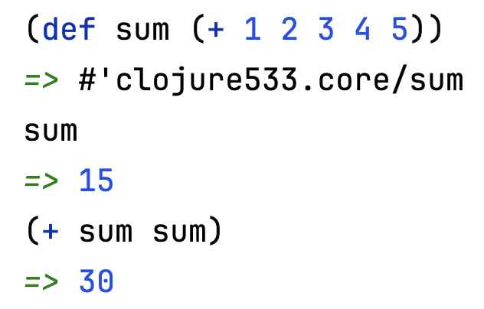
Scalars (cont.)
symbols
    symbols are names (identifiers) used to represent another value
    sum num1 firstName first-name help? ft->m
    can bind a symbol to a value using def
    note: symbols are NOT variables
    more like constants (not reassignable)
keywords
    keywords are symbols (starting with colon) that always evaluate to themselves
    essentially, new literals in the language
    :a :b :red :Dave :root :left :right

Slide 4
Scalars (cont.)
strings
    strings are implemented using Java Strings, but can include line breaks
    "" "foo" "foo bar" "Howdy "Howdy\ndo"
    do"
characters
    characters are specified using a backslash, implemented using Java chars
    \a \B \4 \\ \u0042
booleans
    true false

Slide 5
Collections
lists
  a list is a sequence of items enclosed in parentheses
    () is a list
    (L1 L2 . . . Ln) is a list, where each Li is either a scalar or a list
  for example:
    () (1)
    (:a :b :c :d) ((:a :b) 1.7 (5 10))
    (((((0)))))
  note the recursive definition of a list – GET USED TO IT!
  also, get used to parentheses (LISP = Lots of Inane, Silly Parentheses)
  lists are very dynamic
    implemented as linked structures, so flexible but do not provide direct access

Slide 6
Collections (cont.)
lists were the only collection type in LISP
  lists are all you need, but not the most efficient for certain operations
Clojure provides other collections, based on Java data structures
  vector: based on Java array, stored contiguously and provides direct access
  [1 2 3 :a :b :c]
  set: based on Java Set, items are unique
  #{:red :blue :green}
  map: based on Java Map, sequence of key & value pairs
  {:first "Chris" :last "Jones" :age 20}
  MORE ON THESE LATER

Slide 7
Function calls
computation in a functional language is via function calls
  function call is represented as a list, with the function first followed by inputs
    (FUNC ARG1 ARG2 . . . ARGn)
    (first [:a :b :c]) (+ 3 (* 4 2))
  prefix notation takes some getting used to
    allows for a function to have an arbitrary number of inputs (< 1 3 6 8 12)
    also removes need for precedence rules
  since function calls can be nested, evaluation is recursive
    e.g., to evaluate (+ 3 (* 4 2))
    evaluate each item (in any order)
    + is a scalar, evaluates to a built-in function (i.e., code)
      3 is a scalar, evaluates to an integer literal
      (* 4 2) is a function call, recursively evaluates to 8
  apply the function code to the input values
    (+ code) applied to 3 and 8 → 11

Slide 8
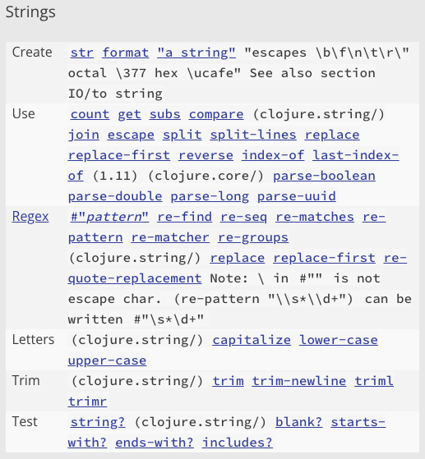
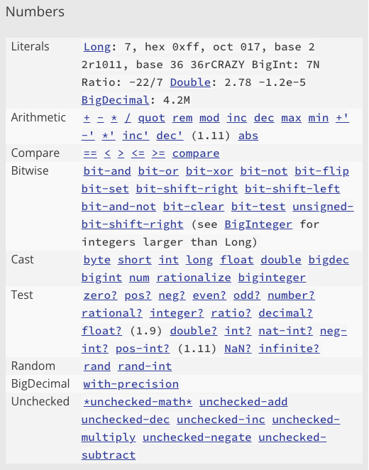
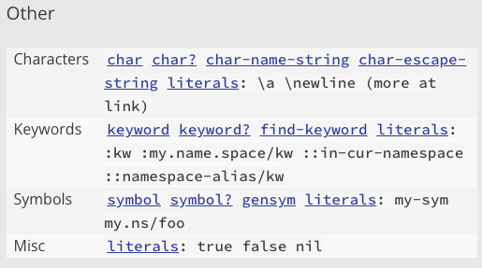
Built-in functions
from the Clojure Cheatsheet
EXPLORE!

Slide 9
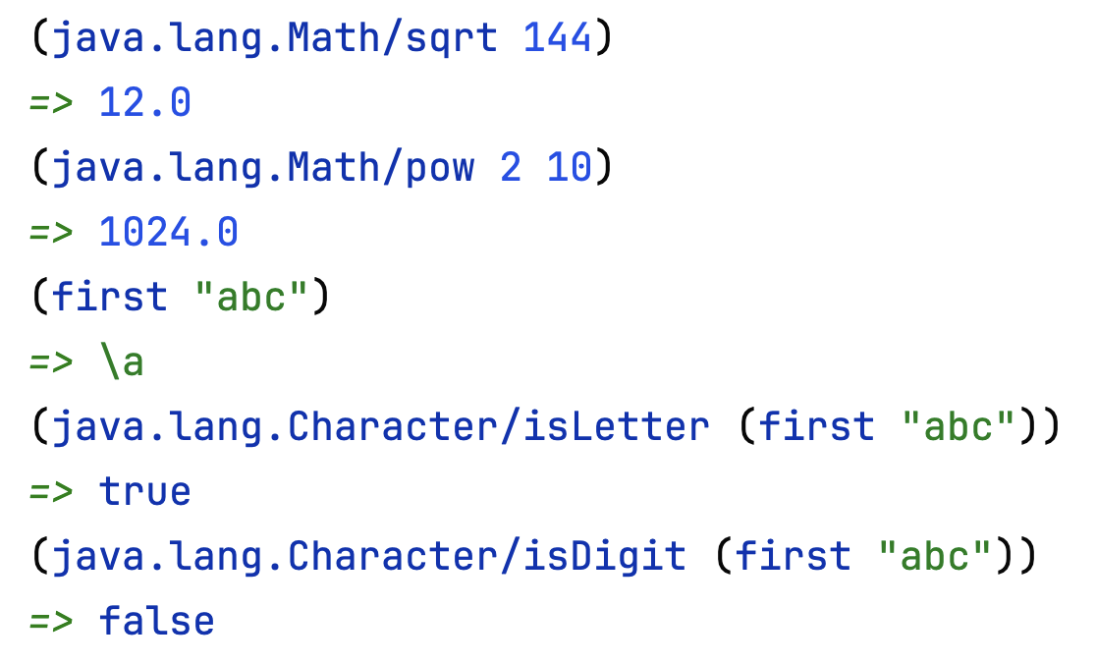
Java libraries
because Clojure is built on the Java Virtual Machine
  can easily access static methods in Java libraries
  specify the library path / method name

Slide 10
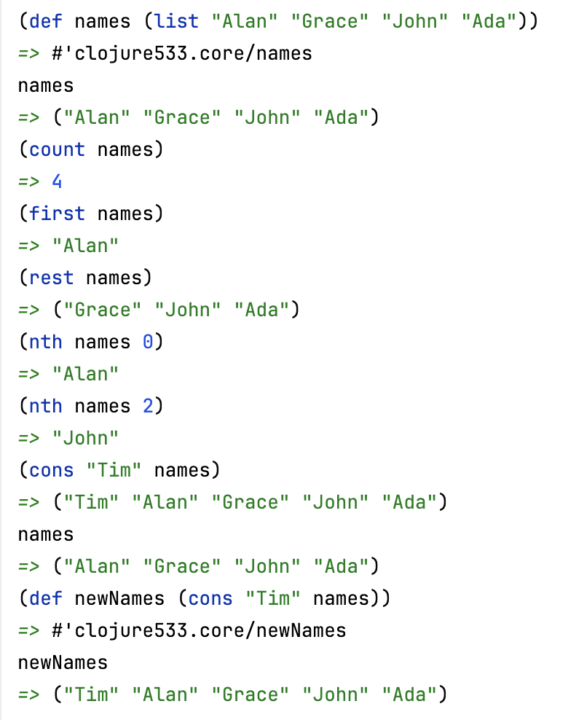
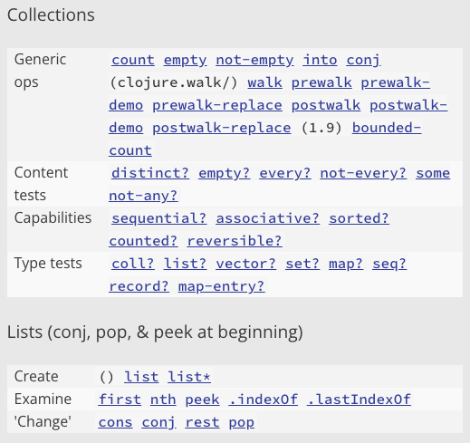
Built-in functions
from the Clojure Cheatsheet
EXPLORE!

Slide 11
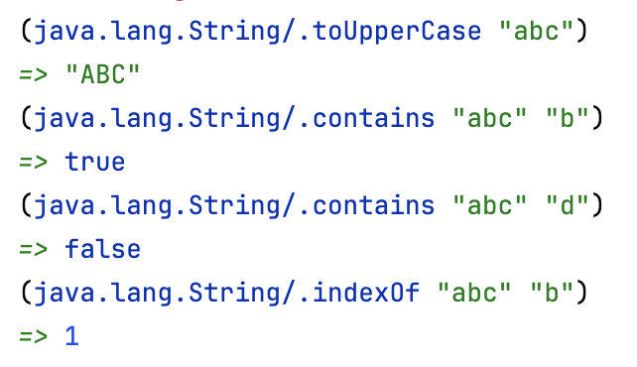
Java libraries
can call Java String methods on Clojure strings
  note: non-static methods must have . prefix
note: calling String methods does not violate our functional principles, since Strings are immutable in Java

Slide 12
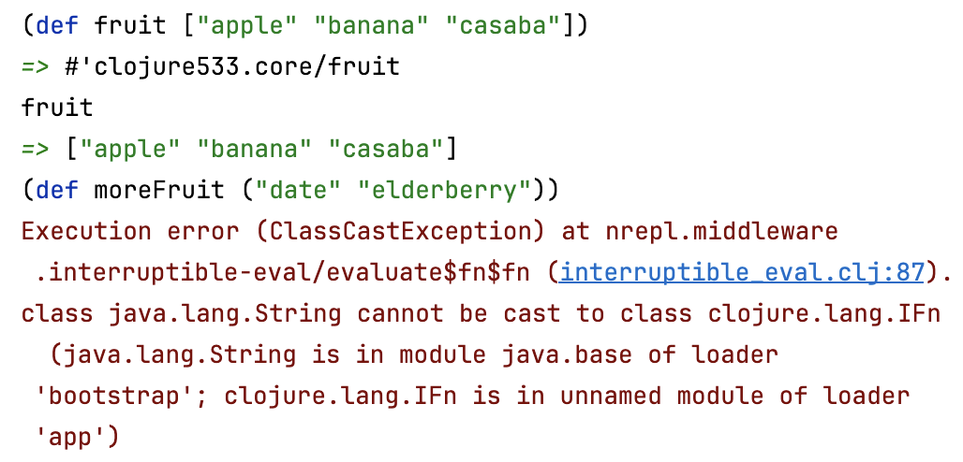
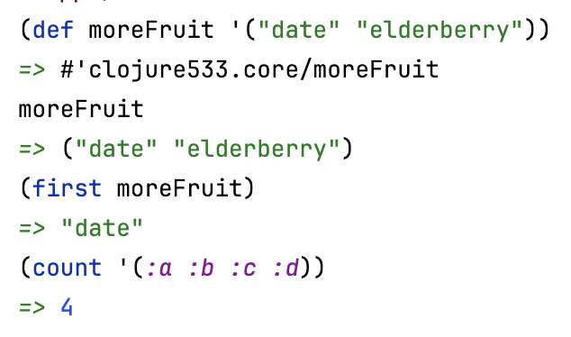
Interesting inconsistency
consider the following definitions
  defining a name for a vector works
  defining a name for a list fails
  WHY?
parentheses serve double-duty in Clojure
  used to represent a list, e.g., ("apple" "banana" "casaba")
  used to represent a function call, e.g., (+ 2 3)
how does the interpreter know which is which?
it can't – it assumes parentheses denote a function call
  if you want to specify a list as data, preface it with a quote
when the interpreter evaluates an expression starting with ', it treats it as data

Slide 13
Defining functions
can define a new function using def and fn
  fn maps a vector of inputs to a single output expression
  def then binds a name to that function
  (def FUNC_NAME
  (fn [input1 input2 … inputN]
  (OUTPUT_EXPRESSION_INVOLVING_INPUTS)))
  (def square (def next-to-last
  (fn [x] (fn [arblist]
  (* x x))) (nth (reverse arblist) 1)))
better yet, can combine def and fn into defn
  (defn FUNC_NAME [input1 input2 … inputN]
  (OUTPUT_EXPRESSION_INVOLVING_INPUTS))
  (defn square [x] (defn next-to-last [arblist]
  (* x x)) (nth (reverse arblist) 1))

Slide 14
Function examples
(defn ft->m [ft]
(* ft 0.3048))
(defn m->ft [m] (defn m->ft [m]
(/ m 0.3048)) (/ m (ft->m 1)))
(defn sum-of-squares [x y] (defn square-of-sum [x y]
(+ (* x x) (* y y))) (* (+ x y) (+ x y)))
(defn round [num]
(int (+ num 0.5)))
(defn palindrome [word]
(= (seq word) (reverse word)))

Slide 15
In-class exercises
define a function that converts from Fahrenheit to Celsius
  note: celsius = 5/9 * (fahr – 32)
  (defn fahr->celsius [temp]
  ( ??? )
similarly, define a function that converts from Celsius to Fahrenheit
  (defn celsius->fahr [temp]
  ( ??? )
define a function that calculates a baseball player's batting average
  (defn BA [hits at-bats]
  ( ??? )

Slide 16
More complex exercise
define a function that calculates the wind-chill index
wind-chill = 35.74 + 0.6215☓temp + (0.4275☓temp – 35.75)☓wind^{0.16}
  (defn wind-chill [temp wind]
  ( ??? ))

Slide 17
Conditional evaluation
can select alternative expressions to evaluate
  (if TEST TRUE_EXPRESSION FALSE_EXPRESSION)
  (defn my-abs [num] (defn grade [test1 test2]
  (if (neg? num) (if (> test2 test1)
  (- 0 num) test2
  num)) (/ (+ test1 test2) 2.0)))
  (defn pass-fail [test1 test2]
  (if (or (and (>= test1 60) (>= test2 60))
  (>= (/ (+ test1 test2) 2.0) 70))
  :pass
  :fail))
and, or, not are standard Boolean connectives
        evaluated from left-to-right, short-circuit evaluation

Slide 18
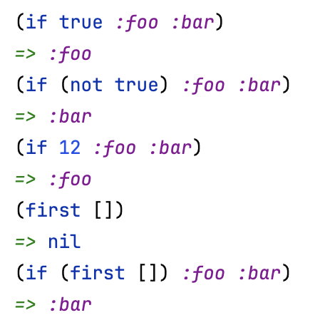
Conditional evaluation (cont.)
note: an if-expression is a special form
  doesn't follow standard evaluation rules
  (if (list? x)
  (first x)
  x)
  anything but false or nil
  (equivalent to Java null value) is "true"
test expression is evaluated first
  if value is "true", first expression is evaluated & returned
  else, second expression is evaluated & returned

Slide 19
Multi-way conditional
when there are more than two alternatives, can
  nest if-expressions (i.e., cascading ifs)
  use the cond special form (i.e., a switch)
  (cond TEST1 EXPRESSION1
  TEST2 EXPRESSION2
  . . .
  :else EXPRESSIONn)
(defn compare-nums [num1 num2]
(cond (> num1 num2) :greater
(< num1 num2) :lesser
:else :equal))
(defn letter-grade [avg]
(cond (>= avg 90) :A
(>= avg 80) :B
(>= avg 70) :C
(>= avg 60) :D
:else :F))
evaluate tests in order
  when reach one that evaluates to "true", evaluate corresponding expression & return

Slide 20
Leap year example
a leap year is divisible by 4 but not 100 except if divisible by 400
  yes: 2000, 2020, 2024, 2028, 2400 no: 2025, 2026, 2027, 2100, 2200, 2300
  (defn leap-year? [year]
  (cond (zero? (rem year 400)) true
  (zero? (rem year 100)) false
  :else (zero? (rem year 4))))
(defn leap-year? [year]
(and (zero? (rem year 4))
(or (zero? (rem year 400))
(not (zero? (rem year 100))))))
write a function that determines the number of days in a year
  (defn days-in-year [year]
  ( ??? ))

Slide 21
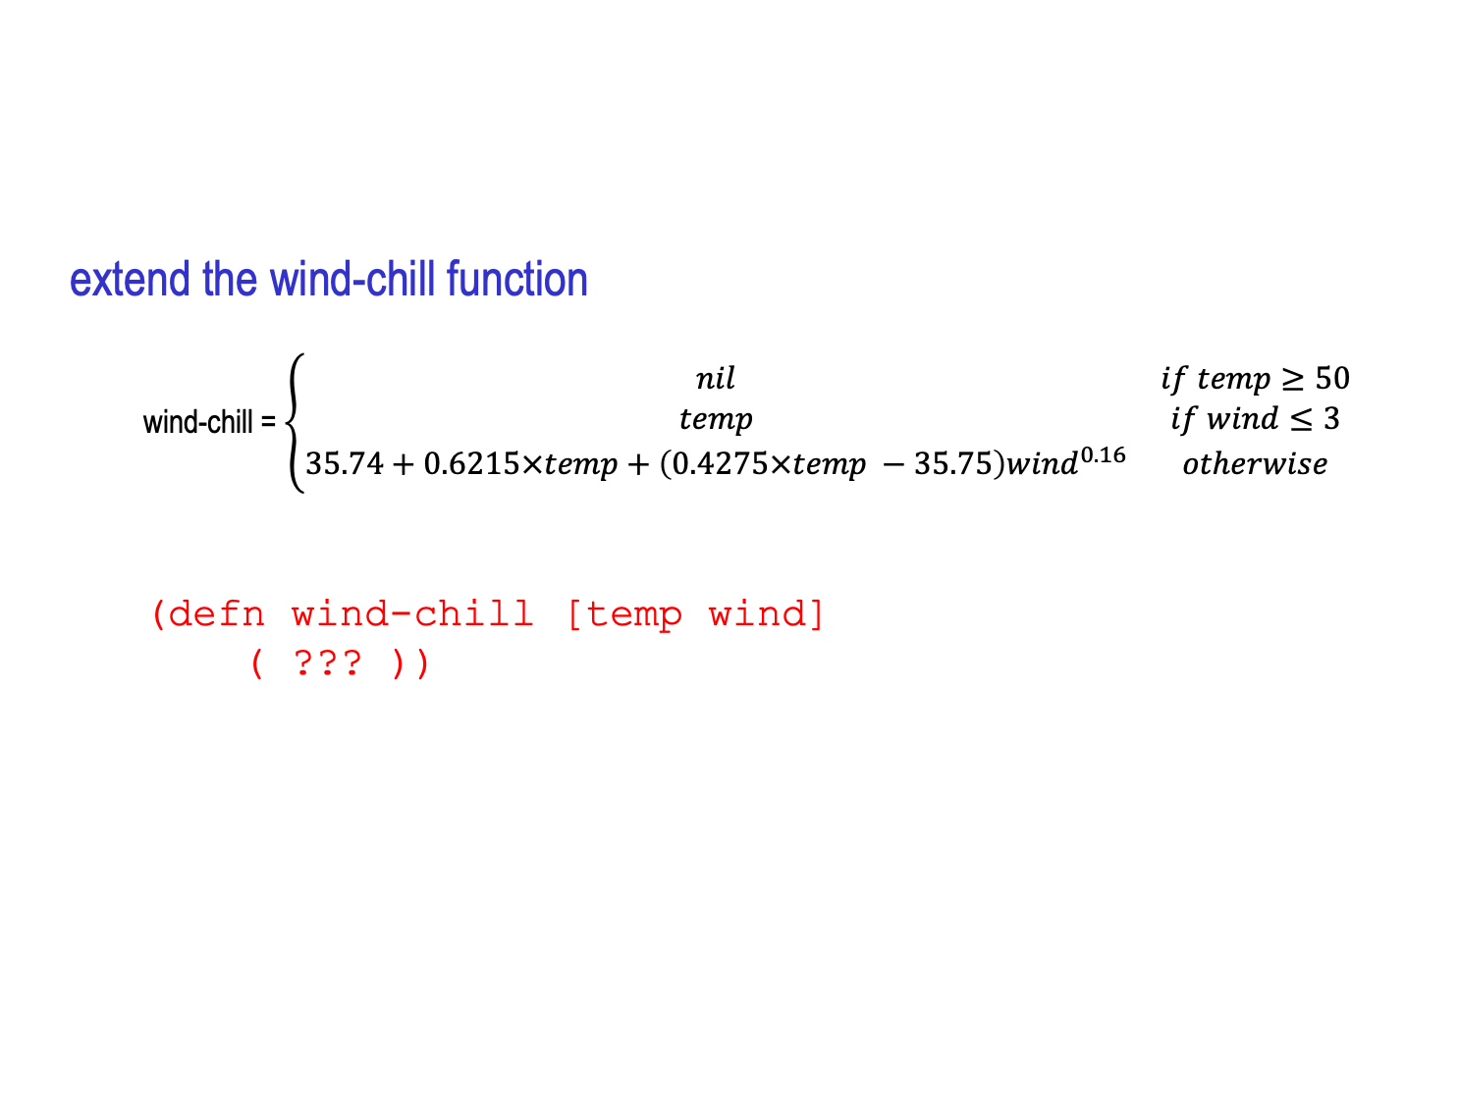
In-class exercise
extend the wind-chill function
  wind-chill = $\left\{\begin{matrix}nil & if temp≥50 & \\ temp & if wind≤3 & \\ 35.74+0.6215×temp+\left(0.4275×temp −35.75\right){wind}^{0.16} & otherwise & \end{matrix}\right.$
  (defn wind-chill [temp wind]
  ( ??? ))

