Slide 1
CSC 533: Programming Languages Spring 2025
Functional programming
functional vs. imperative
functional programming principles
functional features in Java
LISP
history and basic design
Clojure
modern updates
installing IntelliJ & Cursive

Slide 2
Functional programming
imperative languages are modeled on the von Neumann architecture
a program is a sequence of statements that alter its state
key features: variable assignments, conditionals, loops, functions
OOP is a specialization that emphasizes modularity & reusability
each object maintains its own state (fields) and modifies via methods
can utilize inheritance and polymorphism to ease development
functional programming represents a very different approach
a program is a collection of functions with no internal state
computation occurs not by executing a sequence of statements, but by composing functions to transform data into its desired form
Procedural approach Functional approach
get list of grades
sort in increasing order (get-last (sort (get-grades)))
get last entry in list

Slide 3
Basic principles
there are several principles that define functional programming
pure functions
functions should return a value based solely on the inputs, with no side-effects
first-class functions
functions are allowed to support all operations available to other entities
e.g., assigning to variables, passing as inputs to functions, returning as outputs of functions
immutability
an entity cannot be modified after it is instantiated
e.g., variables can't be reassigned, data structures can't be changed
referential transparency
replacing an expression with its corresponding value should have no impact on the program's behavior

Slide 4
Functional programming in imperative languages
it is possible (but not necessarily easy) to program in a functional style using imperative languages
public class Funky {
public static void main(String[] args) {
double[] numbers = { 1, 3, 10, 8 };
System.out.println(square(sum(numbers)));
}
public static double square(double x) {
return x * x;
}
public static double sum(double[] nums) {
double sum = 0.0;
for (double n : nums) {
sum += n
}
return sum;
}
}
functions not first class
variables not immutable (nor are most objects)
definitely not referential transparency

Slide 5
Functional programming in Java
Java 8 (2014) introduced many functional programming constructs
lambda expressions (unnamed functions)
first-class functions
streams with filter, map, reduce, …
to really understand the function approach, you need to learn a functional language
int sumAbove = 0;
for (int n : nums) {
if (n > 50) {
sumAbove += n;
}
}
-------------------------------------------------------------------------
int sumAbove = nums.stream().filter(n -> n > 50).reduce(0, Integer::sum);

Slide 6
LISP
the 2nd high-level language developed was LISP (List Processing Language)
while FORTRAN was well-suited to scientific computing, not so much for AI
Artificial Intelligence was driving a number of initiatives in 50's, and required a language closer to human reasoning symbolic
(dynamic) list-oriented vs. array-oriented
transparent memory management vs. programmer-controlled
functional vs. imperative
LISP was developed by John McCarthy at MIT in 1958
instantly popular as the language for AI
functional approach produced a separation from the underlying architecture that made it less efficient (and usually interpreted)
over the years, many variants have been developed
e.g., Scheme (1975), Common Lisp (1984), Racket (1994), Clojure (2005)

Slide 7
LISP design
LISP is very simple and orthogonal
only 2 kinds of data objects
atoms (symbols, strings, numbers, booleans, …)
red above "foo" 12 1.5 #t #f
lists (of atoms and sublists)
unlike arrays, lists do not have to store items of same type/size
do not have to be stored contiguously
do not have to provide random access
()
(1 2 3)
("foo" 100 #t)
(block1 (color red) (above block2))

Slide 8
LISP design
all computation is performed by applying functions to arguments
function calls appear as lists: (FUNC ARG1 ARG2 … ARGn)
no variables, no assignments, no iteration
(+ 3 2)
5
(+ 3 (* 2 5))
13
(list 'a 'b 'c)
(a b c)
(car '(foo bar biz baz))
foo
(cdr '(foo bar biz baz))
(bar biz baz)

Slide 9
LISP design
functions and function calls are also represented as lists
no distinction between program and data
(define FUNC
(lambda (ARG1 ARG2 . . . ARGn)
RETURN_EXPRESSION))
(define square (define last
(lambda (x) (lambda (arblist)
(* x x)) (car (reverse arblist)))
(square 3) ➢ (last '(a b c))
9 c
(square 1.5) ➢ (last '(foo))
2.25 foo

Slide 10
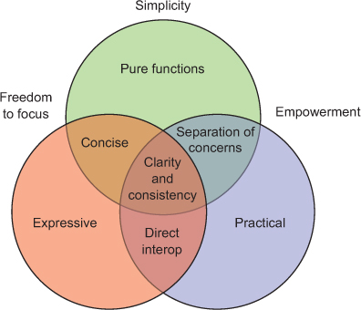
Clojure
Clojure is a modern variant of LISP
developed by Rich Hickey in 2005
very LISP-like, with some updates to relate to more modern expectations
concepts underlying the Clojure philosophy, from The Joy of Clojure (2nd ed.)

Slide 11
Clojure details
dynamic typing (like LISP)
dynamic memory management (like LISP)
static scoping (unlike LISP)
whereas LISP was interpreted (and slow), Clojure uses a hybrid approach
code is compiled into Java Byte Code, then interpreted
takes advantage of wide popularity & availability of Java
utilizes Java's garbage collection, support for concurrency, data types, …
this approach also makes it easy to integrate Clojure and Java code
can import Java classes, create objects and call methods
added modern features
additional built-in data structures: arrays, sets, maps (based on Java)
support for exception handling, concurrency

Slide 12
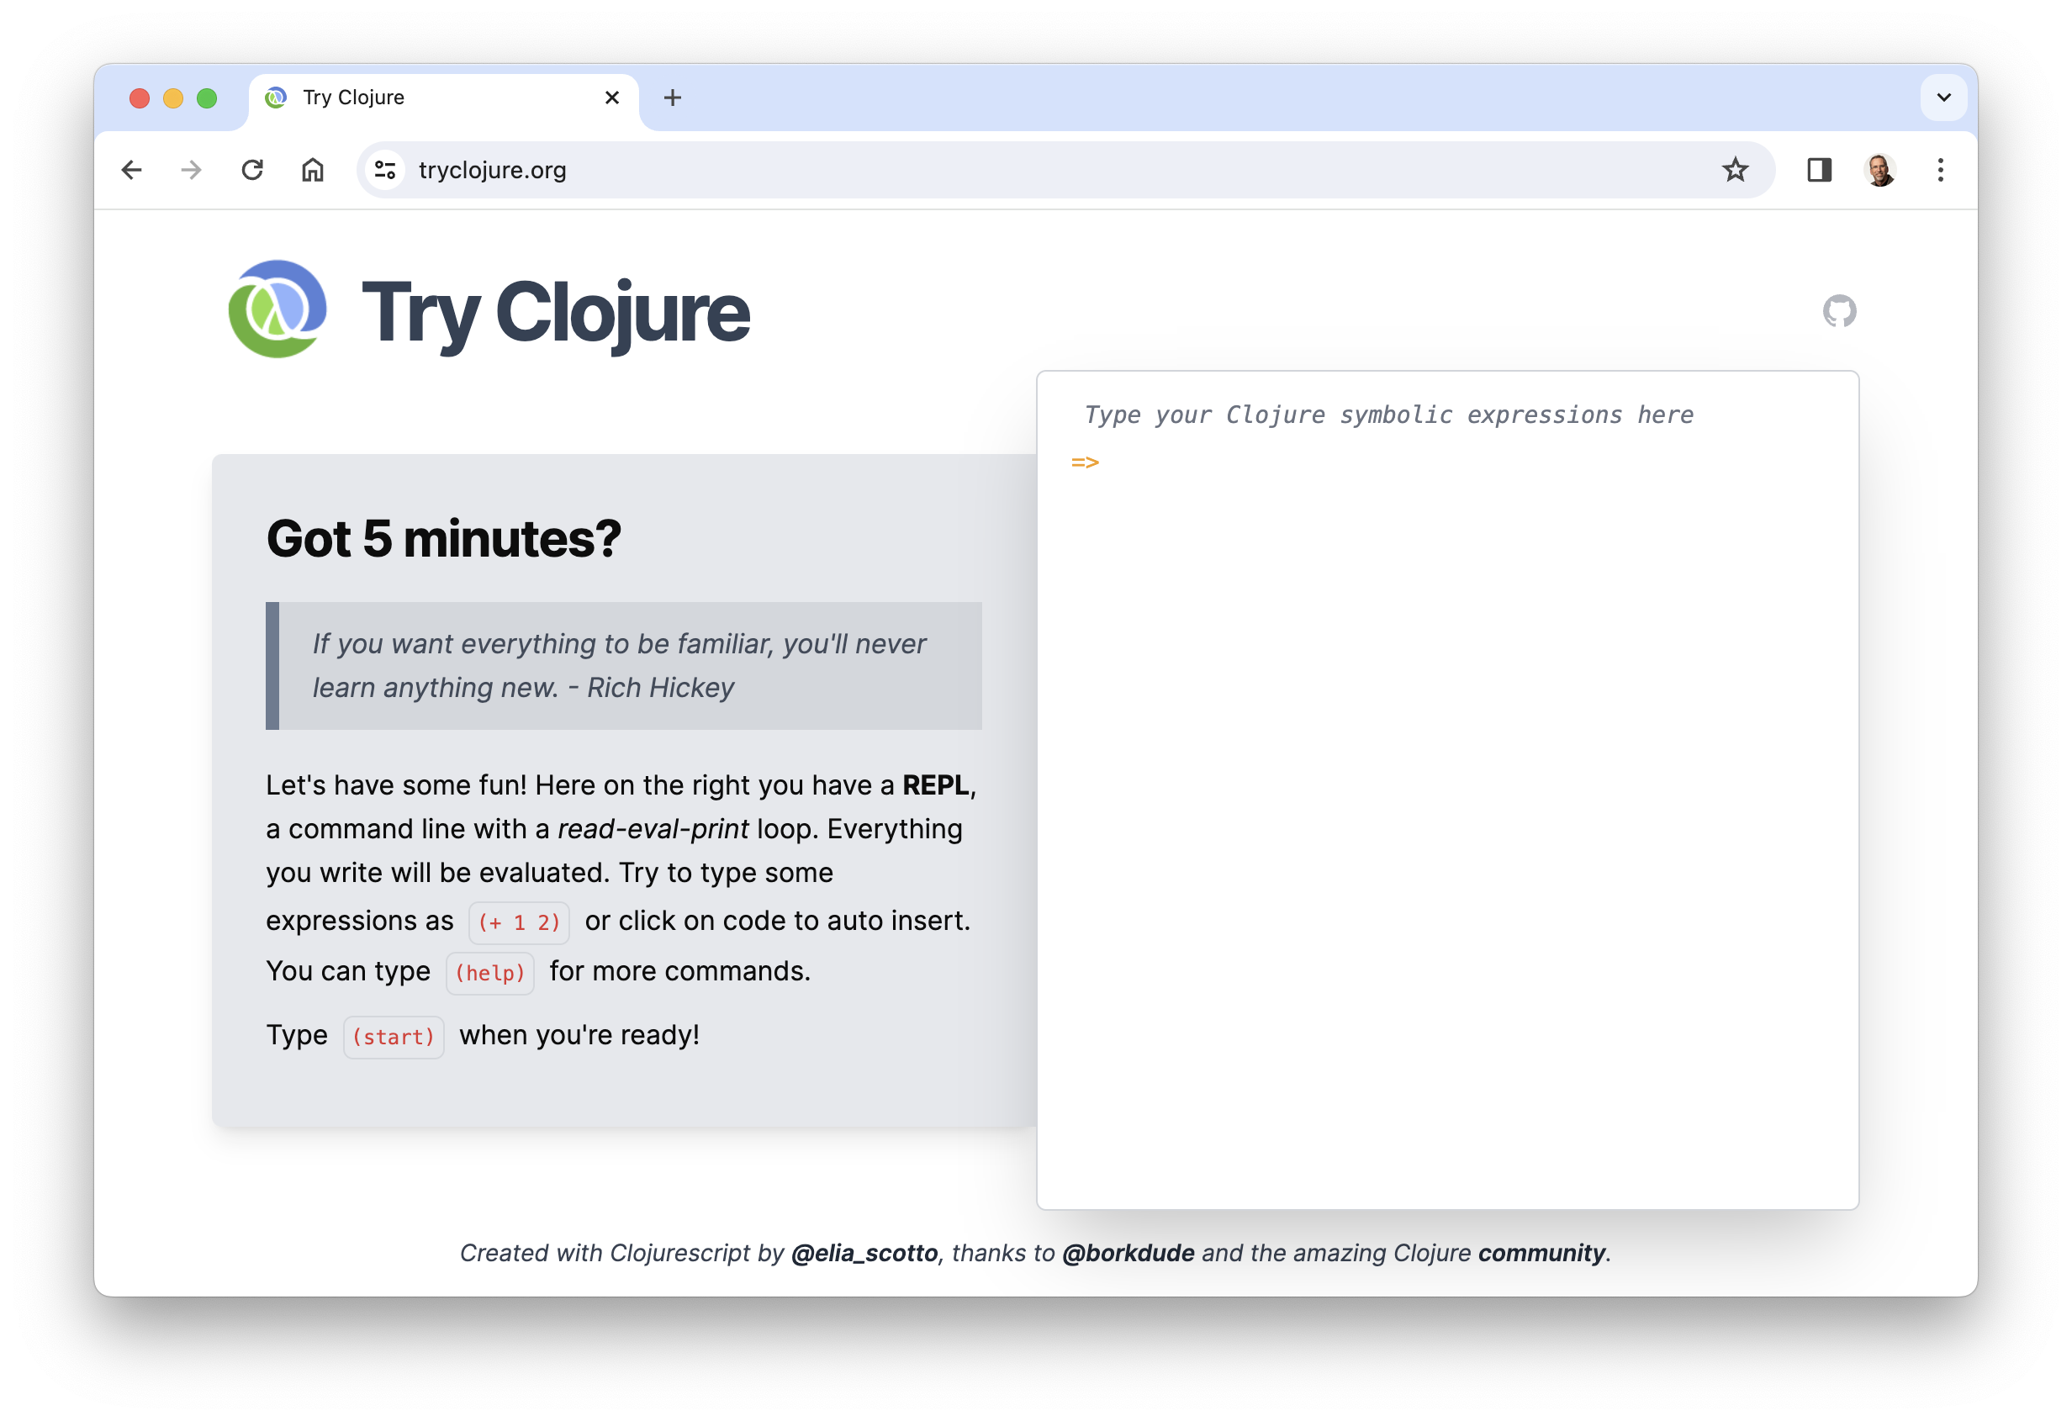
Online Clojure tutorial

Slide 13
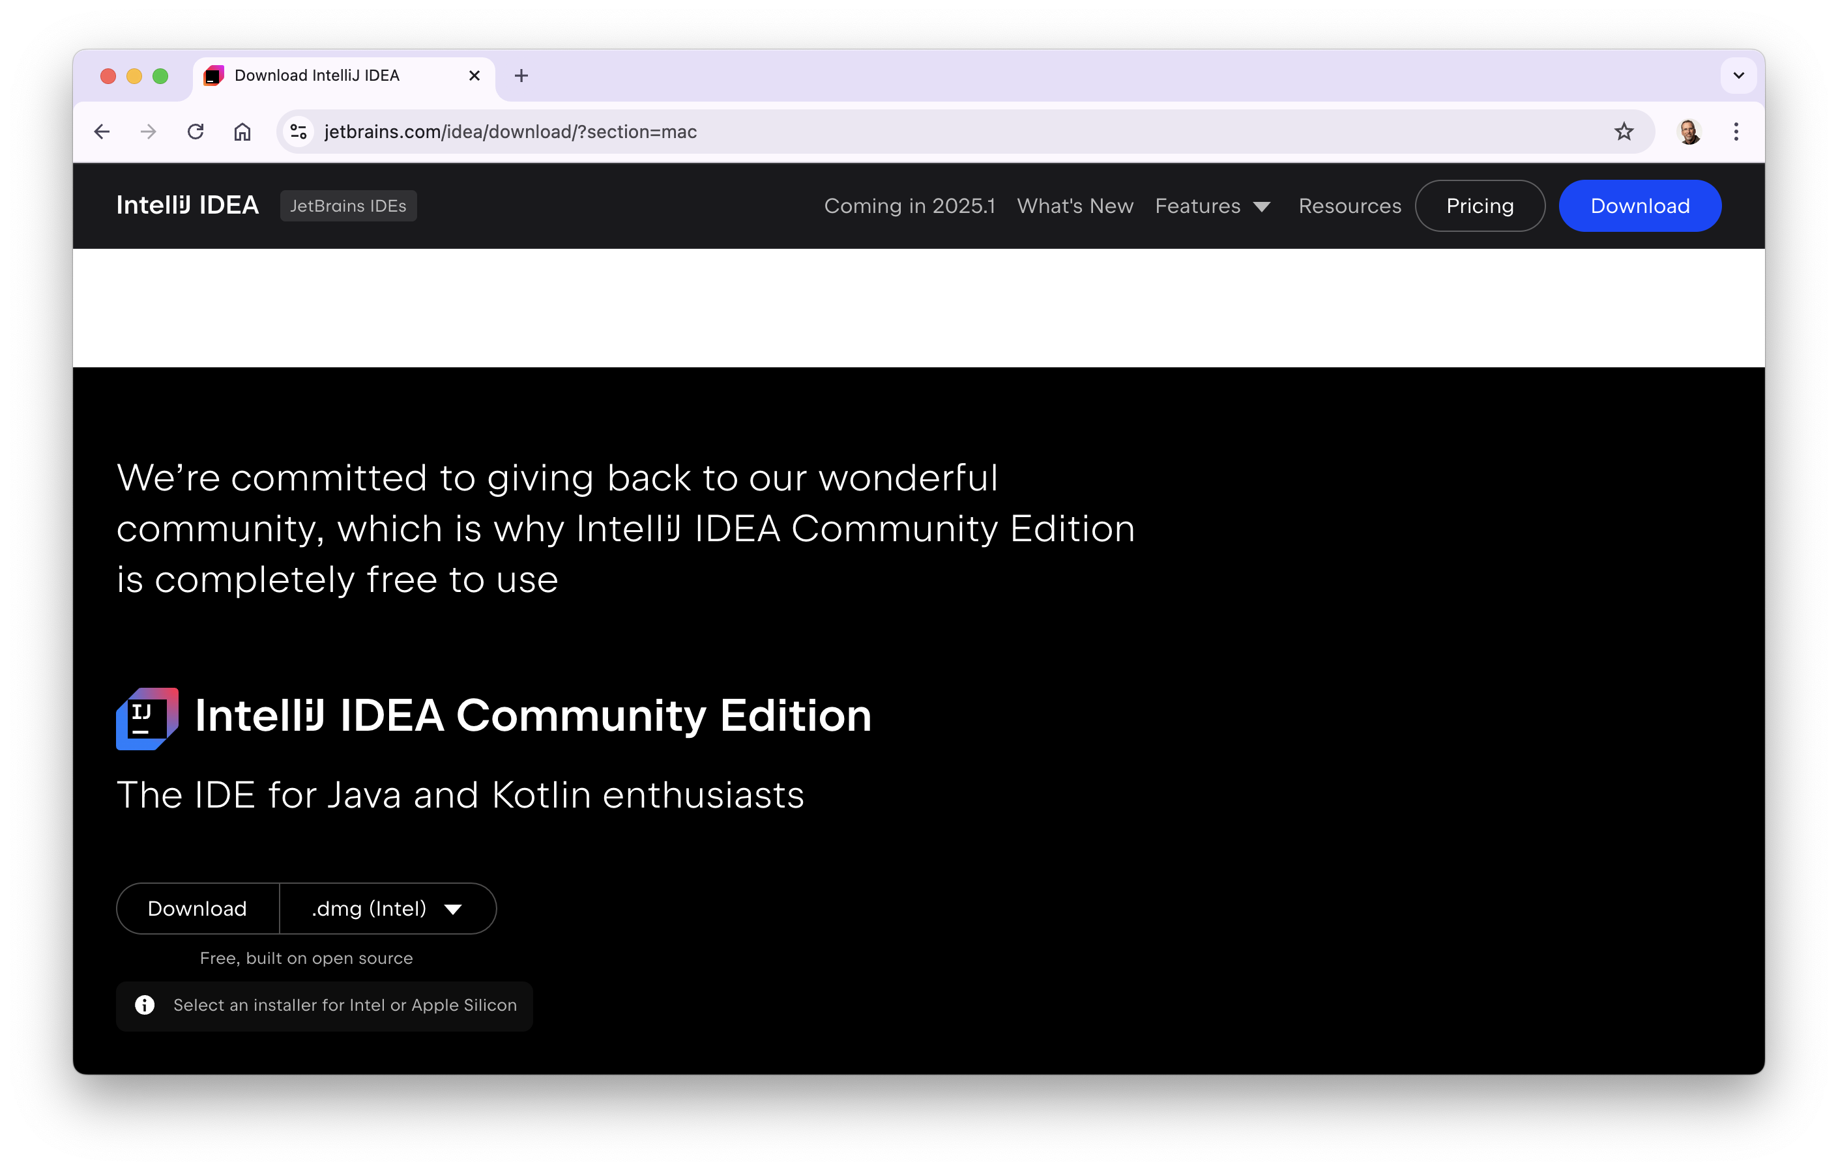
Installing IntelliJ
download and install IntelliJ IDEA Community (free) edition
scroll down from top of page (or else you get the commercial edition)
if on a Mac, be sure to select the correct CPU type

Slide 14
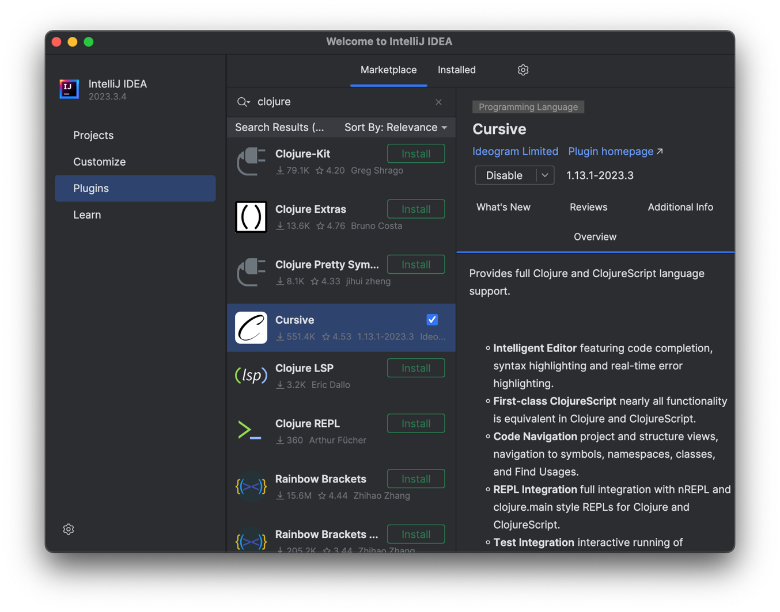
Installing the Cursive plugin
start up IntelliJ IDEA
select Plugins from the left, and type clojure in the search box
click on and install Cursive, the Clojure editor and REPL
restart the IDE when done installing

Slide 15
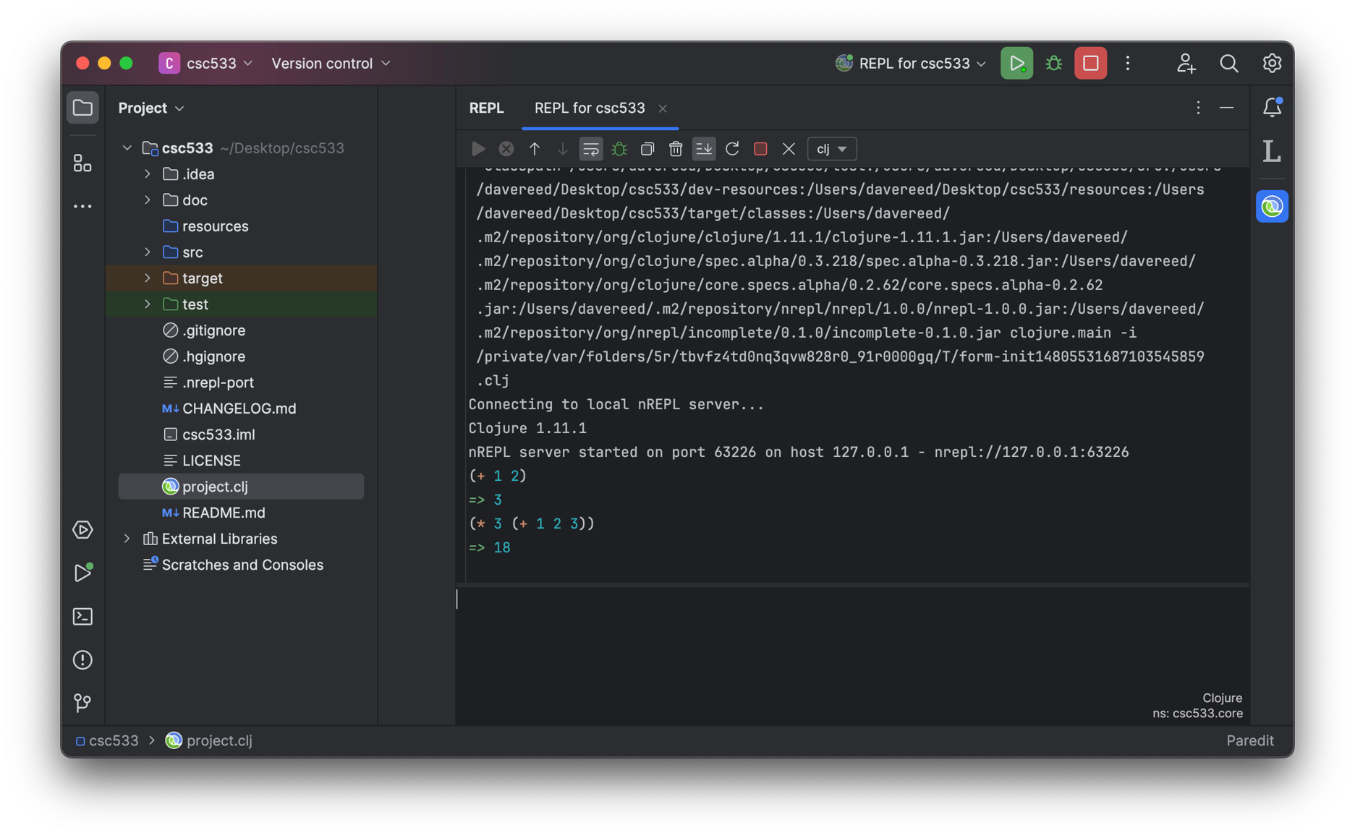
Creating a Clojure project
select New Project → Clojure → Leiningen
specify the project name (e.g., csc533) and folder – no capital letters
right click on project.clj and select Run 'REPL for csc533'
creates a REPL pane on the right, enter expressions to evaluate at bottom

Slide 16
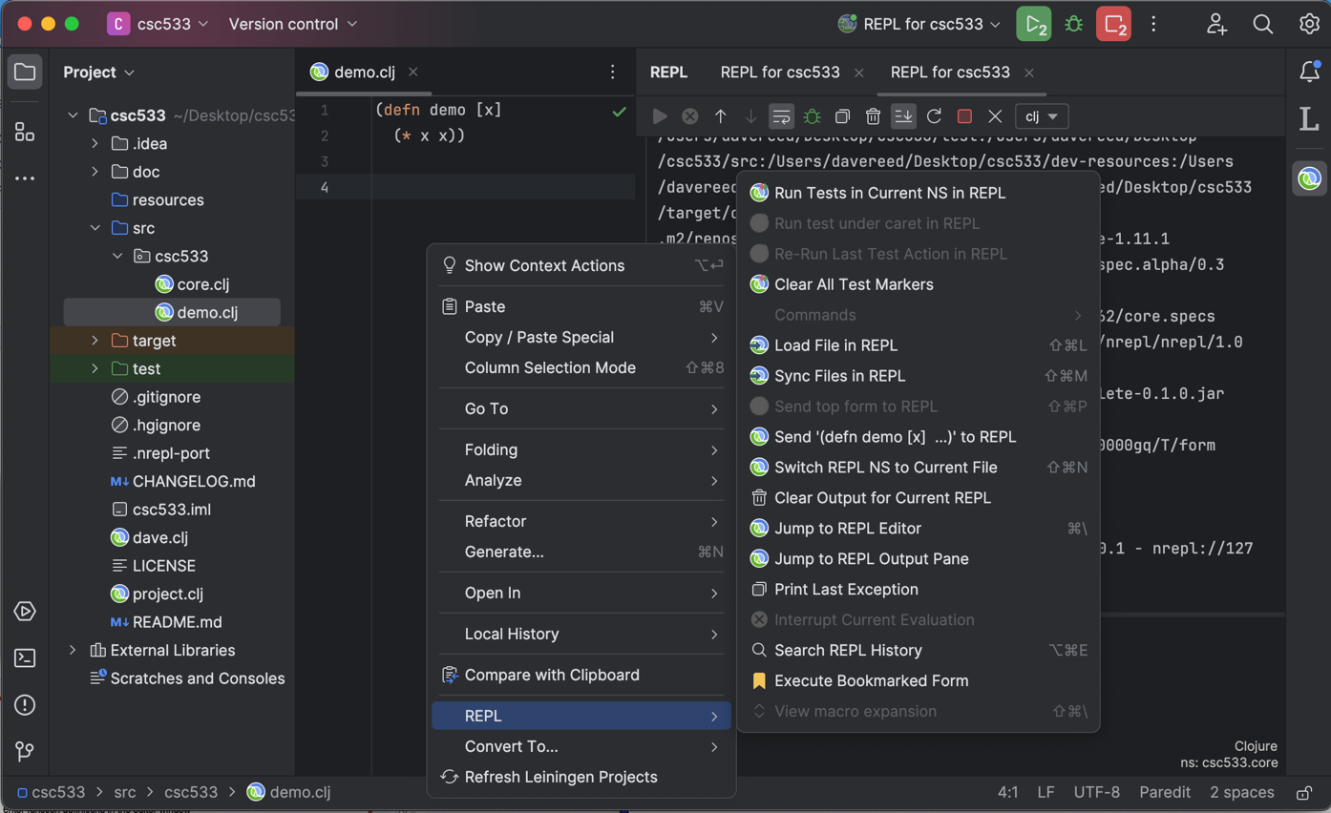
Adding a file
select the src folder on the left
right-click and select New → File
save the file with a .clj extension
enter function definitions in the editor window
to load, right-click in the window and select REPL → Load File in REPL

