Slide 1
CSC 533: Programming Languages Spring 2025
See online syllabus at:
http://dave-reed.com/csc533
Course goals:
understand issues in designing, implementing, and evaluating programming languages
appreciate strengths and tradeoffs of different programming paradigms
working knowledge of Java, Clojure, & a modern scripting language

Slide 2
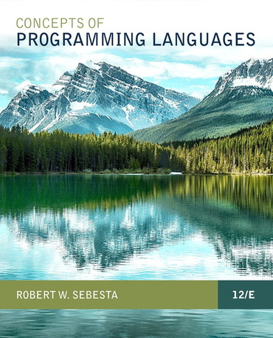
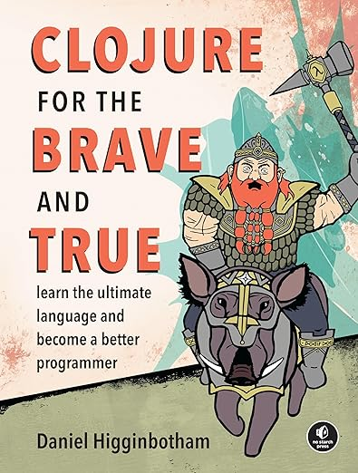
Course texts
the official text is the 12th edition of Sebesta (2018)
if you are interested in programming languages (and can afford it), buy it
otherwise, free PDFs are available
in the 2nd half, we will be referencing a free, online (and humorous) book about Clojure

Slide 3
Why are there different programming languages?
in theory, all programming languages are equivalent
compiled/interpreted into basic machine operations
Church-Turing thesis applies
Why are there different natural languages?
in practice, different languages provide distinct voices
different cultures (application domains)
different primitive concepts (operations)
different ways of thinking about the world (perspectives)

Slide 4
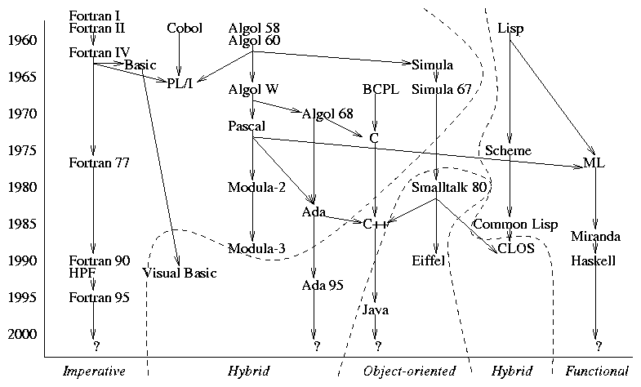
Family tree of (some) early high-level languages

Slide 5
Programming paradigms
similarly, different problem-solving approaches (paradigms) exist and are better suited to different types of tasks
imperative approaches: programs specify sequences of state changes
procedure-oriented: subroutines & nested scopes (Pascal, C)
object-based: interacting objects (Ada, Modula)
object-oriented: objects + inheritance (C++, Java, Smalltalk)
functional approach: programs transform data by applying functions
e.g., LISP/Scheme, ML, Haskell
logic approach: programs are statements in logic that describe a solution
e.g., Prolog, Oz
scripting? visual? concurrent?

Slide 6
Example: Circle of Friends
consider a group of friends
note: friends are not necessarily bidirectional (?)
Amy is friends with Bob and Dan
Bob is friends with Amy and Dan
Chris is friends with Dan and Elle
Dan is friends with Chris
Elle is friends with Amy, Bob, Chris and Dan
we can define a circle of friends:
circle (level 1) of Dan = direct friends of Dan = {Chris}
circle (level 2) of Dan = direct friends of Dan + their direct friends – Dan
= {Chris} + {Dan, Elle} – Dan
= {Chris, Elle}
circle (level N) of Dan = circle (level N-1) of Dan + their direct friends – Dan
suppose we want to enter a collection of friends and determine friend circles
solution in Java? input format? data structures? algorithm?

Slide 7
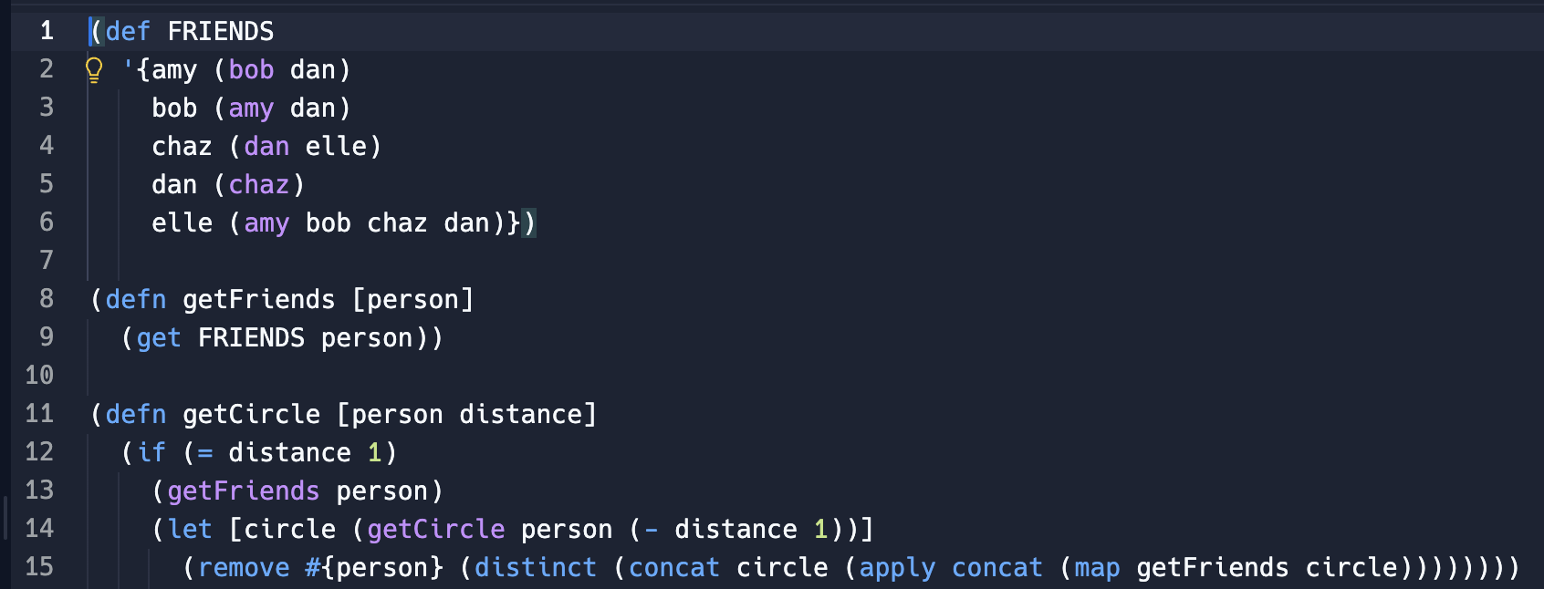
Example: Circle of Friends in Clojure
this problem is ideal for a functional language such as Clojure
it is symbolic, can represent words and text as easily as numbers
it has primitives for manipulating lists and structures
recursion is natural and efficient
can compactly represent the friends as a collection of lists
can write the basic code in 7 lines

Slide 8
Why study programming languages?
increased capacity to express ideas
broader perspective on programming and problem solving, new paradigms
improved background for choosing appropriate languages
know tradeoffs between different languages
simplify programming task by choosing best-suited language
increased ability to learn new languages
as with natural languages, 2nd language is hardest to learn
languages come and go, must be able to adapt/adjust
better understanding of the significance of implementation
can use language more intelligently if understand implementation
also aids in identifying bugs
increased ability to design/implement new languages

Slide 9
How do we judge a programming language?
readability
in software engineering, maintenance cost/time far exceeds development cost/time
want code to be easy to understand, modify, and maintain
simplicity: language should be as small as possible, avoid redundant features
Java is pretty complex, e.g., x++; ++x; x +=1; x = x + 1;
orthogonality: small set of primitive constructs, can be combined independently and uniformly (i.e., very few special cases)
Java is OK but some exceptions,.e.g., no primitives in ArrayList
natural control and data structures: provide useful, high-level abstractions
Java is good but does include some tricky ones, e.g., :? switch continue
simple and unambiguous syntax: intended form of code is clear to reader
Java not so good, e.g., overall complexity, dangling else, optional { }

Slide 10
How do we judge a programming language (cont.)?
writability
want to make programming as simple as possible for the programmer
simplicity + orthogonality + natural control & data structures + simple & unambiguous syntax
support for abstraction: need to be able to define and utilize abstractions
Java is good, e.g., support for functions, libraries, classes
expressivity: language provides convenient ways of specifying computations
Java is good, e.g., if & switch, while & do-while & for, bitwise operators, …
note: readability & writability are often at odds
e.g., more control structures can simplify programmer's task, but make code harder to read and maintain (more to know, more redundancy)

Slide 11
How do we judge a programming language (cont.)?
reliability
want to ensure that a program performs to its specifications under all conditions
want to build in strong error checking and recovery capabilities
also want to help the programmer to avoid errors
readability + writability
type checking: identify errors either at compile-time or during execution
Java is good, e.g., most types checked at compile time
exception handling: ability to intercept and recover from errors in code
Java is good, e.g., try/catch, libraries require exception handling
memory management: control memory accessing, allocation/deallocation, aliasing
Java is good, e.g., garbage collection, must explicitly allocate dynamic

